Slide 1
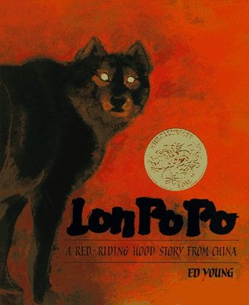

Slide 2
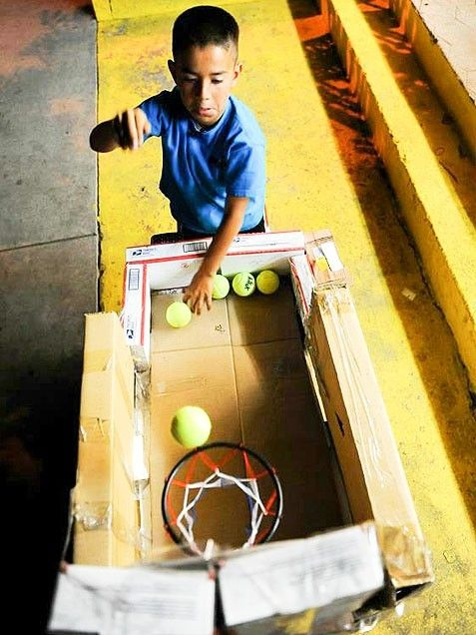
clever
https://www.pinterest.com/pin/362328732511116460/?nic_v2=1a18YqhJw
Notes:
A word in the story is clever.
In Spanish it is listo (lees-toh).
Clever means very smart.
Let’s say the word clever together. Ready?
“Clever.” When you say clever, I hear a /c/ sound at the beginning of the word.
Look, clever begins with the letter c.
Here is a picture that shows clever. The child shows he is very smart by building a mini basketball court with materials he had found.

Slide 3
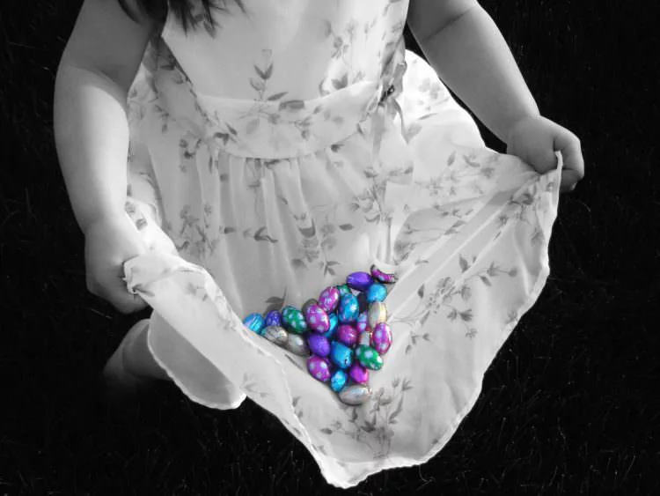
clever
Notes:
Here is another picture that shows clever.
How does this picture show clever? Turn and talk to your partner.
This girl is being clever; she is using her dress to carry all the jelly beans.
How many syllables are in the word clever? Let’s find out by clapping. Ready?
“Cle-ver.” Two syllables.
Now, let’s say clever three times by clapping the syllables. Ready?
“Cle-ver, cle-ver, cle-ver.”

Slide 4
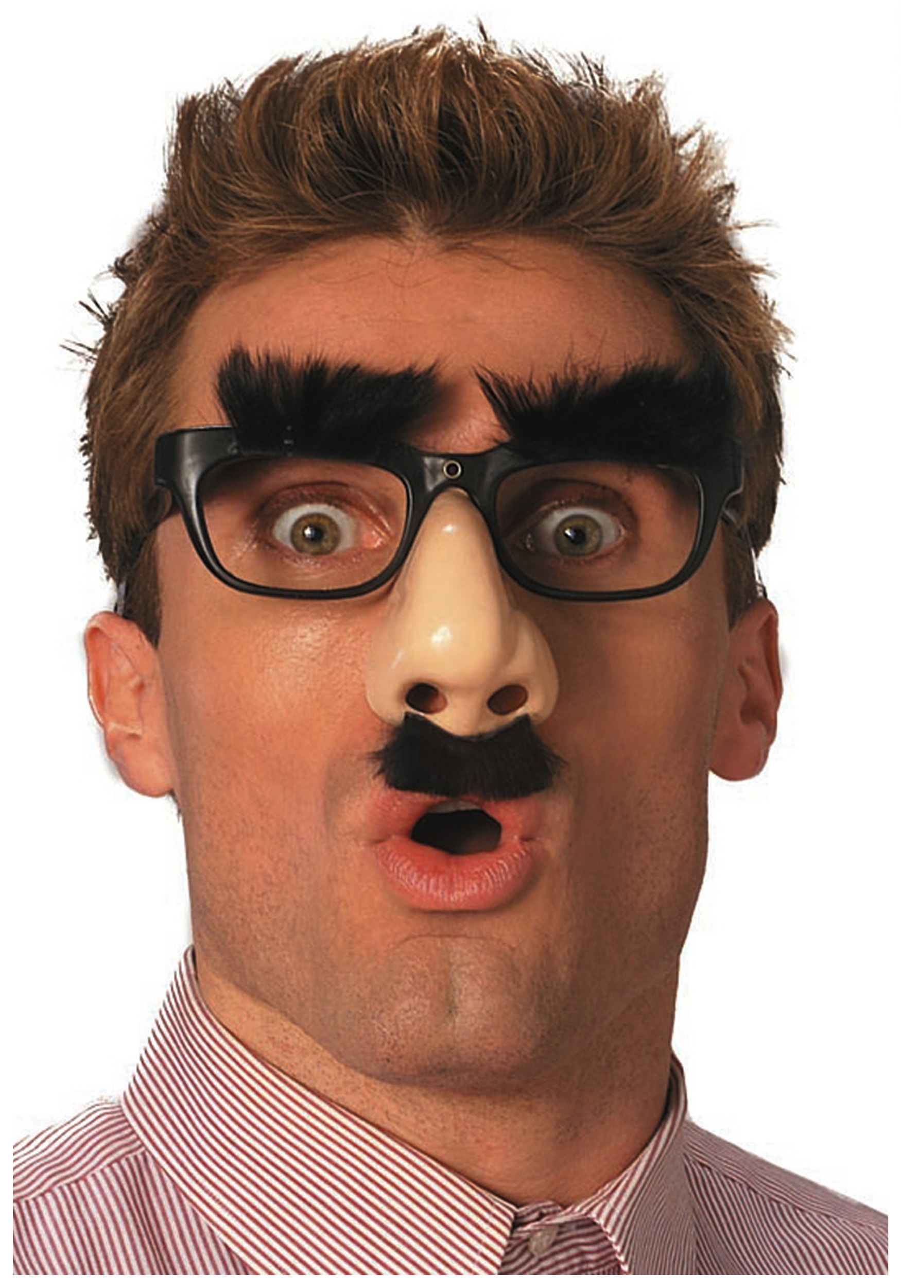
disguise
https://www.halloweencostumes.com/funny-nose-glasses.html
Notes:
Another word in the story is disguise.
In Spanish it is disfrazar (dees-frah-sahr).
Disguise means to do something to look like something or someone else, such as with a costume, so you cannot be recognized.
Let’s say the word disguise together. Ready?
“Disguise.” When you say disguise, I hear a /d/ sound at the beginning of the word.
Look, disguise begins with the letter d.
Here is a picture that shows disguise. This person is wearing a disguise of fake glasses, eyebrows, big nose, and mustache.

Slide 5
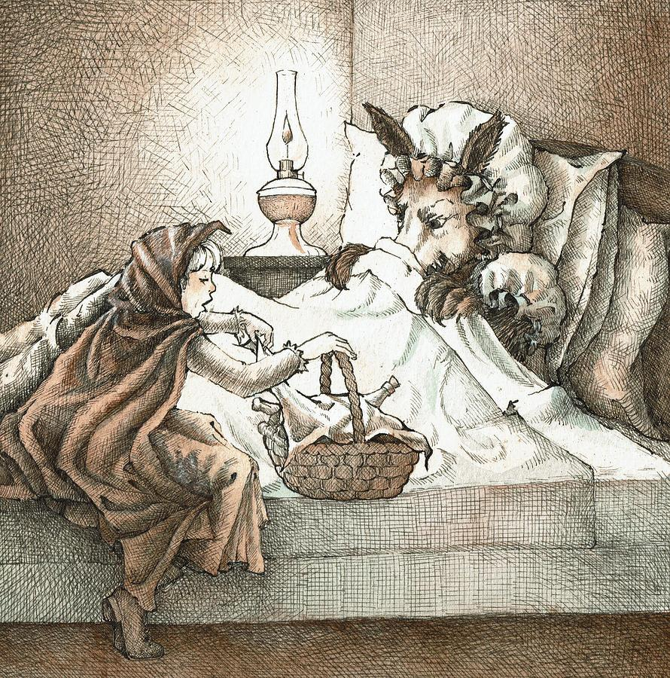
disguise
some of the classifications
Notes:
Here is another picture of disguise.
How does this picture show the meaning of disguise? Turn and talk to your partner.
The wolf wears a disguise of a grandmother. The wolf is disguised.
How many syllables are in the word disguise? Let’s find out by clapping. Ready?
“Dis-guise.” Two syllables.
Now, let’s say disguise three times by clapping the syllables. Ready?
“Dis-guise, dis-guise, dis-guise.”

Slide 6
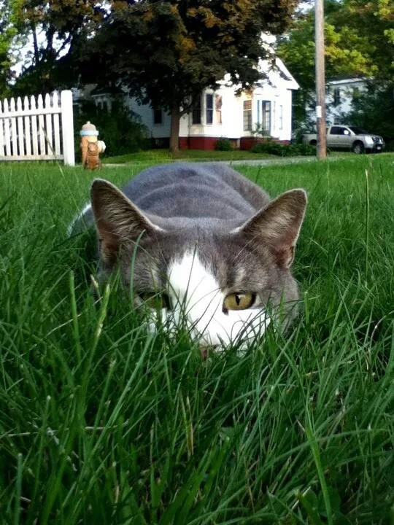
cunning
https://www.reddit.com/r/aww/comments/1ip0ll/little_bear_trying_to_sneak_up_on_you/
Notes:
A word in the story is cunning.
In Spanish it is tramposo (trahm-poh-soh).
Cunning means sneaky or tricky.
Let’s say the word cunning together. Ready?
“Cunning.” When you say cunning, I hear a /c/ sound at the beginning of the word.
Look, cunning begins with the letter c.
Here is a picture that shows cunning. The cat is moving in a cunning way so that its prey won’t notice him.

Slide 7
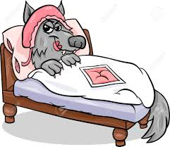
cunning
Notes:
Here is another picture of cunning.
How does this picture show the meaning of cunning? Turn and talk to your partner.
The wolf is being very cunning by pretending to be Little Red Riding Hood’s grandmother.
How many syllables are in the word cunning? Let’s find out by clapping. Ready?
“Cun-ning.” Two syllables.
Now, let’s say cunning three times by clapping the syllables. Ready?
“Cun-ning, cun-ning, cun-ning.”

Slide 8
furious
https://www.ahaparenting.com/blog/What_To_Do_When_Your_Child_Gets_Angry
Notes:
A word in the story is furious.
In Spanish it is furioso (foo-ryoh-soh).
Furious means very angry.
Let’s say the word furious together. Ready?
“Furious.” When you say furious, I hear a /f/ sound at the beginning of the word.
Look, furious begins with the letter f.
Here is a picture that shows furious. This child looks very angry. We can also say that he looks furious.

Slide 9
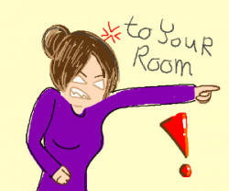
furious
https://webstockreview.net/pict/getfirst
Notes:
Here is another picture of furious.
How does this picture show the meaning of furious? Turn and talk to your partner.
This mom is furious at her child; she is saying “Go to your room!” Her child might have done something that was not right.
How many syllables are in the word furious? Let’s find out by clapping. Ready?
“Fur-i-ous.” Three syllables.
Now, let’s say furious three times by clapping the syllables. Ready?
“Fur-i-ous, fur-i-ous, fur-i-ous.”

