Slide 1
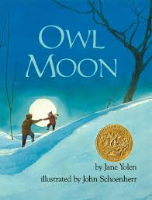

Slide 2
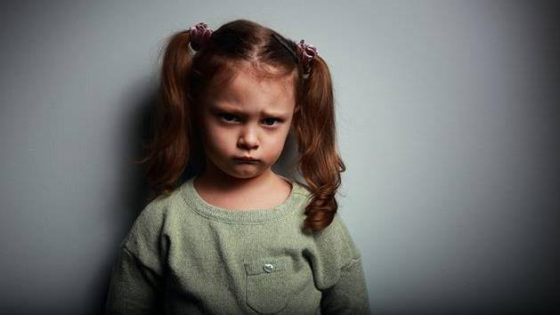
disappointed
https://divorcedmoms.com/coparenting-how-i-deal-when-he-makes-promises-to-the-kids-he-doesnt-keep/
Notes:
A word in the story is disappointed.
In Spanish it is decepcionado/a (deh-sehp-syoh-nah-doh/dah).
Disappointed is a sad feeling you have when something doesn’t happen the way you wanted.
Let’s say the word disappointed together. Ready?
“Disappointed,” When you say disappointed, I hear a /d/ sound at the beginning of the word.
Look, disappointed begins with the letter d.
Here is a picture that shows disappointed. This girl is showing us with ger face that she is disappointed. Maybe her family said they would do something together, and now they’ve told her they can’t do it.

Slide 3
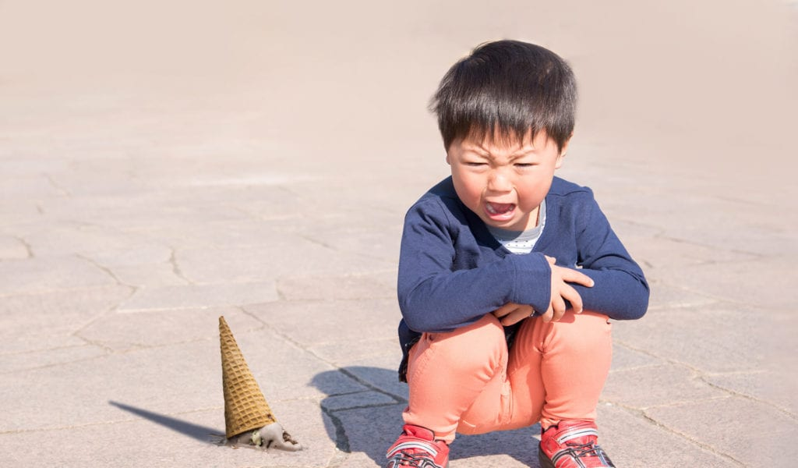
disappointed
https://www.nicklausmarketing.com/7-tips-to-avoid-summer-sales-meltdowns/
Notes:
Here is another picture of disappointed.
How does this picture show the meaning of disappointed? Turn and talk to your partner.
This child has dropped an ice cream cone! The child is certainly disappointed to have dropped an ice cream he was looking forward to eating. Maybe it was even his favorite flavor, with sprinkles—a special treat!
How many syllables are in the word disappointed? Let’s find out by clapping. Ready? “Dis-ap-point-ed.” Four syllables.
Now, let’s say disappointed three times by clapping the syllables. Ready?
“Dis-ap-point-ed, dis-ap-point-ed, dis-ap-point-ed.”

Slide 4
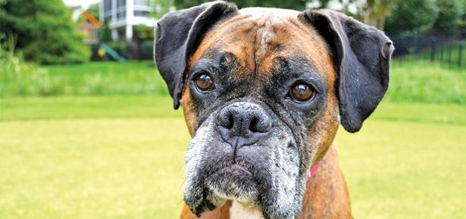
stare
https://moderndogmagazine.com/articles/why-my-dog-staring-me/89272
Notes:
A word in the story is stare.
In Spanish it is mirar fijamente (mee-rahr fee-hah-mehn-teh).
Stare means to look straight at something for a long time.
Let’s say the word stare together. Ready?
“Stare.” When you say stare, I hear a /s/ sound at the beginning of the word.
Look, stare begins with the letter s.
Here is a picture that shows stare. The dog is looking straight at the camera for a long time. He stares at the camera.

Slide 5
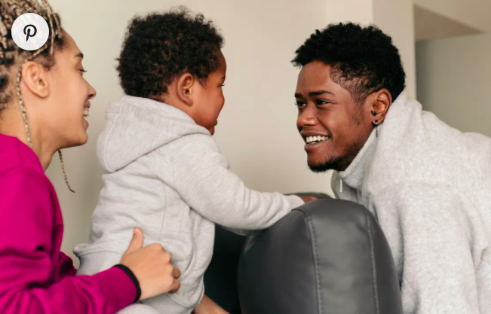
stare
https://www.healthline.com/health/baby/why-do-babies-stare
Notes:
Here is another picture of stare.
How does this picture show the meaning of stare? Turn and talk to your partner.
The baby is staring at his grownup. He is looking at him for a long time. He loves this grownup’s face, and looking at him makes him happy.
How many syllables are in the word stare? Let’s find out by clapping. Ready?
“Stare.” One syllable.
Now, let’s say stare three times by clapping the syllables. Ready?
“Stare, stare, stare.”

Slide 6
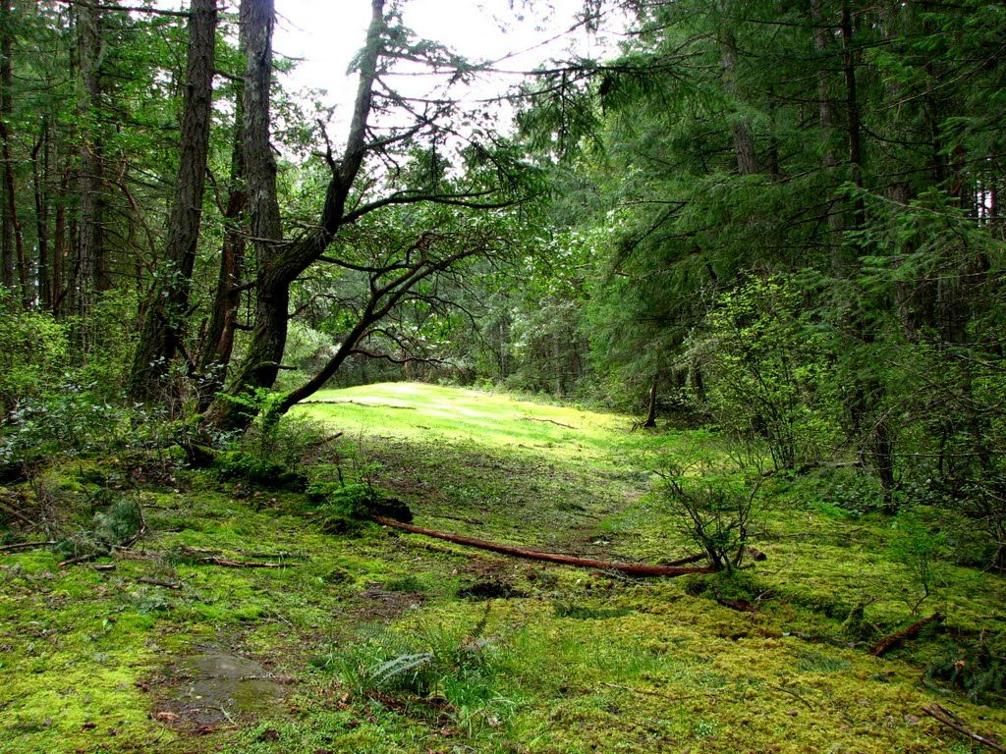
clearing
https://www.pinterest.com/pin/350014202275177389/?autologin=true&nic_v2=1a18YqhJw
Notes:
A word in the story is clearing.
In Spanish it is claro (klah-roh).
A clearing is an open space in the forest.
Let’s say the word clearing together. Ready?
“Clearing.” When you say clearing, I hear a /k/ sound at the beginning of the word.
Look, clearing begins with the letter c.
Here is a picture that shows clearing. This is an open space in the middle of the forest.

Slide 7
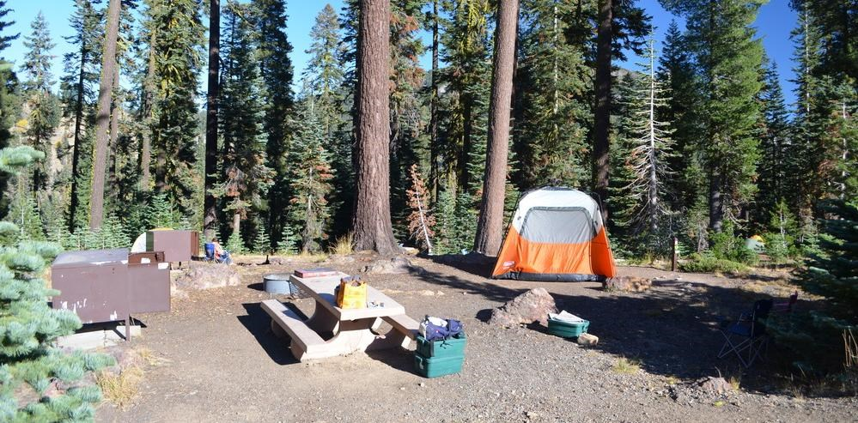
clearing
https://www.nps.gov/lavo/planyourvisit/camping-in-campgrounds.htm
Notes:
Here is another picture of clearing.
How does this picture show the meaning of clearing? Turn and talk to your partner.
People set up their tent and other camping gear in the forest clearing.
How many syllables are in the word clearing? Let’s find out by clapping. Ready?
“Clear-ing.” Two syllables.
Now, let’s say clearing three times by clapping the syllables. Ready?
“Clear-ing, clear-ing, clear-ing.”

