Slide 1
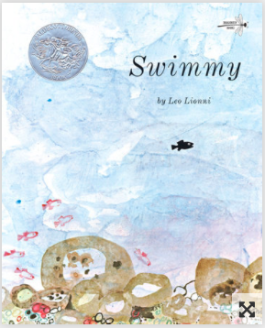

Slide 2
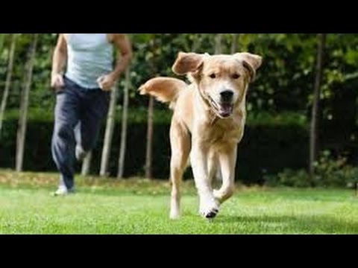
escape
https://www.youtube.com/watch?v=w5u_Kb8fo9o
Notes:
A word in the story is escape
In Spanish it is escapar (ehs-kah-pahr).
Escape means to get away.
Let’s say the word escape together. Ready?
“Escape.” When you say escape, I hear the /e/ sound at the beginning of the word.
Look, escape begins with the letter e.
Here is a picture that shows escape. The dog got away from the person. The dog escaped, and the person is trying to catch it.

Slide 3
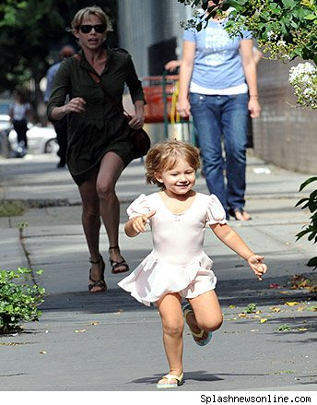
escape
https://gohorseshow.com/2017/04/diagnosis-horse-crazy-horses-creep-our-everyday-lives/running-after-toddler1/
Notes:
Here is another picture of escape.
How does this picture show the meaning of escape? Turn and talk to your partner.
The little girl escaped from her grown up’s side. Maybe she wanted to feel like a grown-up! She got away from the grown up she was with.
How many syllables are in the word escape? Let’s find out by clapping. Ready?
“Es-cape.” Two syllables.
Now, let’s say escape three times by clapping the syllables. Ready?
“Es-cape, es-cape, es-cape.”

Slide 4
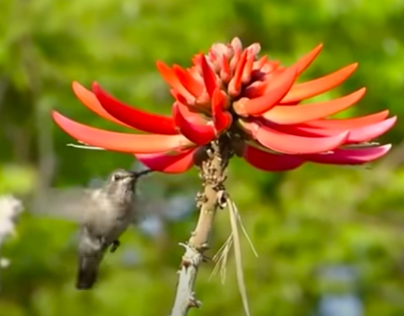
swift
Click on the image to show the video.
https://www.youtube.com/watch?v=_u5lgo8kAgQ
Notes:
A word in the story is swift.
In Spanish it is rápido (rrah-pee-doh).
Swift means fast.
Let’s say the word swift together. Ready?
“Swift.” When you say swift, I hear a /s/ sound at the beginning of the word.
Look, swift begins with the letter s.
Here is a video that shows swift. Let’s watch for a few seconds and pay attention to the wings of the hummingbird. The hummingbird moves its wings very fast. The hummingbird makes swift movements with its wings.

Slide 5
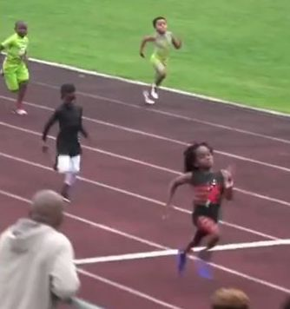
swift
https://www.boredpanda.com/100m-sprint-seven-years-old-fastest-boy-rudolf-blaze-ingram/?utm_source=google&utm_medium=organic&utm_campaign=organic
Notes:
Here is another picture of swift.
How does this picture show the meaning of swift? Turn and talk to your partner.
The runner passes the finish line very fast. The runner is swift enough to win the race!
How many syllables are in the word swift? Let’s find out by clapping. Ready?
“Swift.” One syllable.
Now, let’s say swift three times by clapping the syllables. Ready?
“Swift, swift, swift.”

Slide 6
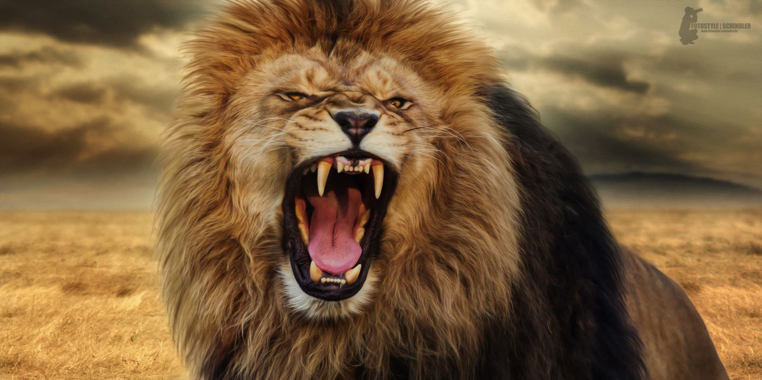
fierce
https://www.pinterest.com/pin/552957660483657803/
Notes:
A word in the story is fierce.
In Spanish it is feroz (feh-rohs).
Fierce means powerful and aggressive.
Let’s say the word fierce together. Ready?
“Fierce.” When you say fierce, I hear the /f/ sound at the beginning of the word.
Look, fierce begins with the letter f.
The lion makes a fierce roar. He sounds very powerful and aggressive when he wants to protect himself and his group from other animals.

Slide 7
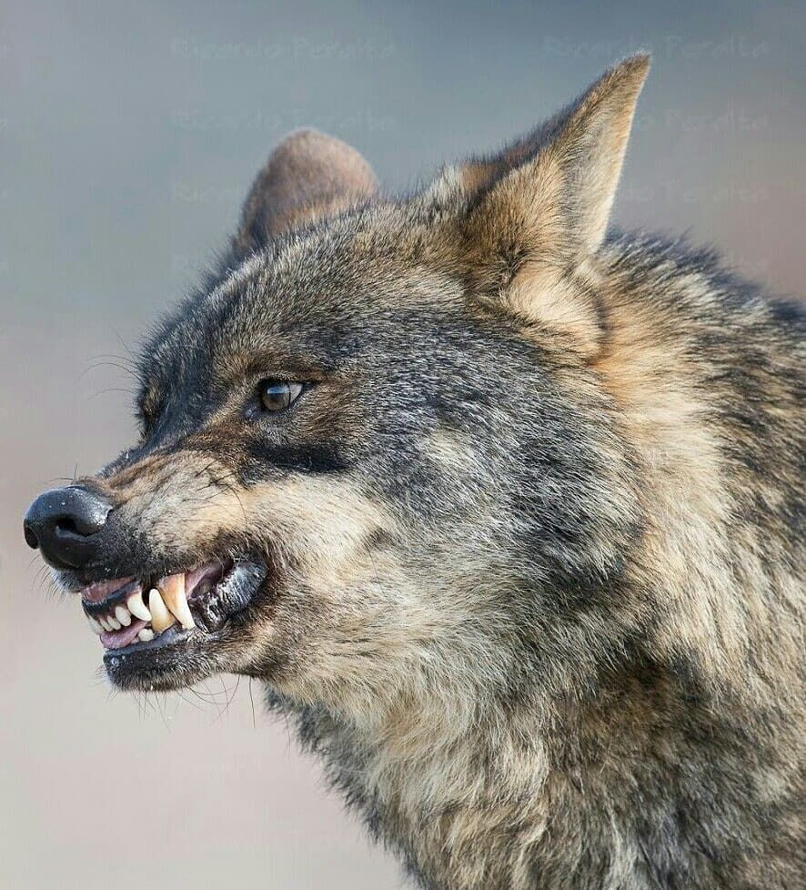
fierce
https://www.pinterest.com/pin/543035667569129499/
Notes:
Here is another picture of fierce.
How does this picture show the meaning of fierce? Turn and talk to your partner.
The wolf has a fierce expression. It is showing its teeth, its ears are straight and pointing upward, and it is looking straight forward with its eyes open.
How many syllables are in the word fierce? Let’s find out by clapping. Ready?
“Fierce.” One syllable.
Now, let’s say fierce three times by clapping the syllables. Ready?
“Fierce, fierce, fierce.”

