Slide 1
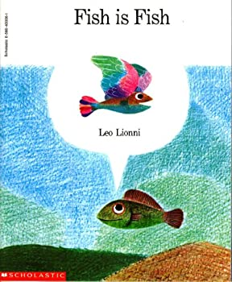

Slide 2
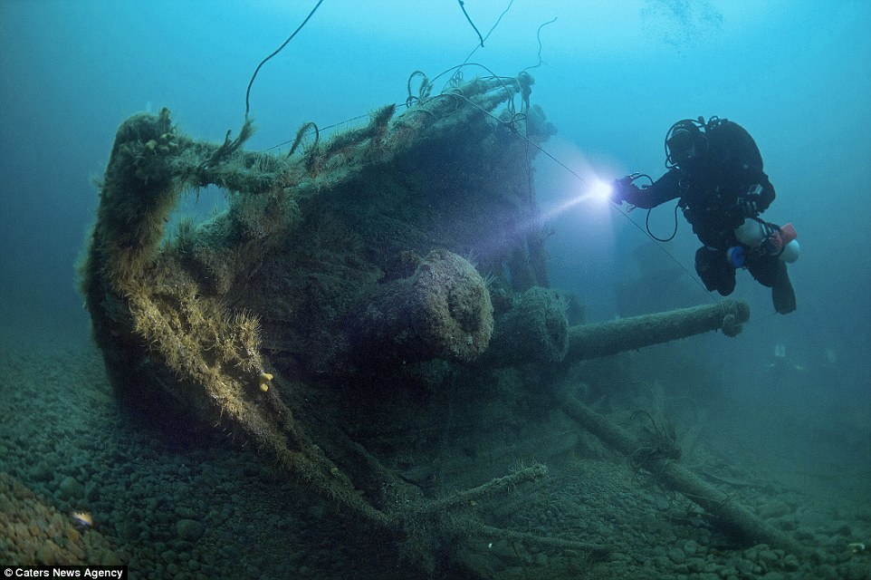
discover
Notes:
A word in the story is discover.
In Spanish it is descubrir (dehs-koo-breer).
Discover means to find out or to learn.
Let’s say the word discover together. Ready?
”Discover.”
When you say discover, I hear a /d/ sound at the beginning of the word.
Look, discover begins with the letter d.
Here is a picture that shows discover. This scuba diver found or discovered a sunken ship at the bottom of the ocean.

Slide 3
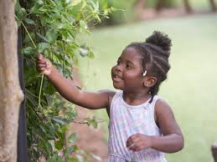
discover
https://www.brighthorizons.com/family-resources/children-and-nature
Notes:
Here is another picture of discover.
How does this picture show the meaning of discover? Turn and talk to your partner.
This child found or discovered a vine climbing through the gate.
How many syllables are in the word discover? Let’s find out by clapping. Ready?
“Dis-cov-er.” Three syllables.
Now, let’s say discover three times by clapping the syllables. Ready?
“Dis-cov-er, dis-cov-er, dis-cov-er.”

Slide 4
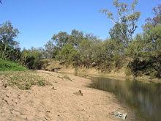
bank
https://en.wikipedia.org/wiki/Bank_(geography)
Notes:
A word in the story is bank.
In Spanish it is la orilla (la oh-ree-yah).
Bank means the edge of land that is a little higher than the water. This word has more than one meaning. In this text bank doesn’t mean the place where people deposit their money and take it out when they need it, like in the book A Chair for my Mother.
Let’s say the word bank together. Ready?
”Bank.”
When you say bank, I hear a /b/ sound at the beginning of a word.
Look, bank begins with the letter b.
Here is a picture that shows this meaning of bank. This is the bank of a river, where the edge of land is a little higher than the water.

Slide 5
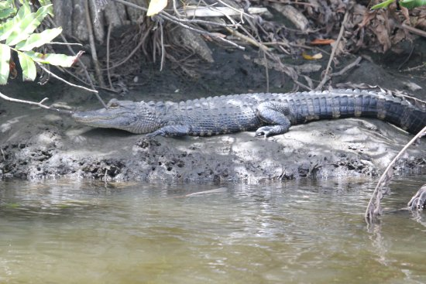
bank
https://www.tripadvisor.com/LocationPhotoDirectLink-g34580-d2413486-i251962729-River_Lilly_Cruises-Port_Saint_Lucie_Florida.html
Notes:
Here is another picture of bank.
How does this picture show the meaning of bank? Turn and talk to your partner.
The alligator is resting on the bank of the river—it is laying on the land that is a little higher than the water.
How many syllables are in the word bank? Let’s find out by clapping. Ready?
“Bank.” One syllable.
Now, let’s say bank three times by clapping the syllables. Ready?
“Bank, bank, bank.”

Slide 6
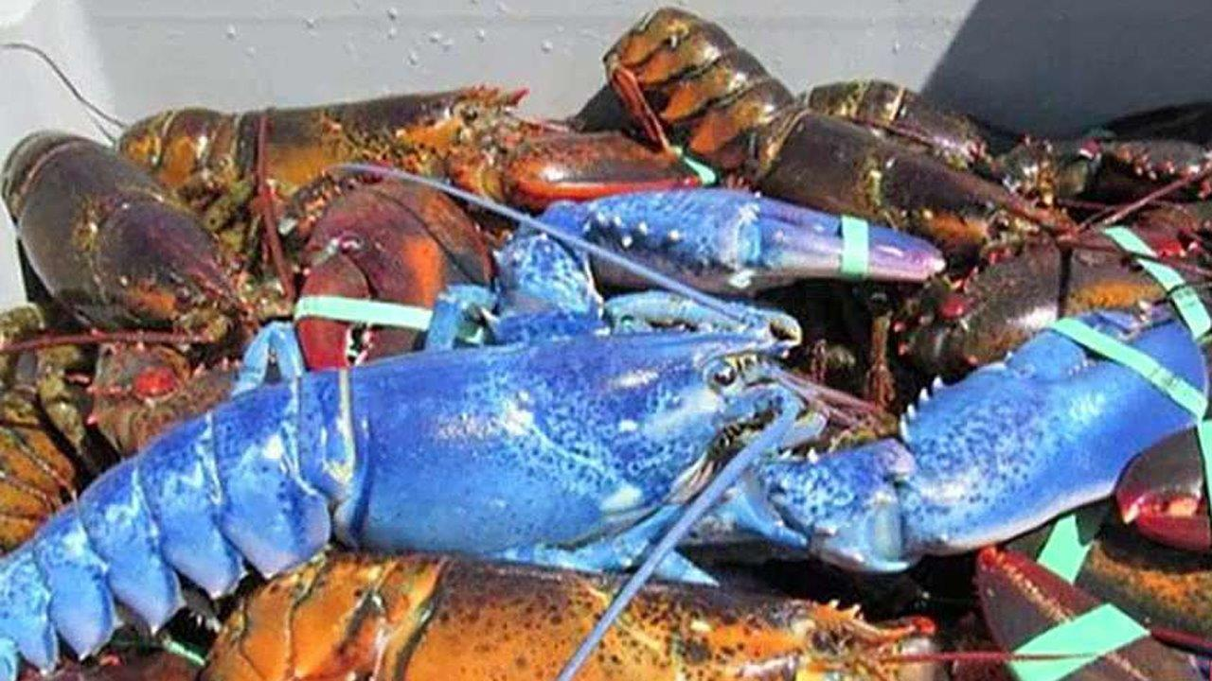
extraordinary
https://www.foxnews.com/science/rare-haul-blue-lobster-caught-in-massachusetts
Notes:
A word in the story is extraordinary.
In Spanish it is extraordinario (ehks-trah-ohr-dee-nah-ryoh).
Extraordinary means very special and unusual.
Let’s say the word extraordinary together. Ready?
”Extraordinary.”
When you say extraordinary, I hear an /e/ sound at the beginning of the word.
Look, extraordinary begins with the letter e.
Here is a picture that shows extraordinary. This lobster is extraordinary. It is very special and unusual because it is very rare to see a blue lobster. Usually lobsters are reddish-brown!

Slide 7
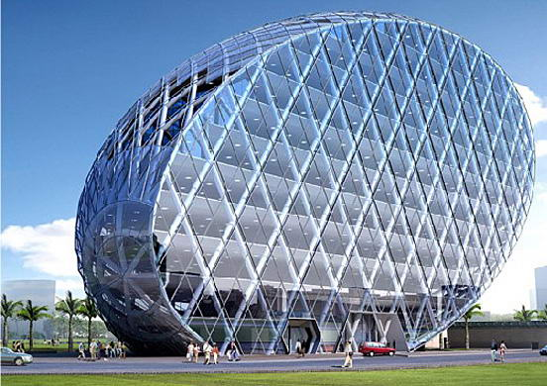
extraordinary
https://www.themost10.com/10-most-unusual-creative-buildings/
Notes:
Here is another picture of extraordinary.
How does this picture show the meaning of extraordinary? Turn and talk to your partner.
This building is extraordinary, or very special and unusual. I have never seen a building like this before.
How many syllables are in the word extraordinary? Let’s find out by clapping. Ready?
“Ex-tra-or-din-ary.” Five syllables!
Now, let’s say extraordinary three times by clapping the syllables. Ready?
“Ex-traor-din-ar-y, ex-traor-din-ar-y, ex-traor-din-ar-y.”

Slide 8
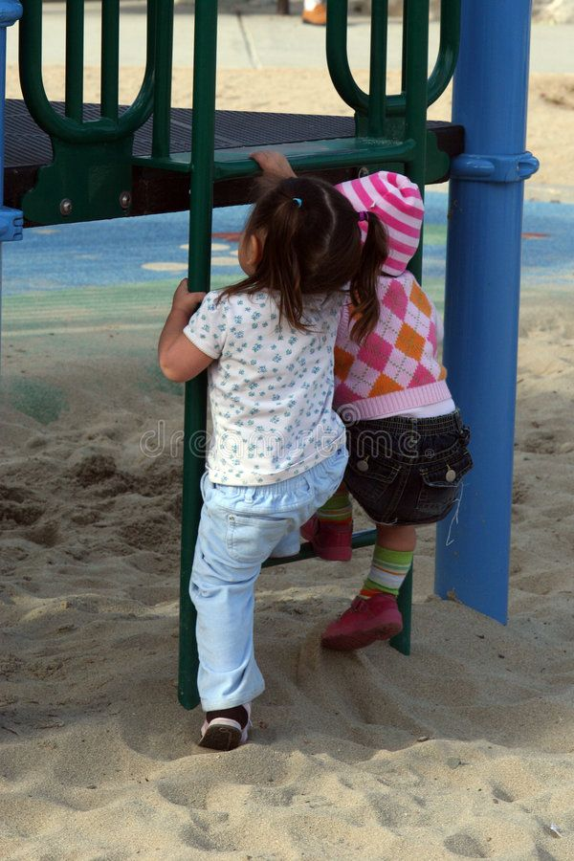
impatient
https://www.pinterest.com/pin/823455113101252501/
Notes:
A word in the story is impatient.
In Spanish it is impaciente (eem-pah-syehn-teh).
Impatient means not wanting to wait.
Let’s say the word impatient together. Ready?
”Impatient”
When you say impatient, I hear an /i/ sound at the beginning of a word.
Look, impatient begins with the letter i.
Here is a picture that shows impatient. The kids don’t want to wait to climb up the structure.

Slide 9
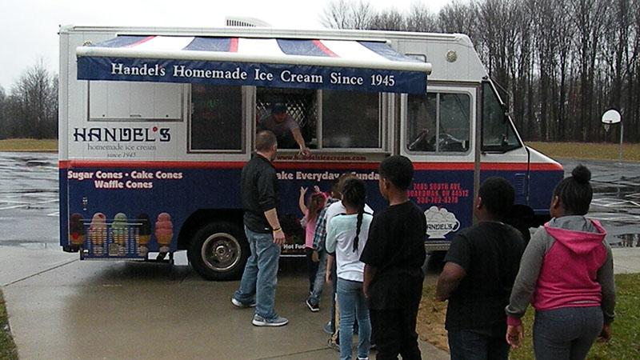
impatient
http://warrencityschools.org/jefferson/2018/05/14/koins-4-kids/
Notes:
Here is another picture of impatient.
How does this picture show the meaning of impatient? Turn and Talk to your partner.
The children in this line might be feeling impatient. They want to have their ice cream right away, but they have to wait in line for a while. They are feeling impatient.
How many syllables are in the word impatient? Let’s find out by clapping. Ready?
“Im-pa-tient.” Three syllables.
Now, let’s say impatient three times while clapping the syllables. Ready?
“Im-pa-tient, im-pa-tient, im-pa-tient.”

