Slide 1
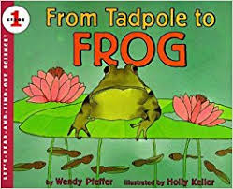

Slide 2
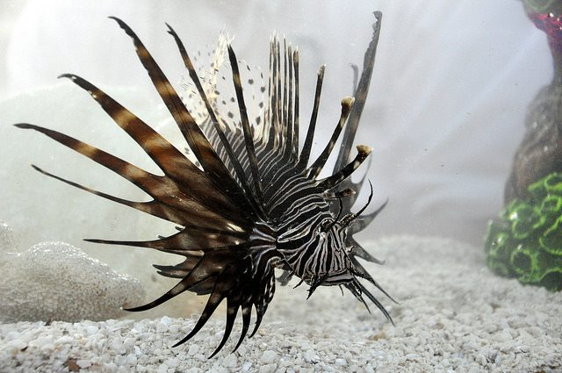
creature
https://www.leisurepro.com/blog/explore-the-blue/10-marine-creatures-named-animals/
Notes:
A word in the story is creature.
In Spanish it is la criatura (la kryah-too-rah).
Creature means a living person or animal.
Let’s say the word creature together. Ready? “Creature.”
When you say creature, I hear the /c/ sound at the beginning of the word.
Look, creature begins with the letter c.
Here is a picture of a lionfish. The lionfish is a creature that lives in the ocean.

Slide 3
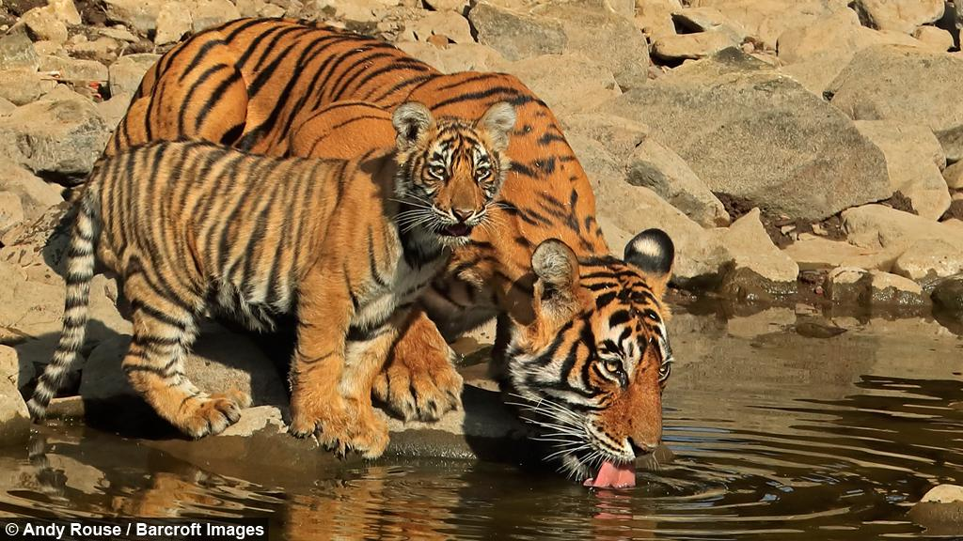
creatures
http://beastly.barcroft.tv/rare-encounter-tiger-baby-cubs-watering-hole-ranthambhore-national-park-india
Notes:
Here is another picture of creature. Because we have two tigers, we say creatures. We add an s to the base word creature.
How does this picture show the meaning of creatures? Turn and talk to your partner.
This is a picture of two creatures, mama tiger and her cub.
How many syllables are in the word creatures? Let’s find out by clapping. Ready?
“Crea-tures.” Two syllables, just like creature. Adding the s did not add a syllable.
Now, let’s say creatures three times by clapping the syllables. Ready?
“Crea-tures, crea-tures, crea-tures.”
Can you think of a time when you saw a creature?

Slide 4
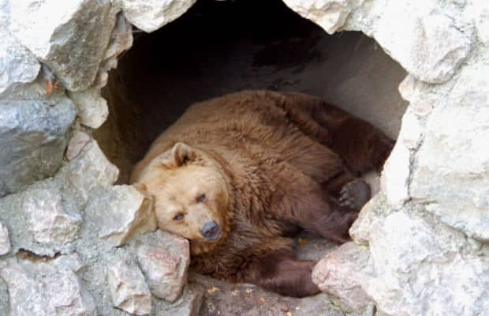
hibernate
https://www.kiwikidsnews.co.nz/what-do-animals-do-in-winter/
Notes:
A word in the story is hibernate.
In Spanish it is hibernar (ee-behr-nahr).
Hibernate means to stay quiet or sleep through the winter to save energy.
Let’s say the word hibernate together. Ready? ”Hibernate.”
When you say hibernate, I hear the /h/ sound at the beginning of the word.
Look, hibernate begins with the letter h.
Here is a picture that shows hibernate. This bear will sleep through the winter in its den to save energy. It is hibernating. (While sleeping, the bear saves energy so that when spring comes it can go out and search for food.)

Slide 5
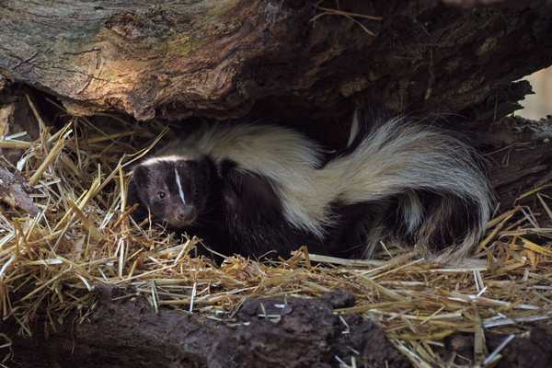
hibernate
https://varmentguard.com/blog/preventing-skunks
Notes:
Here is another picture of hibernate.
How does this picture of a skunk show the meaning of hibernate? Turn and talk to your partner.
The skunk is hibernating in between the rocks. It will stay quiet and in a light sleep until the weather gets warmer.
How many syllables are in the word hibernate? Let’s find out by clapping. Ready?
“Hi-ber-nate.” Three syllables.
Now, let’s say hibernate three times by clapping the syllables. Ready?
“Hi-ber-nate, hi-ber-nate, hi-ber-nate.”

Slide 6
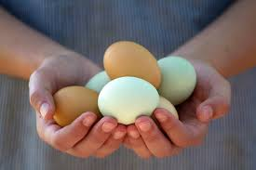
carefully
https://www.cdc.gov/healthypets/pets/farm-animals/backyard-poultry.html
Notes:
A word in the story is carefully.
In Spanish it is con cuidado (kohn kwee-dah-doh).
Carefully means to do something while paying close attention not to harm anything or anybody.
Let’s say the word carefully together. Ready? ”Carefully.”
When you say carefully, I hear the /c/ sound at the beginning of the word.
Look, carefully begins with the letter c.
Here is a picture that shows carefully. This person is carefully holding the eggs. They are paying close attention so they won’t break the eggs.

Slide 7
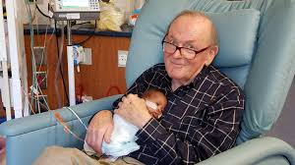
carefully
https://www.fox5atlanta.com/news/82-year-old-man-cuddles-nicu-babies
Notes:
Here is another picture of carefully.
How does this picture show the meaning of carefully? Turn and Talk to your partner.
This person is carefully holding the baby. He is paying close attention to keep the baby safe.
How many syllables are in the word carefully? Let’s find out by clapping. Ready?
“Care-ful-ly.” Three syllables.
Now, let’s say carefully three times while clapping the syllables. Ready?
“Care-ful-ly, care-ful-ly, care-ful-ly.”

