Slide 1
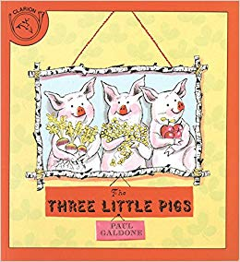

Slide 2
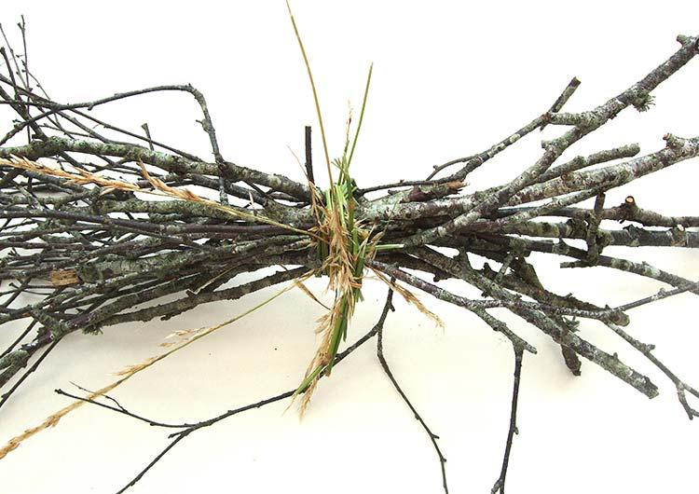
bundle
https://artdotearth.org/peter-ward/
Notes:
A word in the story is bundle.
In Spanish it is bulto (bool-toh).
A bundle is a group of things, all tied together.
Let’s say the word perfect together. Ready?
”Bundle.” When you say bundle, I hear the /b/ sound at the beginning of the word.
Look, bundle begins with the letter b.
Here is a picture that shows bundle. We see a group of sticks all tied up together with some grass, a bundle of sticks.

Slide 3
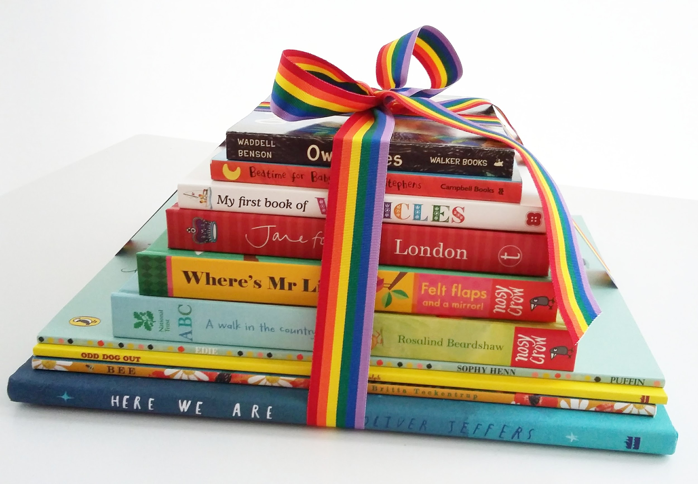
bundle
https://acornbooksblog.wordpress.com/2018/02/18/a-gift-for-a-new-baby-first-book-bundle/
Notes:
Here is another picture of bundle.
How does this picture show the meaning of bundle? Turn and talk to your partner.
This is a bundle of children’s books all tied up with a colorful ribbon.
How many syllables are in the word bundle? Let’s find out by clapping. Ready?
“Bun-dle.” 2 syllables.
Now, let’s say bundle three times by clapping the syllables. Ready?
“Bun-dle, bun-dle, bun-dle.”

Slide 4
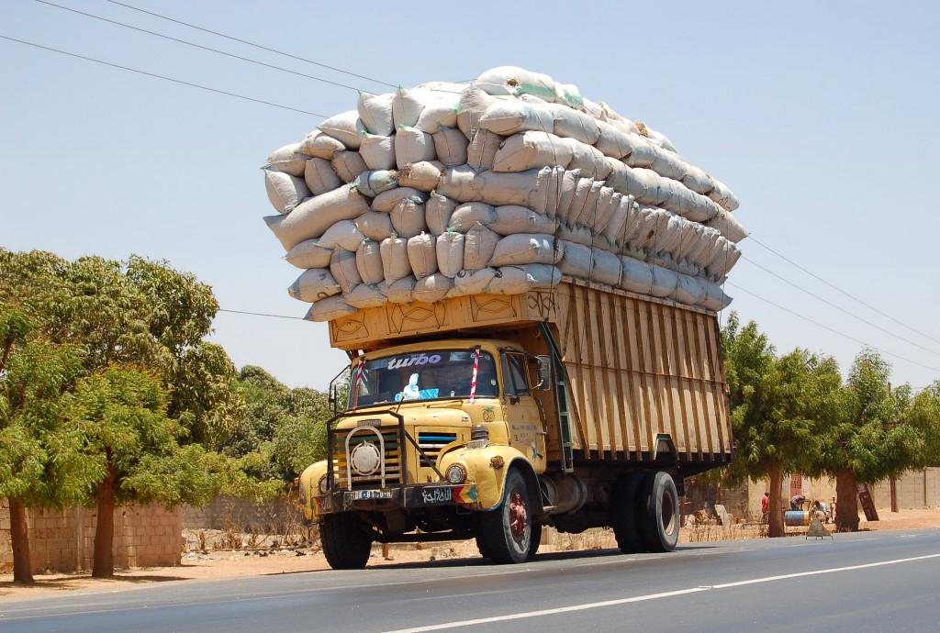
load
https://sandartsupplies.com/shipping/
Notes:
Another word in the story is load.
In Spanish it is carga (kahr-gah).
A load is a heavy thing being carried. You might have used the word load when a document or a movie is loading in the computer. In this text load is a heavy thing being carried.
Let’s say the word load together. Ready?
”Load.” When you say load, I hear the /l/ sound at the beginning of the word.
Look, load begins with the letter l.
Here is a picture that shows a load. This truck is carrying a heavy load of bags of sand.

Slide 5
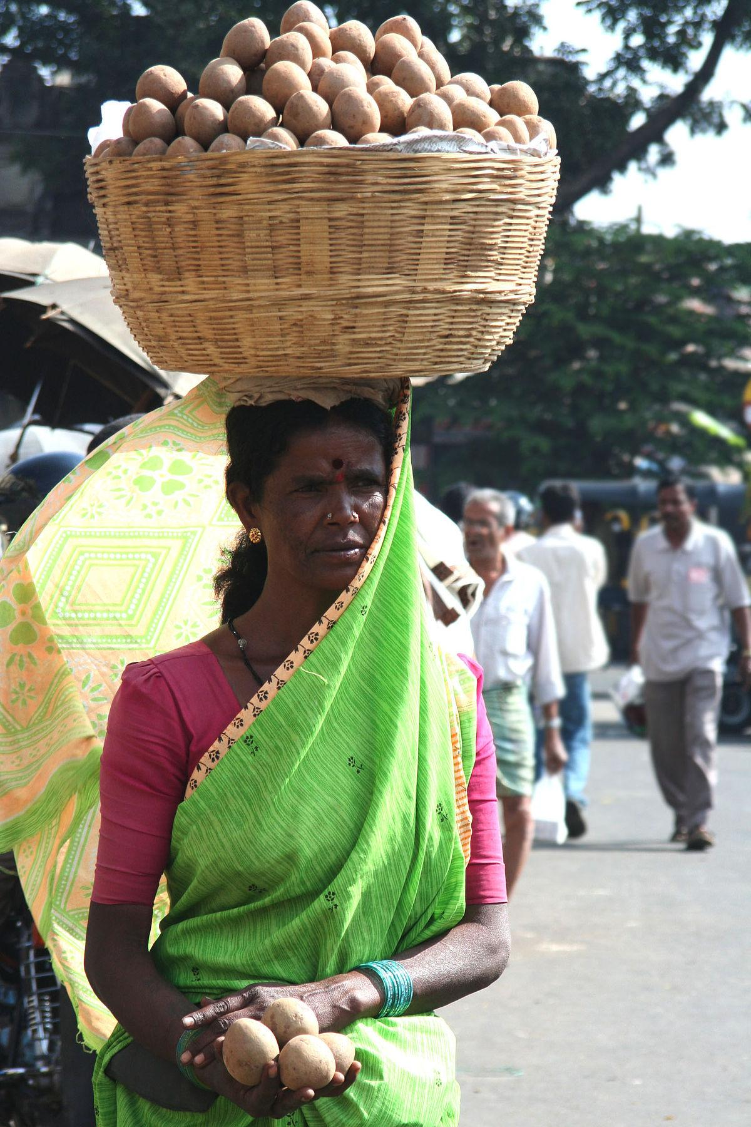
load
https://en.wikipedia.org/wiki/Head-carrying
Notes:
Here is another picture of load.
How does this picture show the meaning of load? Turn and talk to your partner.
This woman is carrying a heavy load of potatoes inside a basket on her head.
How many syllables are in the word load? Let’s find out by clapping. Ready?
“Load.” 1 syllable.
Now, let’s say load three times while clapping the syllables. Ready?
“Load, load,load.”

Slide 6
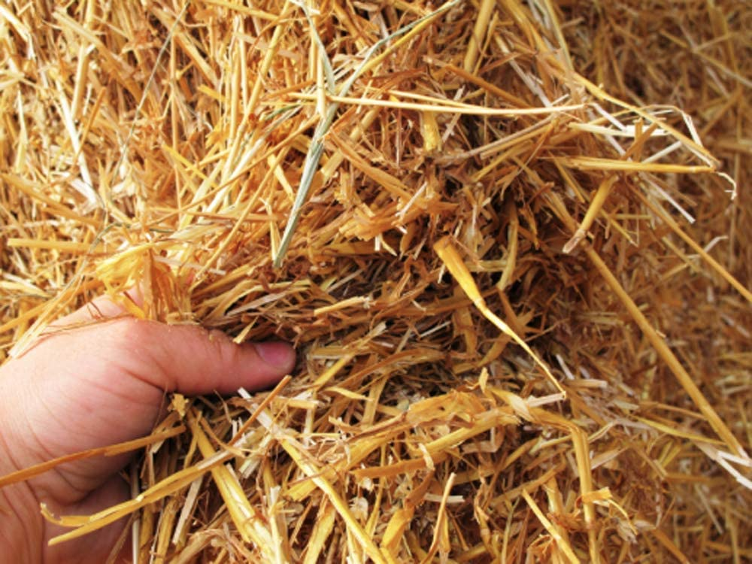
straw
https://www.amazon.com/Cubic-Natural-Organic-Wheat-Straw/dp/B0055UGKHM
Notes:
A word in the story is straw.
In Spanish it is paja (pah-hah).
Straw is long, hard, dried pieces of grass. We also use the word “straw” to describe a thin cylinder we use to drink juice or milk. Straw has two different meanings. In the text it refers to dried grass.
Let’s say the word straw together. Ready?
”Straw.” When you say straw, I hear the /s/ sound at the beginning of the word.
Look, straw begins with the letter s.
Here is a picture that shows straw. We can see lots of dried pieces of grass. We know they are dry because they are yellow.

Slide 7
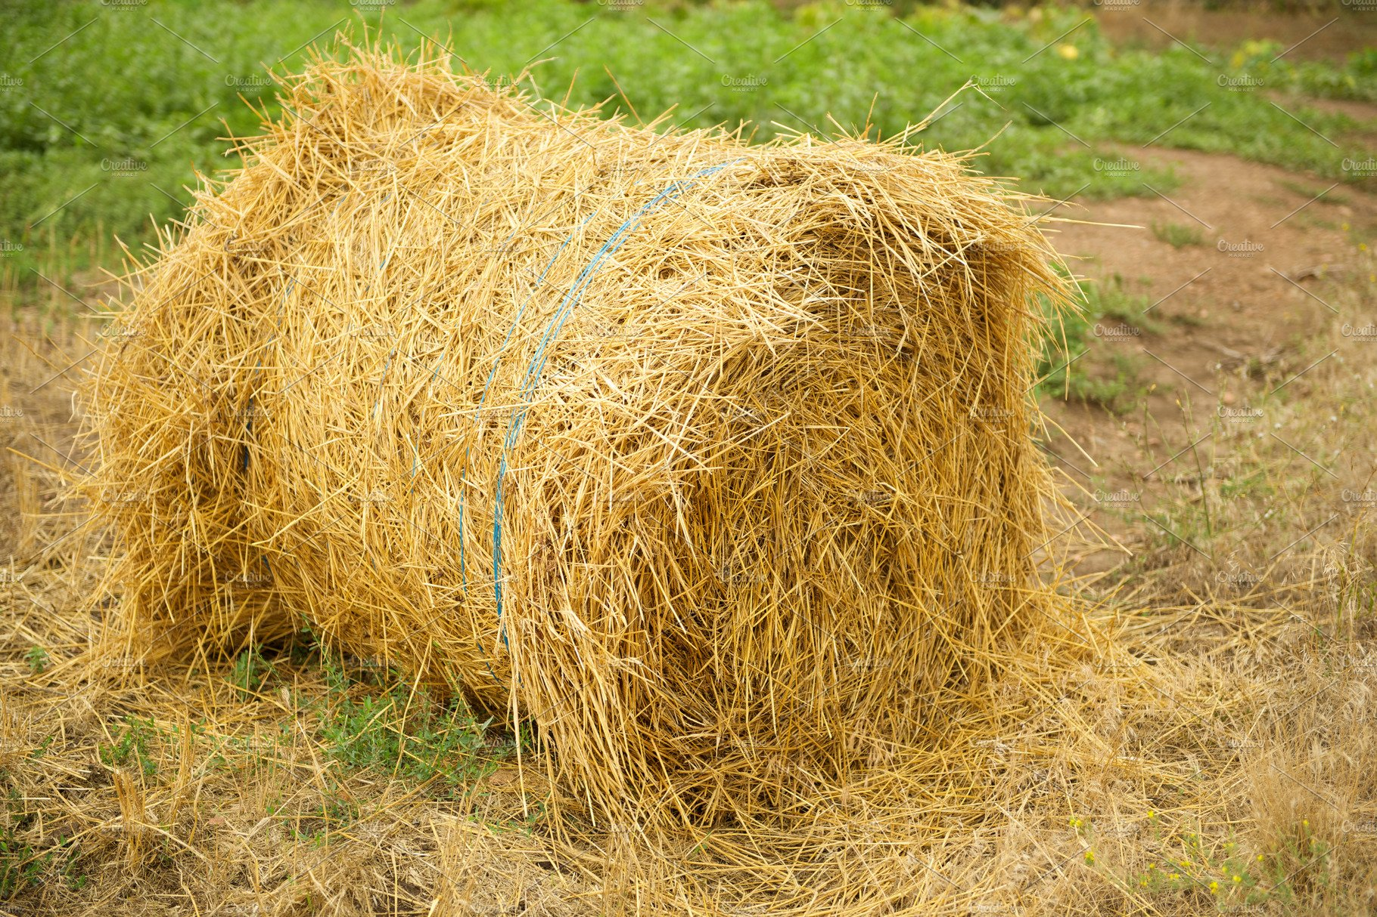
straw
https://creativemarket.com/IrynaKondrashova/3106166-Bale-of-hay-on-the-field
Notes:
Here is another picture of straw.
How does this picture show the meaning of straw? Turn and talk to your partner.
This is a bundle of straw. We call it a bale of straw. Farmers make these bales and use them to give animals bedding.
How many syllables are in the word straw? Let’s find out by clapping. Ready?
“Straw.” 1 syllable.
Now, let’s say straw three times by clapping the syllables. Ready?
“Straw, straw, straw.”

Slide 8
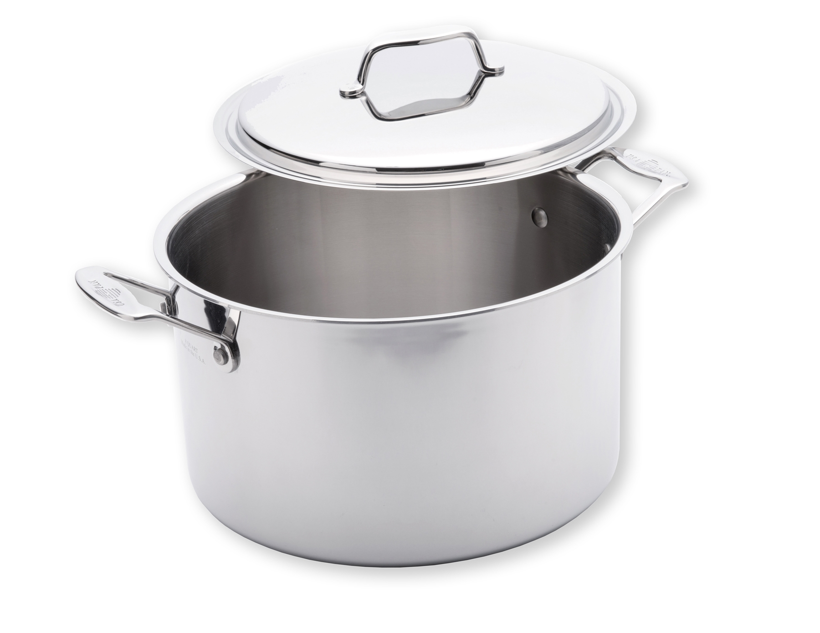
cover
https://www.usapan.com/8-qt-stock-pot-with-cover-1520cw
Notes:
A word in the story is cover.
In Spanish it is tapa (tah-pah).
A cover is a thing that goes over or around something to protect or keep inside.
Let’s say the word cover together. Ready?
”Cover.” When you say cover, I hear the /c/ sound at the beginning of the word.
Look, cover begins with the letter c.
Here is a picture that shows cover. This is the cover of a pot. We can also call it the lid of the pot. We put the cover on the pot when we cook food so nothing comes out of or goes into the pot.

Slide 9
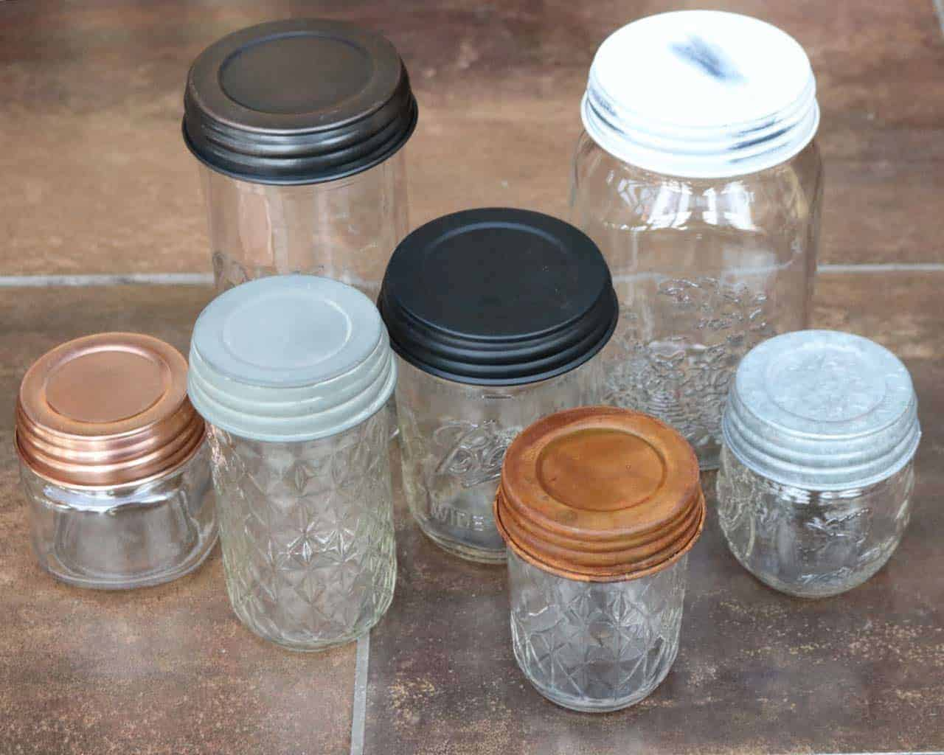
cover
https://masonjarlifestyle.com/product/shiny-copper-decorative-mason-jar-lids-4-pack/
Notes:
Here is another picture of cover.
How does this picture show the meaning of cover? Turn and talk to your partner.
All these jars have a cover. People close the jars using covers to protect what is inside and to keep it from spilling all over.
How many syllables are in the word cover? Let’s find out by clapping. Ready?
“Co-ver.” 2 syllables.
Now, let’s say cover three times by clapping the syllables. Ready?
“Co-ver, co-ver, co-ver.”

Slide 10
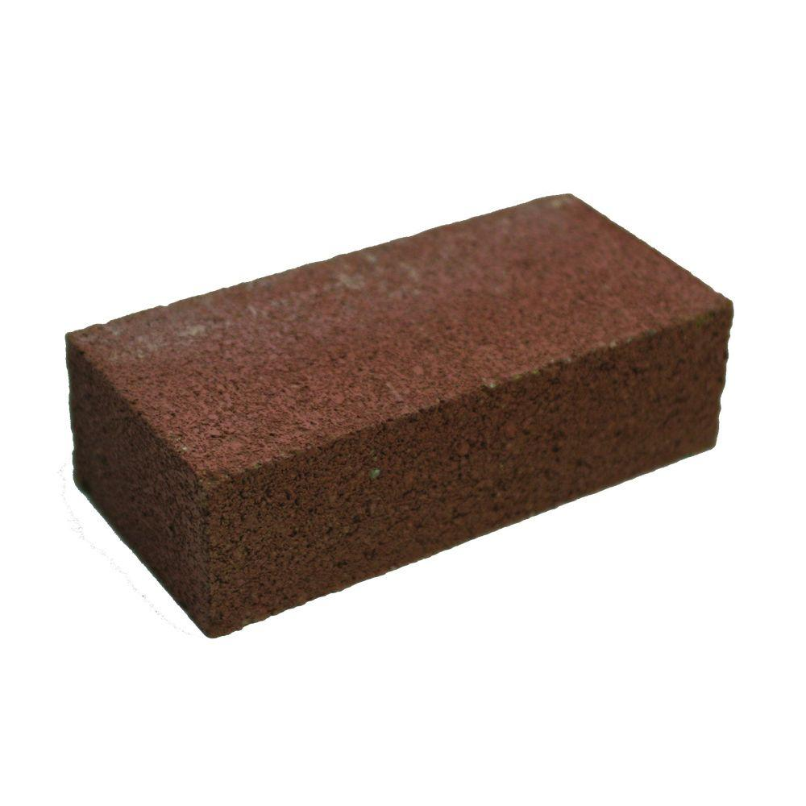
brick
https://www.homedepot.com/p/4-in-x-2-in-x-8-in-Red-Concrete-Brick-100003009/100321940
Notes:
Another word in the story is brick.
In Spanish it is ladrillo (lah-dree-yoh).
A brick is a rectangular-shaped material for building, made out of clay.
Let’s say the word brick together. Ready?
”Brick.” When you say brick, I hear the /b/ sound at the beginning of the word.
Look, brick begins with the letter b.
Here is a picture that shows brick. You can see its rectangular shape. Typically bricks are red or orange because they are made out of clay. They are fired, or dried, in big ovens to become hard and strong for building with.

Slide 11
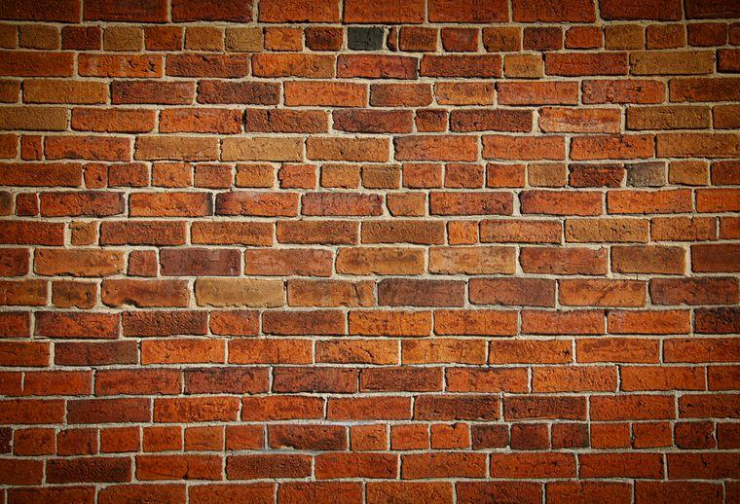
brick
https://www.popsci.com/history-bricks-game-thrones/
Notes:
Here is another picture of brick.
How does this picture show the meaning of brick? Turn and talk to your partner.
This wall is built out of bricks. It is a sturdy wall.
How many syllables are in the word brick? Let’s find out by clapping. Ready?
“Brick.” 1 syllable.
Now, let’s say brick three times by clapping the syllables. Ready?
“Brick, brick, brick.”

