Slide 1
Notes:
powerful: strong
flexible: able to bend
focus: see something clearly
rely: need
communicate: send and receive messages

Slide 2
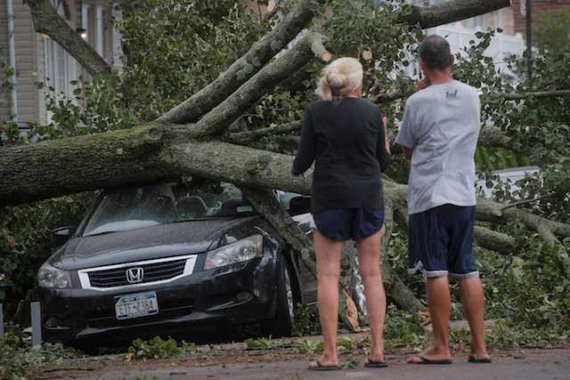
powerful
https://www.thejakartapost.com/news/2020/08/05/four-killed-as-tropical-storm-isaias-pounds-us-northeast.html
Notes:
A word in the story is powerful.
In Spanish it is poderoso (poh-deh-roh-soh).
Powerful means strong.
Let’s say the word powerful together. Ready?
“Powerful.” When you say powerful, I hear a /p/ sound at the beginning of the word.
Look, powerful begins with the letter p.
Here is a picture that shows powerful. The wind was so powerful it blew the tree down.

Slide 3
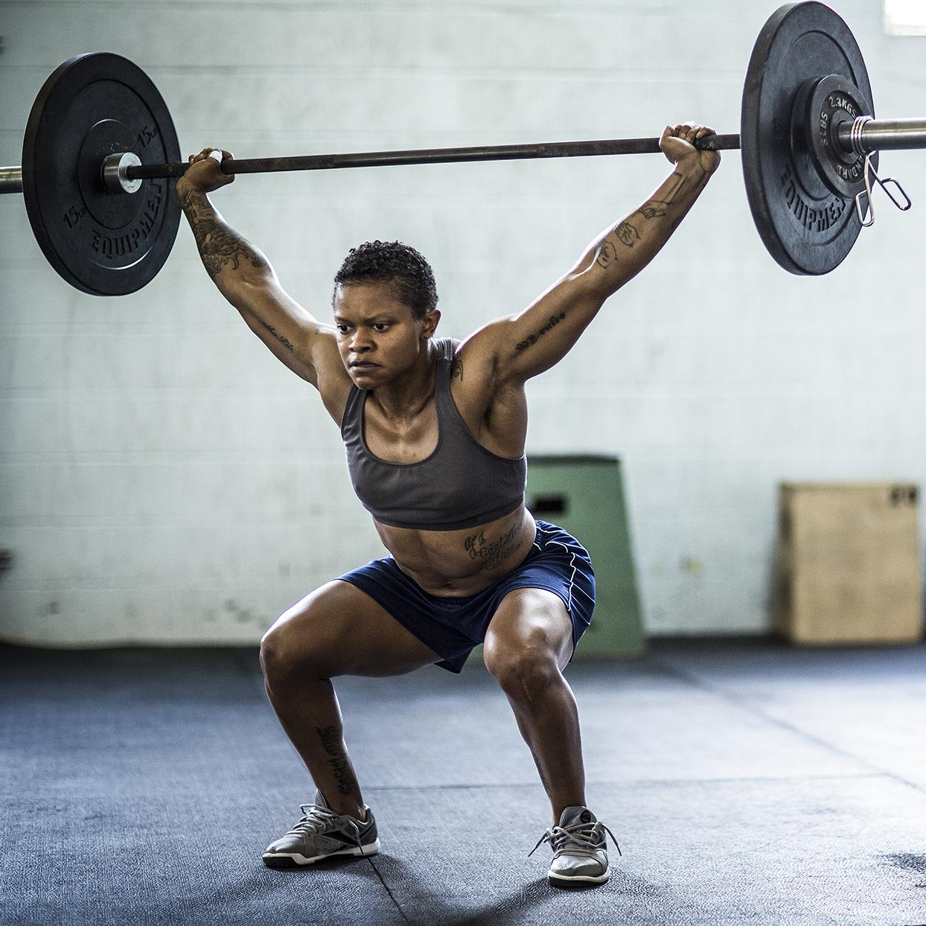
powerful
https://www.shape.com/fitness/workouts/18-inspirational-fitness-quotes-motivate-every-aspect-your-workout
Notes:
Here is another picture of powerful.
How does this picture show the meaning of powerful? Turn and talk to your partner.
This girl is lifting very heavy weights. She is very strong and powerful.
How many syllables are in the word powerful? Let’s find out by clapping. Ready?
“Pow-er-ful.” Three syllables.
Now, let’s say powerful three times by clapping the syllables. Ready?
“Pow-er-ful, pow-er-ful, pow-er-ful.”

Slide 4
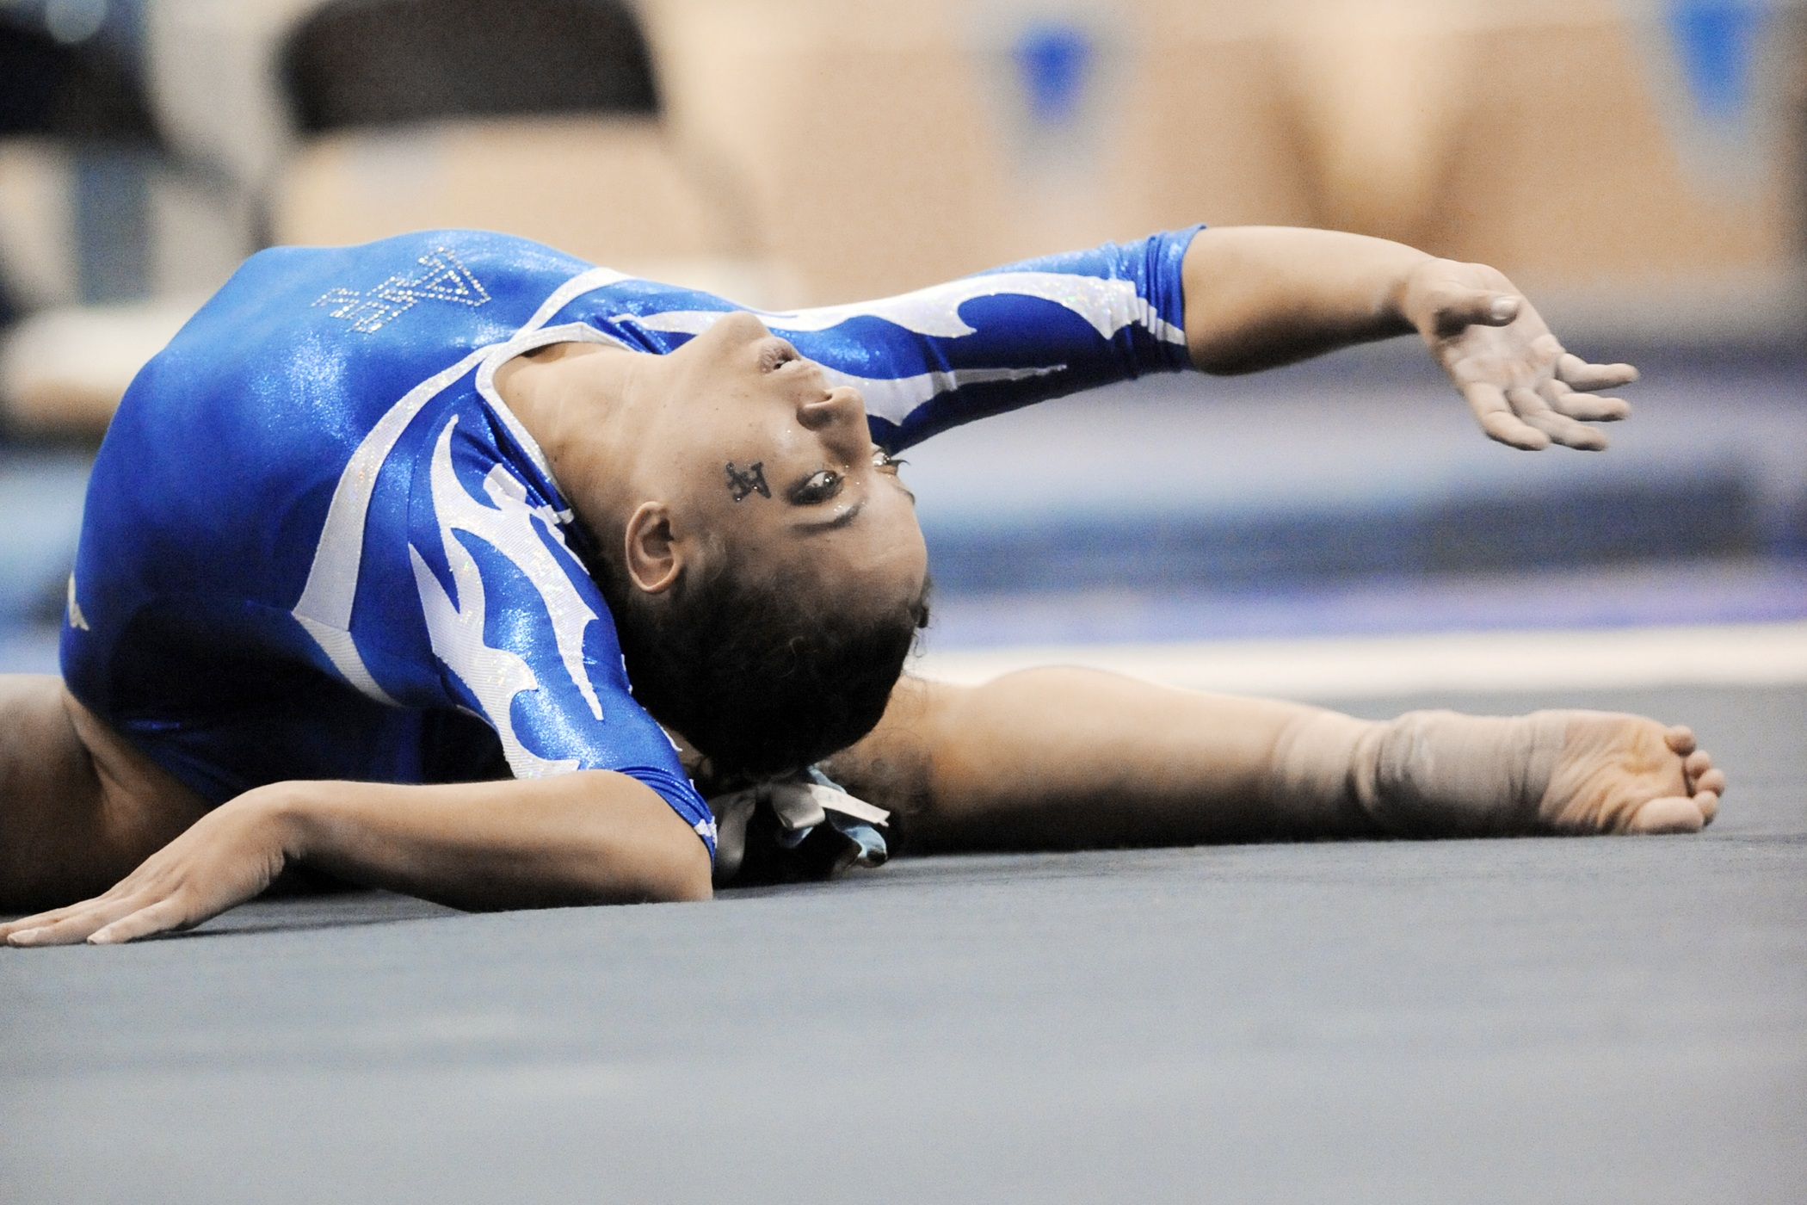
flexible
https://jooinn.com/gymnast.html
Notes:
A word in the story is flexible.
In Spanish it is flexible (flehk-see-bleh).
Flexible means able to bend.
Let’s say the word flexible together. Ready?
“Flexible.” When you say flexible, I hear a /f/ sound at the beginning of the word.
Look, flexible begins with the letter f.
Here is a picture that shows flexible. This gymnast is very flexible. She can bend her body easily.

Slide 5
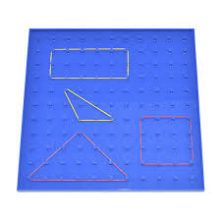
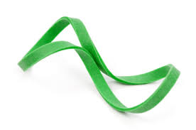
flexible
https://www.featurepics.com/online/Green-Rubber-Band-691760.aspx, https://store.rightstartmath.com/geoboards/
Notes:
Here is another picture of flexible.
How does this picture show the meaning of flexible? Turn and talk to your partner.
Rubber bands are very flexible and easy to bend into different shapes on a geoboard.
How many syllables are in the word flexible? Let’s find out by clapping. Ready?
“Flex-i-ble.” Three syllables.
Now, let’s say flexible three times by clapping the syllables. Ready?
“Flex-i-ble, flex-i-ble, flex-i-ble.”

Slide 6
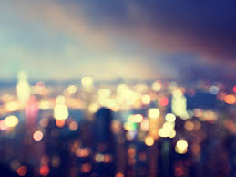
focus
https://digital-photography-school.com/tips-shooting-out-of-focus-cityscape-bokeh-images-blue-hour/
Notes:
A word in the story is focus.
In Spanish it is foco (foh-koh).
Focus means to see something clearly.
Let’s say the word focus together. Ready?
“Focus.” When you say focus, I hear a /f/ sound at the beginning of the word.
Look, focus begins with the letter f.
Here is a picture that shows the opposite of focus. The photo is out of focus because we cannot see clearly what this photo is about.

Slide 7
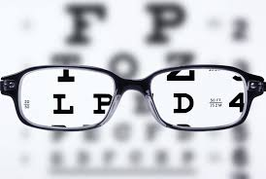
focus
https://www.allthingshair.com/en-uk/mens-hairstyles-haircuts/black-mens-hairstyles/afro-hairstyles-for-men-instagram/, ,, https://gretchenrubin.com/2015/10/video-on-clarity
Notes:
Here is another picture of focus.
How does this picture show the meaning of focus? Turn and talk to your partner.
Now that this man has glasses, his eyes can focus and see the letters clearly.
How many syllables are in the word focus? Let’s find out by clapping. Ready?
“Fo-cus.” Two syllables.
Now, let’s say focus three times by clapping the syllables. Ready?
“Fo-cus, fo-cus, fo-cus.”

Slide 8
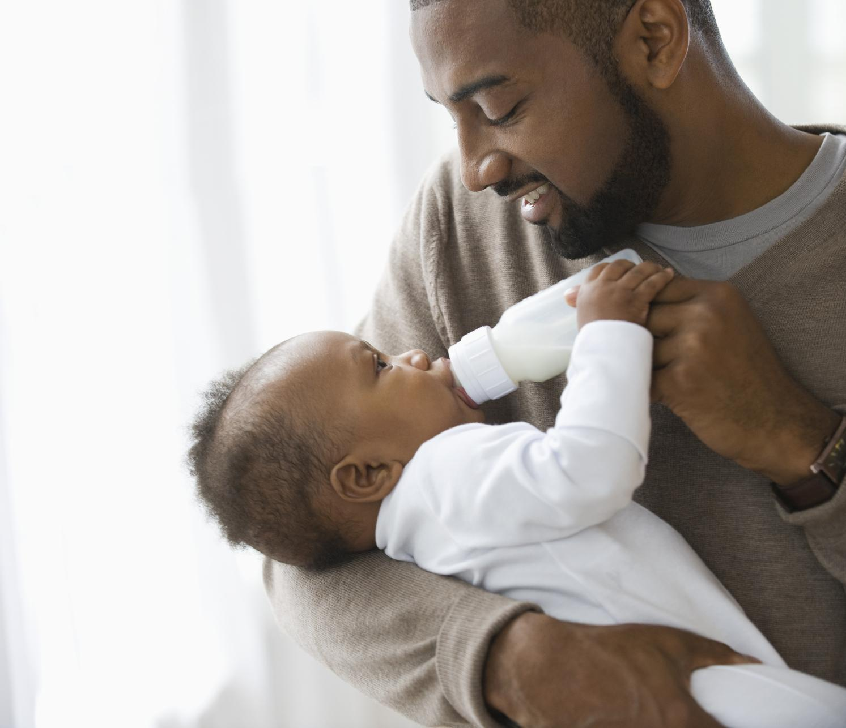
rely
llynsatterinstitute.org/how-to-feed/child-feeding-ages-and-stages/child-development-ages-and-stages-2/
Notes:
A word in the story is rely.
In Spanish it is contar con (kohn-tahr kohn).
Rely means to need.
Let’s say the word rely together. Ready?
“Rely.” When you say rely, I hear a /r/ sound at the beginning of the word.
Look, rely begins with the letter r.
Here is a picture that shows rely. This baby relies on the adult to be fed. Babies cannot feed themselves.

Slide 9
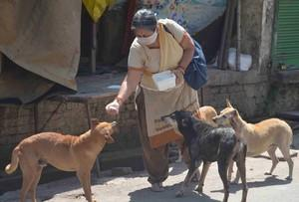
rely
http://www.uniindia.com/photoes/333040.html#
Notes:
Here is another picture of rely.
How does this picture show the meaning of rely? Turn and talk to your partner.
These stray dogs rely on the woman to feed them.
How many syllables are in the word rely? Let’s find out by clapping. Ready?
“Re-ly.” Two syllables.
Now, let’s say rely three times by clapping the syllables. Ready?
“Re-ly, re-ly, re-ly.”

Slide 10
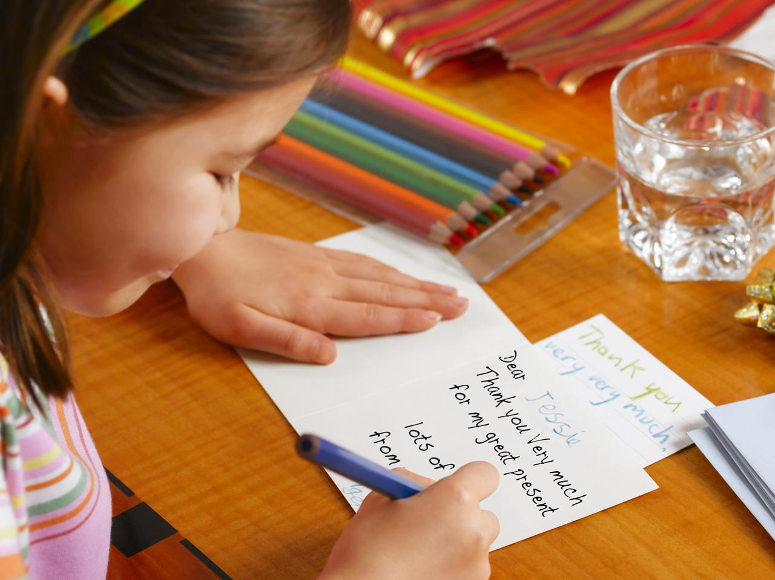
communicate
https://www.today.com/parents/should-kids-be-forced-write-thank-you-notes-1B8057224
Notes:
A word in the story is communicate.
In Spanish it is comunicarse (koh-moo-nee-kahr-seh).
Communicate means to send and receive messages
Let’s say the word communicate together. Ready?
“Communicate.” When you say communicate, I hear a /c/ sound at the beginning of the word.
Look, communicate begins with the letter c.
This child communicates with her friend by writing her a card. She is sending a message by writing it down and putting it in the mail.

Slide 11
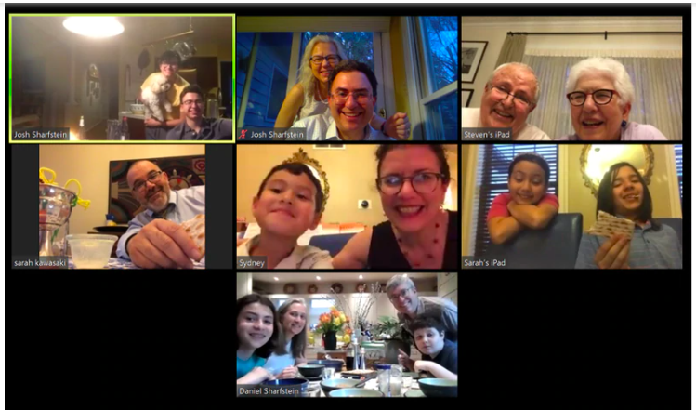
communicate
https://www.baltimoresun.com/coronavirus/bs-md-coronavirus-passover-seder-20200409-hacaojmyqzfgfplur3zqtsz6om-story.html
Notes:
Here is another picture of communicate.
How does this picture show the meaning of communicate? Turn and talk to your partner.
This family is communicating via Zoom. They want to share news and good wishes with one another.
How many syllables are in the word communicate? Let’s find out by clapping. Ready? “Com-mu-ni-cate.” Four syllables.
Now, let’s say communicate three times by clapping the syllables. Ready?
“Com-mu-ni-cate, com-mu-ni-cate, com-mu-ni-cate.”

