Slide 1
School Breakfast Program:
Meal Pattern • Market Research • Promotion
Kaitlin Fayle

Slide 2
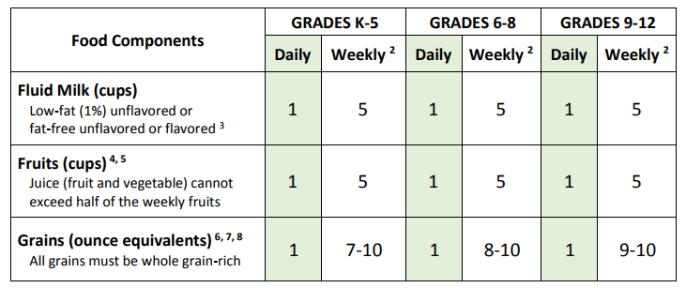
Breakfast Meal Pattern
Notes:
Here is the breakfast meal pattern overview, as you can see requirements are similar across all grades with the exception of the weekly requirements for grain items.

Slide 3

Meal Pattern Refresher
Milk
Daily Requirements
1 Cup for Grades k-12
Weekly Requirements
5 Cups for Grades k-12
Schools must offer a “variety” of milk
Schools to offer at least 2 different 8 oz. options:
Low-Fat (1%) unflavored
Fat Free (skim) unflavored
Fat Free (skim) flavored
Lactaid treated milk

Slide 4

Meal Pattern Refresher
Fruit/Vegetables
Daily Requirements
1 Cup for Grades k-12
Weekly Requirements
5 Cups for Grades k-12
Vegetables served at breakfast will credit toward the daily and weekly fruit requirement.
Fruit options:
100% fruit or vegetable juice
Fresh whole fruit
Dried - ¼ cup serving of dried fruit counts as ½ cup of fruit
Canned in 100% Juice, light syrup, or water

Slide 5

Meal Pattern Refresher
Starchy Vegetables
In order to credit starchy vegetables (like a potato product) as a part of the fruit/vegetable component at breakfast, the starchy vegetable will need to be offered in addition to two cups from the additional vegetable subgroups throughout the week.
Good ways to meet these include:
Salsa or beans in a breakfast burrito
Vegetables in an omelet
Vegetable juice, try a combination fruit/vegetable juice, if first ingredient (aside from water) is a vegetable it counts towards the vegetable offering.

Slide 6

Meal Pattern Refresher
Grains
Daily Requirements
1oz for Grades K-5
1oz for Grades 6-8
1oz for Grades 9-12
Weekly Requirements
7oz for Grades k-5
8oz for Grade 6-8
9oz for Grade 9-12
Tip: plan for 2oz daily!
Planning to offer each student 2oz. of grain at breakfast will make it easy to meet the weekly requirement.
Notes:
Daily requirements are the same

Slide 7

Meal Pattern Refresher
Meat/Meat Alternate (optional)
M/MA can count towards the weekly grain requirement.
To credit:
must be served in addition to a 1oz. grain item.
Examples:
Sausage and pancakes
Ham, egg and cheese on an English muffin
Omelet and toast

Slide 8
Offer Versus Serve- Breakfast
  Offer vs Serve is optional at Breakfast for all grade groups.
  • Offer 4 items from the 3 food components in full serving size:
  – Milk
  – Fruit (can also be a non-starchy vegetables)
  – Grains (can also be M/MA if served in addition to a grain)
Larger items (like a bagel) can count as two or more items
Reimbursable meal using OvS contains:
-At least 3 food items, one being, ½ cup fruit/vegetable
Notes:
You must

Slide 9
Components vs Items
Food Component
One of three food groups that comprise a reimbursable breakfast
Food Item
A specific food offered within a food component.

Slide 10
Components vs Items
Component = Food Group
1. Grains
2. Fruit
3. Milk
Item = Serving
1 oz. toast
2. 1 cup Grapes
3. 8 oz. skim milk

Slide 11
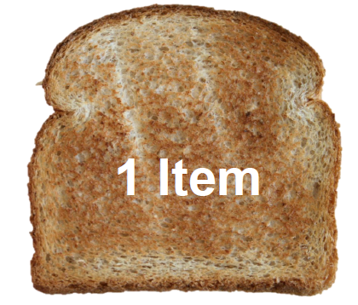
Offer Versus Serve - Items
1 oz. grain eq.

Slide 12

Offer Versus Serve- Items
1 oz. grain eq.
1 oz. grain eq.

Slide 13
Foods With More Than 1 Oz Eq
Larger foods can count as more than 1 item.
2 oz. eq. bagel =
2 food items (grains)
3 oz. eq. bagel =
3 food items (grains)

Slide 14
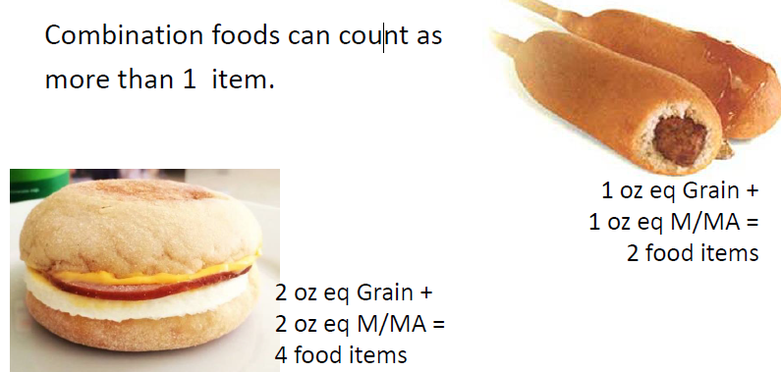
Combination Foods

Slide 15

Juice
Juice can only make up 50% of the weekly fruit offering (5cups)
You can offer a choice of ½ cup fruit and ½ cup 100% juice every day and it will meet the 50% requirement.
Notes:
Liquid breakfast not substantial enough

Slide 16
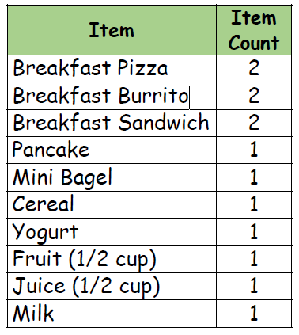
Counting Items

Slide 17
Identifying A Reimbursable Breakfast at POS
Look for ½ cup fruit (vegetable)
Look for at least 2 other items
Notes:
Remember, the student needs 3 items on the tray and one must be at least a ½ cup from the fruit component.
First, look for the fruit requirement. If you see it on the tray then
Second look for at least two other items. Remember the 2 items may be combined (breakfast sandwich, big bagel) OR they may be separate (toast & eggs, cereal and milk)

Slide 18
Offer Vs Serve Fruit
You must offer 1 Cup of fruit total- a student may take ½ cup of fruit and it will count as 1 Item.
You May Offer:
1 oz. Grain
½ cup Fruit
½ cup Fruit
1 cup Milk
A Student May Take:
1 oz. Grain
½ cup of Fruit
1 Cup Milk

Slide 19
Summary of OvS at Breakfast
Must offer 4 food items
from 3 food components
Option A
1 oz Grain
1 oz Grain
1 cup Fruit
1 cup Milk
Option B
1 oz Grain
1 oz (M/MA)
1 cup Fruit
1 cup Milk
Option C
1 oz Grain
½ cup Fruit
½ cup Fruit
1 cup Milk
Notes:
A quick summary of what we’ve talked about:
You must offer 4 items from the 3 required components
M/MA can be offered and can count as a grain as long as a grain item is offered as well
1 Cup of fruit must be offered daily.
The menu planner decides how fruit will be offered: offer 1 cup of fruit = 1 food item or ½ cup fruit and ½ cup fruit is 2 items.

Slide 20
OvS at Breakfast
Student may decline 1 item
Option A
1 oz Grain
1 oz Grain
1 cup Fruit
1 cup Milk
Option B
1 oz Grain
1 oz (M/MA)
1 cup Fruit
1 cup Milk
Option C
1 oz Grain
½ cup Fruit
½ cup Fruit
1 cup Milk
Notes:
For a breakfast to be reimbursable, the student has to choose 3 items, one must be at least a ½ cup fruit

Slide 21

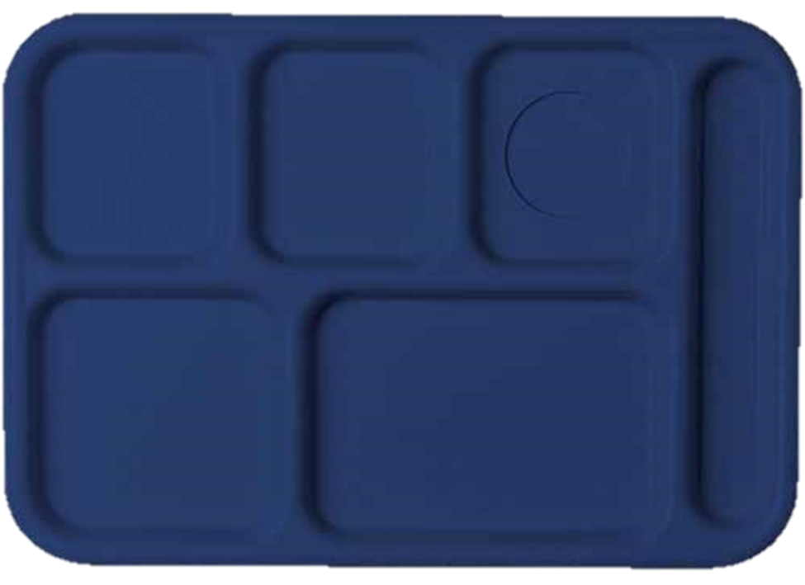



Offer Versus Serve - Breakfast
½ cup Fruit
½ cup Fruit
1 cup milk
1 oz Grain (M/MA)
1 oz Grain

Slide 22
Offer Versus Serve - Breakfast
Notes:
How many items on this tray? 3 items
-Is there a minimum of ½ cup fruit or vegetable? No
-Is this tray reimbursable? No
What do you do?
-Do you say “go back and get a fruit.” or do you say, ”This comes with your meal!”
-If they refuse, you charge a la carte prices

Slide 23
Offer Versus Serve - Breakfast
Notes:
How many items on this tray? 3 items
-Is there a minimum of ½ cup fruit or vegetable? No
-Is this tray reimbursable? No
What do you do?
-Do you say “go back and get a fruit.” or do you say, ”This comes with your meal!”
-If they refuse, you charge a la carte prices

Slide 24
Offer Versus Serve - Breakfast
Notes:
How many items on this tray? 3 items
-Is there a minimum of ½ cup fruit or vegetable? Yes
-Is this tray reimbursable? Yes

Slide 25
Offer Versus Serve - Breakfast
Notes:
How many items on this tray? 3 items
-Is there a minimum of ½ cup fruit or vegetable? Yes
-Is this tray reimbursable? Yes

Slide 26
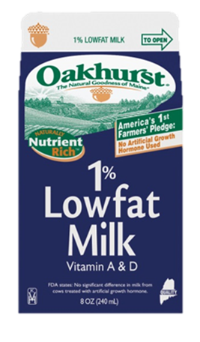

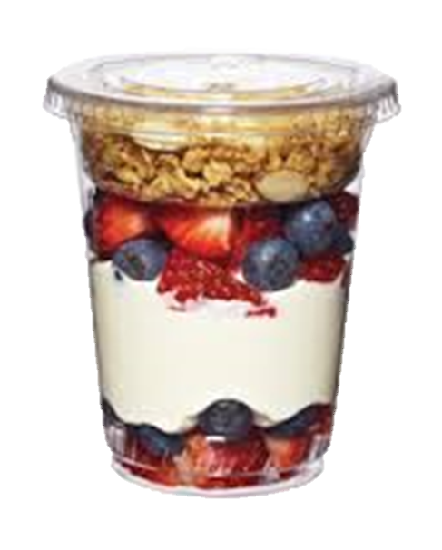
Offer Versus Serve - Breakfast
½ cup Fruit
1 cup milk
1 oz Grain
½ cup Fruit
1 oz Grain
Notes:
Here is our planned menu with 1 cup of milk, yogurt parfait with 1 oz eq of Grain, 1 oz eq of Grain (yogurt) and ½ cup of fruit and ½ cup of fruit juice

Slide 27
Offer Versus Serve - Breakfast
Notes:
How many items on this tray? 3 items
-Is there a minimum of ½ cup fruit or vegetable? Yes
-Is this tray reimbursable? Yes

Slide 28
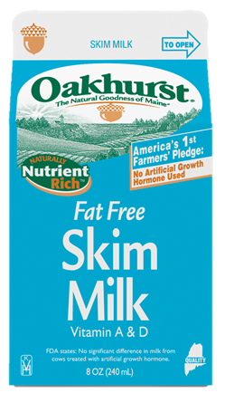

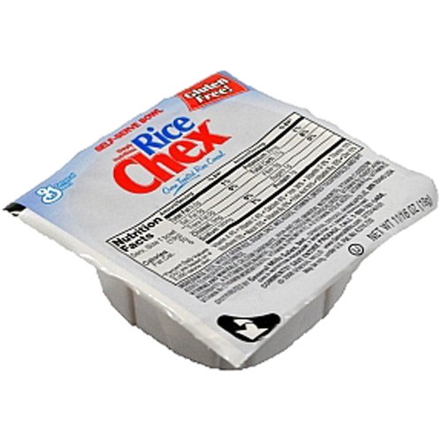

Offer Versus Serve - Breakfast
1 oz Grain
½ cup Fruit
1 cup milk
½ cup Fruit
1 oz Grain
Notes:
Here is our planned menu with 1 cup of milk, 1 oz eq of cereal, 1 oz eq of toast and ½ cup of fruit and ½ cup of fruit juice

Slide 29
Offer Versus Serve - Breakfast
Notes:
How many items on this tray? 3 items
-Is there a minimum of ½ cup fruit or vegetable? No
-Is this tray reimbursable? NO

Slide 30
Offer Versus Serve - Breakfast
Notes:
How many items on this tray? 3 items
-Is there a minimum of ½ cup fruit or vegetable? No
-Is this tray reimbursable? NO

Slide 31

Offer Versus Serve - Breakfast
Notes:
How many items on this tray? 3 items
-Is there a minimum of ½ cup fruit or vegetable? YES
-Is this tray reimbursable? Yes

Slide 32
Offer Versus Serve - Breakfast
Notes:
How many items on this tray? 3 items
-Is there a minimum of ½ cup fruit or vegetable? YES
-Is this tray reimbursable? Yes

Slide 33


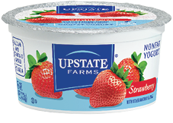

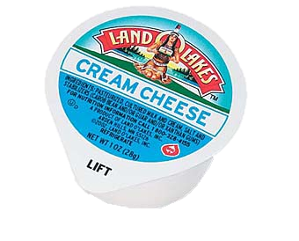
Offer Versus Serve - Breakfast
½ cup fruit
½ cup fruit
1 cup milk
1 oz M/MA= 1 oz Grain
2 oz Grain
Notes:
Let’s look at several trays where we count the M/MA (yogurt) counted as a grain
So the planned menu is 1 cup of milk, a carton of yogurt that counts as a 1 oz grain, a WG bagel that is 2 oz eq of grain, ½ cup of fruit, and ½ cup juice:
The yogurt that is 1 oz equivalent of M/MA is an counted as a grain

Slide 34
Offer Versus Serve - Breakfast
Notes:
How many items on this tray? 4 items
What are the items? (cc doesn’t count)
-Is there a minimum of ½ cup fruit or vegetable? No
-Is this tray reimbursable? No

Slide 35
Offer Versus Serve - Breakfast
Notes:
How many items on this tray? 4 items
What are the items? (cc doesn’t count)
-Is there a minimum of ½ cup fruit or vegetable? No
-Is this tray reimbursable? No

Slide 36
Offer Versus Serve - Breakfast
Notes:
How many items on this tray? 3 items
-Is there a minimum of ½ cup fruit or vegetable? YES
-Is this tray reimbursable? Yes

Slide 37
Offer Versus Serve - Breakfast
Notes:
How many items on this tray? 3 items
-Is there a minimum of ½ cup fruit or vegetable? YES
-Is this tray reimbursable? Yes

Slide 38


Offer Versus Serve - Breakfast
½ cup Fruit
1 cup milk
½ cup Fruit
2 oz G + 2 oz M/MA =4 G
Notes:
The breakfast sandwich can count as
4 ITEMS: Count both grains oz eq AND count the 2 oz M/MA as grains
2 ITEMS: Count both grains oz eq and count the 2oz M/MA as EXTRA
1 ITEM: Count the 2oz grains as 1 item and count the 2oz M/MA as EXTRA
The planned menu is 1 cup of milk, a breakfast sandwich that is 2oz eq of grain and 2 oz equivalent of M/MA and ½ cup of juice and ½ cup of fruit

Slide 39
Offer Versus Serve - Breakfast
Notes:
How many items on this tray? 3 items
-Is there a minimum of ½ cup fruit or vegetable? No
-Is this tray reimbursable? No

Slide 40
Offer Versus Serve - Breakfast
Notes:
How many items on this tray? 3 items
-Is there a minimum of ½ cup fruit or vegetable? No
-Is this tray reimbursable? No

Slide 41
Offer Versus Serve - Breakfast
Notes:
How many items on this tray? 3 items
-Is there a minimum of ½ cup fruit or vegetable? YES
-Is this tray reimbursable? Yes

Slide 42
Offer Versus Serve - Breakfast
Notes:
How many items on this tray? 3 items (a FULL cup of fruit/juice is considered an item)
-Is there a minimum of ½ cup fruit or vegetable? YES
-Is this tray reimbursable? Yes

Slide 43
Offer Versus Serve - Breakfast
Notes:
If a student doesn’t have the required components, what do you do?
This is what I hear:
“go get a fruit”
“do you want a juice’ (gives student opportunity to say no)
“you HAVE to have a fruit” (what kids wants to be told what they HAVE to have?)
“here sweetie, this comes with all meals today” while placing the required item on the tray. Or maybe don’t say anything but smile!
If they still decline what’s required for a RM, it just means it can’t be claimed for reimbursement. Charge a la carte.

Slide 44
Offer Versus Serve - Breakfast
Notes:
If a student doesn’t have the required components, what do you do?
This is what I hear:
“go get a fruit”
“do you want a juice’ (gives student opportunity to say no)
“you HAVE to have a fruit” (what kids wants to be told what they HAVE to have?)
“here sweetie, this comes with all meals today” while placing the required item on the tray. Or maybe don’t say anything but smile!
If they still decline what’s required for a RM, it just means it can’t be claimed for reimbursement. Charge a la carte.

Slide 45
Non-Creditable Foods
Cream Cheese
Bacon
Non-whole grain rich items
Popcorn
Potato chips
Condiments

Slide 46
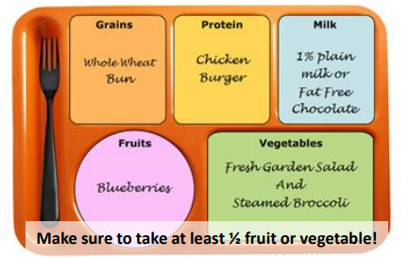
Meal Signage is Required
Must identify all foods that are part of a reimbursable meal before the serving line.

Slide 47
Statewide Breakfast Participation
Unfortunately, participation in the Breakfast Program is about half that of the Lunch Program.
Maine Breakfast participation hovers around 30% for elementary & middle school and at 20% for high school.

Slide 48

2017 Market Research
Increasing School Breakfast Program Participation
Outreach:
-22 School Nutrition Staff
-92 intercept interviews at in 6 locations throughout the state.
-150 direct mail responses
Notes:
Analytic insight conducted market research for the DOE on increasing breakfast participation.
They conducted interviews with school staff, parents and families

Slide 49
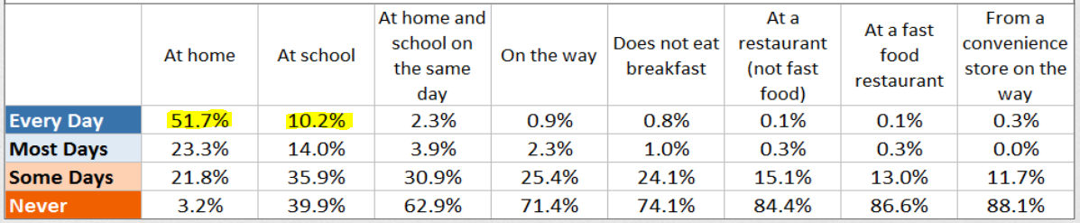
Current Participation
*51.7% eat at home everyday
compared to
*10.2% eat at school everyday
*39.9% never eat at school

Slide 50
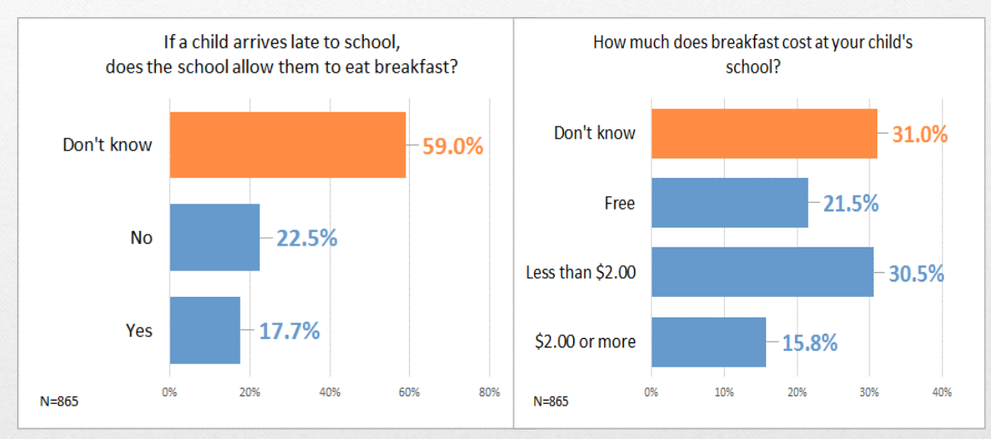
How much do parents know?
Notes:
59% of parents are not sure if the school can provide a late breakfast.
31% are unaware of the cost of breakfast at their school

Slide 51
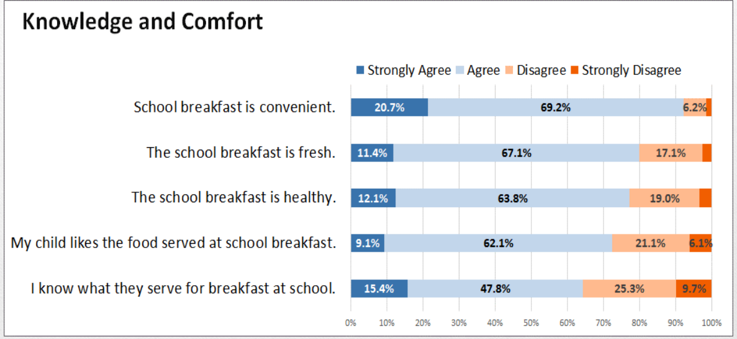
Food Quality
*Areas in red are areas for improvement!
Notes:
The red and orange areas of this chart show areas for improvement, but mostly parents have a perception that the breakfast is fresh and healthy.
About 30% of parents are unsure of what the school provides for breakfast.

Slide 52
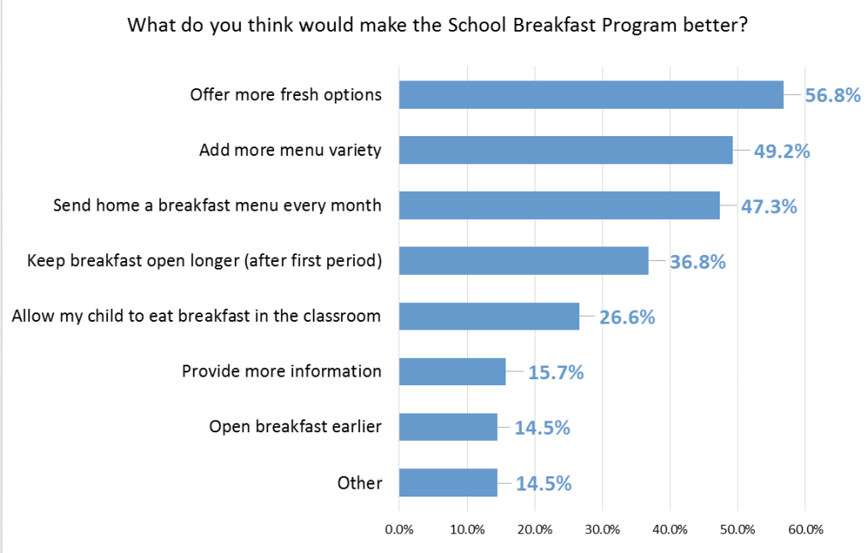
Parent Perceptions
Notes:
What parents think would make the program better

Slide 53
Marketing and Advertising
Promote, promote, promote!
Is your breakfast menu as readily available as your lunch menu?
Send reminders throughout the year
  Clarify prices and serving times and promote the healthy items you serve!
Use creative meal names, wording on menus, descriptive signage, and themes

Slide 54
Staff Perceptions
What Nutrition Programs can do:
1. Gain teacher and administration support and improve communication at the school level for promotion to come from school staff.
2. Alter or add other service delivery methods to reach additional students

Slide 55
Other Service Delivery Methods
Breakfast in the Classroom (BIC)
Breakfast After the Bell
Grab and Go
Universal Breakfast

Slide 56
Breakfast in the Classroom (BIC)
Pros:
Works best with elementary age kids
Allows the morning to start with everyone in the classroom
Teachers can take the opportunity to make announcements, take attendance, collect homework
Can be a good jumping off point for curriculum
Cons:
Teachers will need to be trained
Creativity needed in-order to serve foods that aren’t messy like substituting syrup with apple sauce.
Custodial support
Notes:
Let teachers know daily what constitutes a reimbursable meal
Keep a cheat sheet on the tote for them
What “served” means- when it is on a kid’s desk/in their position
Have a share bucket/table, helpful for snack
Can return milk to kitchen; temp it

Slide 57
Breakfast After the Bell
Call it whatever you want!
  Like snack
Mainly suited for high schools
Helpful for late students or those who are not hungry first thing in the morning

Slide 58
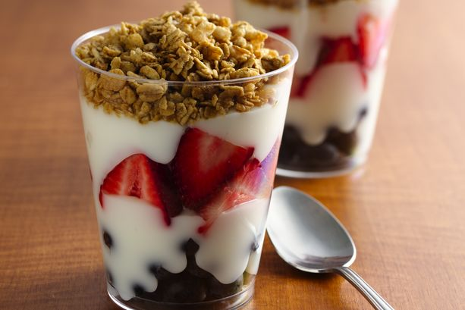

Grab and Go
Quick and Convenient
Generally not eaten in the cafeteria
Fairly simple to prepare, but packaging might be pricey
Must include 1 cup of fruit
Notes:
I nice all in one grab and go item would be a smoothie! Where it has all required items in one!

Slide 59
Universal Breakfast
Breakfast is served at no cost to all students regardless of their eligibility for free or reduced meals.
Benefits: reduces the stigma associated with eating free school meals
Challenges: may not be financial viable for all schools & school districts, especially if the school has low enrollment in free or reduced meals
Can and should be paired with other delivery models

Slide 60
Universal Breakfast Feasibility
Schools with a high percentage of free & reduced-price eligible children, 75% and above, generally are able to make up any lost revenue from paid meals.
However, the “break-even” point for each school or district is different depending on labor costs, food costs, and school size.

Slide 61
Assess Your Participation
For traditional breakfast service, a good baseline for minimum expected participation is either ¼ of your total enrollment, or 1/3 of your F&R students.

Slide 62

Where Are You Now?
LOOK AT YOU NUMBERS!!
  Do you know your per-meal cost?
  Do you know your participation?
What is your competition?
  Starbucks
  D&D
Taste-testing- try out new recipes.
Notes:
Are you serving items similar to you competition

Slide 63
Food Quality and Variety
Assess what you have are serving:
Cold vs. hot meals
Cold items every day?
Can you add more variety?
Create theme days?
How do you currently market your program????

Slide 64

Jazz it up with a Breakfast Bar
Self-Service Breakfast Bars: Practically any breakfast item can be put into “bar” form.
Oatmeal Toppings Bar
dried, fresh, frozen, canned fruit, especially berries, nuts, homemade granola, syrup and spices
Yogurt Parfait Bar
fruit like berries or more exotic like kiwi and pineapple, homemade granola, cereal
Bagel Bar – sweet or savory
tomatoes, cucumber, cheese, hummus, nut butter, jam, various cream cheese flavors
Notes:
You have a salad bar at lunch, why not create a breakfast bar?!

Slide 65
Equipment
Would you like to start a different serving style like breakfast in the classroom or Grab and GO?
Grants are available for equipment items like carts and insulated bags.
-Apply for grants from Full Plates Full Potential
Be creative in your application!
Notes:
If you would like to start a different serving style and need equipment you can apply for grants through full plates full potential
- they have an open and rolling grant process.

Slide 66
National School Breakfast Week
It’s Not Too late!
National School Breakfast Week March 6-10, 2018
School Nutrition Association provides marketing recourses including:
Handouts –logos and merchandise
Stakeholder presentations & press releases

Slide 67
https://schoolnutrition.org/home.aspx
According to a 2015 survey of SNA members, 96 percent said that their student participation increases during NSBW.
Recognizing NSBW in your schools can help you:
Increase student participation
Spread the message to parents that you’re serving a healthy, tasty breakfast at school each day
Earn media coverage from local papers, blogs, and TV stations
Connect with teachers and administrators at your school, and throughout the district, to spread the word that school meals are healthy and delicious

Slide 68
Questions?

