Slide 1
Owl Rules
Poem

Slide 2
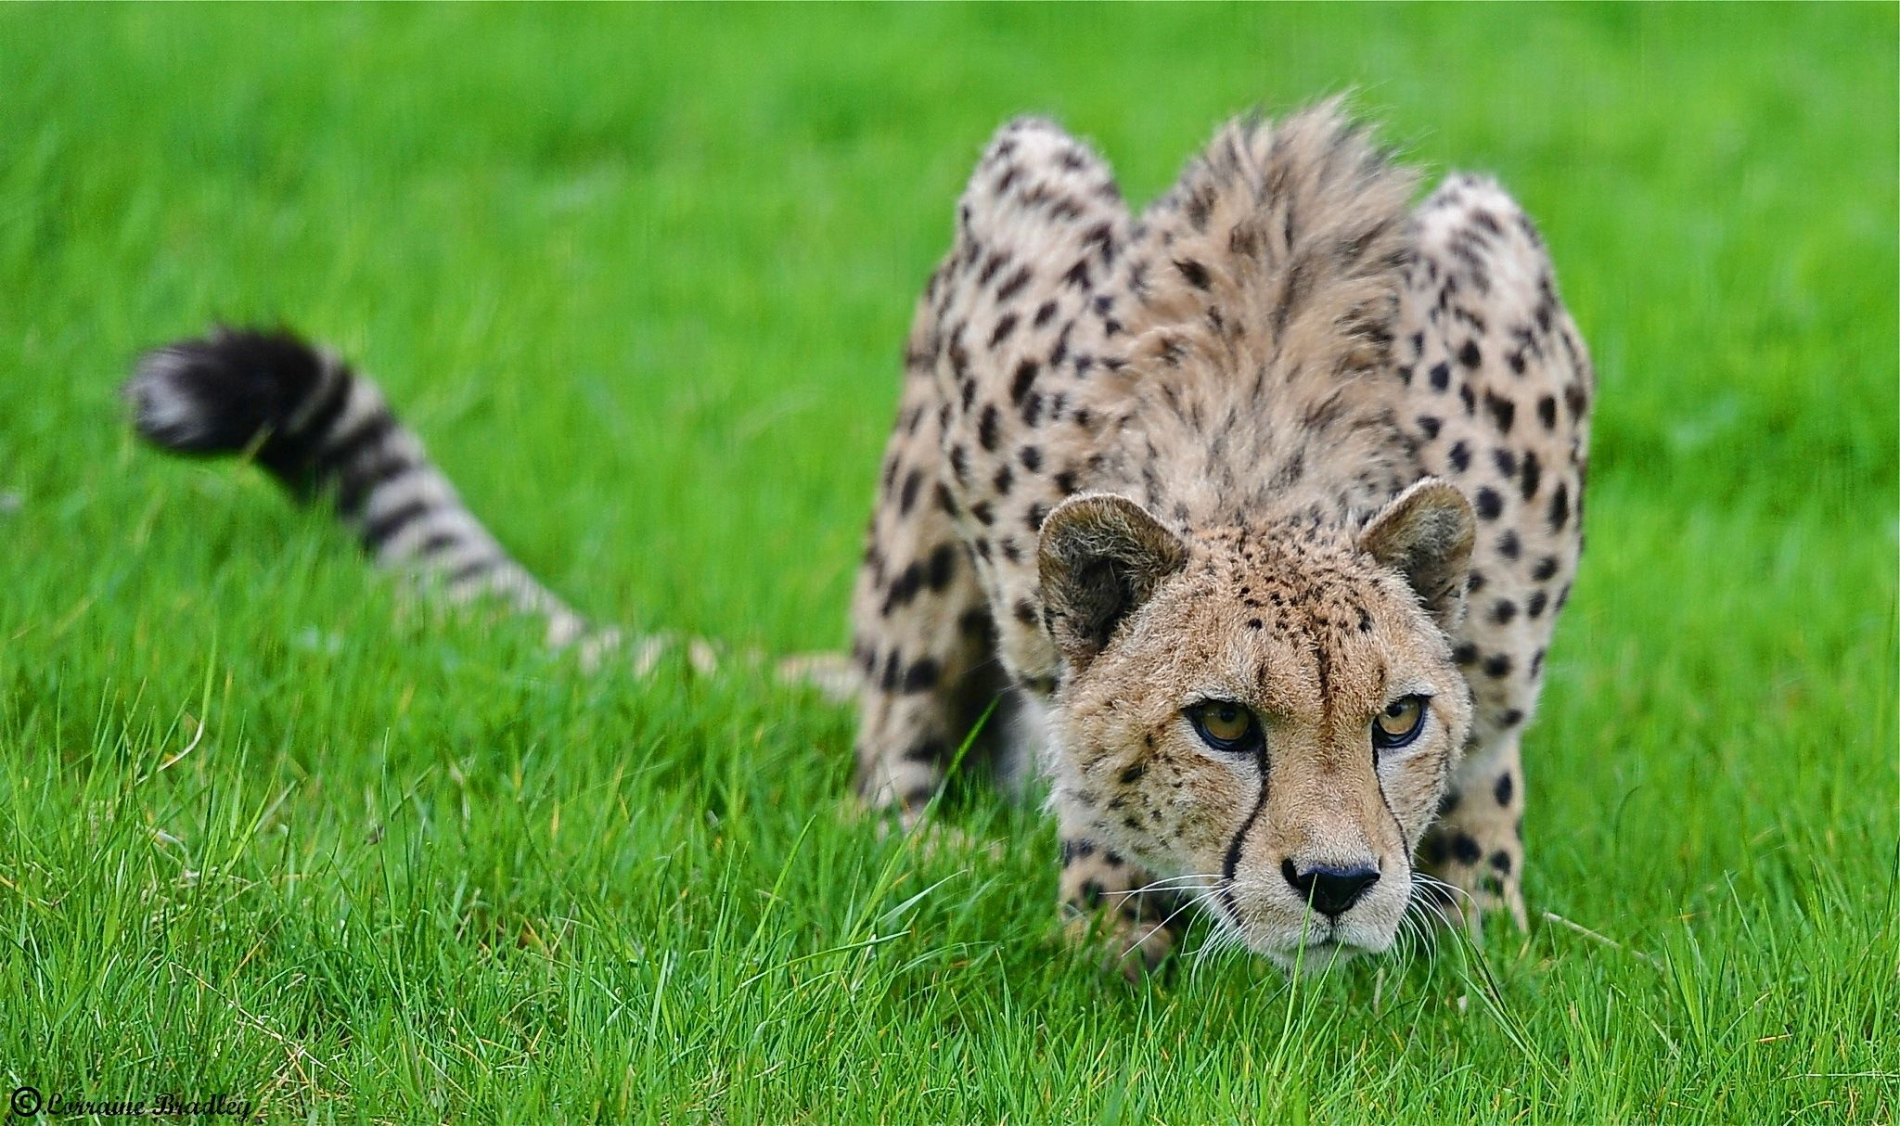
creep
https://www.pinterest.com/pin/439452876113313854/?nic_v2=1a18YqhJw
Notes:
A word in the poem is creep.
In Spanish it is deslizarse (dehs-lee-sahr-seh).
Creep means to move slowly and carefully so as not to be heard or seen.
Let’s say the word creep together. Ready?
“Creep.” When you say creep, I hear a /c/ sound at the beginning of the word.
Look, creep begins with the letter c.
Here is a picture that shows creep. The cheetah is creeping through the grass to catch its prey. The cheetah doesn’t want its prey to hear it approaching.

Slide 3
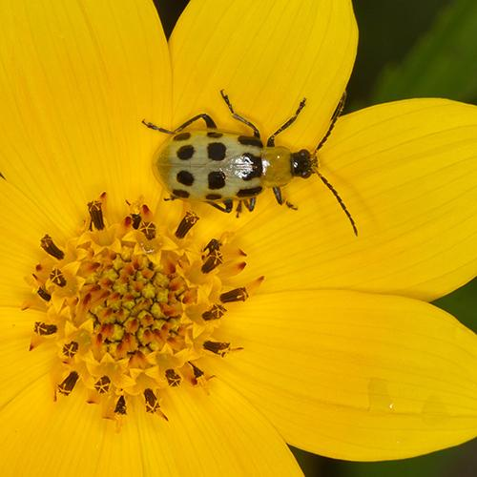
creep
https://earthbox.com/bug-chart
Notes:
Here is another picture of creep.
How does this picture show the meaning of creep? Turn and talk to your partner.
This beetle is creeping on the petals of the flower looking for leaves to eat.
How many syllables are in the word creep? Let’s find out by clapping. Ready?
“Creep.” One syllable.
Now, let’s say creep three times by clapping the syllables. Ready?
“Creep, creep, creep.”

Slide 4
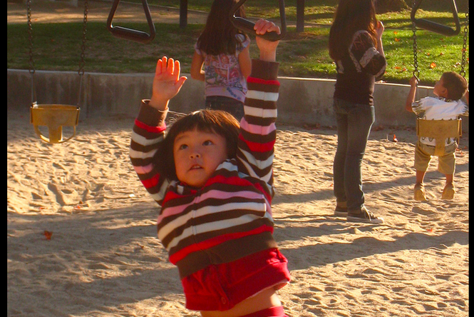
effort
https://noogatoday.6amcity.com/monkey-bars-and-career-moves-reaching-for-bigger-risks-and-rewards/
Notes:
A word in the poem is effort.
In Spanish it is esfuerzo (ehs-fwehr-soh).
Effort means trying to do something.
Let’s say the word effort. Ready?
“Effort” When you say effort, I hear the /e/ sound at the beginning of the word.
Look, effort begins with the letter e.
Here is a picture that shows effort. The child is making an effort to cross to the other side of the structure with the monkey bars.

Slide 5
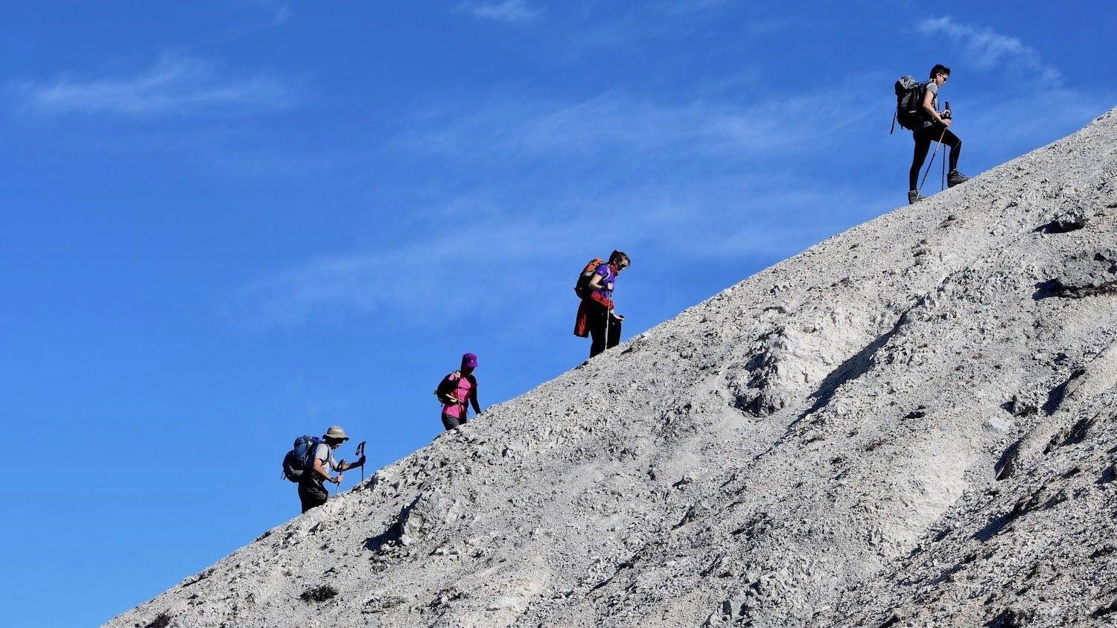
effort
https://cosmosmagazine.com/mathematics/the-mathematics-of-hill-walking/
Notes:
Here is another picture of effort.
How does this picture show the meaning of effort? Turn and talk to your partner.
The hikers are making an effort to climb up the mountain. The hillside is steep, and a person can get tired quickly. This hikers keep going—trying very hard to get to the top.
How many syllables are in the word effort? Let’s find out by clapping. Ready?
“Ef-fort.” Two syllables.
Now, let’s say effort three times by clapping the syllables. Ready?
“Ef-fort, ef-fort, ef-fort.”

