Slide 1
MAINE DEPARTMENT OF EDUCATION (DOE)
Assessment Technical Assistance
Level 2
February - June 2025
Please send all questions related to this module to the appropriate member of the Maine DOE Assessment Team
Presented by: The Assessment Team
Notes:
Jodi

Slide 2
Mission & Vision
To promote the best learning opportunities for all Maine students by providing information, guidance, and support to our schools, educators, and leaders and by providing adequate and equitable school funding and resources.
Notes:
Jodi

Slide 3
Assessment Technical Assistance (TA)
Purpose
Technical assistance supports Maine School Administrative Units (SAUs) and schools with areas of challenge while also highlighting and sharing areas of excellence. Through collaborative partnerships, the Maine Department of Education (DOE) and SAUs work together to improve the opportunity for all students to demonstrate what they know and can do in relation to grade level academic content.
Welcome to the Maine DOE
Meet Our Team
Assessment
Jodi Bossio-Smith
Director of Assessment
Jodi.Bossio-Smith@maine.gov
Krista Averill
Assessment Coordinator, Maine Through Year & Maine Science
Krista.Averill@maine.gov
Mechelle Ganglfinger
Assessment Coordinator, MSAA & ACCESS
Mechelle.Ganglfinger@maine.gov
Dr. Regina Lewis
Assessment Coordinator, NAEP & International Assessments
Regina.Lewis@maine.gov
Notes:
Jodi

Slide 4
Assessment Technical Assistance
Purpose
ESSA includes the expectation all assessment administration practices be reviewed and supported within the State system: the general academic assessments, the general English Language Proficiency (ELP) assessments, the alternate academic assessments, and the alternate ELP assessments. Additionally, equitable access to assessment participation for all students falls within the larger framework of inclusive education. Inclusive education takes place when all students are deemed competent and worthy of a high-quality and challenging education.
Notes:
Jodi

Slide 5
Levels of Technical Assistance
Level 1 – voluntary participation
Collaborative feedback for Maine DOE as well as for SAU & Schools
When possible, assessment team member observes in person
Level 3 – identified due to concerns related to assessment security or participation. Includes collaborative action planning by Maine DOE and SAU
Technical Assistance –Overview & Update
Levels 1 & 3 technical assistance have been underway for the past two school years
Level 1 TA:
Assessment technical assistance is available to all Maine SAUs based on specific needs, upon request
Level 3 TA:
Participation rates, assessment security
Includes action planning and SEA observation visit
Notes:
Jodi

Slide 6
Levels of Technical Assistance
Level 1 – voluntary participation
Collaborative feedback for Maine DOE as well as for SAU & Schools
When possible, assessment team member observes in person
Level 2 – randomly selected cohort cycle
Level 3 – identified due to concerns related to assessment security or participation. Includes collaborative action planning by Maine DOE and SAU
Technical Assistance –Overview & Update
Introducing Level 2
Assigned based on a 10-year, randomly selected cohort cycle
Assessment observations to be conducted by SAU and school personnel, with support from members of the Assessment Team
Observation checklists provided by Maine DOE
Potential of follow up conversations
Data around how Maine students and educators are interacting in the assessment environment
Notes:
Jodi

Slide 7
Technical Assistance is for all Maine Educational Assessments
Notes:
Jodi

Slide 8
Level 2 – The Process
The Maine DOE Assessment Team contacts the selected SAUs District Assessment Coordinator (DAC), as identified in the NEO public database.
DAC and any applicable school assessment coordinators review the asynchronous training provided by Maine DOE.
Maine DOE Assessment Team works with DAC to verify that all local Assessment Coordinators (ACs) have necessary trainings. ACs ensure that all assessment administrators and proctors complete all required training prior to administration.
During the administration window, the DAC and any applicable school assessment coordinators conduct local observations across the Maine Educational Assessments (MEA) and submit notes via the online Checklist Tool.
When possible, the Maine DOE Assessment Team provides an in-person assessment administration observation.
Following the administration windows, the Maine DOE Assessment Team connects back with local SAU leadership to provide and receive feedback as well as to answer any questions.
Notes:
Jodi
Level 2 Technical Assistance for the Spring 2025 administrations of the MEAs includes the following steps:
The District Assessment Coordinator (DAC) provides the Maine DOE Assessment Team with the names and contact information for the School Assessment Coordinator (SAC) at each school in the SAU. Please provide this information by [date].
The DAC and SACs participate in a brief asynchronous training.
The Maine DOE Assessment Team verifies that all Assessment Coordinators have completed the necessary training for the assessments under their purview. Assessment Coordinators ensure that all assessment administrators and proctors complete all required training for the applicable assessments prior to administration.
During the administration window, Assessment Coordinators conduct local observations across the Maine Educational Assessments (MEA) and submit notes via the online Checklist Tool. This includes one observation of a general assessment, an alternate assessment, and where applicable an English Language Proficiency assessment. These visits should be conducted across grade spans, student populations, and content areas.
When possible, the Maine DOE Assessment Team provides an in-person assessment administration observation. Although the team endeavors to visit as many SAUs as possible, we recognize that there are many SAUs we will not have the opportunity to connect with each year.
Following the administration windows, the Maine DOE Assessment Team connects back with local SAU leadership to provide and receive feedback as well as to answer any questions.

Slide 9
Observations – Which assessments?
A minimum of one observation of each of the following:
A general assessment,
An alternate assessment
These visits should be conducted across grade spans, student populations, and content areas.
** Note that in AY 2026 observation of English Language Proficiency Assessments will be a requirement.
Notes:
Jodi
Assessment Coordinators conduct local observations across the Maine Educational Assessments (MEA) and submit notes via the online Checklist Tool. This includes one observation of a general assessment, an alternate assessment, and where applicable an English Language Proficiency assessment. These visits should be conducted across grade spans, student populations, and content areas.
Local Observations and monitoring administration of state assessments is the joint responsibility of the local assessment coordinators and the Maine DOE Assessment Team. The information collected through assessment observations provides contextual data to be used in conjunction with quantitative sources to provide a more comprehensive picture of assessment administration practices across the State. Any irregularities observed during local review should be immediately reported as described in the Assessment Security Handbook. When reported quickly, the SAU may be able to resolve the irregularity and avoid potential downstream effects such as the invalidation of student assessment results. All SAUs are encouraged to conduct local observation(s) and to submit the online Assessment Administration Observation Checklist Tool. The checklists are provided as tools to support the consistent administration of the assessment and in some cases, provide additional information to assist with gauging the assessment experience of the student.

Slide 10
Observation Checklist Tool – online & on paper
Most basic version of the online observation checklist tool
The first section collects basic information about the assessment, the school, and the observer.
** Note that the observation forms all contain similar elements that take place before, during, and after the assessment, but the individual assessment specific surveys also contain elements that are specific to the assessments.
Notes:
Gina
The checklists are provided as tools to support the consistent administration of the assessment and in some cases, provide additional information to assist with gauging the assessment experience of the student.
The Assessment Administration Observation Checklist Tool is linked in this slide for your reference. The Assessment Team will be holding drop in office hours via Zoom to answer questions and provide additional assistance with the technical assistance process.
Every year, we learn more about how Maine students are experiencing state assessments, and where we need to improve. Data from these locally conducted observations will be triangulated in order to plan for the upcoming school years.
Thank you in advance for your participation

Slide 11
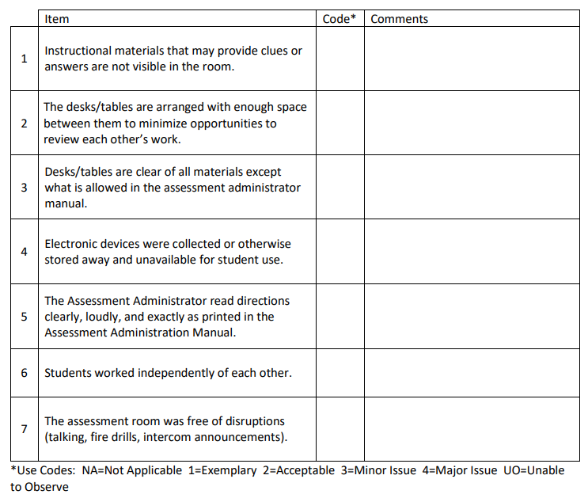
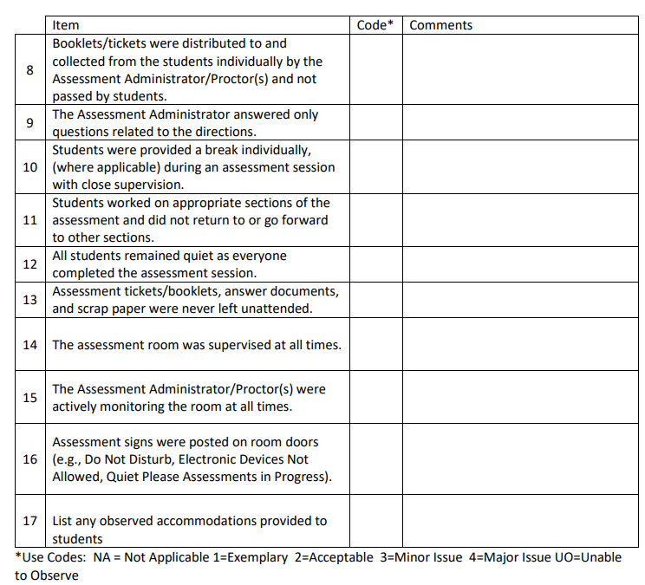
Observation Checklist – Environmental Considerations
Notes:
Gina
Please also note any observations of the use of accommodations.

Slide 12
Observation Checklist continued
Is this the TA’s first time administering the assessment?
TA’s level of confidence administering the assessment.
Does the proctor/TA/AA feel they received sufficient training and support to administer the assessment?
Was the student(s) provided an opportunity to participate in a practice session?
Were any of the students, or the specifically observed student observed hurrying through the assessment?
Were any of the students observed using the universal tools provided in the assessment?
Notes:
Gina

Slide 13
Observation Checklist continued
Why make note of accommodations?
Federal requirement to ensure students receive accommodations when appropriate
Maine DOE Assessment Team does not have access to student IEP, 504, or ILAP
When providing feedback, please provide any insight including specific topics for additional assessment training offered by the Maine Department of Education.
Ask those you observe for their feedback as well
Include feedback in your notes
Notes:
Gina
When providing feedback, please provide any insight including specific topics for current and future additional assessment training offered by the Maine Department of Education.
As those you observe for their feedback as well.
Include feedback in your notes. Your notes will be invaluable for future planning.

Slide 14
Conducting the observations
Please print the form and review
Serves as guidance for what to look for
Allows for additional notes to be taken -
Try to be a silent observer
Provides copy for the SAU records
Also prevents use of additional bandwidth by observer device
Access the online form and complete form using your notes
Submit to Maine DOE Assessment Team (Automatically sent when submitted)
**Suggestions
Complete multiple observations when possible.
If others are conducting the trainings have them assist with observations
Notes:
Gina

Slide 15
After submission
Review all forms from observations for areas of excellence as well as for areas of needed improvement
Make recommendations for future action (examples)
Revision to training
Reminders to use assessment administration scripts
Reminders related to assessment security
Reminders related to logistics
Reminders related to student preparation/instructions
Seek optional feedback from Maine DOE Assessment Team
Notes:
Gina

Slide 16
Review & Summary
Monitoring the administration of assessments is a federal requirement
Ensures consistency and fidelity of administration across schools, grades, classrooms
For all state assessments
Ensures students are participating in the appropriate assessments if applicable:
Consistent with instruction
Consistent with IEP, 504, or ILAP
The Maine DOE Assessment Team provides:
Observation Checklist Tool
Training
Support
In person observations when possible
Notes:
Gina
Monitoring, including observation of, the administration of its State assessments to ensure that standardized test administration procedures are implemented with fidelity across districts and schools. Monitoring of test administration should be demonstrated for all assessments in the State system: the general academic assessments and the Alternate Assessments.
Monitoring, including observation of, test administration in SAUs and schools ensures that appropriate assessments, with or without accommodations, are selected for all students with disabilities and ELs so that they are appropriately included in assessments and receive accommodations that are:
Consistent with state and local policies for accommodations;
Appropriate for addressing a student’s disability or language needs for each assessment administered;
Consistent with accommodations provided to the students during instruction and/or practice;
Consistent with the assessment accommodations identified by a student’s IEP Team under IDEA, placement team convened under Section 504; or for students covered by Title II of the ADA, the individual or team designated by a district to make these decisions; or another process for an EL;
Administered with fidelity to test administration procedures;
Monitored for administrations of all required academic content assessments, Alternate Assessment, ELP assessments, and Alternate ELP Assessments.

Slide 17
Thank You!
FMI: Contact the Maine DOE Assessment Team

