Slide 1
Allergy and Anaphylaxis Management
1 hour training
Pre and post-test
Notes:
The focus will be mainly on food allergies although we do touch on environmental allergies.

Slide 2
Overview
Definitions
  Standing Orders
  Collaborative Practice Agreement
Causes of Anaphylaxis
Prevention
Signs, Symptoms and Treatments
Confidentiality and Rights
Practice
Storage and Reporting
Notes:
The focus is always “report back to the school nurse”, include the school nurse at every step of this process.

Slide 3
Allergy Management Pre-Test
Name: ____________________________ School: _______________ Date: __________
True / False Questions:
1. T/F Anaphylaxis is a life threatening emergency.
2. T/F Allergy symptoms can worsen suddenly.
3. T/F Only people with known allergies can develop anaphylaxis.
4. T/F Anaphylaxis may be caused by insect bites or stings, foods, medications or contact with latex or other substances.
5. T/F The recommended injection site for epinephrine autoinjector is the outer mid-thigh muscle.
6. T/F When a student having an anaphylactic reaction and epinephrine is given, it is not necessary to call 911.
7. T/F The epinephrine autoinjector must be held firmly in the thigh muscle for at least 10 seconds after injection.
8. T/F Students with known life-threating allergies need to have an Individualized Allergy Emergency Care Plan for staff to follow.

Slide 4
Definitions
Allergy - an immune response to a foreign antigen resulting in inflammation and organ dysfunction.
Allergic Reaction - a reaction of the immune system to a specific protein as a problem and initiates a response resulting in the release of chemical mediators such as histamine.
Anaphylaxis - a life-threatening, often rapidly progressing type of allergic reaction. Anaphylactic reactions usually begin within minutes of exposure to allergen.
Maine School Health Manual www.maine.gov/education/sh
National Center for Biotechnology Information- www.ncbi.nlm.nih.gov

Slide 5
Standing Orders
Definition: “..are intended to cover those individuals who are not yet identified as known reactors and, for that reason, do not have their own emergency medication and individualized medical order in place.” Legal Issues in School Health Services Schwab and Gelfman, 2005 p. 211

Slide 6
School Health Advisor Standing Order (Sample)
In the event that an individual presents with a sudden onset of any of the following:
Symptoms can include:
Hives (red, itchy bumps on your skin)
Lip, tongue and throat swelling
Nausea, vomiting, diarrhea, cramping
Shortness of breath, wheezing, coughing
Drop in blood pressure
Loss of consciousness
(Source: https://www.aap.org/en-us/Documents/medicalhome_resources_anaphylaxisguide.pdf)
If indicated, the first available school staff member must administer epinephrine autoinjector- .3mg ( over 55 pounds) or epinephrine autoinjector -.15mg (under 55 pounds) and call the Rescue Department (911). Monitor the patient’s vital signs (school nurse if available) and keep warm until rescue arrives. Be sure to have student data available for the rescue team.
For milder local allergic reactions such as hives without respiratory symptoms, the school nurse may administer Benadryl 25 mg by mouth. Proceed with Epi-pen if above anaphylactic symptoms present.
_______________________ _____________________________
Date School Health Advisor

Slide 7
Collaborative Practice Agreement
6305.1Definitions.
A. "Collaborative practice agreement" means a written and signed agreement between a physician licensed to practice in the state of Maine or a school health advisor under Sec. 6402-A and a school nurse under Sec. 6403-A that provides for the prescription of epinephrine autoinjectors by the physician or school health advisor and administration of the epinephrine autoinjectors by a school nurse or designated school personnel to students during school or a school-sponsored activity under emergency circumstances involving anaphylaxis.
Citation: http://legislature.maine.gov/ros/LawsOfMaine/#Statutes/20-A/title20-Asec6305

Slide 8
Collaborative Practice Agreement
B. “Designated School Personnel” means those employees, agents or volunteers of a school administrative unit or an approved private school designated by a collaborative practice agreement between a physician licensed in this State or a school health advisor under section 6402-A and a school nurse under section 6403-A who have completed the training required by rule to provide or administer an epinephrine autoinjector to a student.
C. “Epinephrine autoinjector” means a device that automatically injects a premeasured dose of epinephrine.
D. “School” means a public or approved private school.
Citation: http://legislature.maine.gov/ros/LawsOfMaine/#Statutes/20-A/title20-Asec6305

Slide 9
Collaborative Practice Agreement
Must include:
  Name and physical address of the school
  Identification and signatures of the physician or school health advisor under section 6402-A and school nurse under section 6403-A
  Dates the agreement is signed by each party
  Beginning and end dates of the period of time within which the agreement is in effect
  Any other information considered appropriate by the physician or school health advisory under section 6402-A and school nurse under section 6403-A
  Citation: http://legislature.maine.gov/ros/LawsOfMaine/#Statutes/20-A/title20-Asec6305

Slide 10
What if you do not have a collaborative practice agreement in place?
School administrative units or approved private schools may authorize the school nurse and designated personnel to administer epinephrine autoinjectors to a student with KNOWN allergies and prescribed epinephrine autoinjectors with prescription on file with the school nurse
Citation: http://legislature.maine.gov/ros/LawsOfMaine/#Statutes/20-A/title20-Asec6305

Slide 11


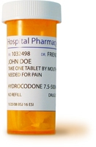

Causes of Anaphylaxis
Anaphylaxis can be triggered by:
Foods (peanuts, tree nuts, eggs, wheat, milk, fish, shellfish, soy)
Insect stings (bee, wasp)
Medications
Latex from natural rubber (gloves, balloons, bananas, tomatoes, carrots, sports equipment, etc.)
Arts and craft materials may contain trace amounts of food allergens

Slide 12

8 Major Food Allergens
Milk
Eggs
Peanuts
Tree nuts
Fin Fish (bass, cod, flounder, etc.)
Shellfish (crab, lobster, shrimp, etc.)
Soy
Wheat
Notes:
Eight Major Food Allergens
In the United States, the Food and Drug Administration (FDA) requires food manufacturers to list the eight most common ingredients that trigger food allergies. Most other countries have similar rules. In the United States, information about food allergies has to be written in simple terms adults and older children can understand. The eight foods included in food allergy labeling account for an estimated 90 percent of allergic reactions.
If one of the eight major allergens is contained in product the label needs to state “Contains,” followed by the name of the food source from which the major food allergen is derived.

Slide 13
Facts About Allergens
It must be understood that in a school setting it is not possible to have a completely allergen free environment
Staff, parents, and students should not have a false sense of security that an allergen has been completely eliminated from school
Each school will develop a protocol to prevent exposure to allergens

Slide 14

Prevention
Steps to prevention:
Avoid exposure to known allergen
Allergy and anaphylaxis training must be provided to school personnel
School may stock life saving medication as allowed by Maine State Law
http://legislature.maine.gov/ros/LawsOfMaine/#Statutes/20-A/title20-Asec6305

Slide 15

Prevention
Encourage and support students to advocate for themselves
Work with the school nurse to identify who is at risk
Educate students, colleagues, and parents about the risk of food anaphylaxis
Epinephrine must accompany students with known allergies on off-campus events

Slide 16

Prevention: Cafeteria
A separate cleaning solution and disposable cloth will be used to clean allergy safe tables/surfaces
Students may access an allergy safe table in the cafeteria
Sharing, touching or trading food should be prohibited
Students should be instructed to use proper hand washing techniques using soap and water
Carefully read all food labels, even if they are known foods
Cross contact: Food handlers should use separate utensils for food preparation and serving

Slide 17

Prevention: Classroom Food
Parents should be notified that there are one or more students with life-threatening food allergies in the class/school and identify the restrictions in bringing certain foods to the school including lunches, parties and snacks
Students should be instructed to use proper hand washing techniques using soap and water
Carefully read all food labels
Sharing, touching or trading food should be prohibited
Cross contamination - prep areas, serving utensils, and containers

Slide 18
Prevention: Classroom Insects
Practical strategies to avoid Insect exposure
If there is a bee/wasp in the classroom, have student with stinging insect allergy leave the room until the insect is removed
Notify custodial staff and office immediately if you notice a nest or presence of bees/wasps
The environment should be checked on a regularly scheduled basis to look for evidence of ground wasps and dealt with by facilities staff
The bus should be checked for evidence of bee/wasp presence before an allergic student gains access

Slide 19


Prevention: Field Trip
Clearly label the location of the epinephrine in the emergency pack carried by designated staff
Designate a trained staff person to be responsible for the administration of epinephrine and implement the emergency response plan if indicated
Provide school staff and bus drivers with the information about the student’s allergy management plan and any necessary precautions, if unknown review protocols before the trip
The bus drivers must have a method of communication for the emergency calls
Allergy Emergency Care Plan and emergency medication should be packaged for all students with known allergy
Hand wipes should be available for hygiene use before and after eating. Note: wipes are not effective in removing some allergens

Slide 20
Allergy Emergency Care Plan
(for known allergies)
Action plans are specific to the individual student
Plan should be shared with school staff responsible for care on a “need to know” basis
Information is CONFIDENTIAL
Everyone should know where medication is and HOW TO REACT
FARE, 2014
http://www.maine.gov/education/sh/contents/foodallergyactionplan2012.pdf

Slide 21
Anaphylaxis
Life-Threatening Reaction (Anaphylaxis)
Usually comes on suddenly Difficulty breathing or feeling faint Often multiple body systems involved Treatment = Epinephrine NOW and call 911
NASN, 2015, Get Trained.

Slide 22
Signs and Symptoms
Anaphylaxis is ANY systemic reaction to an allergen
HEART: Pale, blue, faint, weak pulse, dizzy
MOUTH: Significant swelling of the tongue and/or lips
LUNG: Short of breath, wheezing, repetitive cough
SKIN: Many hives over body, widespread redness
Notes:
Symptoms of anaphylaxis (severe allergic reaction):
difficulty or noisy breathing
swelling of the tongue
swelling/tightness in the throat
difficulty talking and/or hoarse voice
wheezing or persistent cough
vomiting or diarrhea
loss of consciousness and/or collapse
young children may appear pale and floppy.

Slide 23
Signs and Symptoms
Anaphylaxis is ANY systemic reaction to an allergen
GUT: Repetitive vomiting, severe diarrhea
THROAT: Tight, hoarse, trouble breathing/swallowing
OTHER: Feeling something bad is about to happen, anxiety, confusion
May be a COMBINATION of symptoms from different body areas

Slide 24
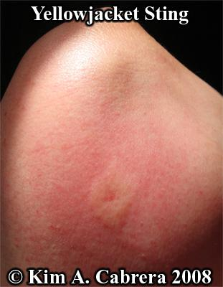
Local reactions occur at insult site only
Notes:
Use your school specific standing orders.

Slide 25
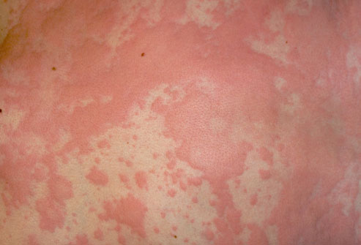
Signs and Symptoms
Hives
Image:Scott Camazine / Phototake
Notes:
Symptoms of a mild to moderate allergic reaction include:
itchy or tingling mouth
a few hives or welts
mild nausea and/or discomfort.

Slide 26

Signs and Symptoms
Tight throat, swollen lips, hives, severe stomach pain

Slide 27
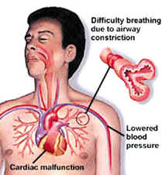
Signs and Symptoms
Physiology
Notes:
Discuss briefly the reasons that the reaction happens.

Slide 28
Treatment
INJECT EPINEPHRINE AUTO-INJECTOR IMMEDIATELY
(Demonstration)
Epinephrine 0.15-0.3 mg auto-injector- up to 2 shots 5 minutes apart.
Record the expiration date of the epinephrine and send the used epinephrine pen with the student to the ER
CALL 911

Slide 29
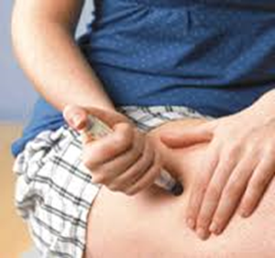
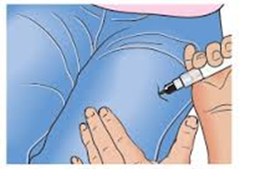
Training Video
Be Safe from Anaphylaxis (Mayo Clinic, YouTube)
Every year up to two thousand people in the United States and Canada die from anaphylaxis -- a serious allergic reaction. The most common causes are allergies to peanuts, insect bites and seafood.

Slide 30
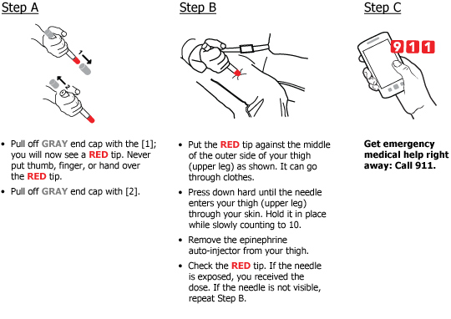
Autoinjector Practice
How to use epinephrine auto-injector
How to use an Epi-pen

Slide 31
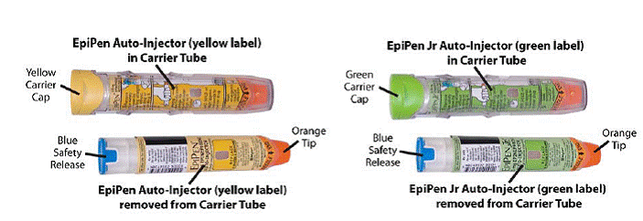
Autoinjector Practice
Pictures of Adult (yellow) and Child (green) injectors
NOTE: Safety caps are BLUE

Slide 32
Epinephrine Storage
Epinephrine autoinjectors will be stored in a secure safe location
Autoinjectors should be readily available when needed
Storage of autoinjectors should ideally be stored out of direct sunlight, at room temperature between 68℉-77℉
Do not leave in cars, on buses, in snow bank, on the beach, or in direct sunlight

Slide 33
Incident Reporting
Individual school incident report forms can be used to report epinephrine administration to the Maine Department of Education.
Debrief with staff after an administration of epinephrine
http://www.maine.gov/education/sh/contents/index.html

Slide 34
Allergy Management Post Test
Name: ____________________________ School: _______________ Date: __________
True / False Questions:
1. T/F Anaphylaxis is a life threatening emergency.
2. T/F Allergy symptoms can worsen suddenly.
3. T/F Only people with known allergies can develop anaphylaxis.
4. T/F Anaphylaxis may be caused by insect bites or stings, foods, medications or contact with latex or other substances.
5. T/F The recommended injection site for epinephrine autoinjector is the outer mid-thigh muscle.
6. T/F When a student having an anaphylactic reaction and epinephrine is given, it is not necessary to call 911.
7. T/F The epinephrine autoinjector must be held firmly in the thigh muscle for at least 10 seconds after injection.
8. T/F Students with known life-threating allergies need to have an Individualized Allergy Emergency Care Plan for staff to follow.

Slide 35

Anaphylaxis Training
Questions

Slide 36
Anaphylaxis
Contact information:
School nurse name:
Phone:
Email:

