Slide 1
WELCOME
Today’s presenters:
Bre Allard, 9th-grade English teacher at Leavitt Area High School, Turner, ME
Michelle DeBlois, 8th-grade Literacy teacher at Lewiston Middle School, Lewiston, ME

Slide 2
A FEW REMINDERS BEFORE WE BEGIN:
TURN OFF YOUR CAMERAS AND MUTE YOUR MICROPHONES UNTIL YOU’RE IN A BREAKOUT ROOM.
HAVE SOMETHING TO WRITE WITH, NOTE PAPER FOR CATCHING SOME REALLY COOL IDEAS, YOUR HANDOUTS, AND YOUR GRADING FOR EQUITY BOOK.
USE THE CHAT BOX FOR COMMENTS AND QUESTIONS.

Slide 3
Let’s take a poll...
“How accurately do your grades represent your students’ work?”

Slide 4
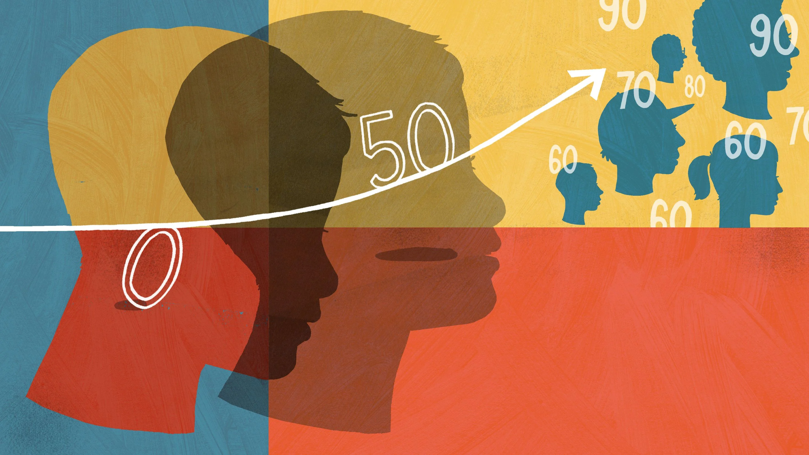
TODAY WE WILL DISCUSS:
AVOIDING ZEROS
MINIMUM GRADING
0-4 SCALE
Chapter 7: Grading for Equity

Slide 5
ACCURACY DRIVING PRINCIPLE:
OUR GRADING MUST USE CALCULATIONS THAT ARE MATHEMATICALLY SOUND, EASY TO UNDERSTAND, AND CORRECTLY DESCRIBE A STUDENT’S LEVEL OF ACADEMIC PERFORMANCE.

Slide 6
NO MATTER WHAT GRADING SOFTWARE YOU USE, IT SHOULD MAKE ALL YOUR GRADES FAIR AND ACCURATE, TRUE?
“That’s just how the math worked out when I entered the grades.”

Slide 7
Student A Student B

Slide 8
The Zero
Here’s how a zero impacts a series of grades.
Assignment | Percentage Score | Letter Grade Equivalent
Assignment #1 | 85% | B
Assignment #2 | 85% | B
Assignment #3 | 0 [missing] | F
Assignment #4 | 85% | B
Assignment #5 | 85% | B
Average | 85+85+0+85+85=340 340/5 assignments = 68% | D ???
Grading for Equity, page 83

Slide 9
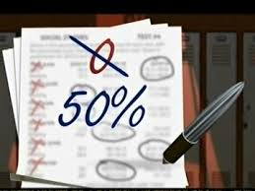
Minimum Grading
“We can correct the 100 point scale’s disproportionality toward failure by instituting a ‘minimum grade’ - that is, setting a percentage that no student can score below.” (Feldman 84)

Slide 10
“Minimum grading actually empowers teachers and schools rather than disempowers them, as it lessons, dampens out, and neutralizes most of the negative aspects of grades and grading… while creating a climate of caring, hope, and support, particularly for those students whose growth and development will most probably always be an intermittent and chaotic process and path.” (Carifio and Carey 24)

Slide 11
Breakout Room
“Circle, Square, Triangle” Discussion Template
A question going Something I learned Three important
AROUND in my mind. that SQUARED with POINTS
my beliefs. to remember.
Assign a Timekeeper
Assign a Discussion Facilitator
Assign a Note Keeper
Notes:
10 minutes, 4-5 people in each room, Circle, Square, Triangle Google Slide to share and complete during discussion.

Slide 12
Share Out (Circle, Square, Triangle)

Slide 13
100-point scale
In the real world (outside the classroom), the 100-point scale is not readily used...
Professional Testing (Bars, Medical Boards, Praxis)
Driver’s Test
There are other alternatives, like the 0-4 Scale, but watch out…
What do the numbers 4, 3, 2, 1, 0 represent?
What scale are “you” going to create?

Slide 14
GPA Scale: 0-100 Scale vs 0-4 Scale
The Grade Point Average Scale is a 0-4 scale.
Where is the focus… on failure or success?
100-90 | A
89-80 | B
79-70 | C
69-60 | D
59-0 | F
4 | A
3 | B
2 | C
1 | D
0 | F
Grading for Equity, page 80 & 89

Slide 15
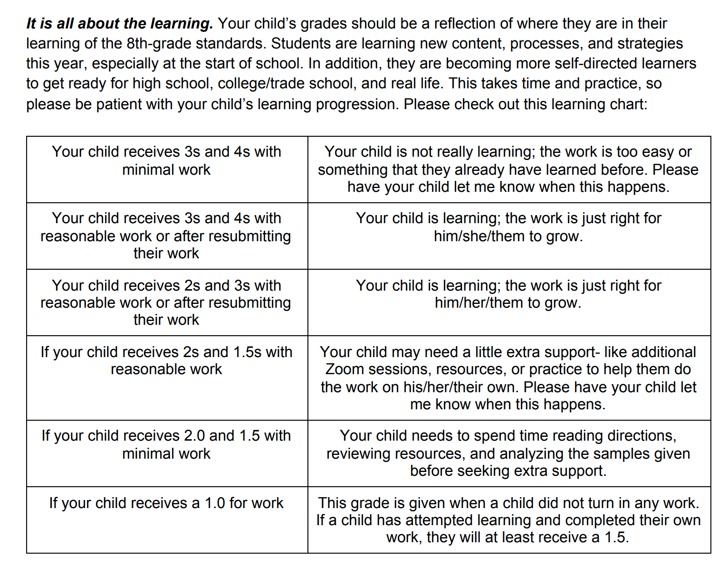
Parent Notice from
Ms. DeBlois

Slide 16
Breakout Room (10 mins)
Assign a Timekeeper
Assign a Discussion Facilitator
Assign a Note Keeper
Notes:
10 minutes, 4-5 people in each room, Circle, Square, Triangle Google Slide to share and complete during discussion.

Slide 17
Breakout Room (Reflection Journal)
What does the text say about the 0-4 Scale?
What do you think about it?

Slide 18
Share Out (Reflection Journal 1)

Slide 19
Breakout Room (10 mins)
Assign a Timekeeper
Assign a Discussion Facilitator
Assign a Note Keeper
Notes:
10 minutes, 4-5 people in each room, Circle, Square, Triangle Google Slide to share and complete during discussion.

Slide 20
Breakout Room (Anticipation Guide)
What did you think about the first three questions?
What do you think now?

Slide 21
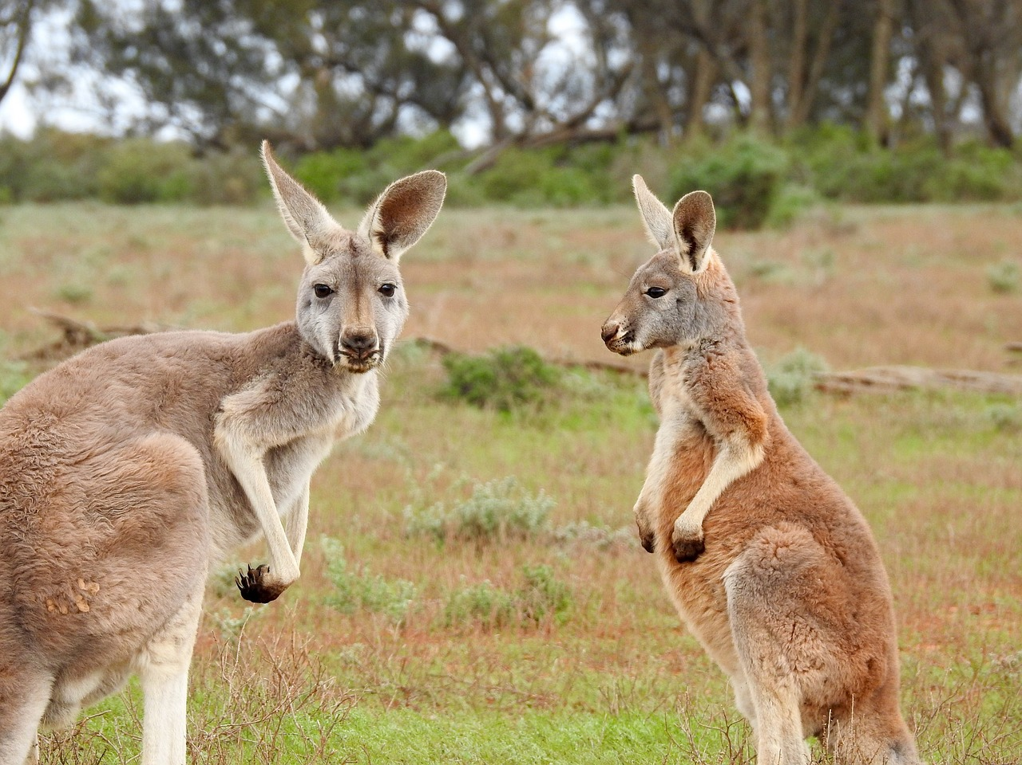
Share Out (Reflection Journal 2)

Slide 22
To recap:
Avoiding Zeros
Minimum Grading
0-4 Scale
THESE IDEAS ARE LIKE A MENU…
PICK & CHOOSE WHERE YOU WANT TO START!

Slide 23
A FEW REMINDERS BEFORE WE LEAVE:
COMPLETE LAST THREE QUESTIONS ON THE ANTICIPATION GUIDE.
READ CHAPTER 8.
NEXT TIME WE ARE FOCUSING ON RECENT ACHIEVEMENTS & GROUP VS INDIVIDUAL ACHIEVEMENT.

