Slide 1
This Photo by Unknown Author is licensed under CC BY-NC
This Training is being Recorded.
Please feel free to ask questions as they come up,
but we will have several Chat Box Check-Ins
throughout the training.

Slide 2
Data Collection Maine Department of Education Special Services
5-22-23

Slide 3
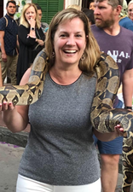
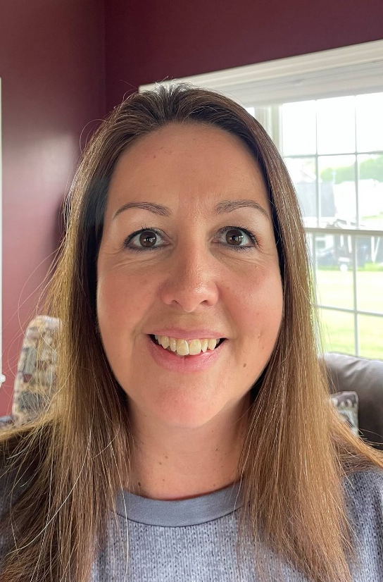
Colette Sullivan
Federal Programs Coordinator
Leora Byras
Special Education Consultant
Jennifer Gleason
Special Education Consultant
Karlie Thibodeau
Special Education Consultant
Julie Pelletier
Secretary Associate

Slide 4
Colette Sullivan – Federal Programs Coordinator
colette.sullivan@maine.gov
Leora Byras – Special Education Consultant
leora.byras@maine.gov
Jennifer Gleason – Special Education Consultant
jennifer.gleason@maine.gov
Karlie Thibodeau – Special Education Consultant
karlie.l.thibodeau@maine.gov
Julie Pelletier – Secretary Associate
julie.pelletier@maine.gov
This Photo by Unknown Author is licensed under CC BY-NC

Slide 5
Supervision, Monitoring, and Support Team Newsletter Sign-Up
https://forms.office.com/g/nV0KHG0DAj

Slide 6
Procedural Manual
https://www.maine.gov/doe/learning/specialed/manual

Slide 7
Maine Unified Special Education Regulations (MUSER)
https://www.maine.gov/doe/cds/muser

Slide 8
Data Collection
used to track academic and/or behavior performance
determines the effectiveness of programming
needs to be systematic and intentional
MUST include information gathering and decision making
MUST be considered when making programming decisions

Slide 9
Things to Do –
Select the Academic Skill and/or Behavior
Define the Skill or Target Behavior(s)
Choose a data collection system
Determine when to collect data
Implement the data collection system
Summarize and graph data
Utilize data to make decisions about program effectiveness

Slide 10
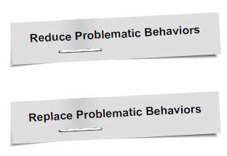
Select the Skill and/or Behavior
Define the skill and/or behavior in descriptive words so that anyone can clearly identify the target.
If looking to reduce a behavior, identify and teach the replacement behavior.
Example:
Don’t tell a student, “Hands Down.”
Teach them what you DO want them to do.
Instead of defining what a person should not do, identify and teach what they should be doing.

Slide 11
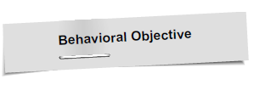
Define the Target Behavior(s)
The definition identifies the target in ways that:
Easily observed
Countable
Have a clear beginning
Have a clear ending
Pinpoint when and under what conditions the behavior occurs

Slide 12
Determine When to Collect Data
Determine the when based on the following:
Target Behaviors
Frequency
Available Resources
For Example –
A teacher interested in collecting data on Math performance may collect information during and after a math session, while behaviors might be better assessed during less structured times, like recess or lunch.

Slide 13
Choose a Data Collection System
We use a variety of data collection techniques.
Your Data Collection System is dependent on what you are intending to measure.

Slide 14
Implement the Data Collection System
Once the data schedule has been established, stick to it.
Consistent data collection tells the best story.
Data can be analyzed effectively, and program changes can be made only if data is consistent.
Interobserver reliability is good practice.
Have 2 observers…
Record the SAME behavior…
Of the SAME student…
At the SAME time!
http://iseesam.com/content/teachall/text/behavior/LRBIpdfs/Data.pdf

Slide 15
Summarize and Graph Data
Raw data, like tallies, are hard to interpret.
All info gathered through data must be easily readable.
Graphing provides an easy, systematic way of showing the information about the skill or target behavior.
Raw data must be converted to a usable form, such as percentages, number correct or rate.
http://iseesam.com/content/teachall/text/behavior/LRBIpdfs/Data.pdf

Slide 16
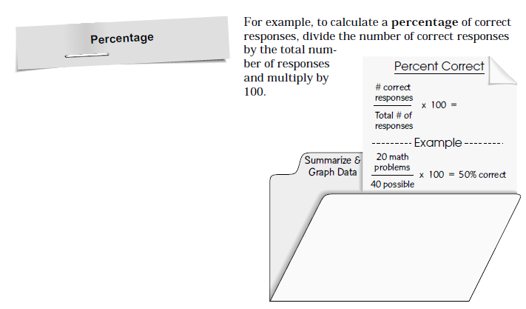
Summarize and Graph Data
http://iseesam.com/content/teachall/text/behavior/LRBIpdfs/Data.pdf

Slide 17
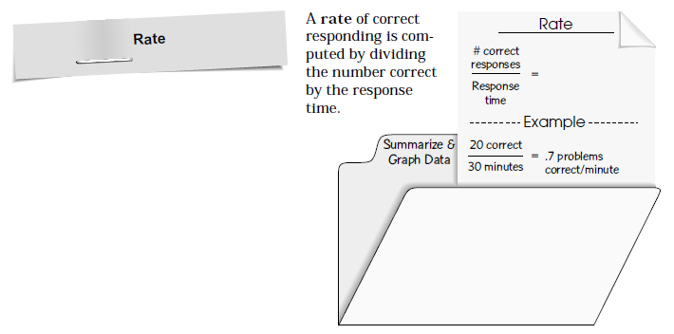
Summarize and Graph Data
http://iseesam.com/content/teachall/text/behavior/LRBIpdfs/Data.pdf

Slide 18
Summarize and Graph Data
http://iseesam.com/content/teachall/text/behavior/LRBIpdfs/Data.pdf

Slide 19
Utilize Data to Make Decisions About Program Effectiveness
Data collection should be a continuous, ongoing process.
Data help determine trends.
Data highlight increases or decreases in performance.
Look for trends of 3 or more data points in the same direction.
Data trends should be used to assist in program effectiveness or determining the need for change.

Slide 20
Thoughts?
Questions?

Slide 22
Quantitative Data
versus
Qualitative Data
Qualitative Data
is descriptive rather than numeric.
Quantitative Data
is in the form of numbers, quantities and values.

Slide 23
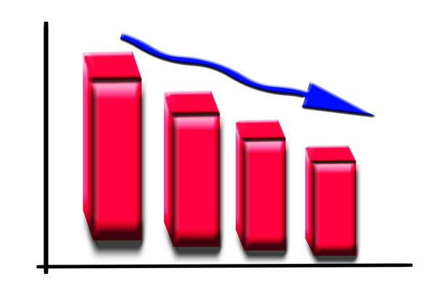
Analysis of Data
Qualitative Data: can be difficult to analyze, especially at scale, as it cannot be reduced to numbers or used in calculations. Responses may be sorted into themes and require an expert to analyze. Different researchers may draw different conclusions from the same qualitative material.
Quantitative Data: can be ranked or put into graphs and tables to make it easier.
https://www.diffen.com/difference/Qualitative_vs_Quantitative

Slide 24
Example of Qualitative Data versus Quantitative Data

Slide 25
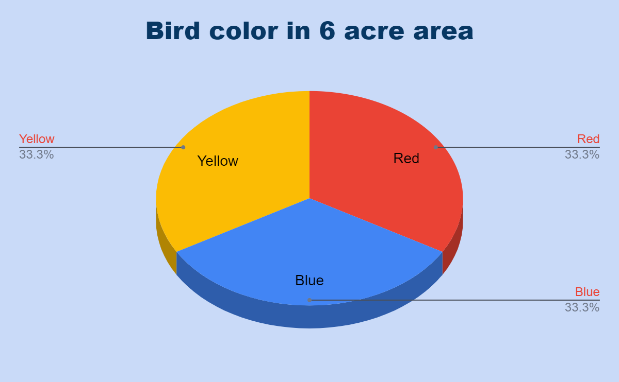
Converting Qualitative Data into Quantitative Data
How many red birds are in the 6-acre area?
How many blue birds are in the 6-acre area?
How many yellow birds are in the 6-acre area?

Slide 26
Why is Quantitative Data important?
Data need to support movement or progress through the IEP.
A child’s IEP goal development should not be based upon qualitative (subjective) data.
For proper progress monitoring IEP Goals, the measures must be data-driven.
This Photo by Unknown Author is licensed under CC BY-SA
https://learningabledkids.com/iep_training/iep_measures_of_progress_idea_specs.htm

Slide 27
What do we know about Sammy the Cat?
https://marketbusinessnews.com/financial-glossary/data-definitio/

Slide 28
In the Chat Box, please share some Qualitative Data about Sammy the Cat.

Slide 29
Qualitative Data
He is black all over except for his paws, chest, chin, and part of his tummy, which are white.
His hair is short-to-medium in length.
He spends most of the day asleep and tends to go out at night.
He is sitting on a brown rug.
https://marketbusinessnews.com/financial-glossary/data-definitio/

Slide 30
In the Chat Box, please share some Quantitative Data about Sammy the Cat.

Slide 31
Quantitative Data
His tail is 30cm (18″) long.
He weighs 5kg (11.2lbs).
Sammy has one sister and one brother.
He is 40cm (15.7″) long (excluding tail).
https://marketbusinessnews.com/financial-glossary/data-definitio/

Slide 32
Chat Box
Check In

Slide 34
Frequency and Event Recording
Frequency (or Rate) Recording – defined as the number of responses per unit of time
Event Recording – encompasses a wide variety of procedures for detecting and recording the number of times a behavior of interest occurs
Cooper, John O., Timothy E. Heron, William L. Heward. Applied Behavior Analysis 2nd Edition, Columbus: Pearson, 2007.

Slide 35
Frequency and Event Recording
Best Used When:
The behavior has a clear beginning and end so that you can easily tell when the behavior starts and when it stops.
Behaviors occur with enough time in between to distinguish between the end of one response and the onset of another.
The behavior can be easily counted.
The intent is to decrease or increase a behavior.
Do Not Use When:
The behavior happens at such high rates that it is hard to document, such as pencil tapping.
The behavior occurs for extended periods of time, such as a tantrum.

Slide 36
Why Choose Frequency Data Collection?
Advantages
Disadvantages
A quantitative measurement on which to base strategies for change
A quick record, with no details, just tallies to record
Useful for quantitative measures
Raw data ,with no details recorded
Only measures one kind of data and makes the results highly selective and somewhat restrictive
Can allow the recorders bias to enter the recording.
https://prezi.com/gqxjbtu-75qq/using-frequency-counts-to-look-at-emotional-development/

Slide 37
Frequency and Event Recording
Examples:
Task initiation
Correct and/or Incorrect academic responses
Tardiness
Leaving seat during class
Interrupting
Requesting help
Praising comments
Littering

Slide 38
Frequency Recording
Target Behavior – Hitting
Hitting is defined as: Any occurrence of making contact with any part of another person’s body with an open or closed hand from a distance of six inches or more.
Non-Examples: Giving a High Five or other common social interactions
Date | Setting/ Activity | Length of Observation | Total # of Times
7/1/22 | Lunch | 10:00-10:30 | 3
7/2/22 | Music | 1:00-1:40 | 0
7/5/22 | Lunch | 10:00-10:30 | 1
7/7/22 | Lunch | 10:00-10:30 | 8
7/8/22 | Lunch | 10:00-10:30 | 6
7/9/22 | Art | 9:00-9:40 | 0

Slide 39
Event Recording
Target Behavior: Interrupting/Talking Out of Turn
This is defined as: Any vocalization that is not teacher initiated and is disruptive to others, out of turn or unrelated to academic context.
Non-Examples: socially appropriate statements, “Excuse Me.” “Thank you” or similar
Date | Instances | Total
7/3/22 | IIII | 4
7/4/22 | I | 6
7/5/22 | III | 3
7/8/22 |  | 5
7/10/22 | II | 2

Slide 40
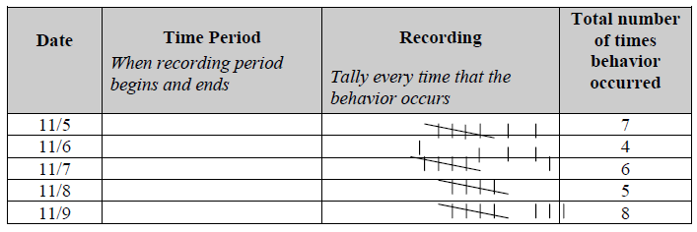
Frequency and Event Recording
Procedures –
Every time you are observing the behavior:
Write down the date
Make a notation every time you see the behavior
At the end of your observation period, total the number of notations for that day

Slide 41
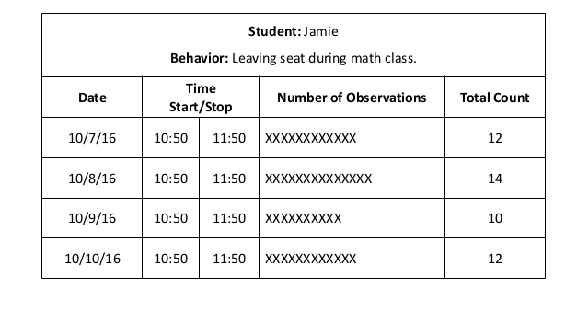
Frequency and Event Recording
https://image.slidesharecdn.com/zaleskiparaprodatacollection-160414135848/95/
introduction-to-data-collection-8-638.jpg?cb=1460642369

Slide 42
Student Name: XXXXX Target Behavior: Correct Responses in Math Class
Date | Time | Number of Occurrences | Total Count
5/8/2020 | Math Period 10:00-10:30 |  | 2
5/9/2020 | Math Period 10:00-10:30 |  | 4
5/10/2020 | Math Period 10:00-10:30 |  | 3
5/11/2020 | Math Period 10:00-10:30 |  | 1

Slide 44
Frequency Goals
https://www.thoughtco.com/data-collection-for-iep-implementation-3110992

Slide 45
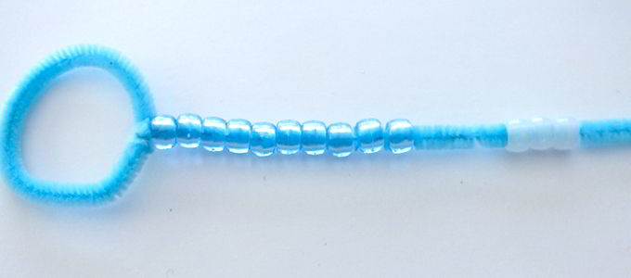
Data Collection Techniques Here are 5 options for easier and more discrete data collection. Each of these techniques offers its own unique advantages and disadvantages. Try them and see what works best for you!
Clicker Counters
Clicker counters are a great tool for counting high frequency behaviors and can easily be used to calculate rate (just calculate frequency/time).. Their major disadvantage is the clicking sound that they make. Avoid these for children whose behavior is reinforced by staff collecting data.
Small Objects in Pockets
Check out this low-tech option for tracking the occurrence of behavior. Put a collection of small objects in one pocket. As behavior occurs, transfer the corresponding number from that pocket into the other pocket. With this option, you risk accidentally dropping the items either back into the original pocket or on the floor when transferring them. In addition, you must count each item at the end of the session. While this creates additional work, it may be the best short-term option if you need a low-tech, discrete data collection method.
Beads on a Pipe Cleaner
Sliding beads on a pipe cleaner offers another low-tech option for frequency data collection. When done well, it appears as though staff are simply fidgeting with the beads or doing a craft while not attending to the child’s behavior. Staff can slide a group of beads onto the top of the pipe cleaner and as behavior occurs, slide the beads to the bottom.
This Photo by Unknown Author is licensed under CC BY-NC-ND

Slide 46
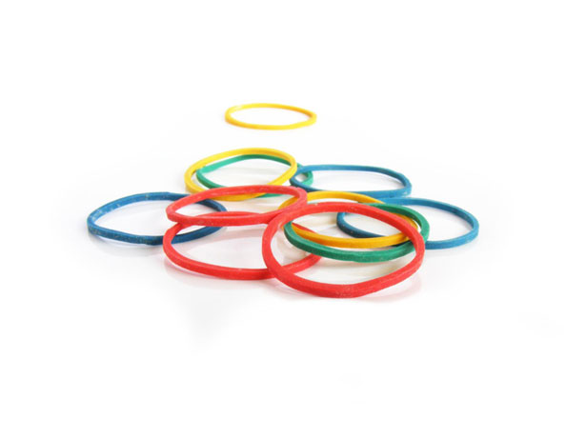
Data Collection Techniques Here are 5 options for easier and more discrete data collection. Each of these techniques offers its own unique advantages and disadvantages. Try them and see what works best for you!
Technology
Technology offers a broad array of options from simple to complex. Many apps provide access to different methods to tally behavior as it occurs. Some apps export or graph this data for you as well. A simpler option is to open a note taking app and add an emoji or other character each time the behavior occurs.
Small Elastics on Fingers
A final low-tech and inexpensive option is to place small elastics on your fingers (hair elastics intended for young children work well). Place spares on one hand and as behavior occurs, roll them over to the other hand. To the child, this may appear as simple fidgeting.
This method may be inefficient for behaviors that occur at a very high frequency. In addition, some staff may find them uncomfortable on their fingers.
This Photo by Unknown Author is licensed under CC BY-SA

Slide 47
Frequency, Rate and Event Recording
Summarizing the Data –
Frequency: At the end of the observation period, total number of occurrences.
Example – Anna left her seat 5 times during 7th period
Rate: Count the number of times the behavior occurred in the time observed. Divide the count by the length of time the behavior was observed.
Example – Anna kicked a peer 30 times in a 10-minute observation, the rate would be 3 kicks per minute (30 kicks divided by 10= 3 kicks per minute).
https://achieve.lausd.net/cms/lib08/CA01000043/Centricity/domain/361/positive%20behavior/Data/Data%20Collection%20Methods.pdf

Slide 48
Frequency, Rate and Event Recording
Special Considerations –
A frequency measure should be used only when the length of observation time is consistent from day to day (e.g., always 2 hours).
A rate measure should be used if the length of observation time varies from day to day (e.g., 60 minutes on Monday, 300 minutes on Tuesday).
https://achieve.lausd.net/cms/lib08/CA01000043/Centricity/domain/361/positive%20behavior/Data/Data%20Collection%20Methods.pdf

Slide 49
Chat Box Check-In

Slide 50
Duration Recording
Duration Recording – defined as the total extent of time in which a behavior occurs
You can measure one or both of 2 Kinds of
Duration Measures
Total Duration per Session – measure of the cumulative amount of time in which a person engages in the target behavior
Duration per Occurrence – measure of the duration of time that each instance of the target behavior occurs
Cooper, John O., Timothy E. Heron, William L. Heward. Applied Behavior Analysis 2nd Edition, Columbus: Pearson, 2007.

Slide 51
Duration Recording
Procedures –
Every time you are observing the behavior:
Make sure that you have a timing instrument available prior to beginning the observation
Each time that the behavior occurs, document:
Date
Time Behavior Began
Time Behavior Stopped
Calculate the length of time that the behavior lasted

Slide 52
Duration Recording
Examples:
Crying
Attention to Task
Reading a Book
Writing in Class
Out of Seat Behavior
Time On Task
Screaming/Yelling
Rocking

Slide 53
Duration Recording
Best Used When:
You want to measure how long a behavior lasts.
The behavior has a clear beginning and ending.
You have consistent access to some timing instrument, like a clock, stop watch or similar.
The behavior does not happen often, but when it does, it lasts a long time.
You want to measure the duration of target behaviors that are either too long or too short of a time period.

Slide 54
Duration Recording

Slide 55
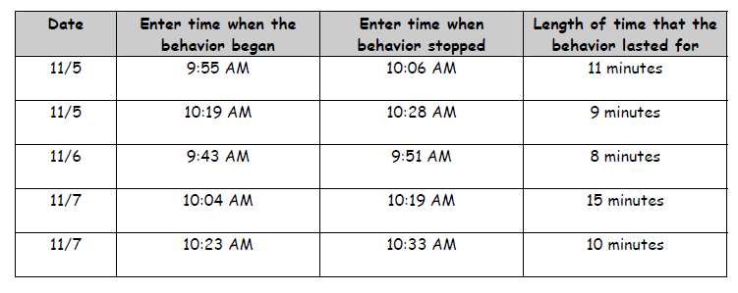
Duration Recording
Behavior: Working individually
Behavior Definition: Sitting at desk, with an assignment on the desk, looking at assignment, not talking to peers. Once student looks up (not looking at assignment any more), the behavior has stopped. If student begins talking to peers while looking at assignment, behavior has stopped.

Slide 56
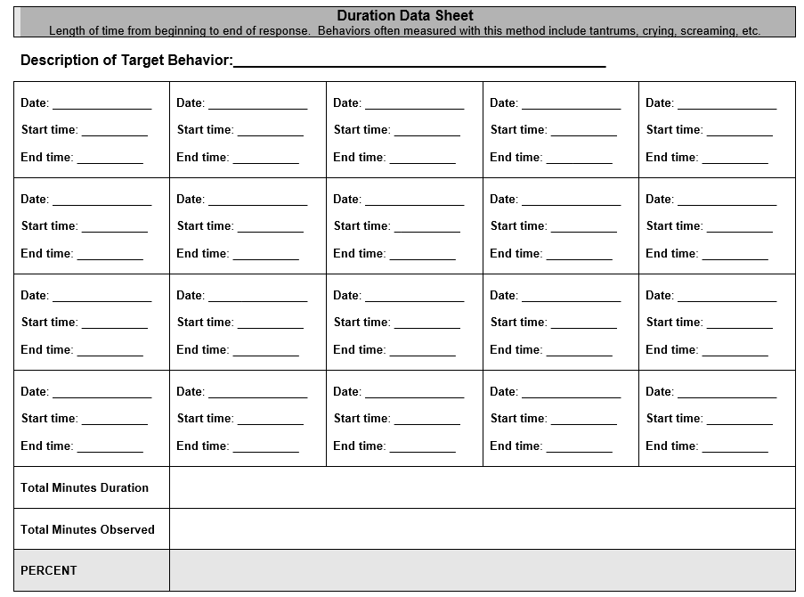
Duration Recording
https://view.officeapps.live.com/op/view.aspx?src=https%3A%2F%2Fwww.swsc.org%2Fcms%2Flib04%2FMN01000693%2FCentricity%2FDomain%2F130%2F4.Duration%2520Data%2520Sheet.doc

Slide 57
Duration Recording
Duration per Occurrence – measure of the duration of time that each instance of the target behavior occurs
Example:
Each time a student leaves their seat, teacher starts a stopwatch.
Teacher stops it when child returns to seat.
Total time is recorded and the timer is reset.
Process is repeated as needed throughout observation period.
Resulting measures yield data on duration of occurrences of each out of seat behavior over the observation period.
Cooper, John O., Timothy E. Heron, William L. Heward. Applied Behavior Analysis 2nd Edition, Columbus: Pearson, 2007.

Slide 58
Duration Recording Duration per Occurrence – measure of the duration of time that each instance of the target behavior occurs
Behavior: Leaving Seat – Any instance in which XXX is at least one foot away from his desk/seat anytime after the lesson has started. Includes times when he has asked, but was not given permission to leave desk/seat area.
Date | Observation Period | Total Duration Per Occurrence
5/6/2020 | Math 12:00-12:45 | 14 minutes
5/7/2020 | Math 12:00-12:45 | 9 minutes
5/8/2020 | Writing 9:15-9:45 | 3 minutes
5/10/2020 | Science 1:00-1:40 | 1 minute
5/11/2020 | Math 12:00-12:45 | 7 minutes
5/12/2020 | Circle Time | 0 minutes

Slide 59
Duration Recording
Total Duration per Session – measure of the cumulative amount of time in which a person engages in the target behavior
Example:
Teacher is concerned that a K student spends too much time playing alone
During Free Play, teacher will start stopwatch anytime child engages in solitary play.
If child engages with peers, teacher stops timer, but does not reset it.
If child drifts into solitary play again, teacher starts stopwatch again.
At the end of the 30 minute play activity, teacher will have total duration of solitary play.
Cooper, John O., Timothy E. Heron, William L. Heward. Applied Behavior Analysis 2nd Edition, Columbus: Pearson, 2007.

Slide 60
Duration Recording Total Duration per Session – measure of the cumulative amount of time in which a person engages in the target behavior
Behavior: Solitary Play – Any instance in which XXX engages in solitary activity, and is not engaging with peers. Can include parallel play.
Date | Activity | Total Duration Per Activity
5/6/2020 | Free Play – 30 Minutes | 12 minutes
5/7/2020 | Free Play – 30 Minutes | 7 minutes
5/8/2020 | Free Play – 30 Minutes | 8 minutes
5/10/2020 | Free Play – 30 Minutes | 15 minutes
5/11/2020 | Free Play – 30 Minutes | 16 minutes
5/12/2020 | Free Play – 30 Minutes | 4 minutes

Slide 61
Frequency/Duration Data Tracking Sheet
https://www.earlywood.org/Page/556

Slide 62
Any Data Collection
Special Considerations –
Intensity – the force with which a behavior occurs
Always consider the INTENSITY of the behavior in conjunction with the duration.
Adjust accordingly
Pay Close Attention
to extreme or intense behaviors

Slide 63
REMEMBER…
Avoid writing Outcomes, either Academic or Functional.
We can not guarantee outcomes.
Focus on Distinctly Measurable and Persistent Gaps.
What skill deficits are interfering with the child’s ability to reach those outcomes we expect for all children?
What skills are you teaching?
Goals and Data should focus on Skills.

Slide 64
Avoid Writing Outcome Goals
Data Collection can continue to be useful when considering teaching skills that will facilitate a change in any outcome based goal.

Slide 65
On an IEP,
Data is necessary to reflect
Present Level.

Slide 66
Academic Goal –
By June 10, 2020, given a variety of inset puzzles and specially designed instruction, XXXXX will demonstrate mastery of 5 inset puzzles, with 100% mastery across 3 consecutive presentations, as measured by data collection, teacher observation, work samples or similar. CCSS.Math.Content.K.G.A.3

Slide 67
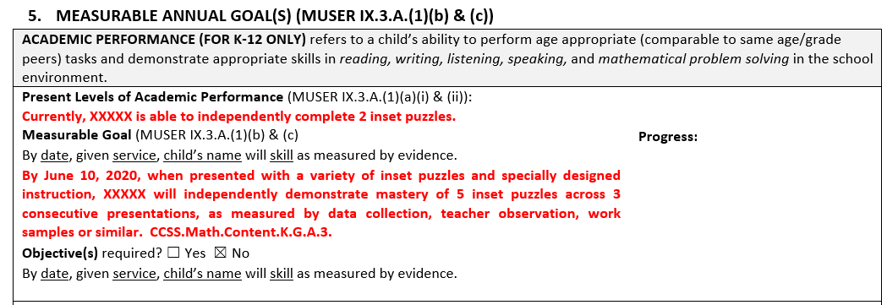
Section 5: Academic Performance Present Level and Standards Based Goals
If there is a goal, there should be a present level of performance directly above it.

Slide 68
Program Name: Puzzles – Inset Numbers – 10 Pieces
Date | 4/10 | 4/11 | 4/12 | 4/13 | 4/20 | 4/25 | 5/1 | 5/5 | 5/8
 | 3/10 | 4/10 | 5/10 | 7/10 | 7/10 | 9/10 | 10/10 | 10/10 | 10/10 | M 5/8
 | 30% | 40% | 50% | 70% | 70% | 90% | 100% | 100% | 100%
1 | - | - | - | - | - | + | + | + | + | M
2 | + | + | + | + | + | + | + | + | + | M
3 | - | - | + | + | + | + | + | + | + | M
4 | + | + | + | + | + | + | + | + | + | M
5 | - | - | - | + | + | + | + | + | + | M
6 | + | + | + | + | + | + | + | + | + | M
7 | - | - | - | - | - | + | + | + | + | M
8 | - | - | - | + | + | + | + | + | + | M
9 | - | + | + | + | + | + | + | + | + | M
10 | - | - | - | - | - | - | + | + | + | M

Slide 69
Program Name: Puzzles – Inset Shapes – 7 Pieces
Date | 5/1 | 5/2 | 5/3 | 5/5 | 5/6 | 5/7 | 5/10 | 5/11 | 5/12 | M 5/12
 | 3/7 | 3/7 | 4/7 | 6/7 | 5/7 | 6/7 | 7/7 | 7/7 | 7/7
 | 43% | 43% | 57% | 86% | 71% | 86% | 100% | 100% | 100%
 |  |  |  |  |  |  |  |  |  | M
Square | + | + | + | + | + | + | + | + | + | M
Circle | - | - | + | + | + | + | + | + | + | M
Triangle | + | + | + | + | + | + | + | + | + | M
Oval | - | - | - | - | - | - | + | + | + | M
Diamond | - | - | + | + | + | + | + | + | + | M
Rectangle | + | - | - | + | - | + | + | + | + | M
Star | - | + | - | + | + | + | + | + | + | M

Slide 70
Functional Goal –
By June 10, 2020, given prepared daily visual schedule and specially designed instruction, XXXXX will follow task analysis to transition through all activities in the day, with 80% mastery across 3 consecutive opportunities, as measured by data collection, teacher observation, work samples or similar.

Slide 71
Section 5: Functional/Developmental Performance – Present Level and Goals
If there is a goal, there should be a present level of performance directly above it.

Slide 72
Program Name: Transitions
Date | 5/1 | 5/2 | 5/3 | 5/4
 | 67% | 80% | 86% | 100
Number of Opportunities | 9 | 10 | 7 | 6
Number of Prompts | 3 | 2 | 1 | 0
Data Analysis –
5/1 – 67%
5/2 – 80%
5/3 – 86%
5/4 – 100%
MASTERED 5/4 – 83%

Slide 73
Review
Joanne will decrease her defiant behavior to 2 or fewer episodes per day.
This Photo by Unknown Author is licensed under CC BY-NC-ND
https://www.thoughtco.com/data-collection-for-iep-implementation-3110992

Slide 74
Do Not Write Goals
Around Outcomes
Examples:
Attendance
Work Completion
Attention to Task
Reduce Aggressions
Reduce Tantrum Behaviors
This Photo by Unknown Author is licensed under CC BY-SA

Slide 75
Do Not Write
Outcome Based Goals
Focus on
Distinctly Measurable and Persistent Skill Gaps.
Instead of: “XXXXX will reduce instances of defiant behavior”
Consider the skill deficits that result in defiant behavior
Write goal around the skills that you are teaching that will reduce the defiant behavior.
“XXXXX will …”

Slide 76
Chat Box Check In
What skill(s) might you teach to decrease the Defiant Behavior?

Slide 77
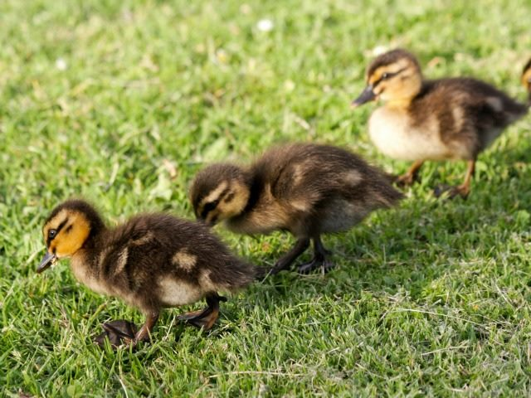
Recording Data
This Photo by Unknown Author is licensed under CC BY-SA
Typically providing the student with biweekly probes in alignment with their goals provides good solid data tracking information.
Keeping the expectation and environment consistent when administering the probes helps keep the data true.
Having the student graph their own data as well maintains a record on their progress that they can see visually as well as motivation for them to try their best.

Slide 78
Tracking and Graphing Data
Keep data sheets consistent with each type of reading and/or math probe.
Stay true to the schedule of administering probes.
Graph data to make it more parent and IEP Team friendly.

Slide 79
Remember –
Data – information, experience and knowledge which helps make decisions AND drives programming.
So, although not everyone collects data, everyone should be looking at it and considering it when developing programming.

Slide 80
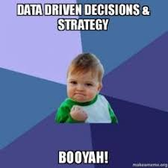
IEP meetings are more meaningful and useful when there is –

Slide 81
Use of Data
Data should be used to:
assist in program effectiveness
determining the need for change

Slide 82
Endrew F. vs. Douglas County School District
https://www.youtube.com/
watch?v=CF7RmLJo32c

Slide 83
UNITED STATES DEPARTMENT OF EDUCATION
WASHINGTON, DC 20202
December 7, 2017
Questions and Answers (Q&A) on
U. S. Supreme Court Case Decision
Endrew F. v. Douglas County School District Re-1
https://sites.ed.gov/idea/files/qa-endrewcase-12-07-2017.pdf

Slide 84
Disclaimer:
The links and websites shared in this PowerPoint are for information and reference only and are not endorsed in any way by the Maine Department of Education.
This Photo by Unknown author is licensed under CC BY-SA.

Slide 85
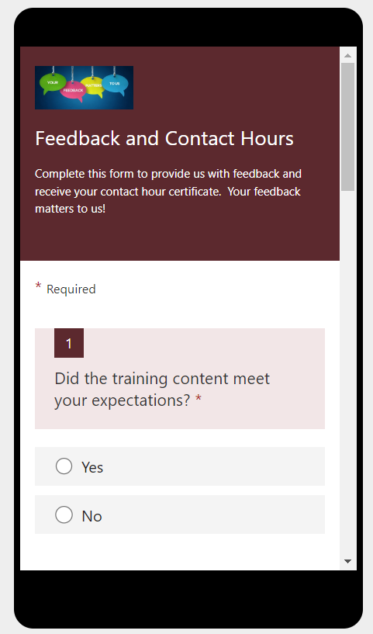
Professional Learning Feedback and Contact Hour Form.
Use the link to complete the form on your computer
OR
Use the QR code to complete the form on your mobile device
https://forms.office.com/g/by472QQLDJ

Slide 86
Resources
Professional Development Calendar –
https://www.maine.gov/doe/calendar
Link for Recordings and Power Points – https://www.maine.gov/doe/learning/specialed/pl
Special Education Resources –
https://www.maine.gov/doe/learning/specialed/supervision
Special Education Laws and Regulations –
https://www.maine.gov/doe/learning/specialed/law
Special Education Forms and Reporting –
https://www.maine.gov/doe/learning/specialed/forms

Slide 87
This Photo by Unknown Author is licensed under CC BY-NC
Colette Sullivan – Federal Programs Coordinator
colette.sullivan@maine.gov
Leora Byras – Special Education Consultant
leora.byras@maine.gov
Jennifer Gleason – Special Education Consultant
jennifer.gleason@maine.gov
Karlie Thibodeau – Special Education Consultant
karlie.l.thibodeau@maine.gov
Julie Pelletier – Secretary Associate
julie.pelletier@maine.gov
This Photo by Unknown Author is licensed under CC BY-NC

