Slide 1
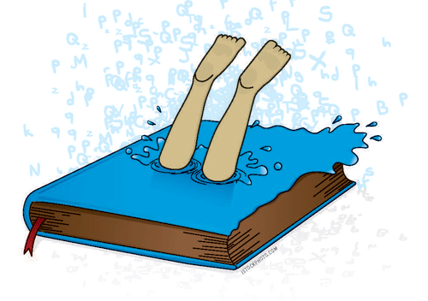
The Deep Dive
Preparing to implement Maine’s updated ELA standards
Notes:
The updated ELA standards reflect current best practices. Analyzing and aligning curriculum in this implementation effort should focus on opportunities to update practice and better prepare students for life and careers.

Slide 2
Not “NEW”
Maine’s updated ELA standards are the same standards we have been working with for nearly a decade
Planning for implementation should involve gentle shifts, course corrections rather than mapping entirely new routes
Analysis of updates should reveal opportunities to revise practices
The updated standards may stimulate thinking about remote and blended learning practices
Notes:
The task for this review was to revise the standards, not reinvent. Therefore, the content of the updated standards should be very familiar, even if the format looks quite different.

Slide 3
What to look for: Guiding Principles
Communicate in a variety of contexts including interpersonal, small group, large group, in-person, and digital with accuracy and clarity
Demonstrate the ability to transfer learning to new contexts with guidance and self-directed, to continuously improve literacy skills
Analyze, evaluate, collaborate and plan to solve problems
Emphasize the qualities of responsible and ethical behavior when gathering and using information, engaging with others, and presenting ideas
Explore multiple perspectives to verify and validate information and ideas
Notes:
The Guiding Principles have remained the same, but the updated standards bring them closer to the content by stating how they are related to the standards.

Slide 4
What to look for: Language
To be a clear and effective communicator, following rules of language use for the context of use is an essential understanding
Provide direct instruction of grammar, usage, mechanics, and word development
Evaluate language use in mentor texts, growing depth of analysis to reflect elevating complexity of texts
Select for instruction “vocabulary” words that may be familiar in one use, but quite different and unfamiliar in another
Teach vocabulary that informs discussion of a topic and appropriate presentation of ideas about a topic or concept
Notes:
Language standards have often been ignored, but they are critically important to understand what makes texts complex, how to speak accurately, and how to increase complexity and accuracy of writing. Deliberate and direct instruction of language standards should be embedded in each unit of study.

Slide 5
What to look for: Speaking & Listening
Hold students accountable for listening during collaborative conversations: consider what is produced during productive talk
Provide mentor texts in a variety of media and include close “reading” practices for “text” analysis that reflects author’s craft
Presentation relies on an understanding of task, purpose and audience. Compare SL.3 to W.3. Look for the connected and transferable learning that is necessary for both standards.
Adapting speech requires an understanding of the context and can also relate to W.3
Notes:
Accountable listening clarifies what happens during discussion. Instead of simple “turn and talk” protocols, productive talk provides students with clear expectations of what they will produce as a result of participating in the conversation. We will provide support for accountable listening in the speaking and listening strand.

Slide 6
What to look for: Reading
Foundational skills may inform intervention strategies or areas to focus on close reading as new genres/forms of text are introduced or increasingly complex texts are examined.
R.4-6 Key Ideas and Details are essential to W.1 Inquiry
R.7-9 Craft and Structure are essential to W.2 and W.3 to develop an understanding of audience and genre norms
R.10-11 are essential to SL and writing as both rely on analysis and synthesis of the context and content
Fluency is critical to independent transfer of learning in any grade
Notes:
The reading strand is critical to teach and assess the other strands. Foundational skills K-12 will be addressed as a separate topic for professional learning. Ultimately, the goal is to help each student read independently increasingly complex texts.

Slide 7
What to look for: Writing
Writing is the culmination of learning in all of the strands
Writing rubrics should reflect the unifying elements of other strands – i.e. analysis and use of evidence is informed by the SL and R standards; appropriate structures and word use is informed by the L standards
Form, the methods of presenting information, and format, the norms for that form, should directly reflect the audience, purpose, and topic
Notes:
The writing revisions shift the focus from teaching students to write essays with specific criteria to teaching students to become effective writers. The learning should easily transfer to effective communication in general.

Slide 8
Study the ELA Standards Progression
Read each standard K-12 and note the developmental changes
Consider need for direct instruction anticipating the next level of development and direct instruction to support the struggling learner
https://www.maine.gov/doe/sites/maine.gov.doe/files/inline-files/ELA%20Vertical%20Progressions%202020_0.docx
Notes:
As you review the updated standards, think about what has been simplified in the standards and how this can be addressed in your curriculum. Instruction will always remain complex and detailed. Please access the ELA standards in their vertical progression.

Slide 9
PAUSE TO REFLECT
What are the possibilities?
Where do you begin or continue?
Notes:
What gaps do you anticipate in your curriculum, instruction, or assessment? Look to the ELA standards website for further support of each strand and critical topics.

