Slide 1
REVISIONS
SOME, NONE, SIGNIFICANT

Slide 2
KEEP IN MIND:
Rule vs. Guidance
Guiding Principles linked to ELA outcomes
Expectation of media literacy embedded
Notes:
Rule vs Guidance reflects the difference between must and may.
The GP is part of the introduction and reflects ELA/literacy application.
Some states created a strand for media literacy. Our teachers argued that media literacy is at the heart of the content area and cannot be viewed as a separate topic but part of everything that is done to develop literacy skills.

Slide 3
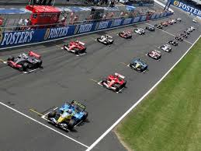
Language
Moved to the first position
No significant content change
Begin with language
Informs complexity of texts
Informs reading strategies
Applies to all strands

Slide 4
CURRENT | PROPOSED
Conventions of Standard English Demonstrate command of the conventions of standard English grammar and usage when writing or speaking. Demonstrate command of the conventions of standard English capitalization, punctuation, and spelling when writing. | Conventions of Standard English Demonstrate command of the conventions of Standard English grammar and usage when writing or speaking. Demonstrate command of the conventions of Standard English capitalization, punctuation, and spelling when writing.
Knowledge of Language Apply knowledge of language to understand how language functions in different contexts, to make effective choices for meaning or style, and to comprehend more fully when reading or listening. | Knowledge of Language Apply knowledge of language to understand how language functions in different contexts, to make effective choices for meaning or style in writing and speaking, and to comprehend more fully when reading or listening.
Vocabulary Acquisition and Use Determine or clarify the meaning of unknown and multiple-meaning words and phrases by using context clues, analyzing meaningful word parts, and consulting general and specialized reference materials, as appropriate. Demonstrate understanding of word relationships and nuances in word meanings. Acquire and use accurately a range of general academic and domain-specific words and phrases sufficient for reading, writing, speaking, and listening at the college and career readiness level; demonstrate independence in gathering vocabulary knowledge when encountering an unknown term important to comprehension or expression | Vocabulary Acquisition and Use Use context clues, analyze meaningful word parts, and consult general and specialized reference materials as appropriate to determine or clarify the meaning of unknown and multiple-meaning words and phrases from grade level content. Demonstrate understanding of figurative language, word relationships, and nuances in word meanings sufficient for reading, writing, speaking, and listening. Acquire and use accurately a range of general academic and domain-specific words and phrases sufficient for reading, writing, speaking, and listening; demonstrate independence in gathering vocabulary knowledge when encountering an unknown term important to comprehension or expression.

Slide 5
Speaking & Listening
Combined similar standards
Presentation of knowledge and ideas more explicitly linked to writing
Multi-media formats expected – essentially elevates viewing and listening to text status

Slide 6
CURRENT | PROPOSED
Comprehension and Collaboration Prepare for and participate effectively in a range of conversations and collaborations with diverse partners, building on others’ ideas and expressing their own clearly and persuasively. Integrate and evaluate information presented in diverse media and formats, including visually, quantitatively, and orally. Evaluate a speaker’s point of view, reasoning, and use of evidence and rhetoric. | Comprehension and Collaboration Prepare for and participate in conversations across a range of topics, types, and forums, building on others’ ideas and expressing their own. Integrate and evaluate information presented in diverse media and formats, including point of view, reasoning, and use of evidence and rhetoric.
Presentation of Knowledge and Ideas Present information, findings, and supporting evidence such that listeners can follow the line of reasoning and the organization, development, and style are appropriate to task, purpose, and audience. Make strategic use of digital media and visual displays of data to express information and enhance understanding of presentations. Adapt speech to a variety of contexts and communicative tasks, demonstrating command of formal English when indicated or appropriate. | Presentation of Knowledge and Ideas Present information and supporting evidence appropriate to task, purpose, and audience so listeners can follow the line of reasoning and incorporate multimedia when appropriate. Adapt speech to a variety of contexts, audiences, and communicative tasks.
Notes:
Media literacy is embedded here – forum, task, purpose, context. Communication does not occur exclusively in presentation of speeches.

Slide 7
Reading
Combined 4 columns into one – no distinction for the different text types or disciplines.
Placed foundational skills first in reading and expanded K-12

Slide 8
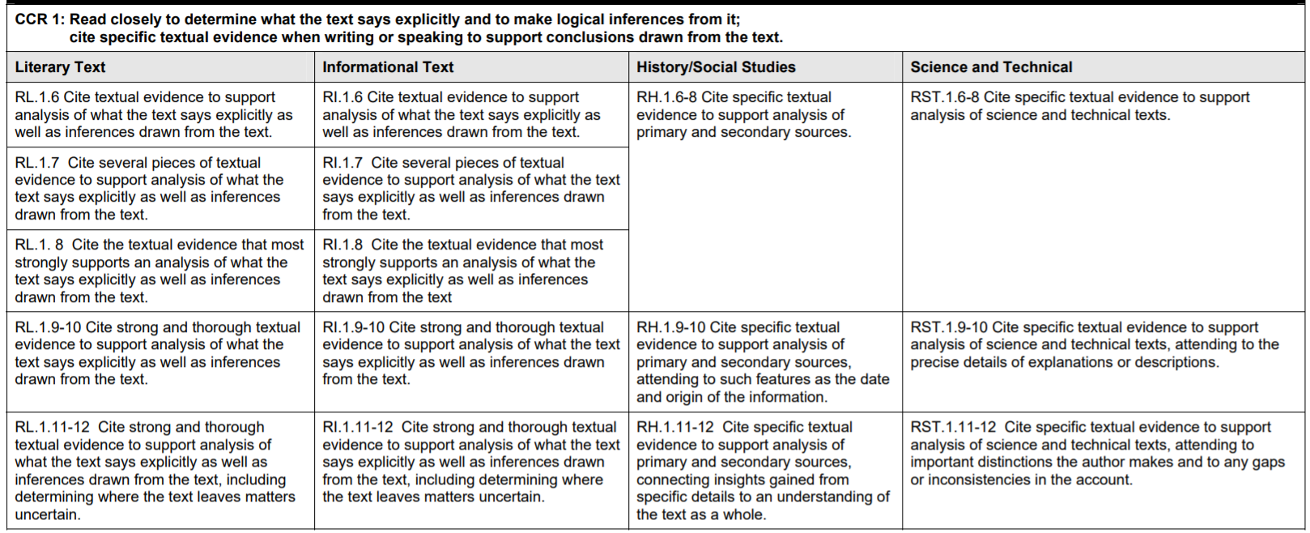

Slide 9
Foundational Skills Print Concepts: Demonstrate an understanding of the organization and basic features of print. Phonological Awareness: Demonstrate understanding of words, syllables, and sounds (phonemes). Phonics and Word Recognition: Know and apply grade-level phonics and word analysis skills in decoding words. Fluency. | Foundational Skills Print Concepts: Demonstrate an understanding of the organization and basic features of print. Phonological Awareness: Demonstrate understanding of words, syllables, and sounds (phonemes). Phonics and Word Recognition: Know and apply grade-level phonics and word analysis skills in decoding words.
Key Ideas and Details Read closely to determine what the text says explicitly and to make logical inferences from it; cite specific textual evidence when writing or speaking to support conclusions drawn from the text. Determine central ideas or themes of a text and analyze their development; summarize the key supporting details and ideas. Analyze how and why individuals, events, and ideas develop and interact over the course of a text. | Key Ideas and Details Read various texts closely to determine what each text explicitly says and to make logical inferences; cite specific textual evidence to support conclusions drawn from the texts. Provide an accurate summary of various texts; determine the central idea(s) or theme(s) and analyze its development throughout each text. Analyze how and why individuals, events, and ideas develop and interact over the course of a text.

Slide 10
Craft and Structure Interpret words and phrases as they are used in a text, including determining technical, connotative, and figurative meanings, and analyze how specific word choices shape meaning or tone. Analyze the structure of texts, including how specific sentences, paragraphs, and larger portions of the text (e.g., a section, chapter, scene, or stanza) relate to each other and the whole. Assess how point of view or purpose shapes the content and style of a text. | Craft and Structure 7. Interpret words and phrases as they are used in various texts, including determining technical, connotative, and figurative meanings, and analyze how specific word choices shape meaning or tone. 8. Analyze the structure of various texts, including how the features and components relate to each other and the whole. 9. Assess how perspective or purpose shapes the content and style of various texts.
Integration of Knowledge and Ideas Integrate and evaluate content presented in diverse media and formats, including visually and quantitatively, as well as in words.* Delineate and evaluate the argument and specific claims in a text, including the validity of the reasoning as well as the relevance and sufficiency of the evidence.1 Analyze how two or more texts address similar themes or topics in order to build knowledge or to compare the approaches the authors take. | Integration of Knowledge and Ideas 10. Evaluate the argument and specific claims in various texts. 11. Analyze and evaluate content presented in various texts (e.g. literary, historical, visual, artistic, quantitative, and technological).

Slide 11
Range of Reading and Level of Text Complexity Read and comprehend complex literary and informational texts independently and proficiently. | Fluency 12. Read with sufficient accuracy and fluency to support comprehension

Slide 12
Writing
Text types moved out of rule – can become guidance
Many standards combined for efficiency
Application to other content areas expected – addressed in preamble

Slide 13
Inquiry to Build and Present Knowledge
Use an inquiry process to gather relevant, credible information/evidence from a variety of sources (e.g., print, digital, discussions, etc.) that build understanding of and lead to conclusions about a subject under investigation.
Notes:
The subject could be a relevant content area topic or a novel study.

Slide 14
Process and Production
Develop, strengthen, and produce polished writing by using a collaborative process that includes the age-appropriate use of technology.
Notes:
Collaborative process may mean accountable talk, peer feedback or edit, working in teams, or any other process that mirrors how work is done.

Slide 15
Composing for Audience and Purpose
Routinely produce a variety of clear and coherent writing in which the development, organization, and style are appropriate to task, audience, and purpose while avoiding plagiarism.
Notes:
What this means is that the form and format follows criteria for audience, purpose, and contextual norms.

Slide 16
Interpreting the standards: our recent experience
What if we organized instruction, curriculum design, units of study, and literacy development around these three pillars that are now the writing standards?
Notes:
Breakout groups for grade span discussions. Study the changes, explanations, then progressions. Note where you see connections to the three pillars in any of the other strands.

Slide 17
The order is important
Language
Speaking & listening
Reading
Writing
Notes:
What does this order suggest about how to approach the standards?

Slide 18
Task: read and annotate
Read and annotate ELA CCSS_2020 Maine Anchor Standards Compared: note explicit and implicit connections to media literacy; indicate explicit and implicit connections to other strands/standards.

Slide 19
Task: read and annotate
Read and annotate Updates Explained: highlight information that may help to guide or direct your curriculum review and instructional planning.

Slide 20
Next:
the deep dive

