Slide 1
Prefixes
Vocabulary and Language Week 6, Days 3-4

Slide 2
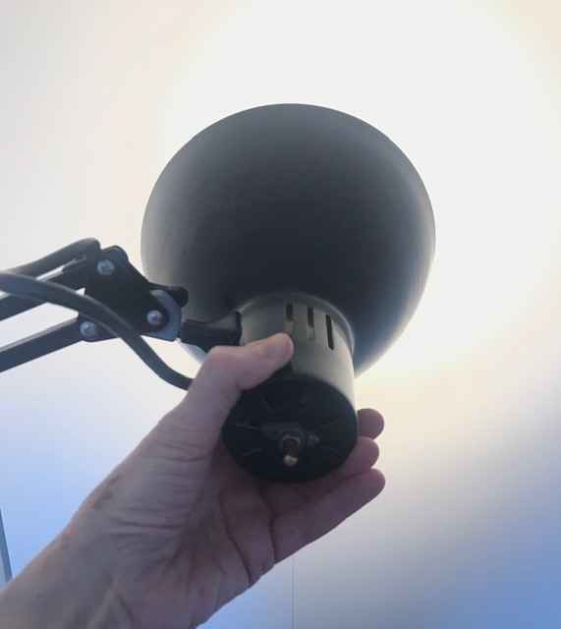
redirect
to change the direction of something
Notes:
Photo: Ana Vaisenstein

Slide 3
reverse
to move into the opposite position or direction
Notes:
https://www.cio.com/article/3267066/why-steve-jobs-is-the-reverse-case-study-for-it-leadership.html

Slide 4
pay

Slide 5
repay

Slide 6
tell

Slide 7
retell

Slide 8
build

Slide 9
rebuild

Slide 10
do

Slide 11
redo

Slide 12
Your turn!
Choose one set of words.
Write a sentence that demonstrates the meaning of the first word.
Write a sentence that demonstrates the meaning of the second word.
pay | repay
tell | retell
build | rebuild
do | redo

