Slide 1
Argument Adjectives
Writing Week 6, Day 5

Slide 2
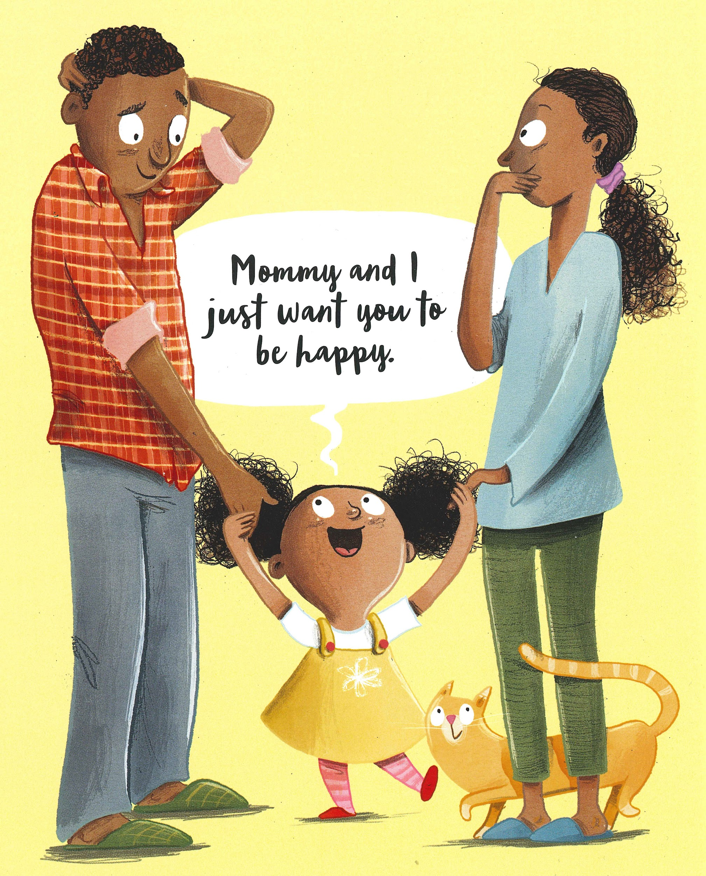
Slide 1
I hope you’re as excited as I am. Tell you what: Tomorrow, we’re going to pick out some special new sheets for your awesome sleeping rectangle.

Slide 3
Slide 2
I hope you’re as excited as I am. Tell you what: Tomorrow, we’re going to pick out some special new sheets for your awesome sleeping rectangle.

Slide 4
Slide 3
September 28, 2017
Dear Lina,
You should put away your Bristle Blocks when you are done playing with them. The blocks are very pointy, and they can hurt people’s feet. When you stepped on a block the other day, you fell over crying because it hurt so much and left a mark on your foot!
When you don’t put away the Bristle Blocks, you have a hard time finding what you need. Last time you wanted to build, you were frustrated because you could not find enough blocks to build the house you were imagining.
Please remember to clean up the Bristle Blocks. You will protect the family’s feet and be able to find everything you need to play!
Love,
Mommy

Slide 5
Slide 4
September 28, 2017
Dear Lina,
You should put away your Bristle Blocks when you are done playing with them. The blocks are very pointy, and they can hurt people’s feet. When you stepped on a block the other day, you fell over crying because it hurt so much and left a mark on your foot!
When you don’t put away the Bristle Blocks, you have a hard time finding what you need. Last time you wanted to build, you were frustrated because you could not find enough blocks to build the house you were imagining.
Please remember to clean up the Bristle Blocks. You will protect the family’s feet and be able to find everything you need to play!
Love,
Mommy

