Slide 1
Explanation Research, part 2
Writing Week 6, Day 1

Slide 2
Explanation Research: Step 1
Read or listen to the next two slides. They are from the book Sound and Light.
As you read or listen, think about the research question,
How does sound travel?

Slide 5
Explanation Research: Step 2
Think about what you learned from the text that answers the research question
How does sound travel?
Explain how sound travels in your own words.

Slide 6
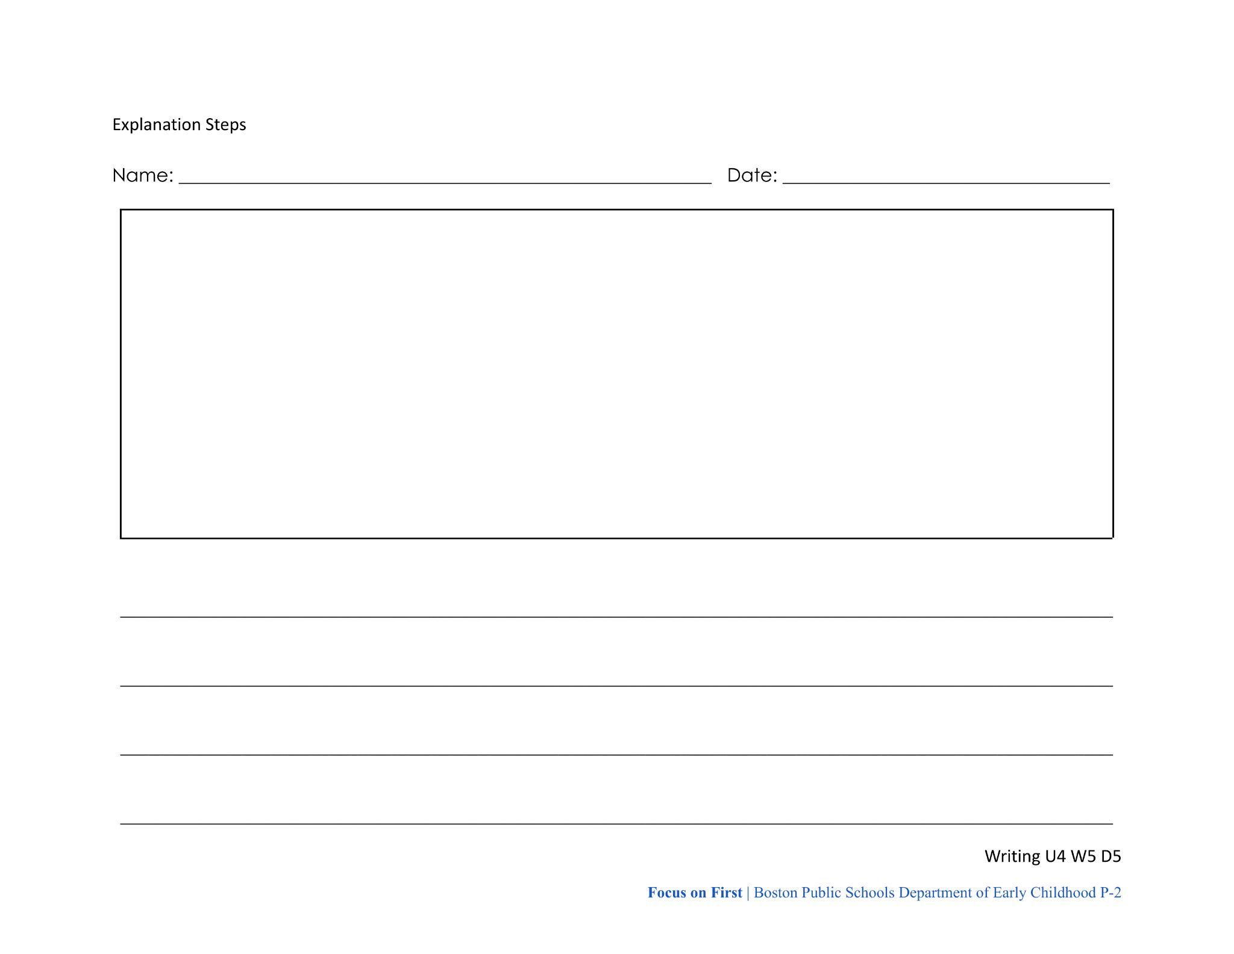
Explanation Research: Step 3
Go back to your notes.
If you learned new steps from this book, add sketches or words to help you remember them.
If you learned something that makes you want to change what you already wrote, revise those notes.

