Slide 1
Explanation Research, part 1
Writing Week 5, Day 5

Slide 2
Explanation Research: Step 1
Read or listen to the next two slides. They are from the book Amazing Sound.
As you read or listen, think about the research question,
How does sound travel?

Slide 3
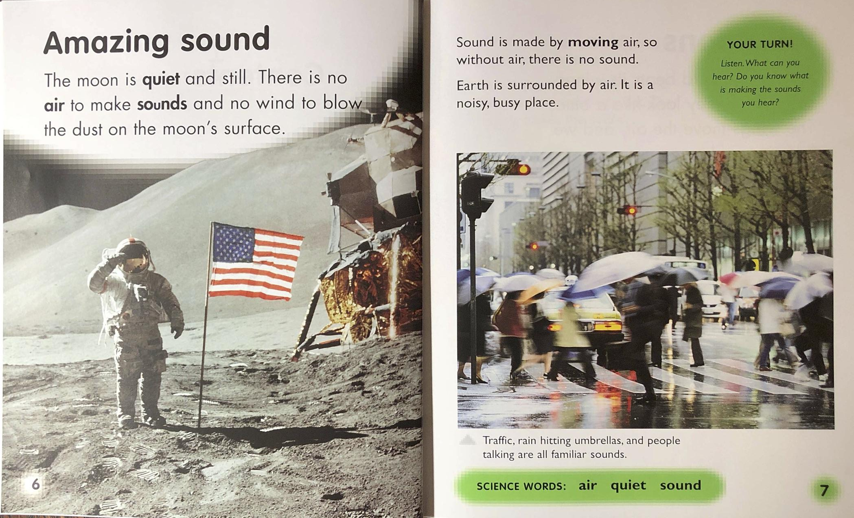


Slide 4
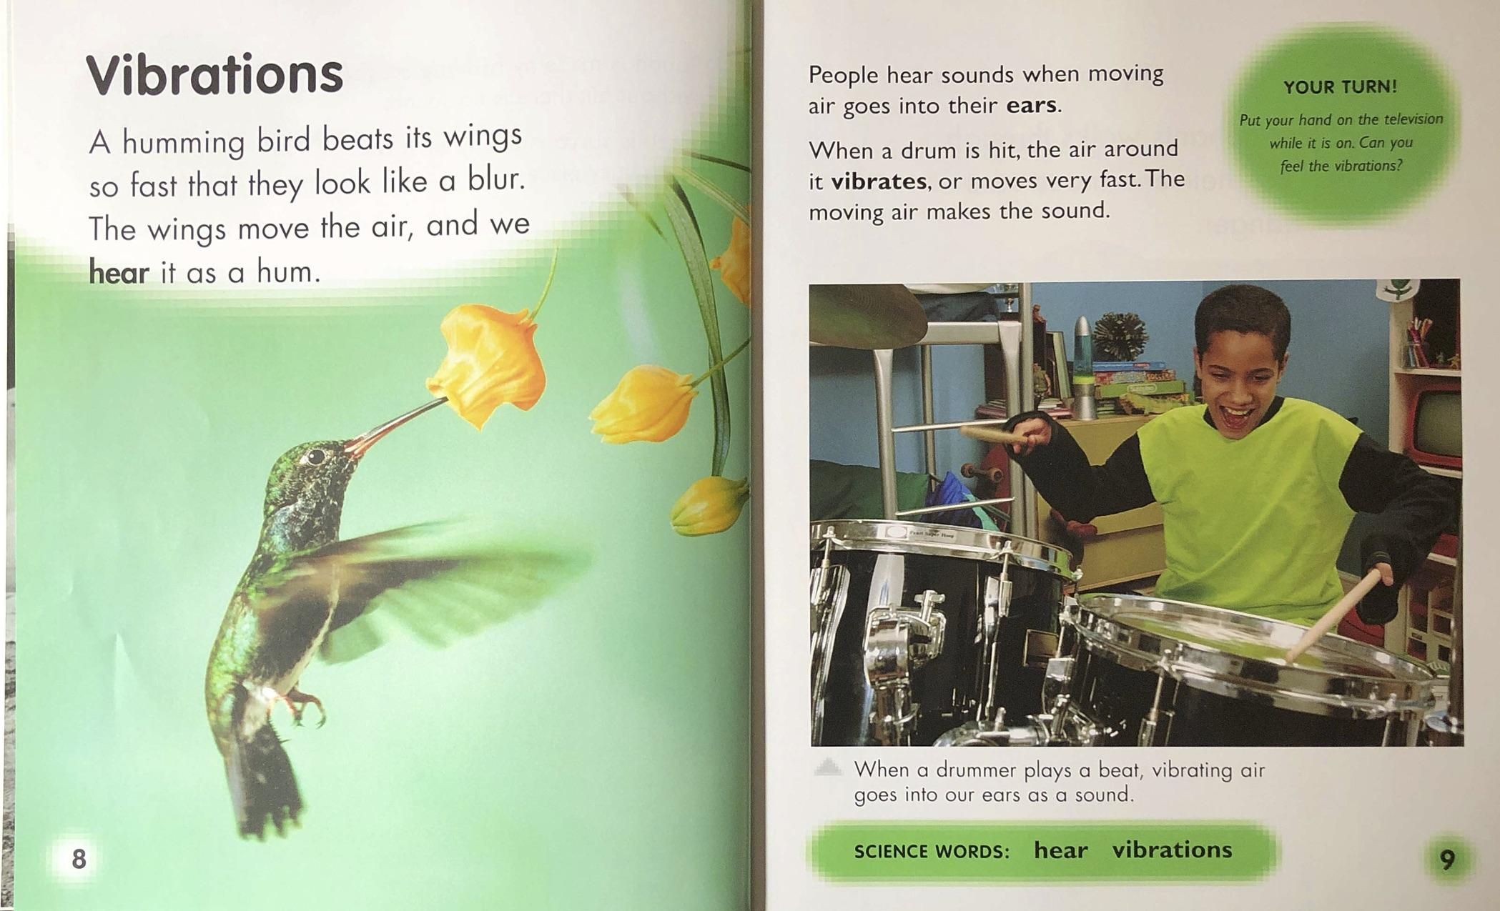

Slide 5
Explanation Research: Step 2
Think about what you learned from the text that answers the research question,
How does sound travel?
Explain how sound travels in your own words.

Slide 6
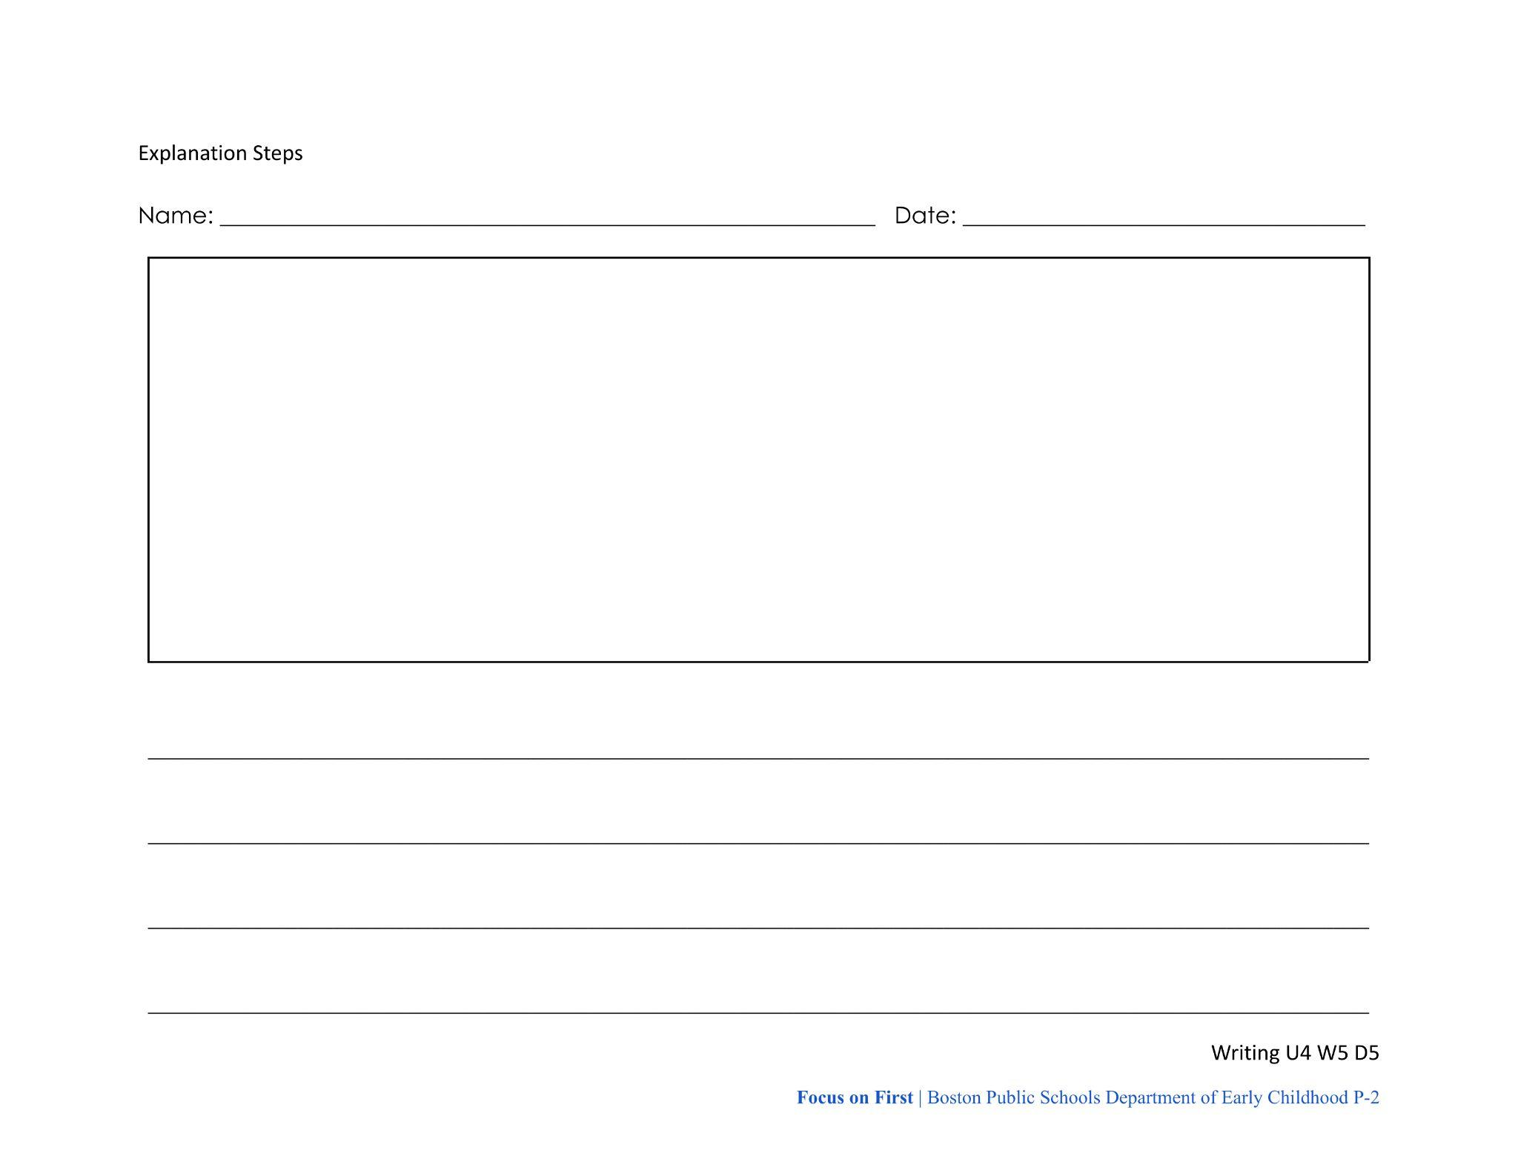
Explanation Research: Step 3
Write down what you said.
You can draw sketches, write words, or both!
Write notes that will help you remember what you learned when you write next week.

