Slide 1
General Nouns
Writing Week 5, Day 3

Slide 2
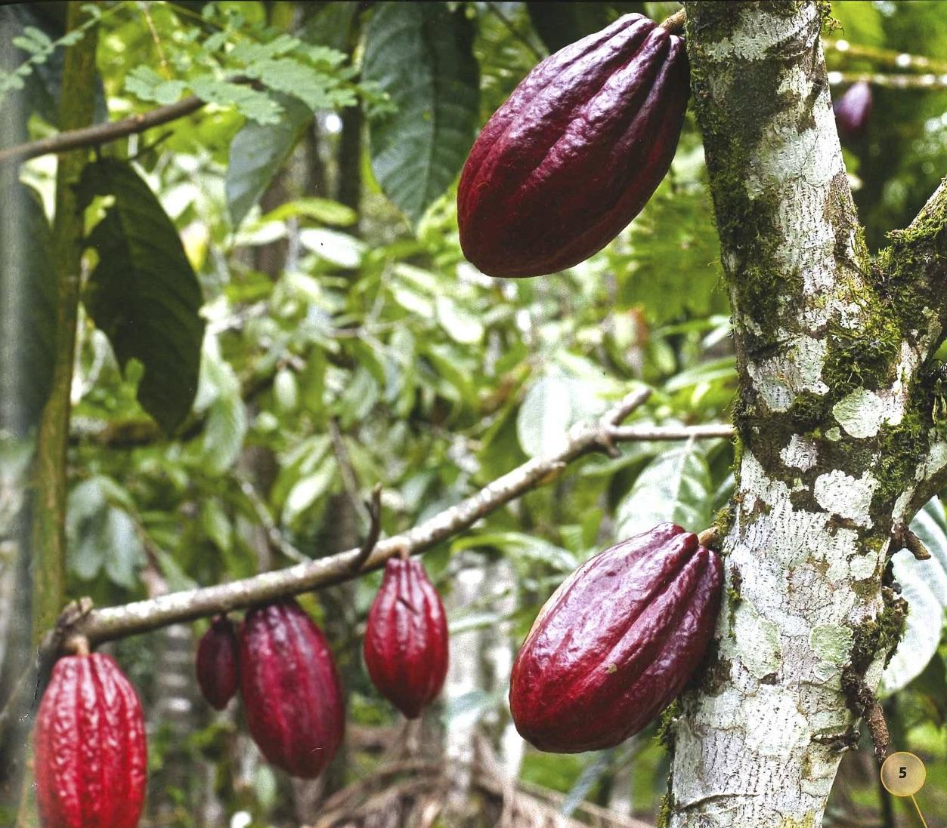
Explanation Language: General Nouns
cocoa beans

Slide 3
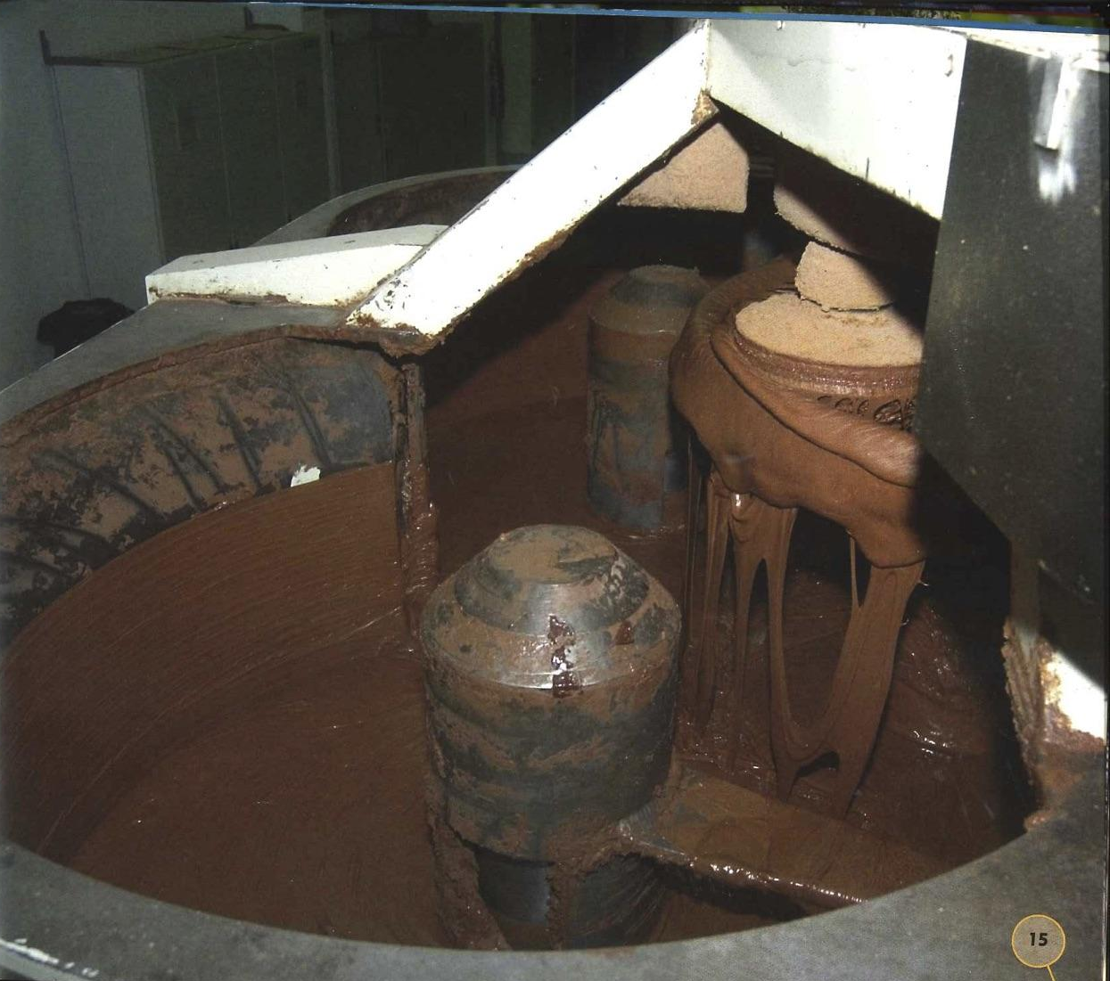
Your turn!

Slide 4
Your turn!

Slide 5
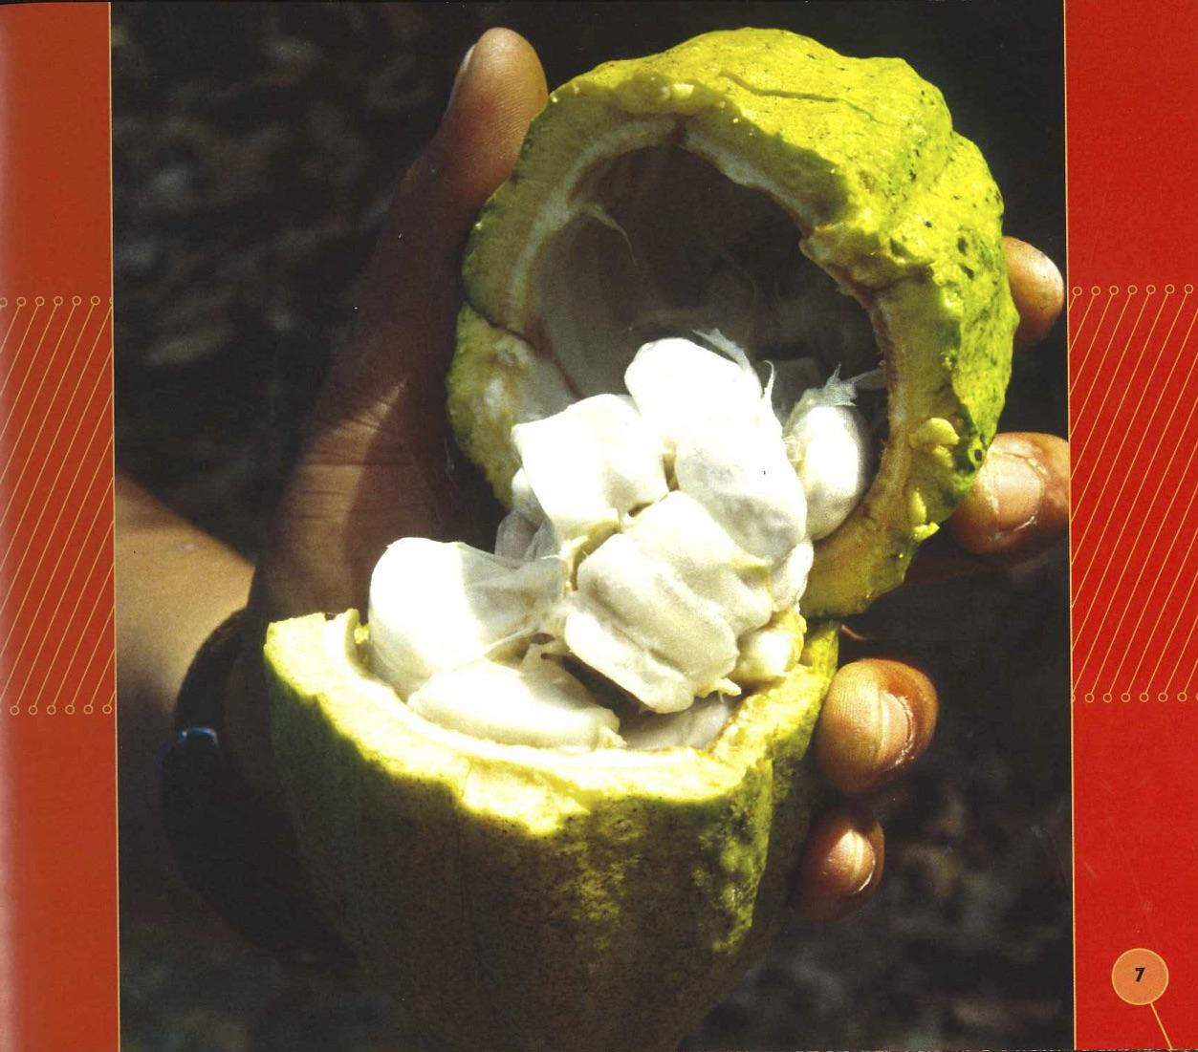
Your turn!

Slide 6
Your turn!

Slide 7
Revise Explanation Nouns
Your turn!
Underline the nouns.
Are they general nouns?
If not, go back and revise.
For example, if you wrote “a pod,” change it to “pods,” so that you are writing about all pods, not one particular pod.

