Slide 1
Poem Shapes and Titles
Writing Week 4, Day 3

Slide 2
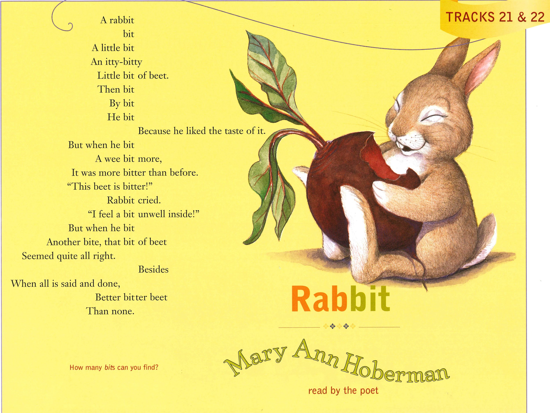
Slide 1

Slide 3
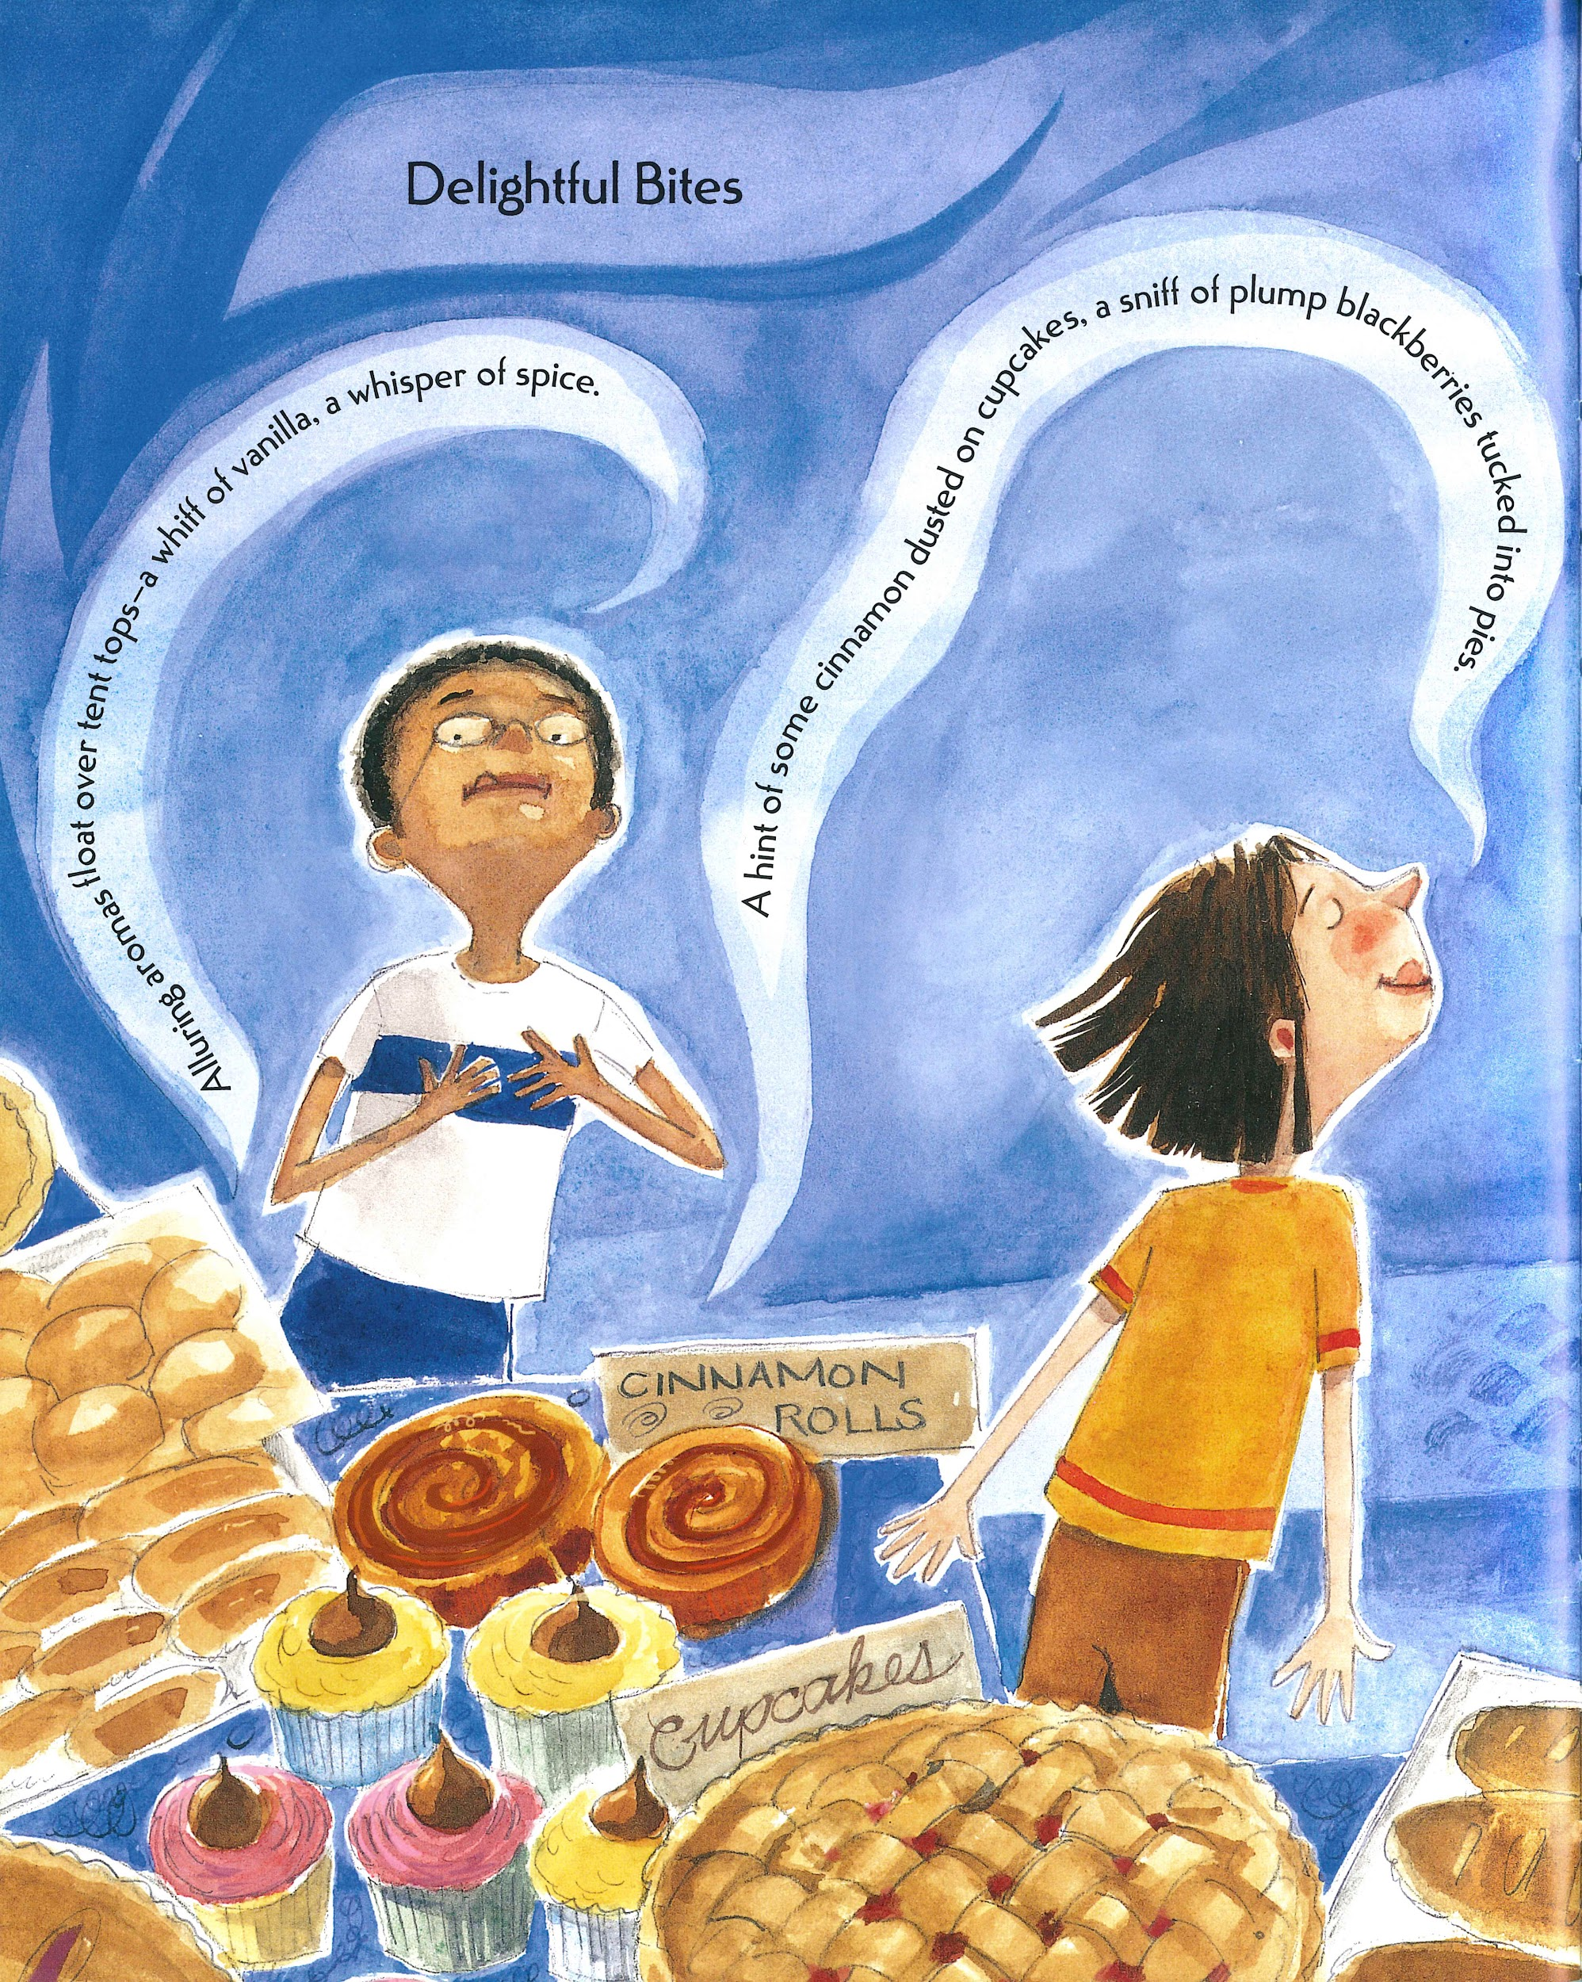
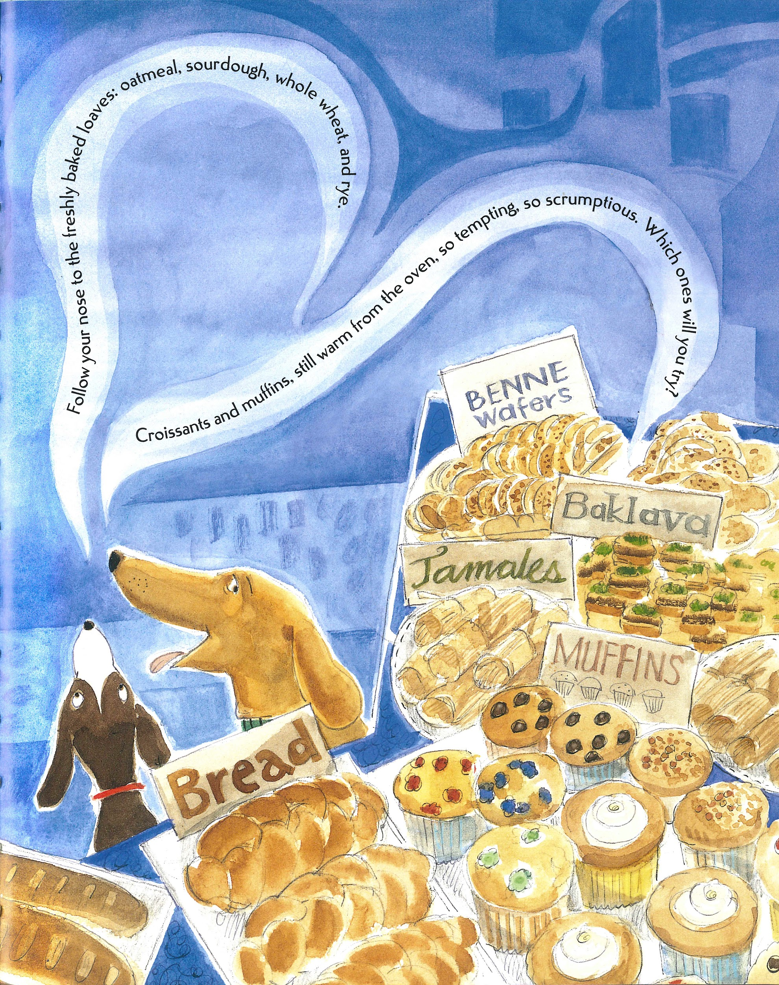
Slide 2

