Slide 1
Report Adjectives
Writing Week 3, Day 4

Slide 2
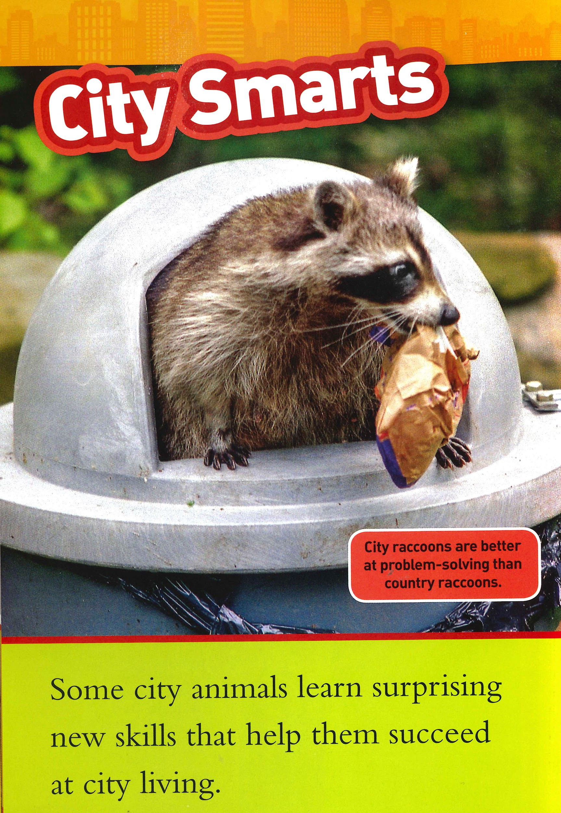
Slide 1
Some city animals learn surprising new skills that help them succeed at city living.

Slide 3
Slide 2
Some city animals learn surprising new skills that help them succeed at city living.

Slide 4
Slide 3
Some city animals learn surprising new skills that help them succeed at city living.

Slide 5
Slide 4
Some city animals learn surprising new skills that help them succeed at city living.

Slide 6
Slide 5
Sea turtles live in water.

