Slide 1
Procedure Adjectives
Writing Week 2, Day 5

Slide 2
Slide 1

Slide 3
Slide 2

Slide 4
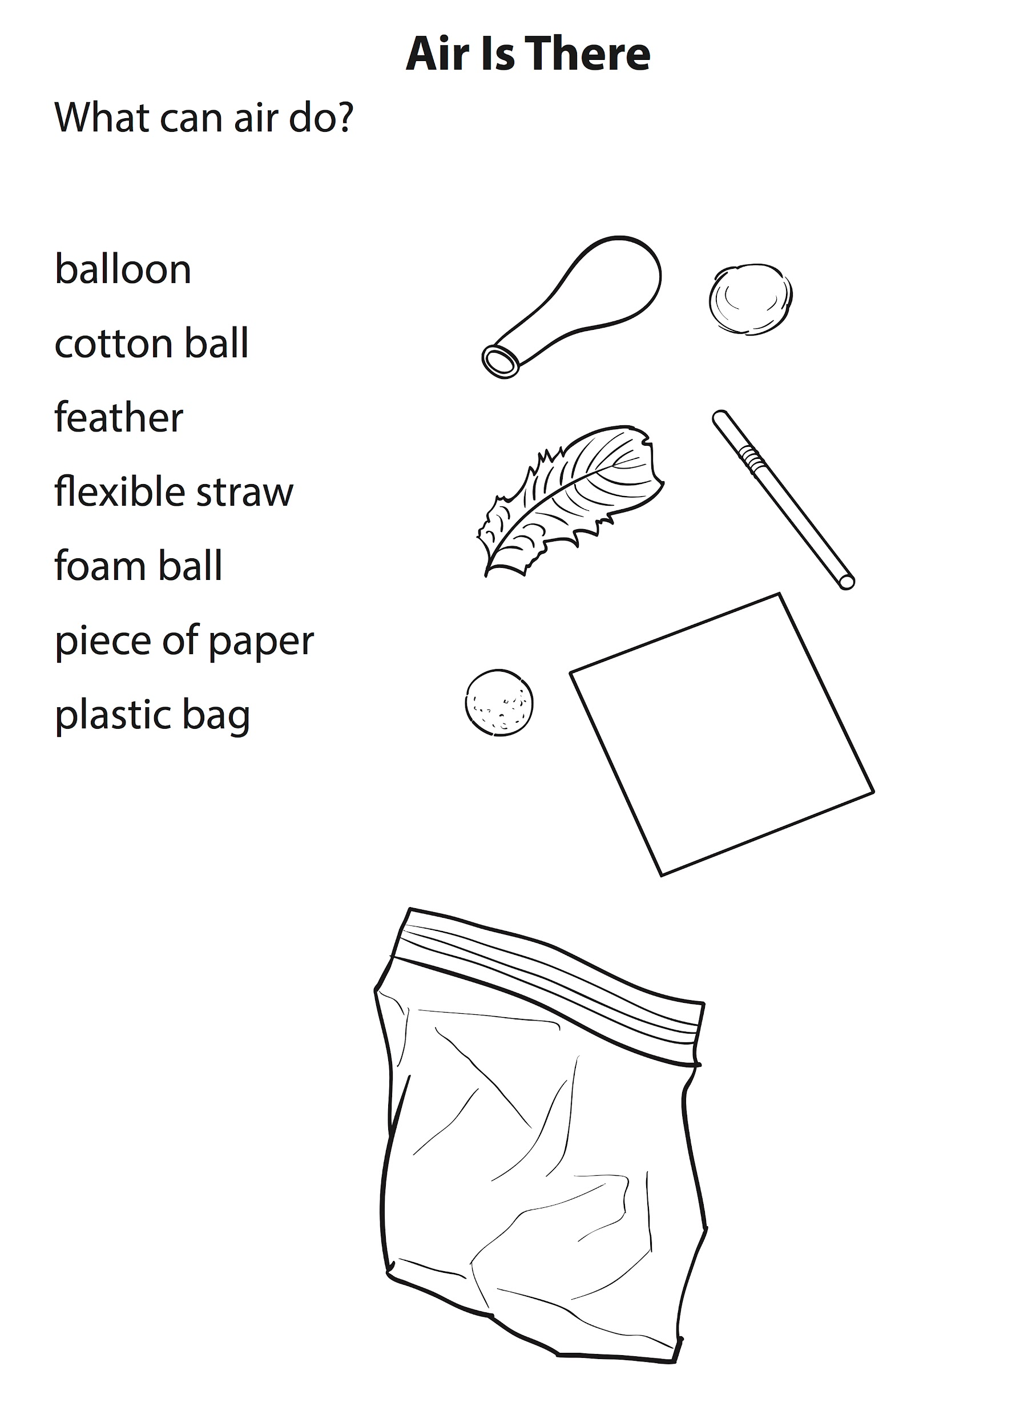
Slide 3

Slide 5
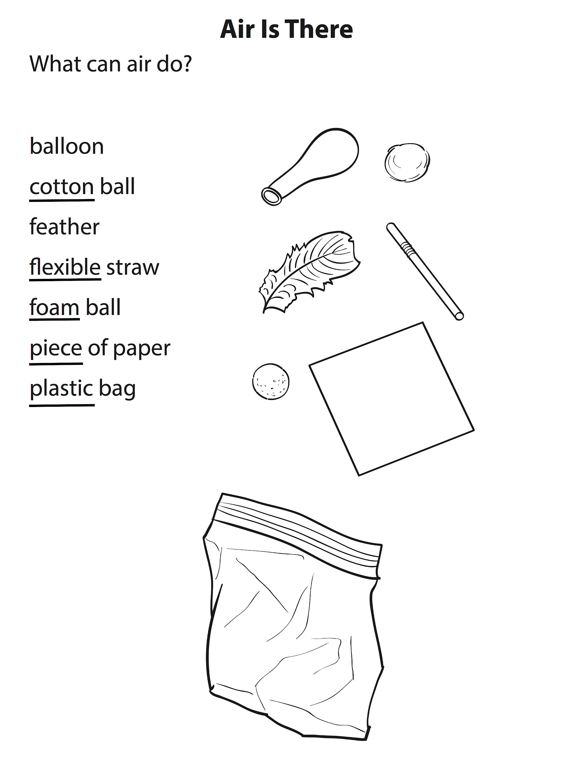
Slide 4

