Slide 1
Rhyme
Writing Week 2, Days 3-4

Slide 2
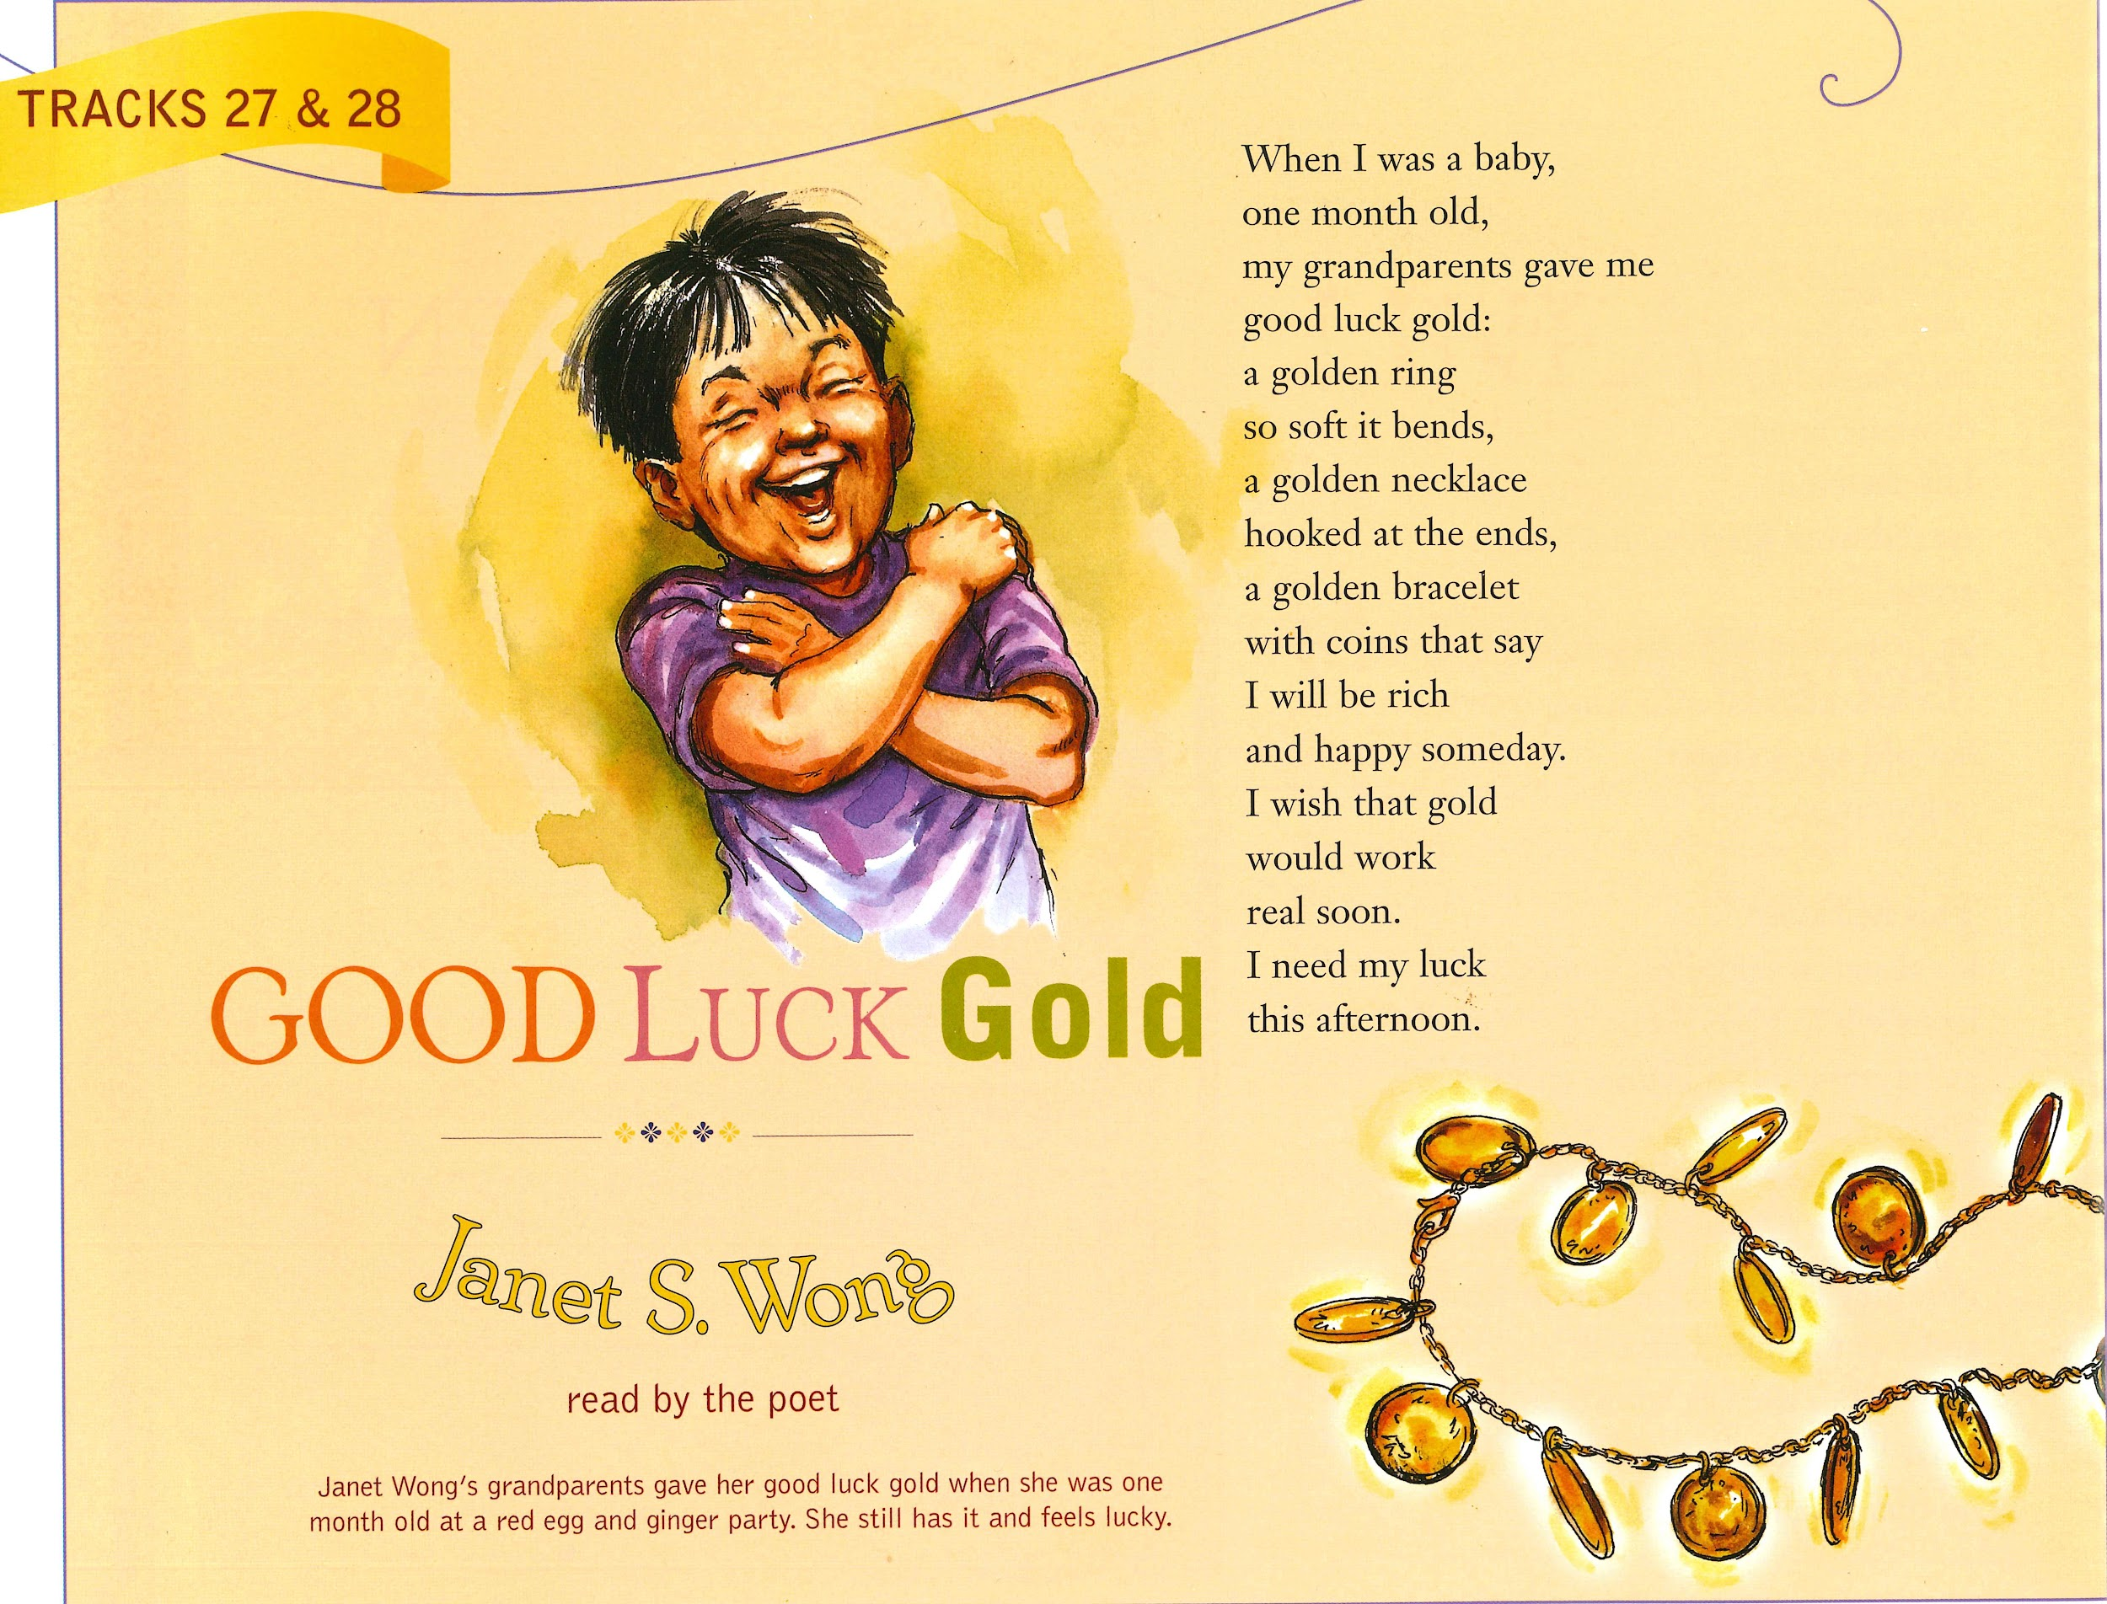
Slide 1

Slide 3
Slide 2
Good Luck Gold
by Janet S. Wong
When I was a baby,
one month old,
my grandparents gave me
good luck gold:
a golden ring
so soft it bends,
a golden necklace
hooked at the ends.
a golden bracelet
with coins that say
I will be rich
and happy someday.
I wish that gold
would work
real soon.
I need my luck
this afternoon.

Slide 4
Slide 3
Good Luck Gold
by Janet S. Wong
When I was a baby,
one month old,
my grandparents gave me
good luck gold:
a golden ring
so soft it bends,
a golden necklace
hooked at the ends.
a golden bracelet
with coins that say
I will be rich
and happy someday.
I wish that gold
would work
real soon.
I need my luck
this afternoon.

Slide 5
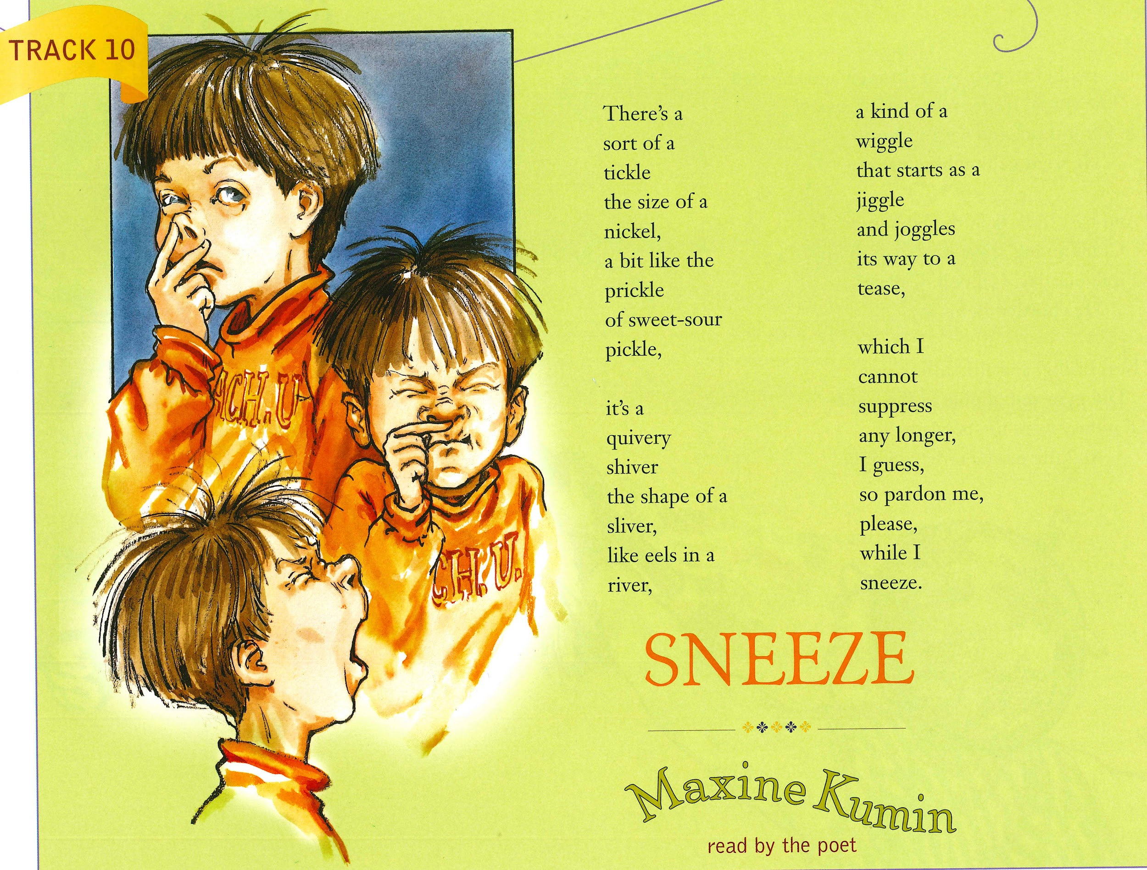
Slide 4

Slide 6
Slide 5
Sneeze by Maxine Kumin
There’s a sort of a tickle the size of a nickel, a bit like the prickle of sweet-sour pickle, | it’s a quivery shiver the shape of a sliver, like eels in a river, | a kind of a wiggle that starts as a jiggle and joggles its way to a tease, | which I cannot suppress any longer, I guess, so pardon me, please, while I sneeze.

Slide 7
Slide 6
Sneeze by Maxine Kumin
There’s a sort of a tickle the size of a nickel, a bit like the prickle of sweet-sour pickle, | it’s a quivery shiver the shape of a sliver, like eels in a river, | a kind of a wiggle that starts as a jiggle and joggles its way to a tease, | which I cannot suppress any longer, I guess, so pardon me, please, while I sneeze.

