Slide 1
Procedure Verbs
Writing Week 2, Day 3

Slide 2
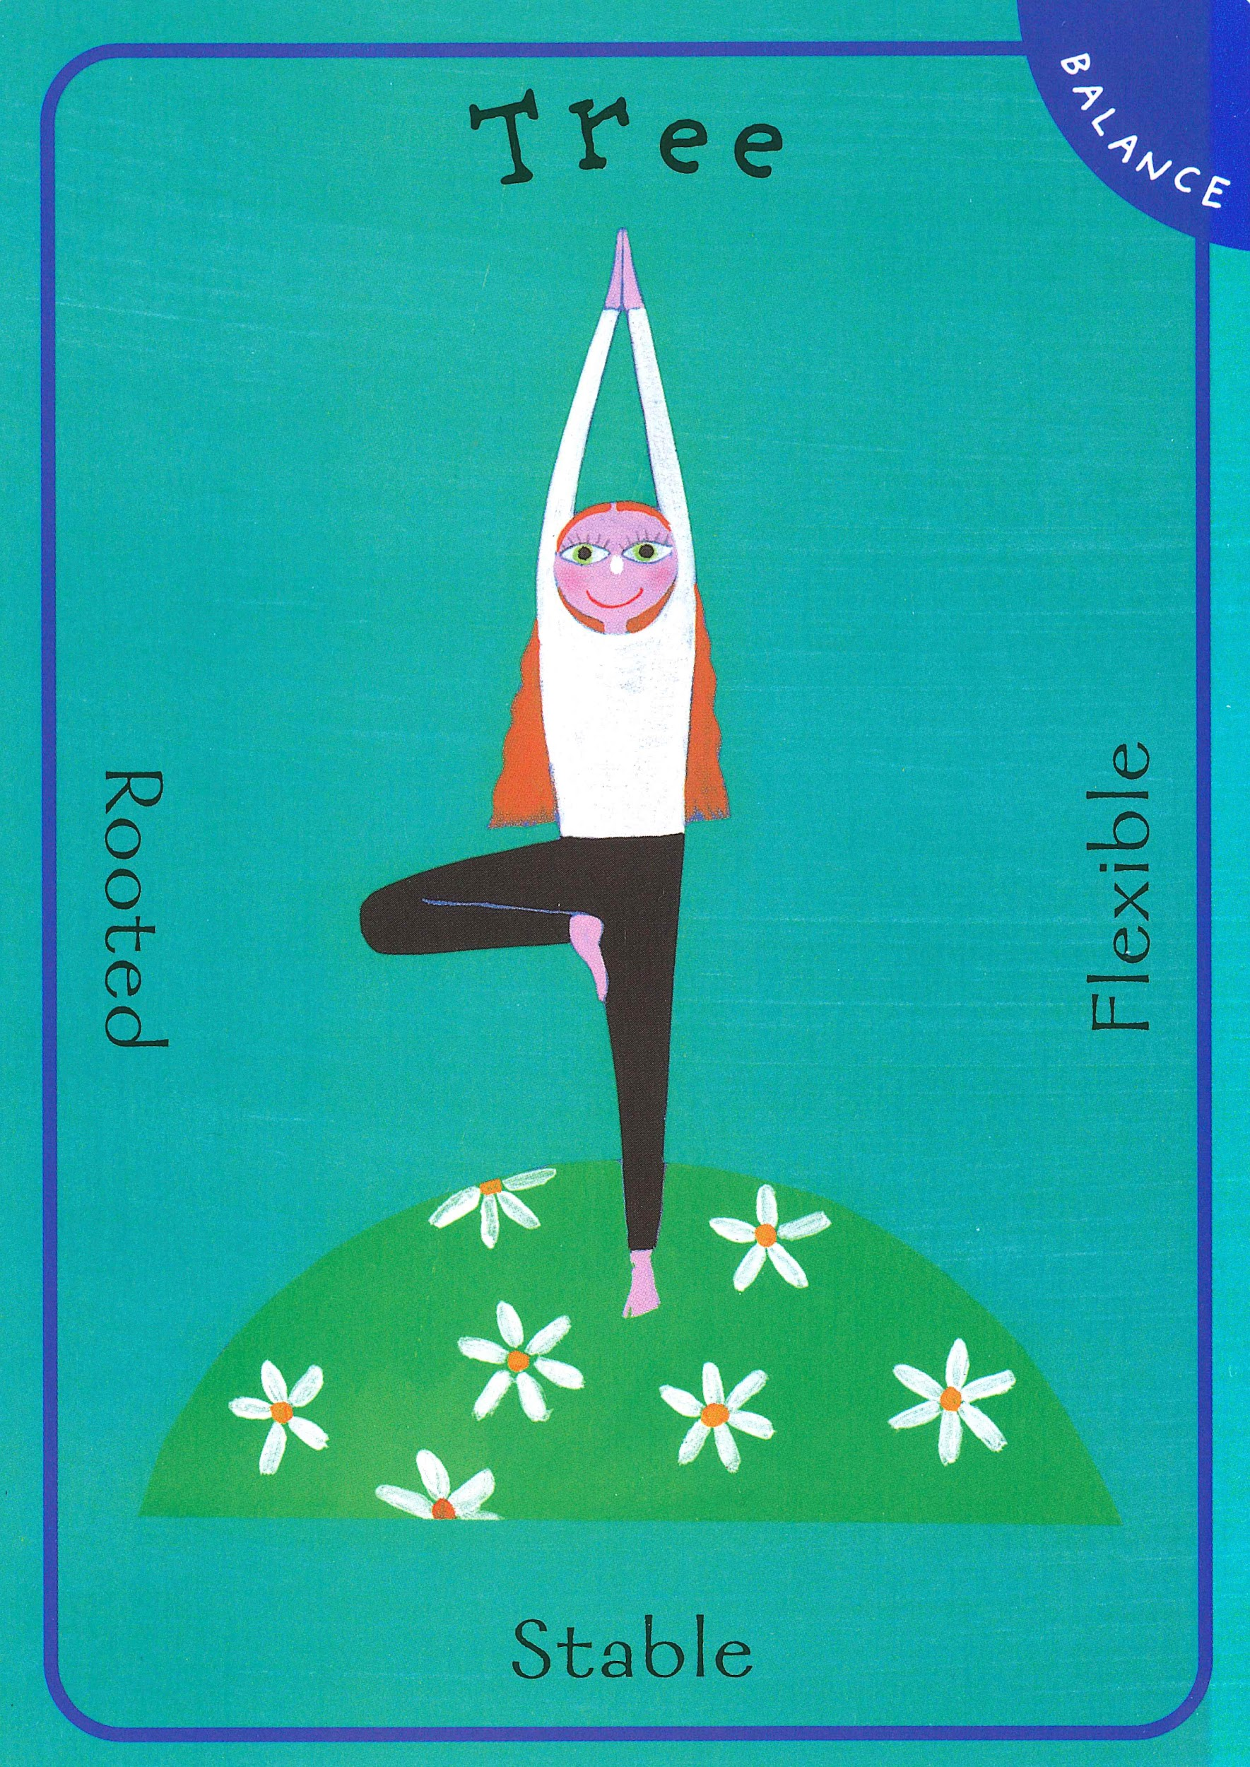
Slide 1

Slide 3
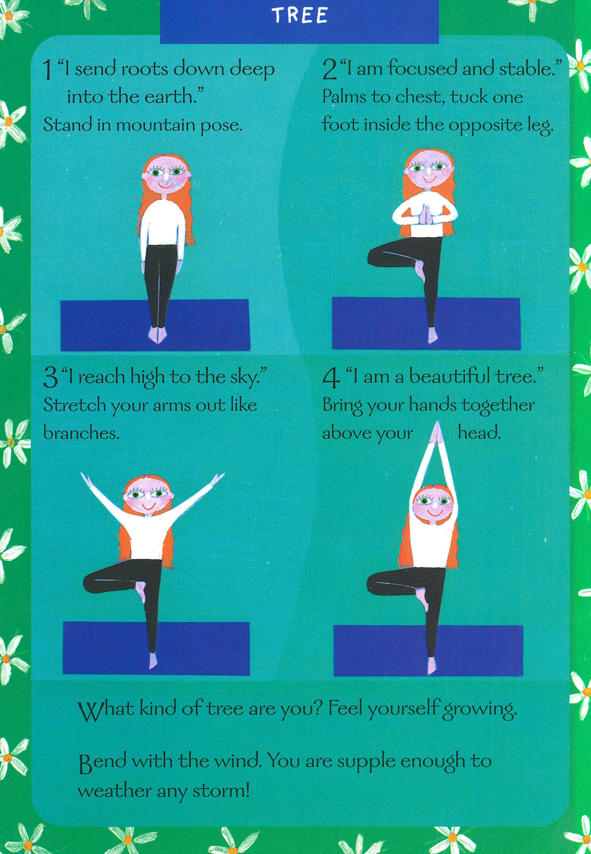
Slide 2
_____
___
___
____

