Slide 1
Repetition
Writing Week 2, Days 1-2

Slide 2
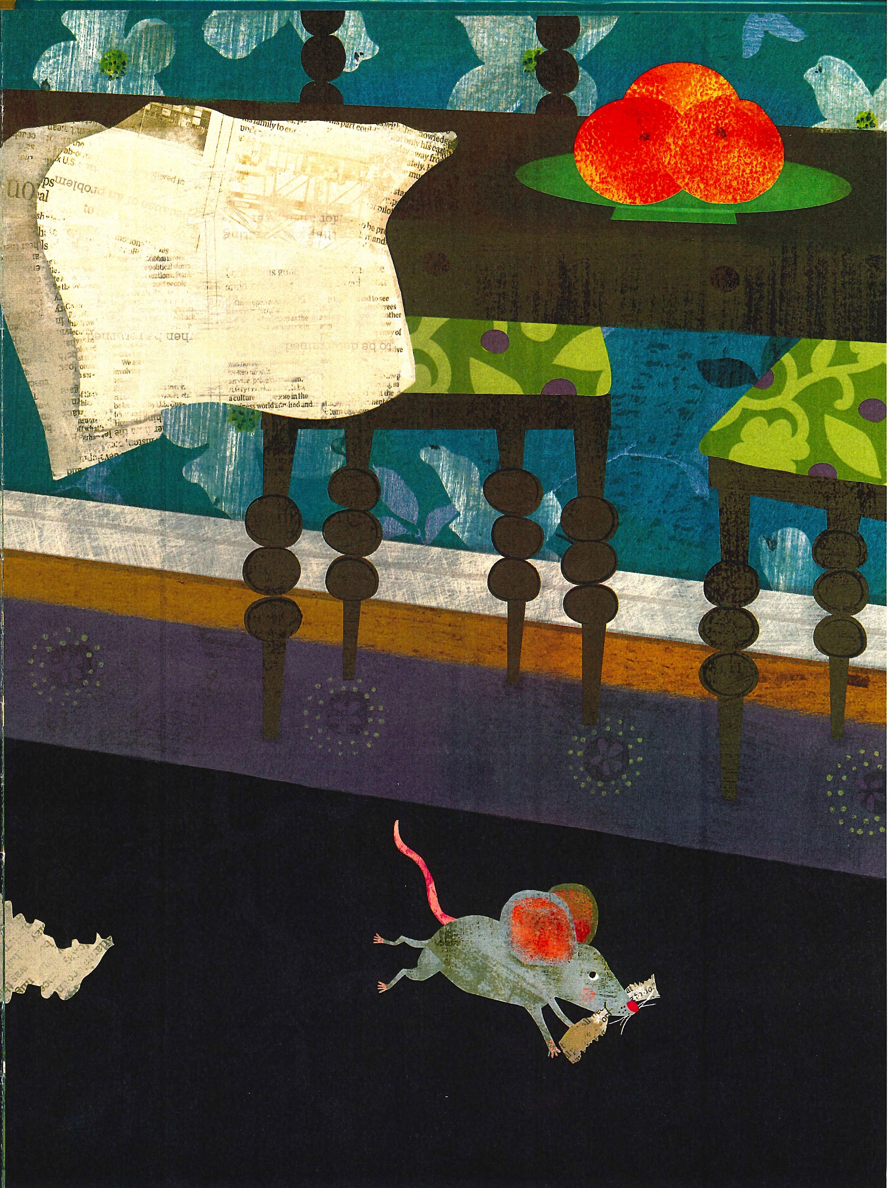
Slide 1
NESTING
by Sarah Grace Tuttle
In the night
under the table
a mother mouse
scurries back and forth. She
rips paper
carries
rips paper
carries
rips paper
carries
forgotten paper away
to build her nest.

Slide 3
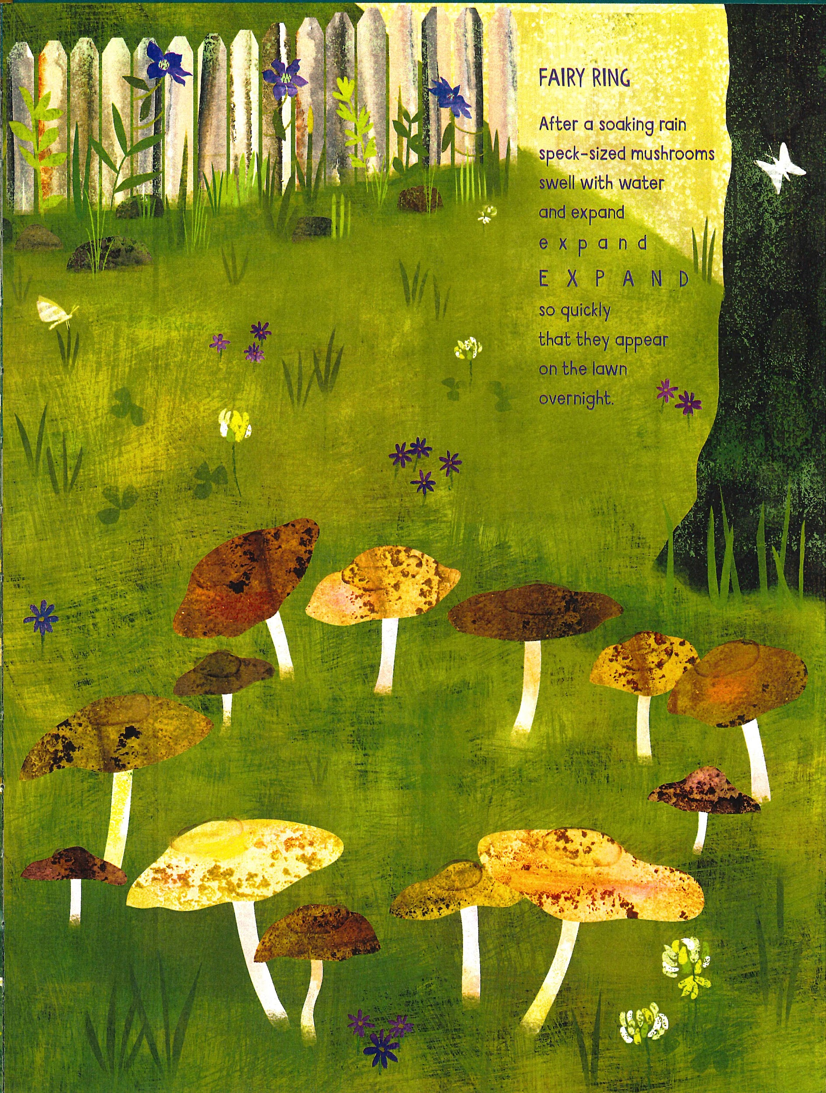
Slide 2
FAIRY RING
by Sarah Grace Tuttle
After a soaking rain
speck-sized mushrooms
swell with water
and expand
e x p a n d
E X P A N D
so quickly
that they appear
on the lawn
overnight.

Slide 4
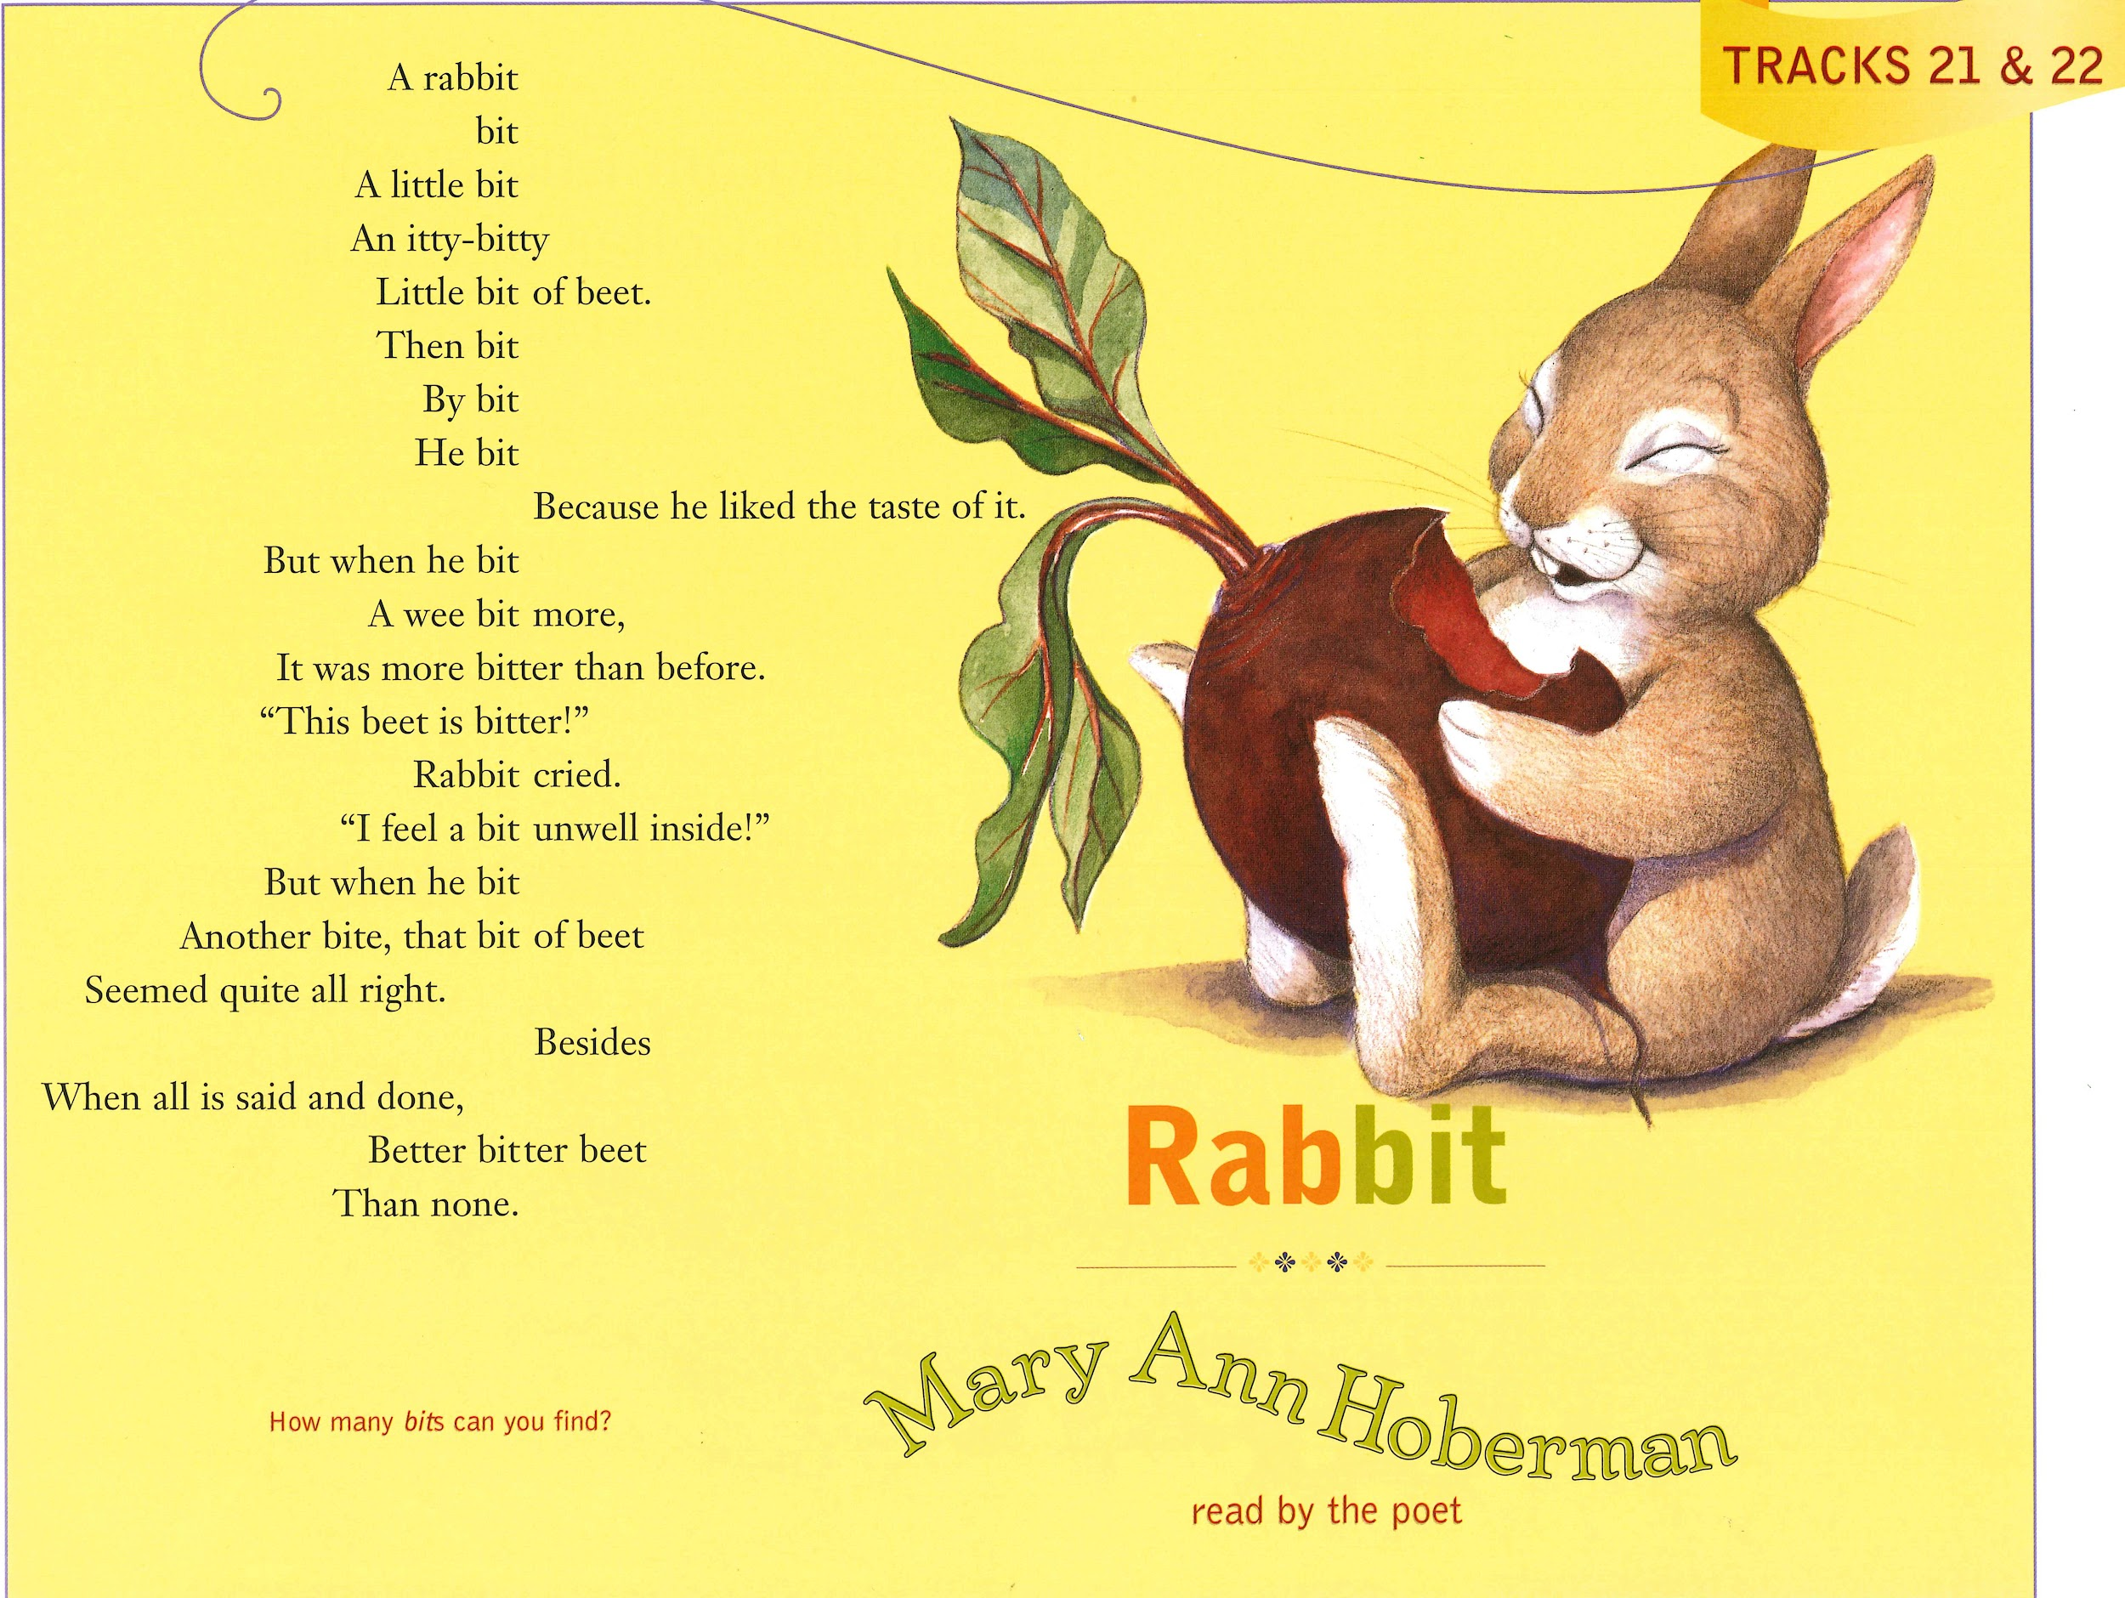
Slide 3

Slide 5
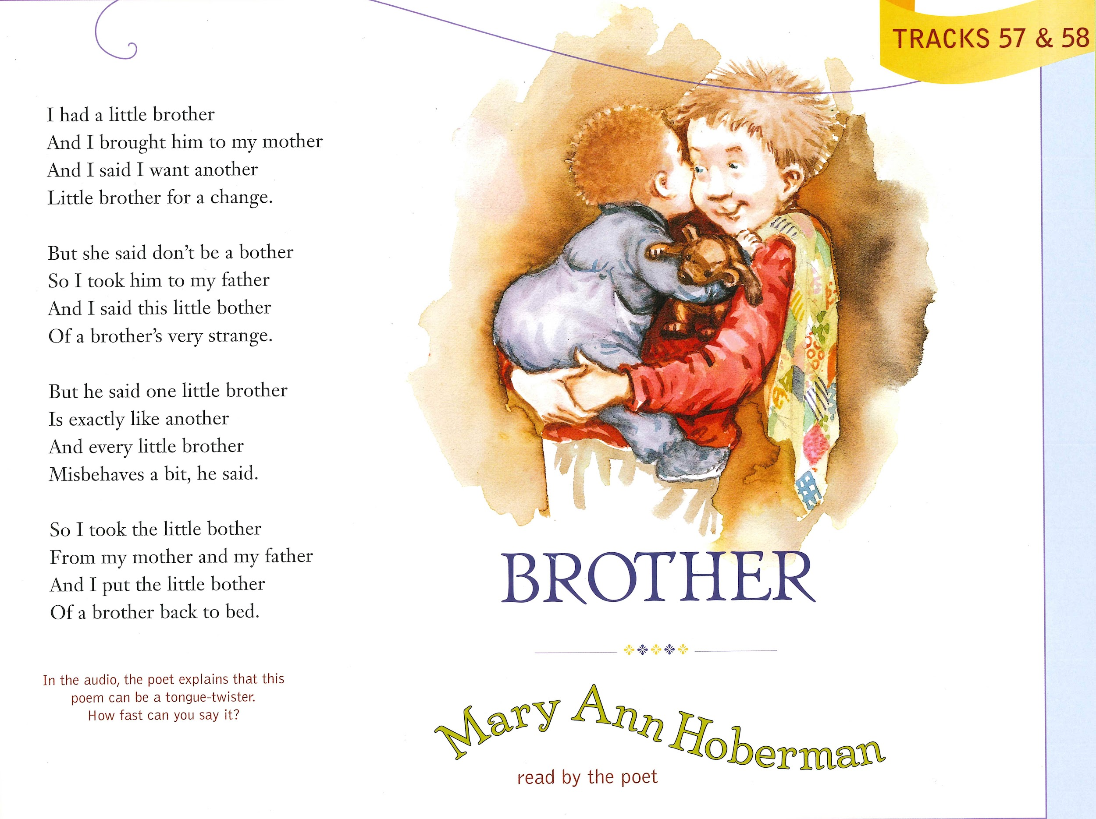
Slide 4

