Slide 1
Sample Posters
Writing Week 2, Day 1

Slide 2
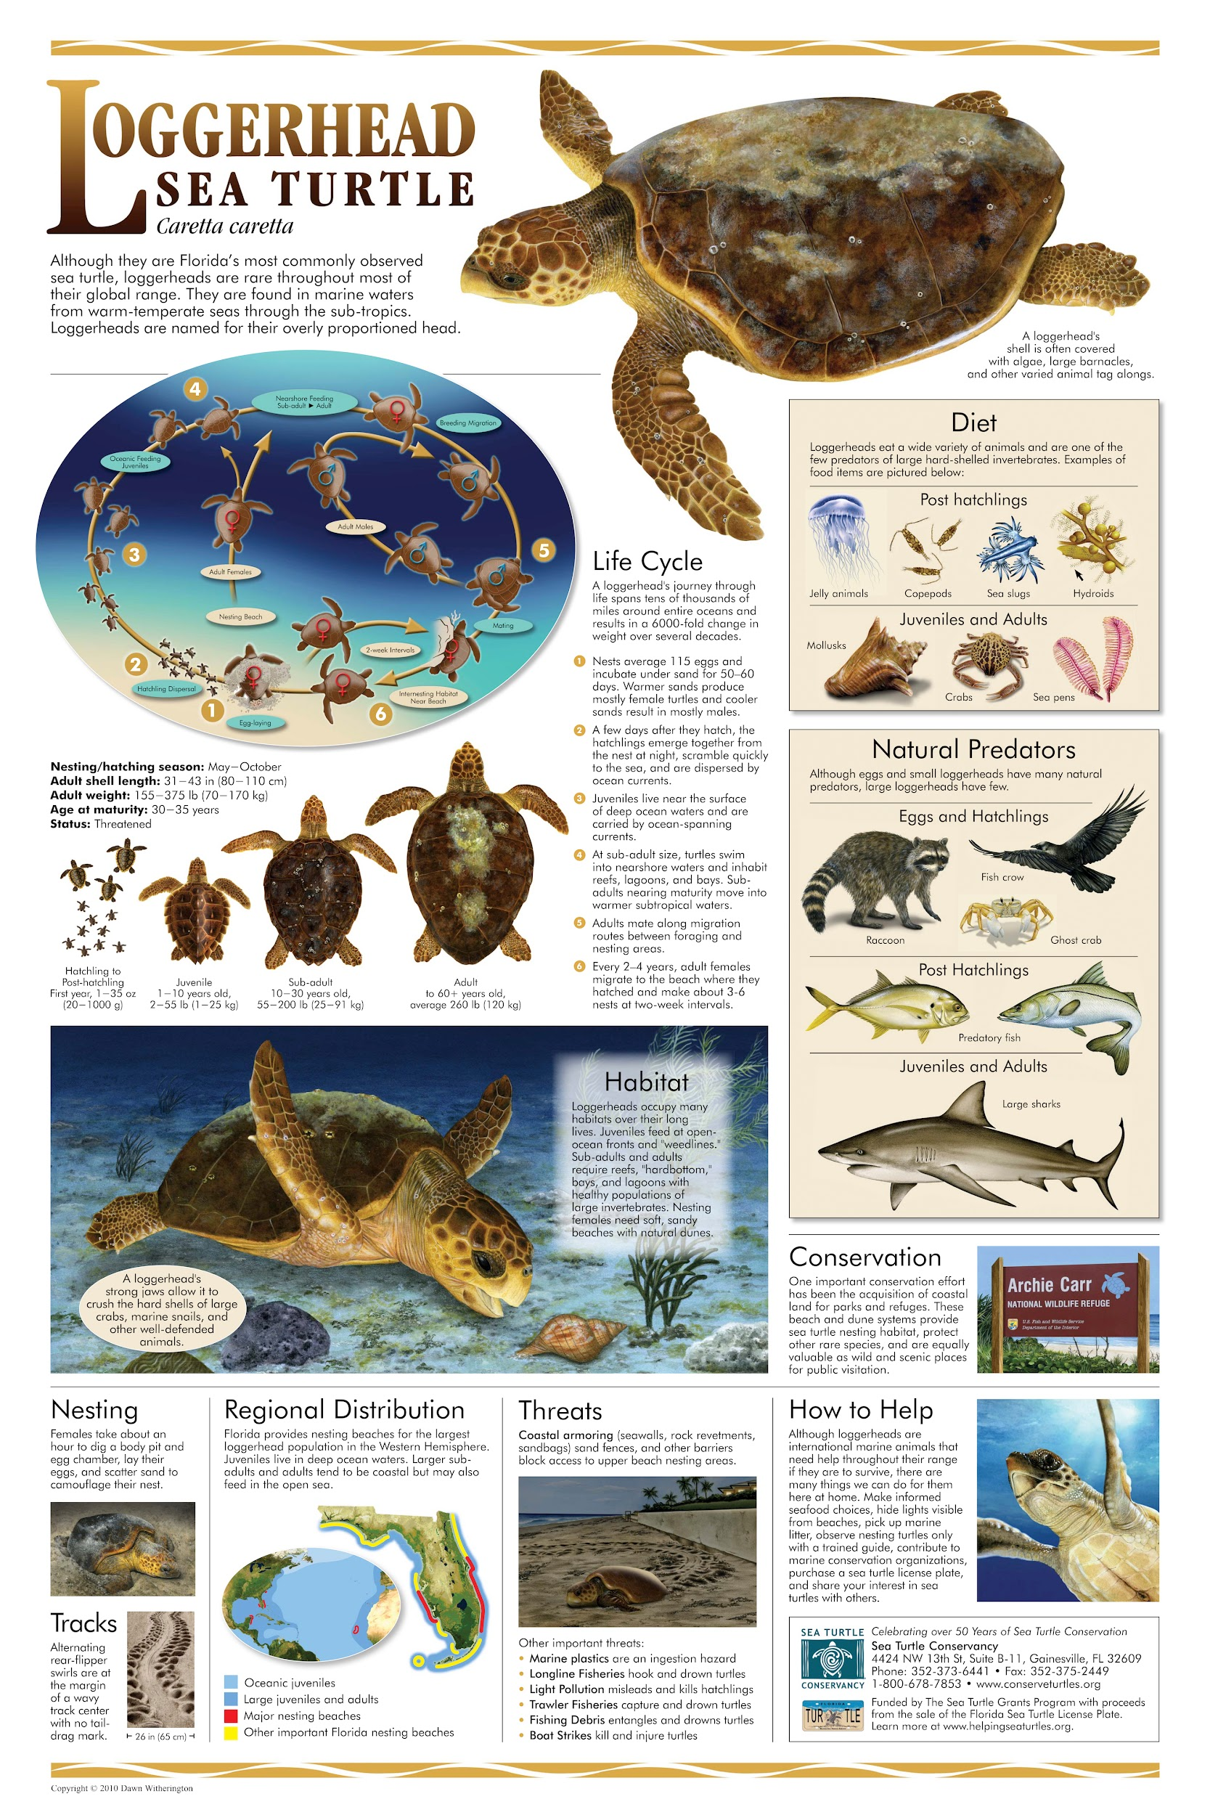
Slide 1
https://conserveturtles.org/educational-initiatives-outreach-materials-life-history-posters/

Slide 3
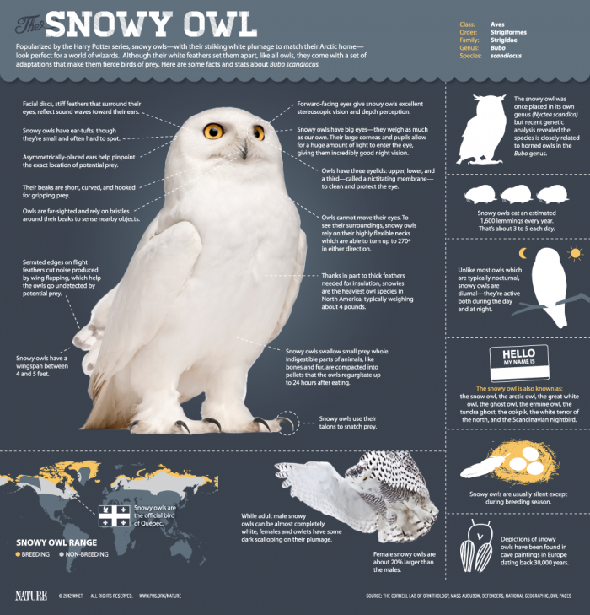
Slide 2
https://www.dailyinfographic.com/the-magic-of-the-snowy-owl-infographic

Slide 4
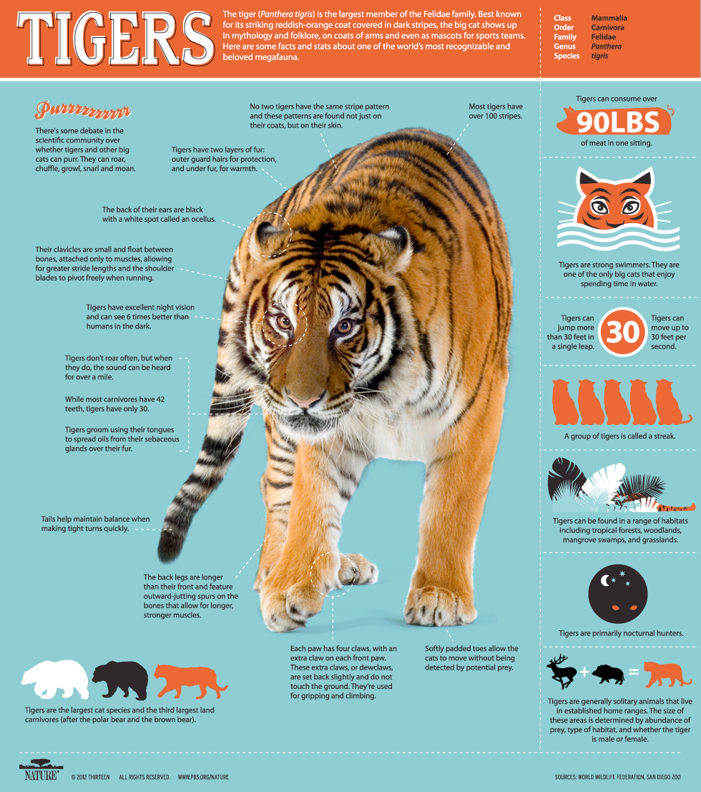
Slide 3
https://www.pbs.org/wnet/nature/siberian-tiger-quest-infographic-all-about-tigers/7844/

Slide 5
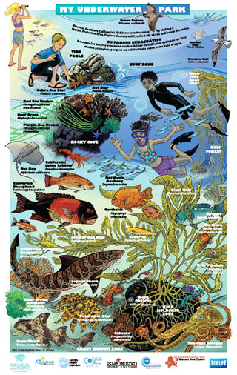
Slide 4
http://californiampas.org/outreach-toolkit/printed-materials/posters

