Slide 1
Procedure Adjectives
Writing Week 1, Day 4

Slide 2
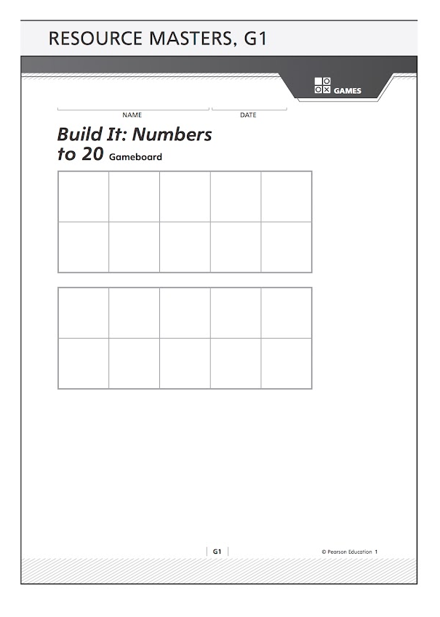
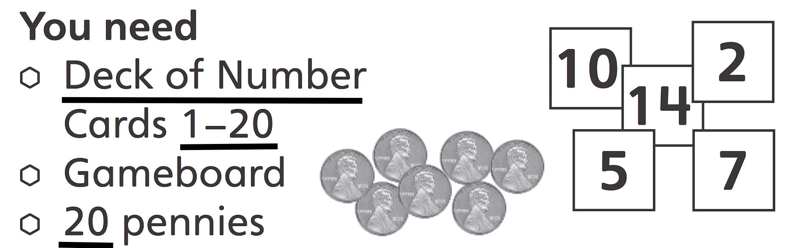
Slide 1

Slide 3
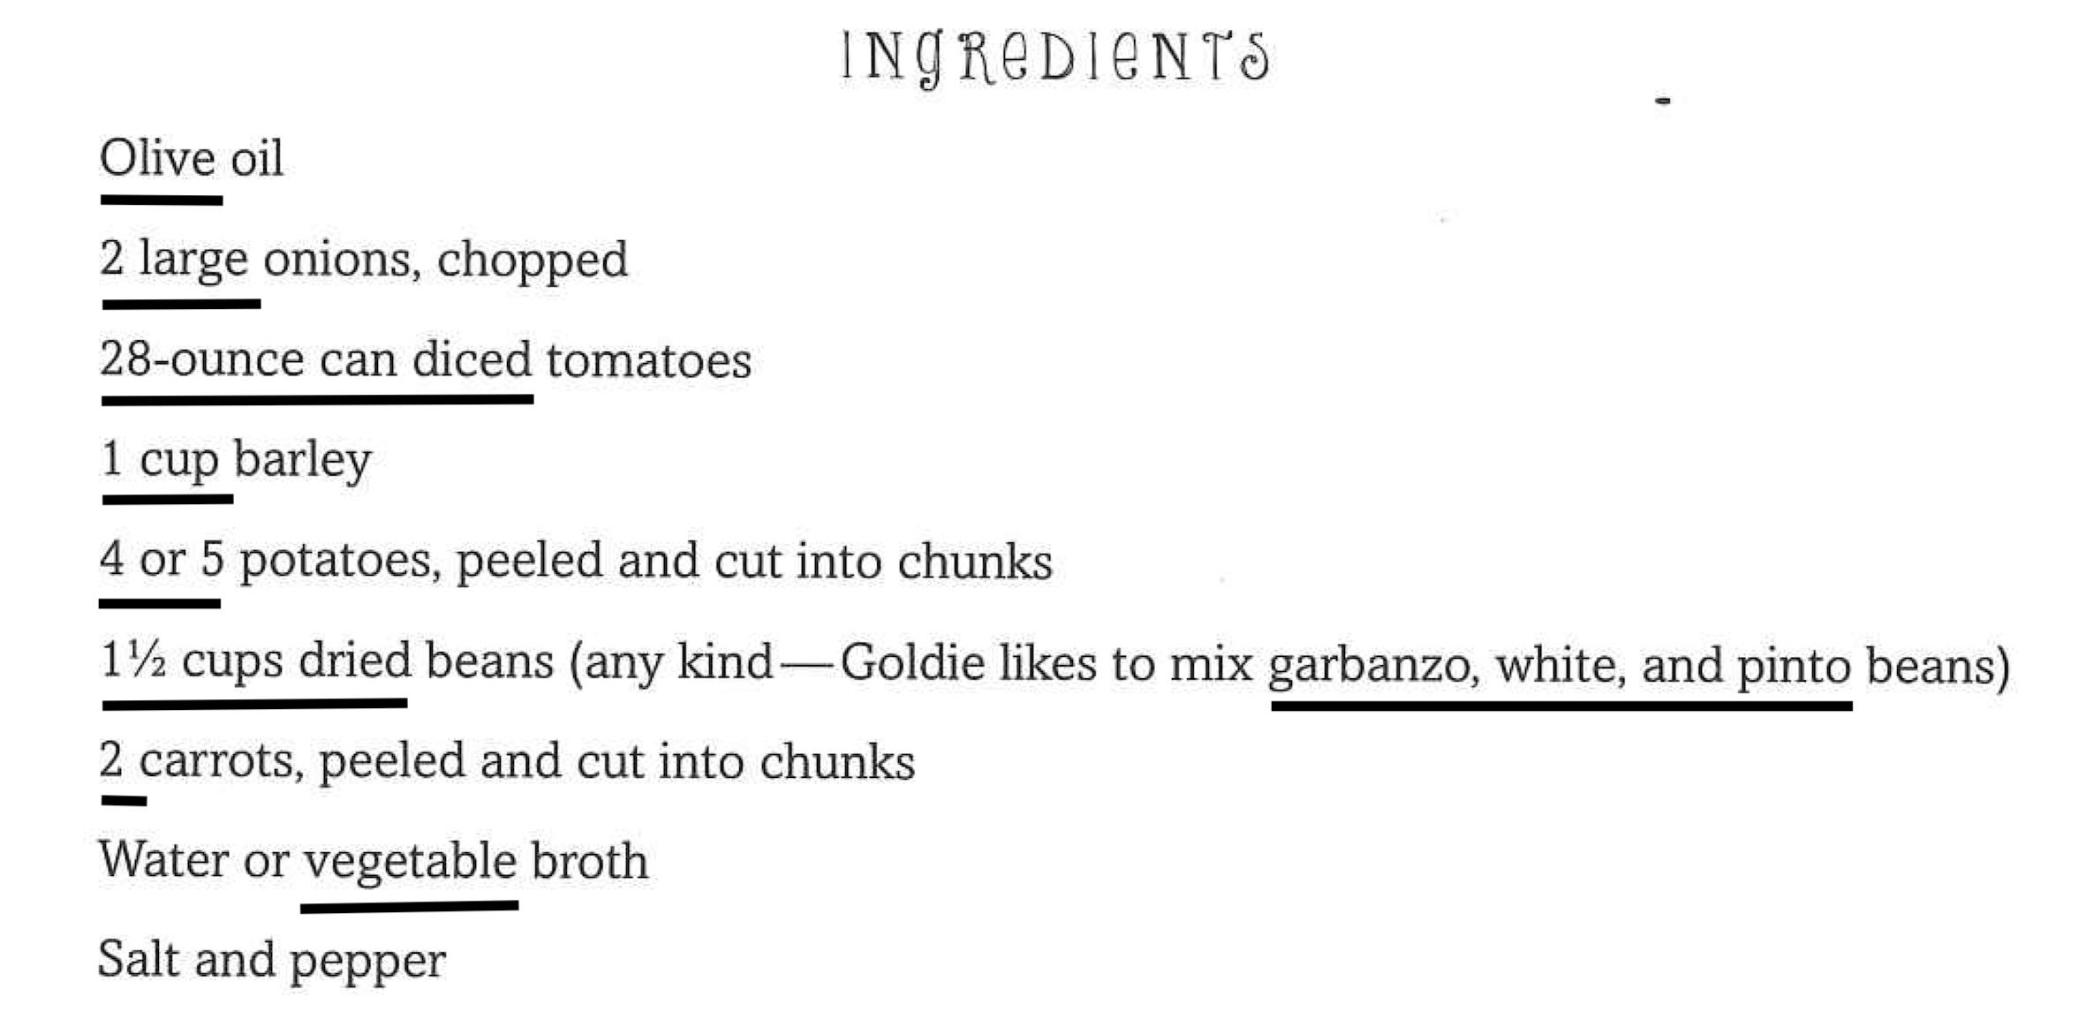
Slide 2

