Slide 1
Sea Turtle Project Introduction
Studios Week 6, Day 3
Notes:
global, map

Slide 2
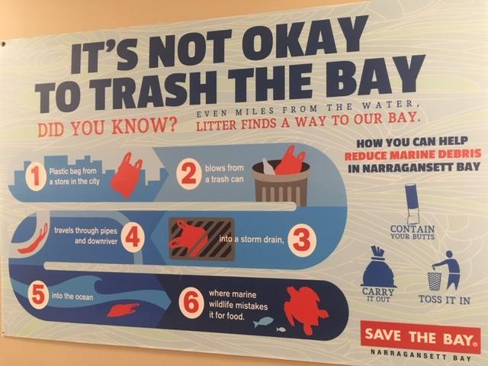
Slide 1
Signs like this can be found in many places.
Have you seen one?
What do you notice?

Slide 3
Slide 2

Slide 4
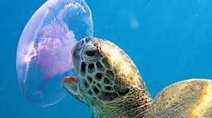
Slide 3
Sea turtles live in oceans around the world.
Sea turtles can live to be 80 years old or more.
But sea turtles are endangered.
Sea turtles eat jellyfish. But a plastic bag can look like a jellyfish. What happens when a sea turtle eats a plastic bag?

Slide 5
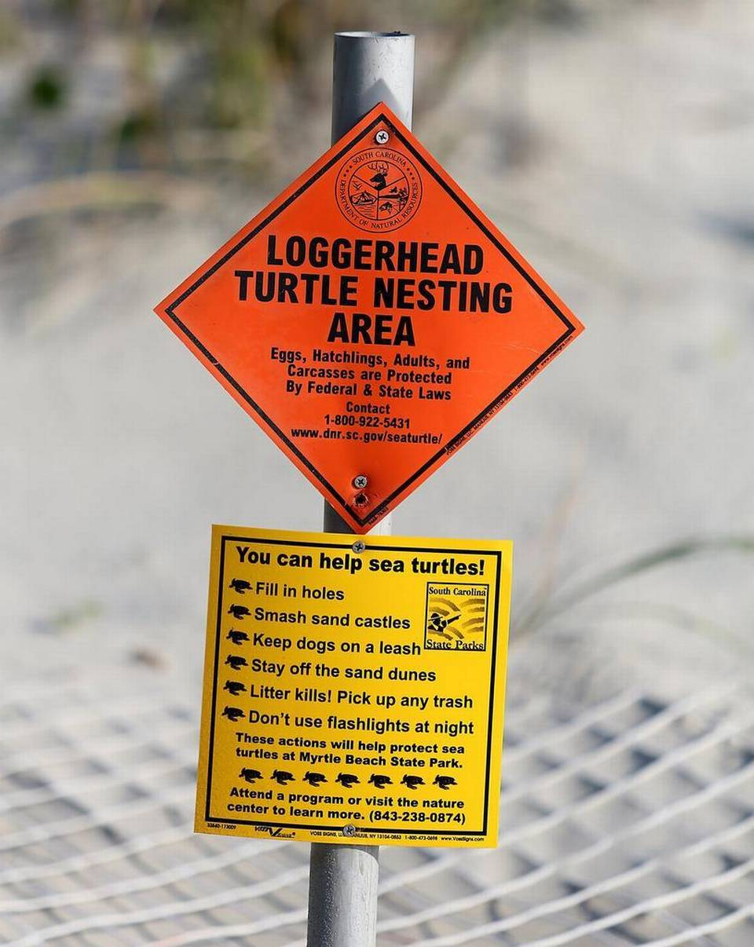
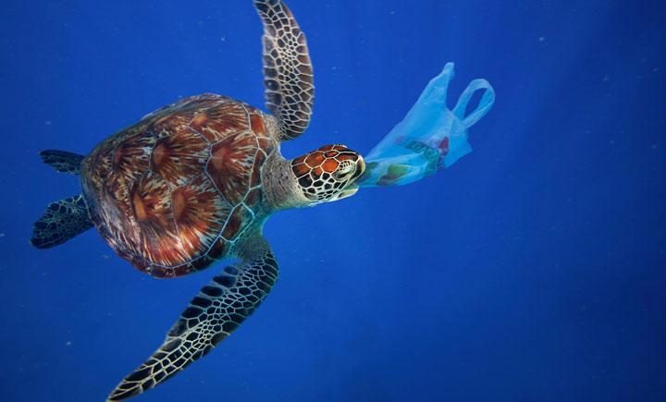
Slide 4
Researchers put up signs to inform people about turtle nesting areas and about what they can do to help protect sea turtles.
Sea turtles are at risk when they encounter plastic in the ocean.
What actions can we take to help protect sea turtles?

Slide 6
Citations
Slides 1 and 2: Photographs by Melissa Tonachel, Focus on First, 2019.
Slide 3: https://medium.com/usfws/the-trash-at-the-edge-of-the-world-47049d25e464
Slide 4: https://blogs.wwf.org.uk/blog/habitats/oceans/marine-turtles-and-plastics/;
https://www.stateparks.org/sc-sea-turtles-finding-sc-beaches-more-often-for-nesting/

