Slide 1
Works of Art:
Animals in their Habitats
Studios Week 4

Slide 2
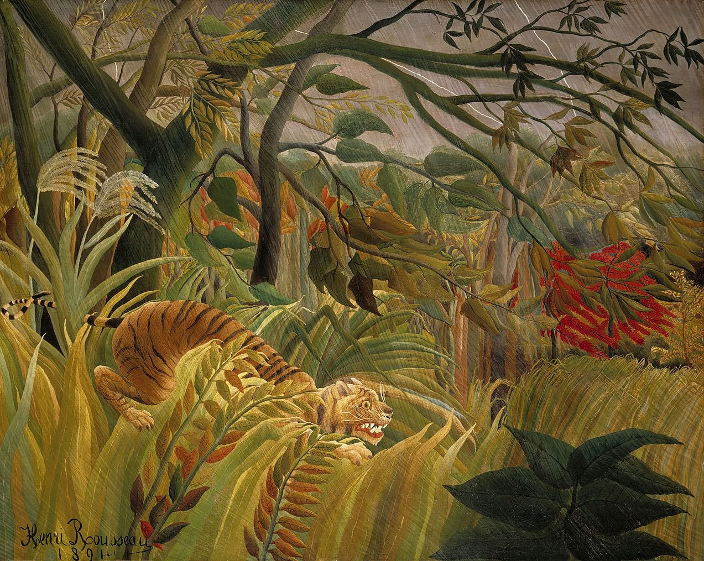
Surprised! (also known as Tiger in a Tropical Storm), Henri Rousseau, France (1891)

Slide 3
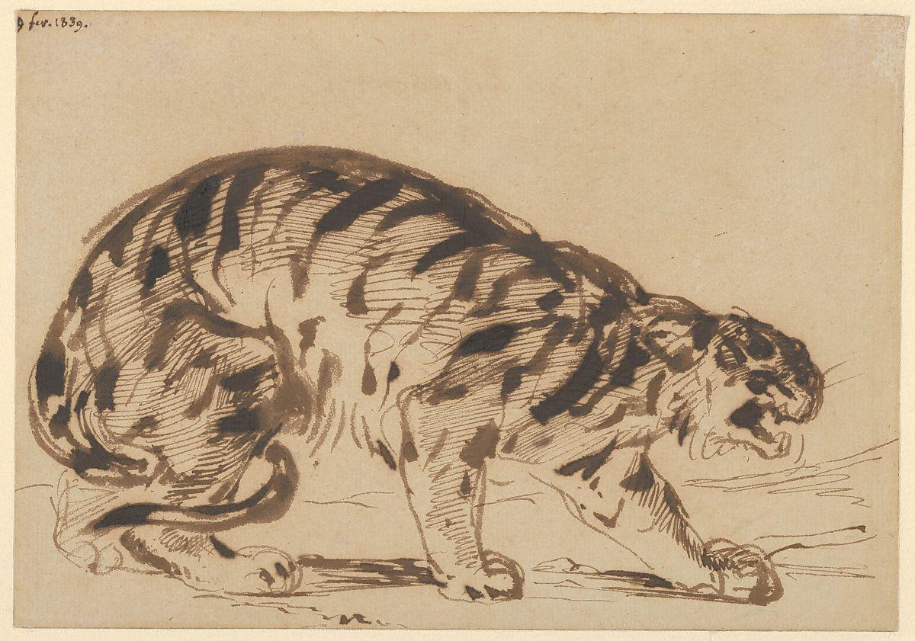
Crouching Tiger, Eugene Delacroix, France (1839)

Slide 4
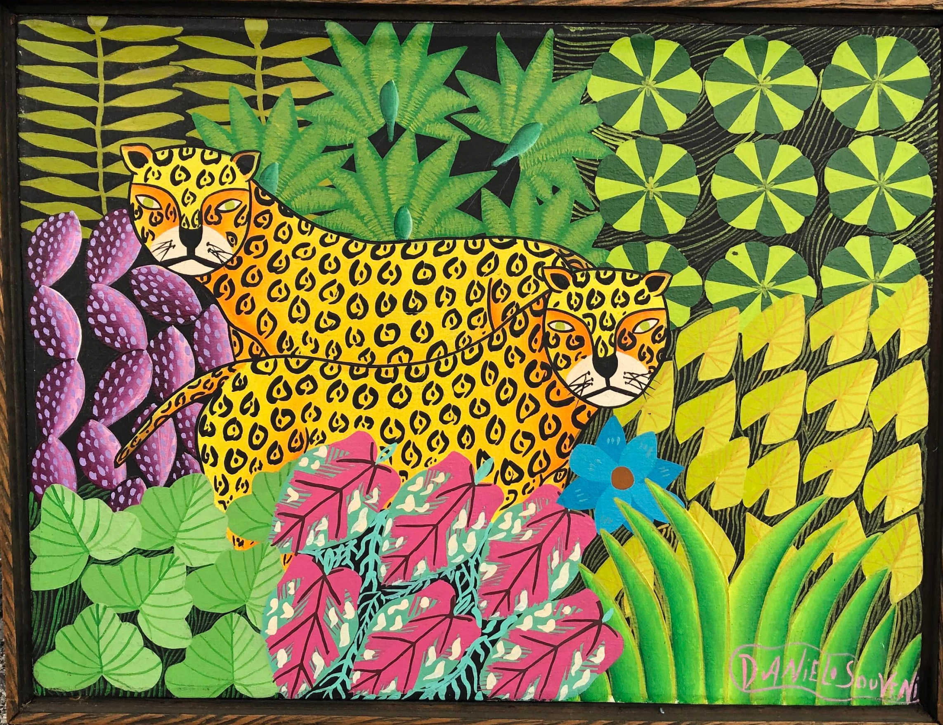
Leopards in a Jungle, Daniel Souvenir, Haiti (contemporary)

Slide 5
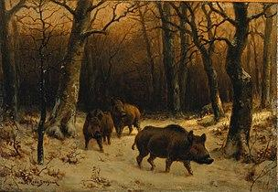
Wild boars in the snow, Rosa Bonheur, France (1870)

Slide 6
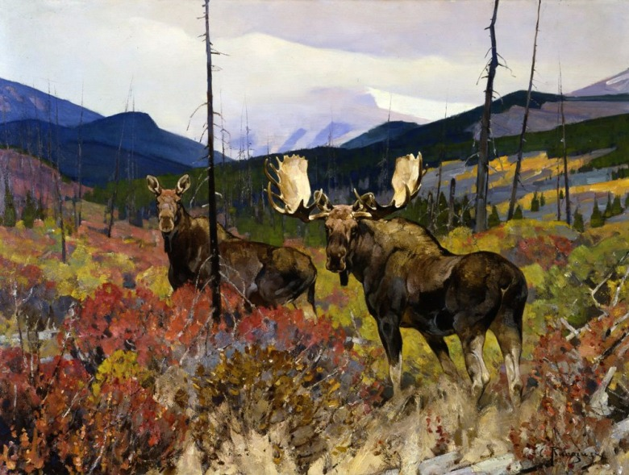
Upper Ram River Valley, Carl Rungius, United States (1935)

Slide 7
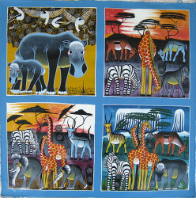
Tinga Tinga, ILO, Zimbabwe (contemporary)

Slide 8
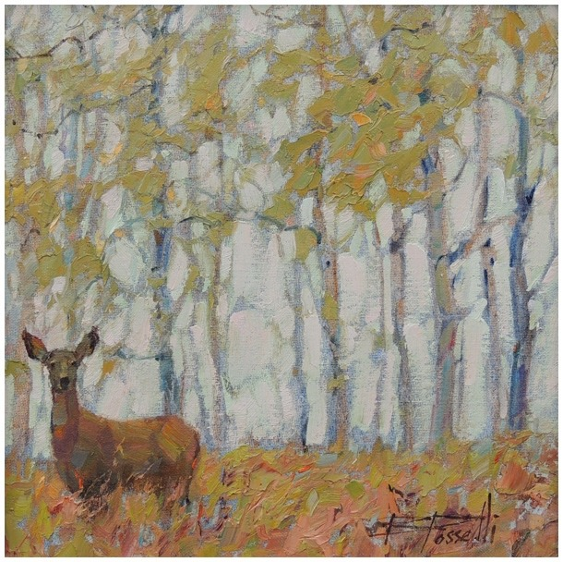
Quiet Reverie, Bonnie Posselli, United States (contemporary)

Slide 9
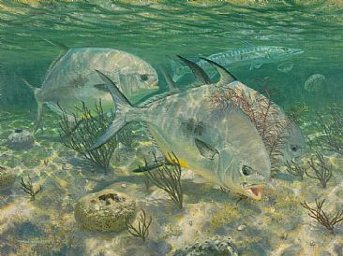
On the Fly, Mark Susinno, United States (2009)

Slide 10
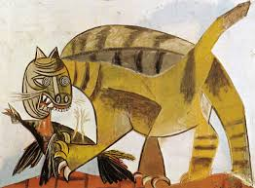
Cat Devouring a Bird, Pablo Picasso, Spain (1939)

Slide 11
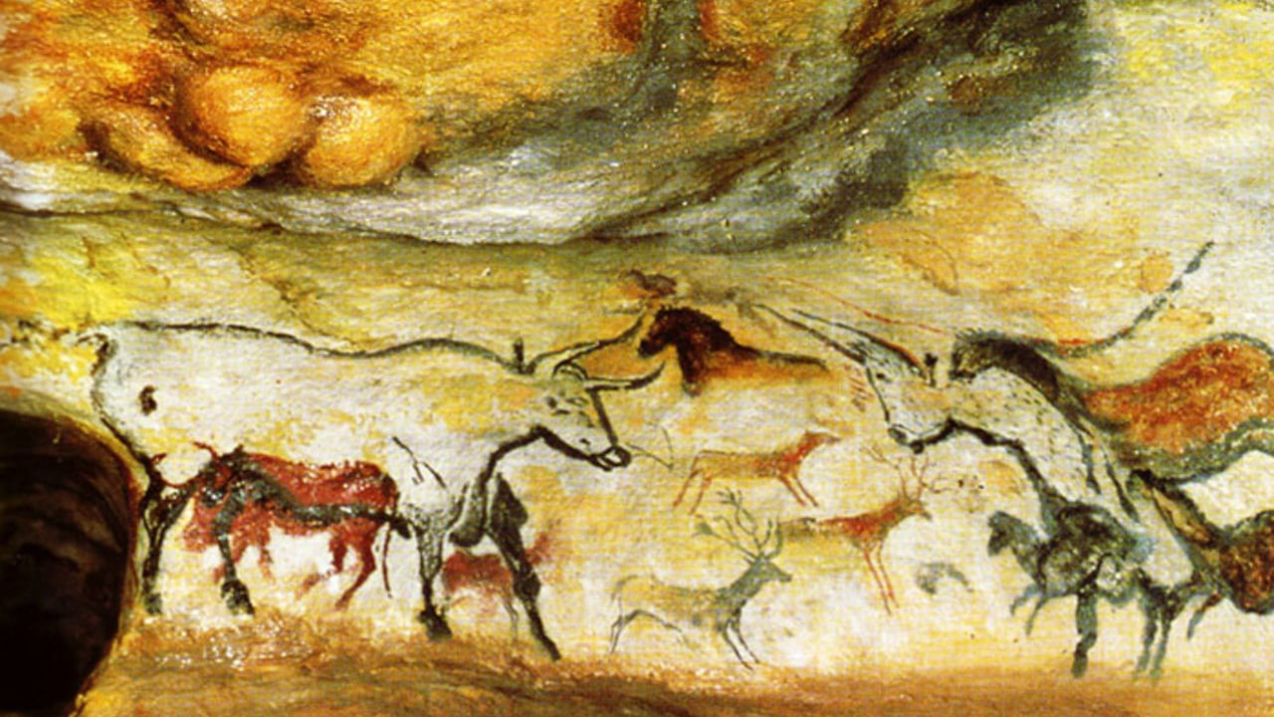
Lascaux cave painting, area now France (approximately 17,300 years ago)

Slide 12
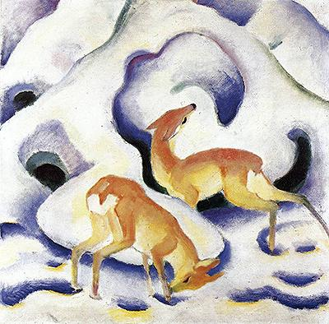
Deer in the Snow, Franz Marc, Germany (1937)

Slide 13
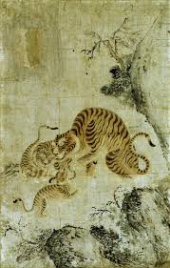
Family of Tigers, artist unknown, Korea (1600s)

Slide 14
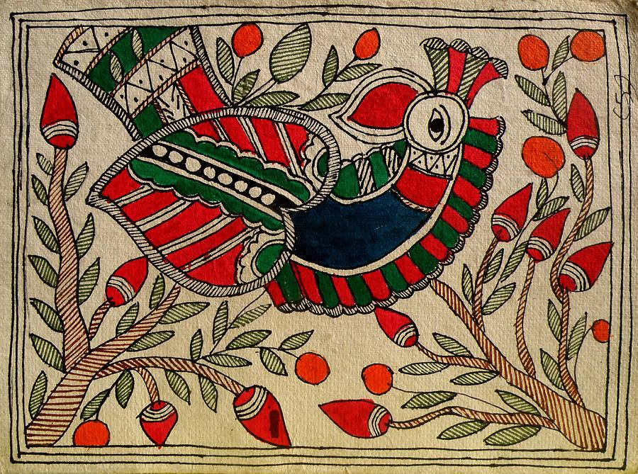
Untitled, Sarita Yadav, India (contemporary)

Slide 15
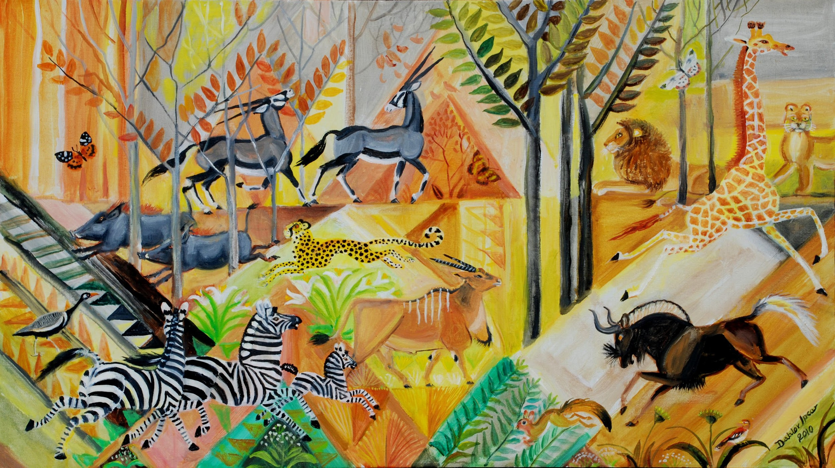
Kalahari Woodland, Dahlov Ipcar, United States (2010)

Slide 16
Citations
Surprised!: http://www.henrirousseau.net/surprised.jsp
Crouching Tiger: https://www.metmuseum.org/art/collection/search/336529
Leopards in a Jungle: https://www.chairish.com/product/1636241/20th-century-haitian-folk-art-painting-of-leopards-in-a-jungle-by-daniel-souvenir
Wild boars in the snow: https://en.wikipedia.org/wiki/Rosa_Bonheur
Upper Ram River Valley (moose): https://mountainjournal.org/nature-and-wildlife-explored-through-art
Tinga Tinga: https://insideafricanart.com/tingatinga/
Quiet Reverie (deer): https://mountainjournal.org/nature-and-wildlife-explored-through-art
On the Fly (fish): http://www.natureartists.com/artists/artist_artwork.asp?ArtistID=665&ArtworkID=21313
Cat Devouring a Bird: https://theculturetrip.com/europe/france/articles/top-10-cats-in-art/
Lascaux cave painting: https://www.zippi.co.uk/thestudio/10-famous-animal-paintings/
Deer in the Snow: http://www.franzmarc.com/deer-in-the-snow/
Family of Tigers: https://denverartmuseum.org/collections/asian-art
Madhubani (bird): https://fineartamerica.com/featured/4-madhubani-sarita-yadav.html
Kalahari Woodland: http://www.visionandartproject.org/authors-forum/dahlov-ipcar-sams%C3%B8n-projects-boston

