Slide 1
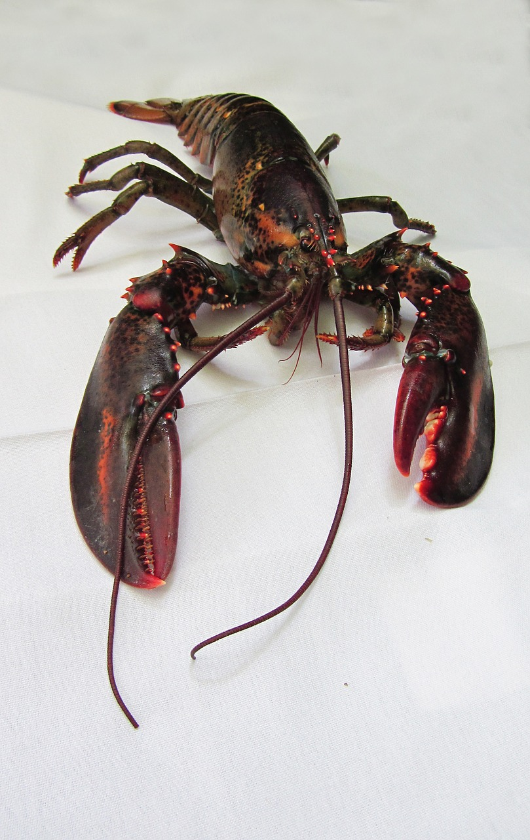
Maine Lobster
Notes:
https://umaine.edu/lobsterinstitute/educational-resources/life-cycle-reproduction/

Slide 2
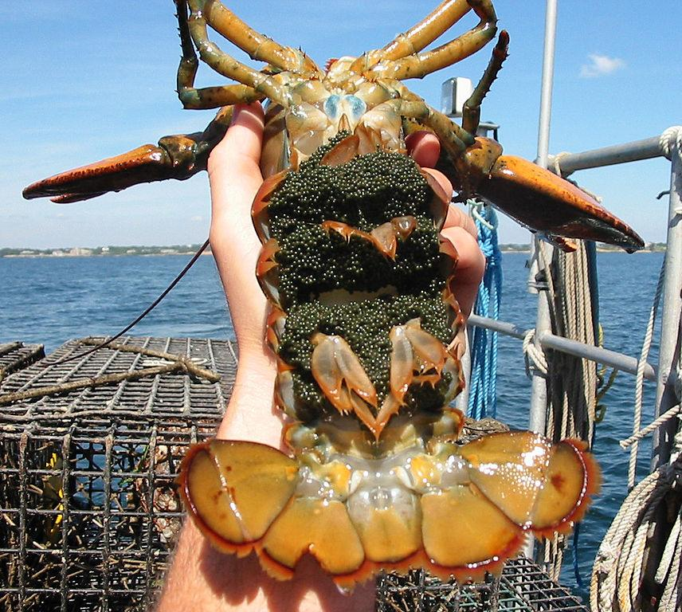
How do lobsters care for their young?
A baby lobster is about as big as
A 1-pound female lobster usually carries approximately 8,000 eggs. A 9-pound female may carry more than 100,000 eggs.
The female lobster carries the eggs inside for 9 to 12 months and then for another 9 to 12 months attached under her tail.

Slide 3
What happens after a lobster releases her eggs?
Newborn lobsters will float near the surface for 4 to 6 weeks. The female lobster no longer cares for them. They face many dangers from predators. They rely on their instincts to survive.
The baby lobsters will continue to grow. They will shed their shells, or molt 4 times as they grow.
After the fourth molt they will settle to the bottom; look for hiding places in rocks, grassy areas. From every 50,000 eggs only about 2 lobsters are expected to survive to legal size.

Slide 4
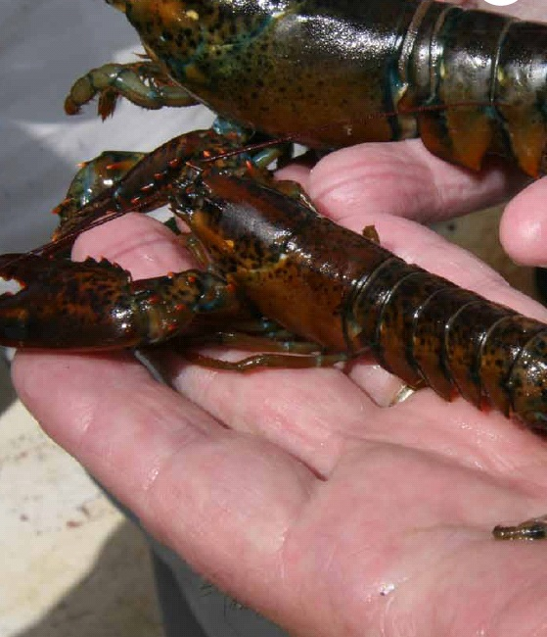
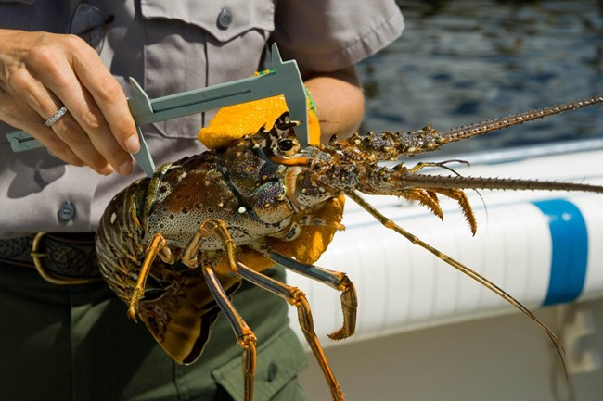
How long does it take a lobster to become an adult?
As the lobsters grow, the become more adventuresome and hide less. Their habits are similar to adult lobsters. It takes 5 to 8 years for a lobster to become an adult.

