Slide 1
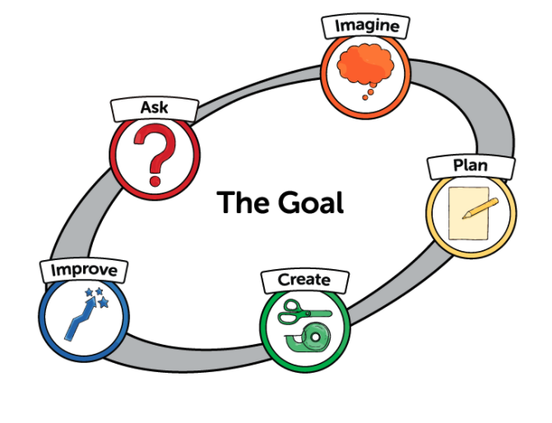
Engineering Design Process
from Engineering is Elementary®, Museum of Science, Boston

Slide 2
Ask
What is the problem?
What am I trying to accomplish?

Slide 3
Imagine and Being Inspired
What are some solutions?
Brainstorm ideas. Choose the best one.

Slide 4
Plan
Draw a diagram.
Make lists of needed materials.

Slide 5
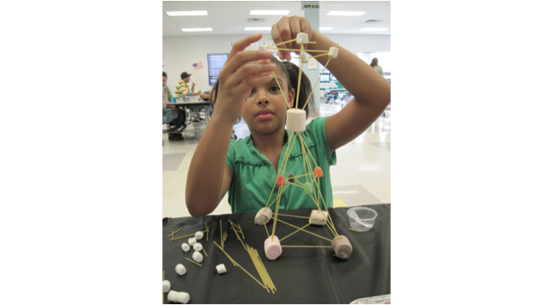
Create
Follow the plan and create something.
Test it out.

Slide 6
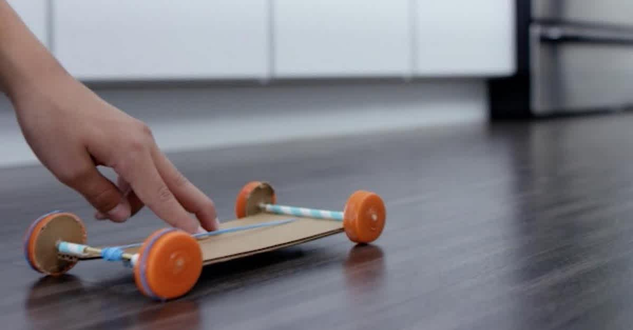
Improve
What works? What doesn't?
What could work better?
Modify the design to make it better.
Test it out.

Slide 7
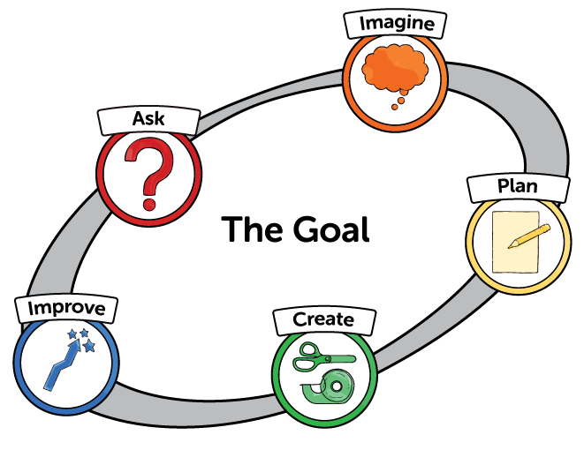
The Engineering Design Process

Slide 8
Citations
Slides 1 & 7: https://www.eie.org/why-eie
Slide 2: https://theconversation.com/kids-may-need-more-help-finding-answers-to-their-questions-in-the-information-age-126911
Slide 3: https://dailyparent.com/articles/10-ways-to-spark-your-childs-imagination-video/
Slide 4: https://www.readingrockets.org/looking-at-writing/pre-k-writing-sample-4
Slide 5: https://www.4cforkids.org/building-with-gum-drops/
Slide 6: https://littlethings.com/home/diy-rubberband-car

