Slide 1
Coats on Animals

Slide 2
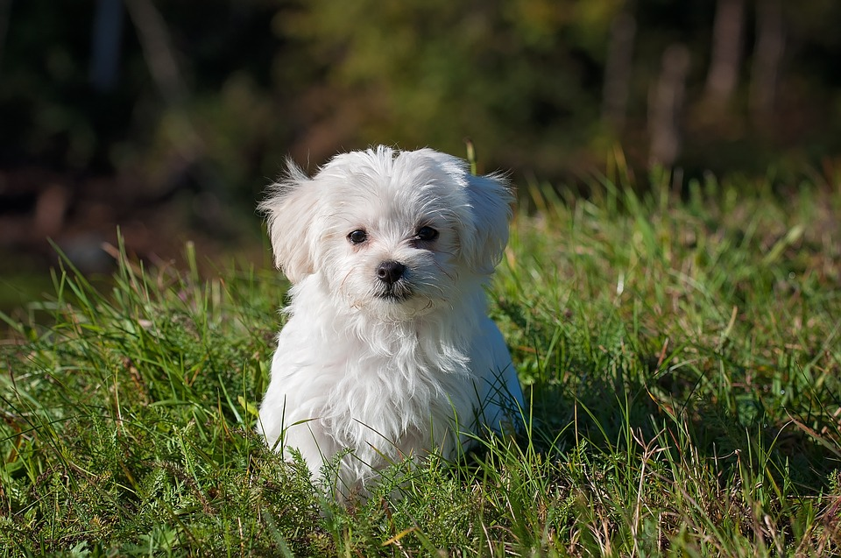

Slide 3
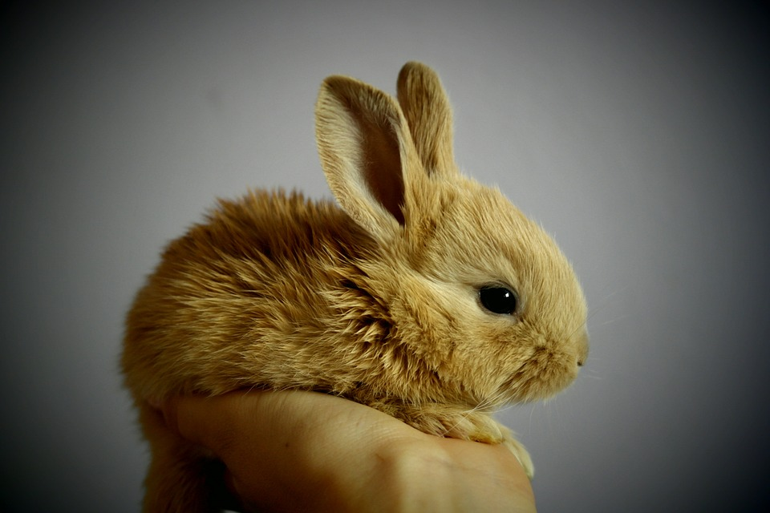

Slide 4
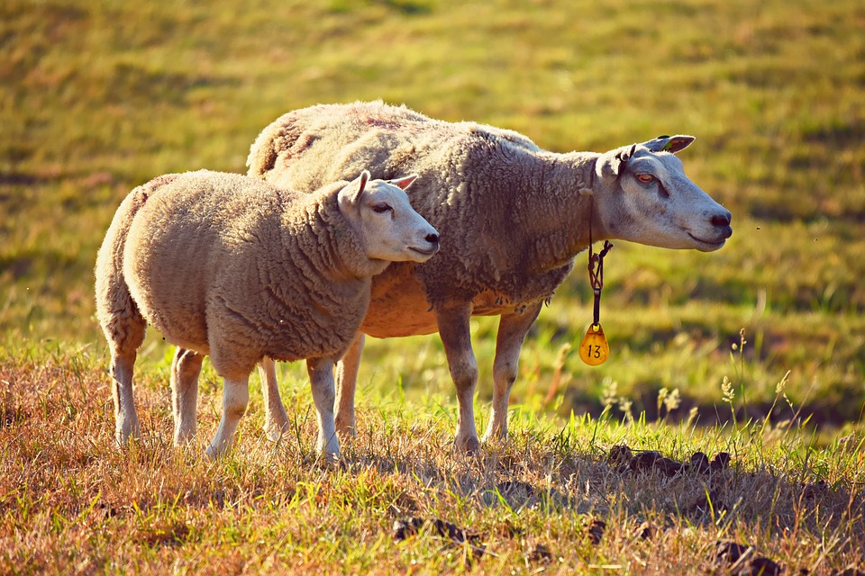

Slide 5
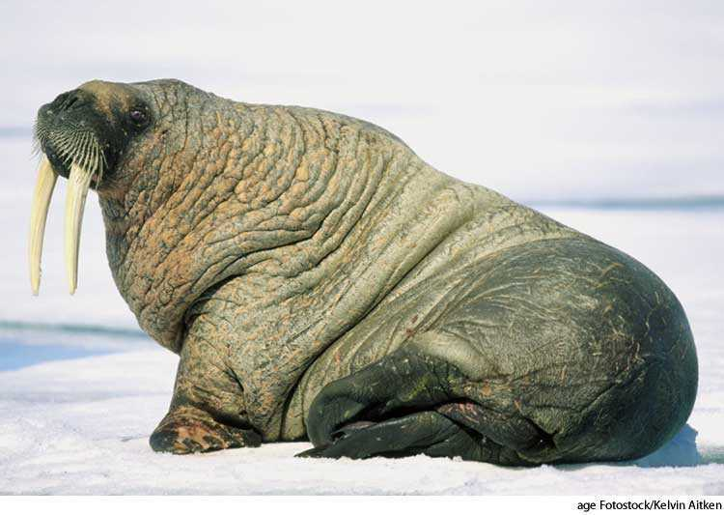

Slide 6
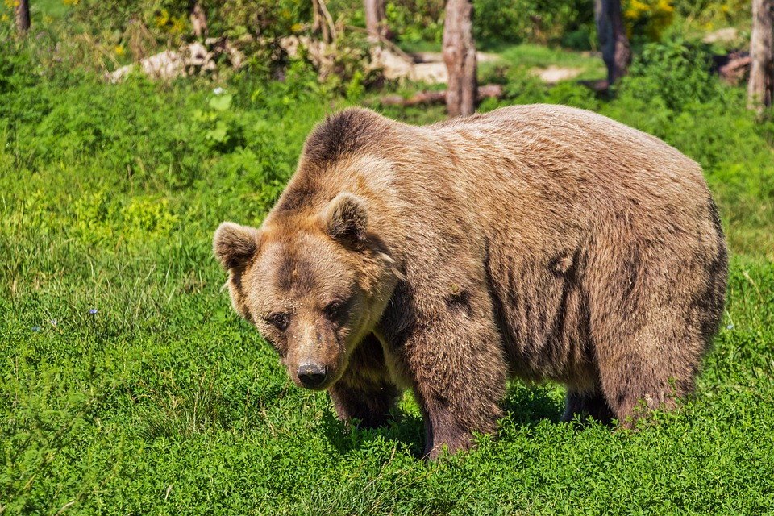

Slide 7
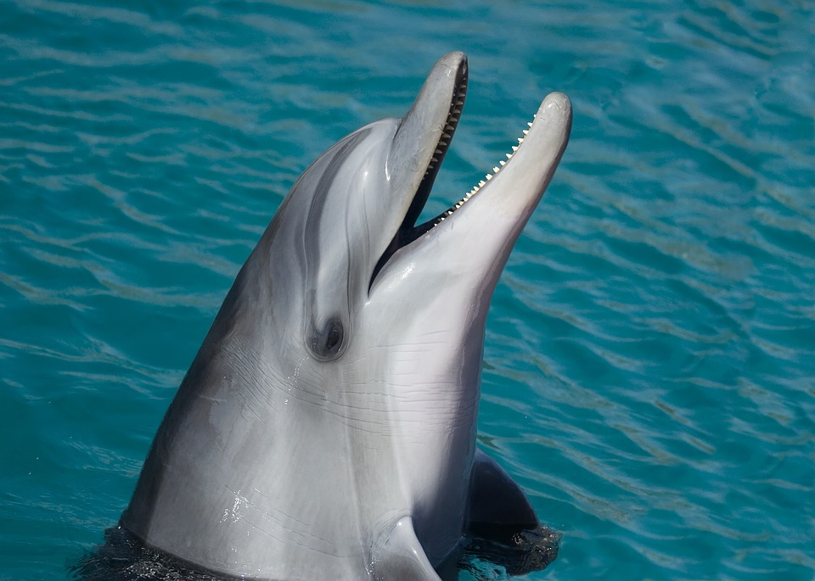

Slide 8
What is the same about all these animals coats?
What is different about their coats?

Slide 9
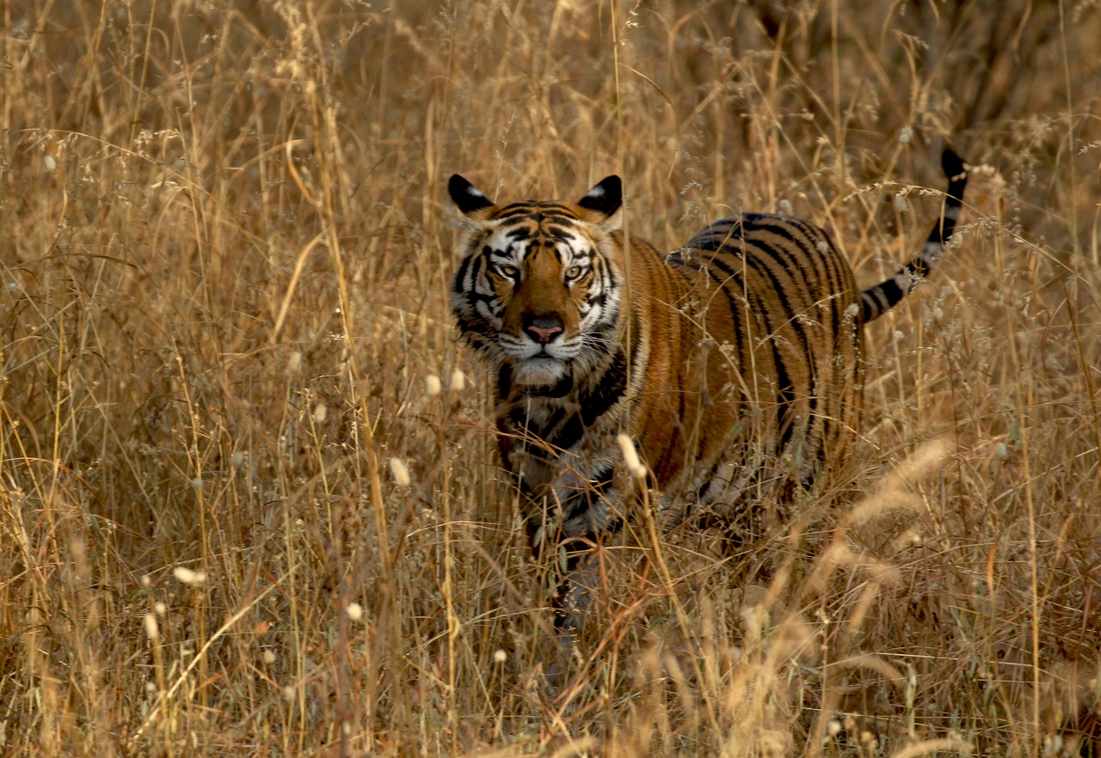
Tiger

Slide 10
How does the tiger’s coat provide protection? Do people use coats for a similar purpose?

Slide 11
Lesson 2: How we use coats

Slide 12
Do you remember some of the coats that animals have?

Slide 13
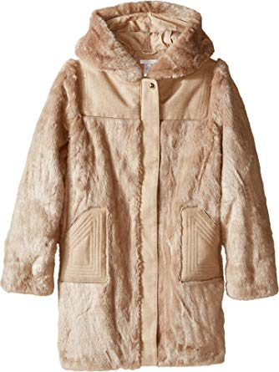
What does this coat remind you of?
When would you use this coat?
Image from: https://www.amazon.com/Chloe-Kids-Girls-Hooded-Beige/dp/B01F7VF3IA

Slide 14
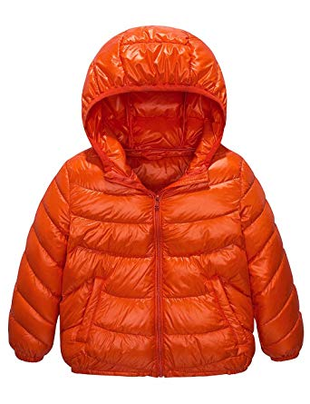
What does this coat remind you of?
When would you use this coat?
Image from: https://www.amazon.com/Spring-Gege-Packable-Lightweight-Windproof/dp/B078WQSFFM/ref=pd_lpo_sbs_193_img_1?_encoding=UTF8&refRID=90N9EV3TFE03KBGZFBE2

Slide 15
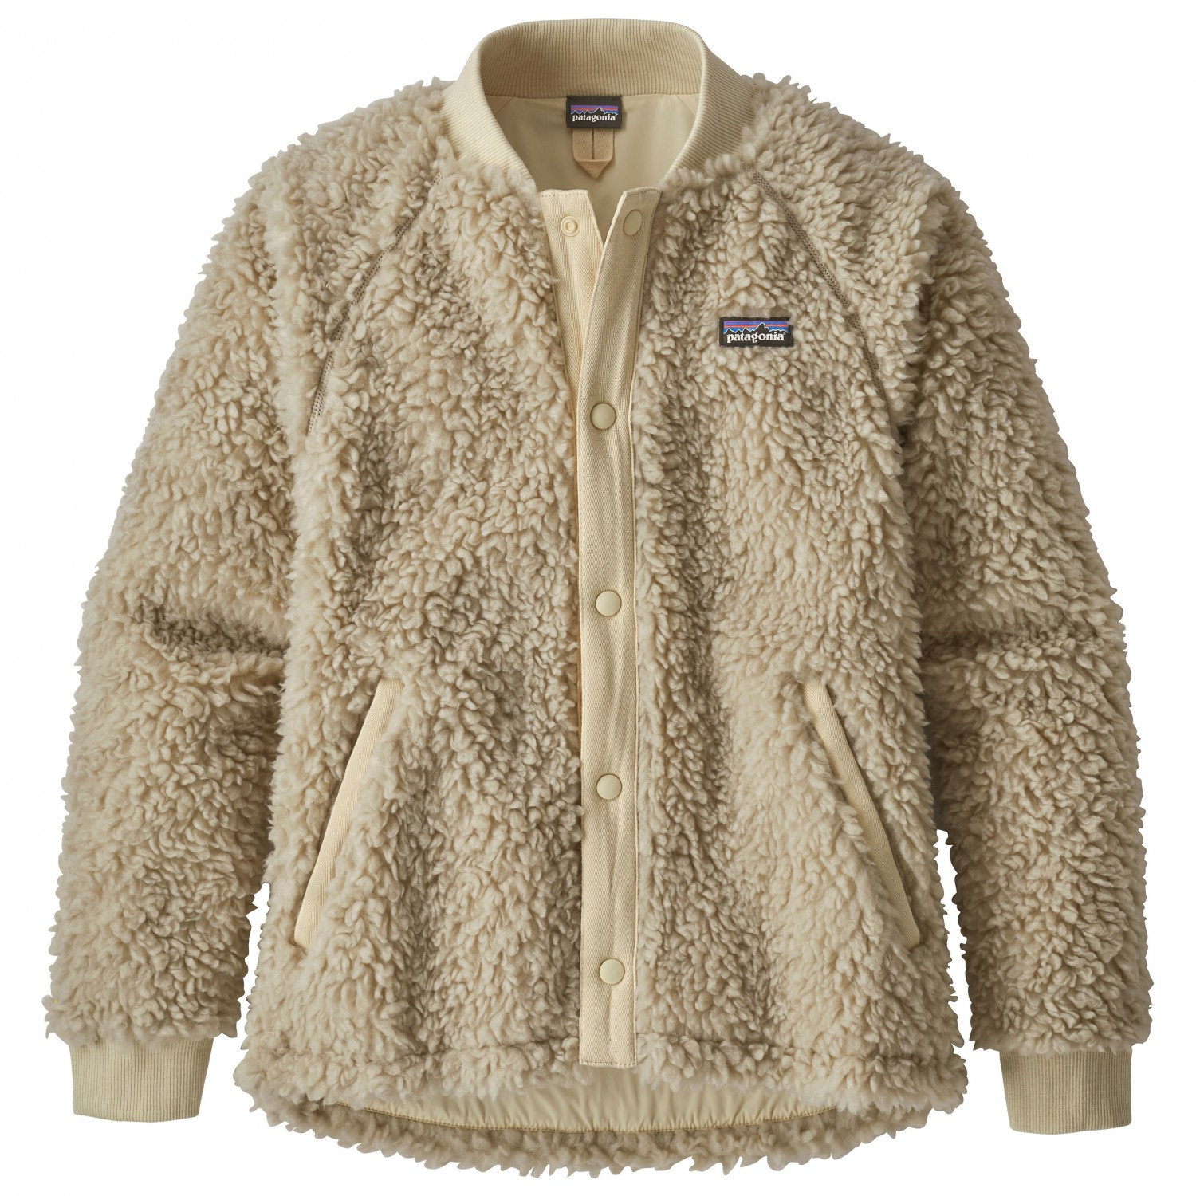
What does this coat remind you of?
When would you use this coat?
Image from: https://www.bergfreunde.eu/patagonia-kids-retro-x-bomber-jacket-fleece-jacket/

Slide 16
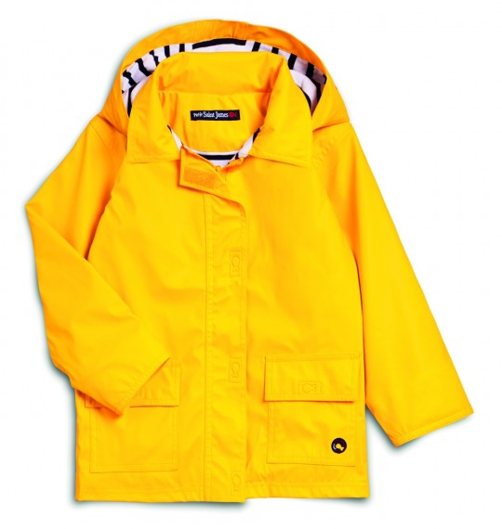
What does this coat remind you of?
When would you use this coat?
Image from: https://www.saint-james.com/us/breton-clothing-classics/breton-classics-kids/lulu-yellow-raincoat-for-kids.html

Slide 17
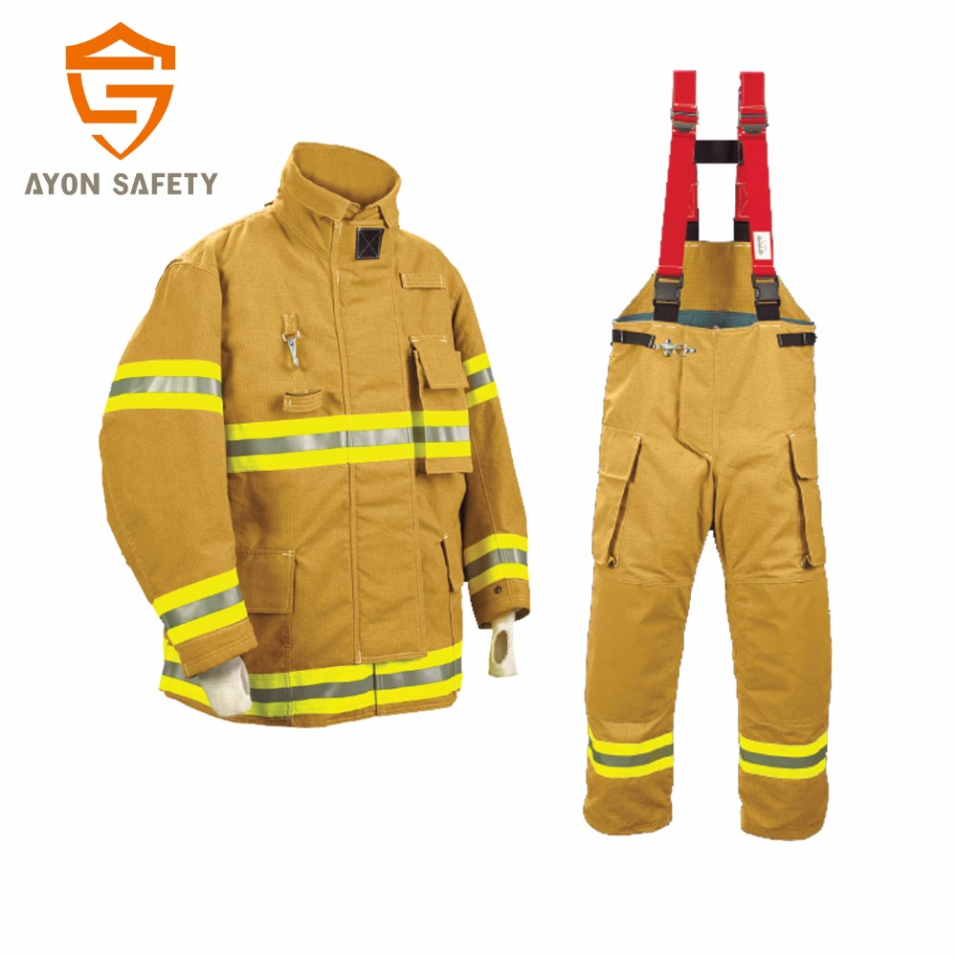

Slide 18
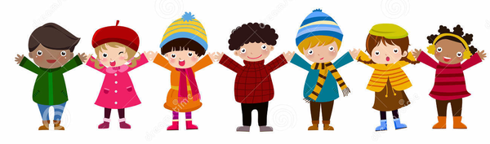
Line Up Game!
Compare your coat with your partners.
Does it remind you of an animal’s coat?
Image from: https://www.clker.com/clipart-738733.html

Slide 19
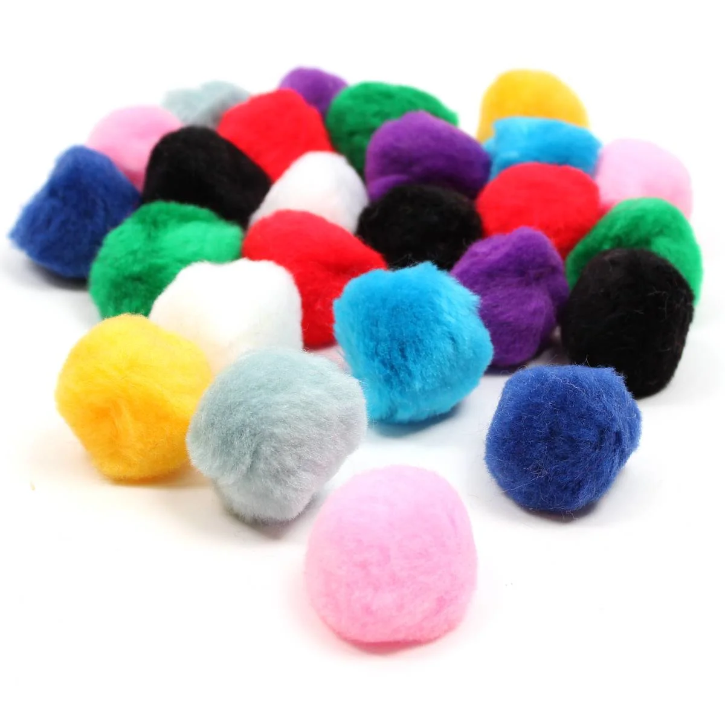
Design a “coat” for your Pom-Pom
Use the materials your teacher has to create a coat for your pom-pom creature!
What material do you want to use?
What shape do you want to make the coat?

