Slide 1
Types of Scientists

Slide 2
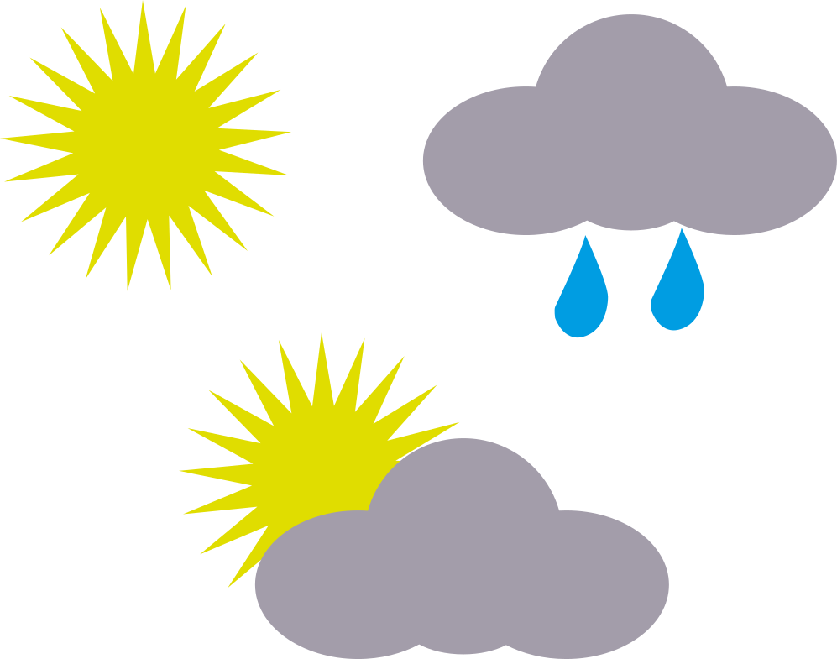
Meteorologist

Slide 3
Chemist

Slide 4
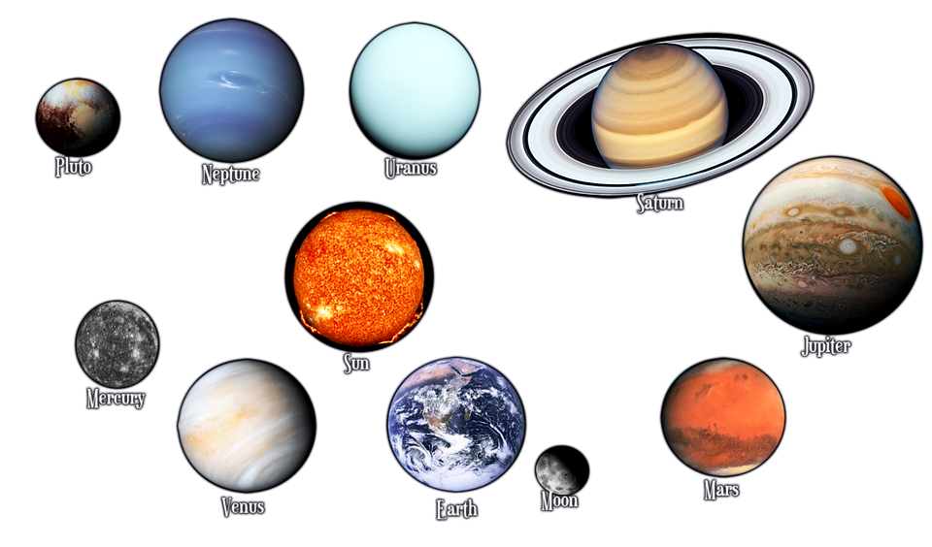
Astronomer

Slide 5
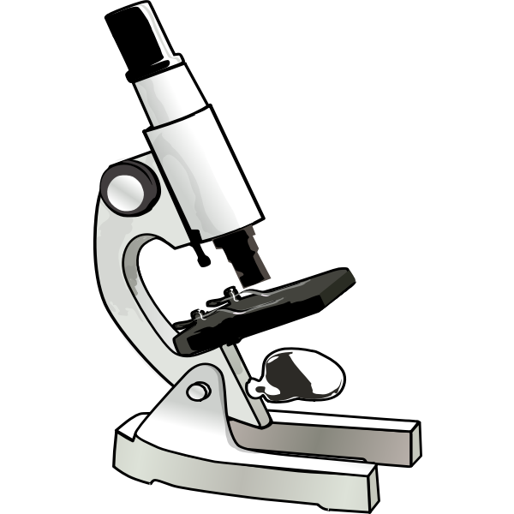
Microbiologist

Slide 6
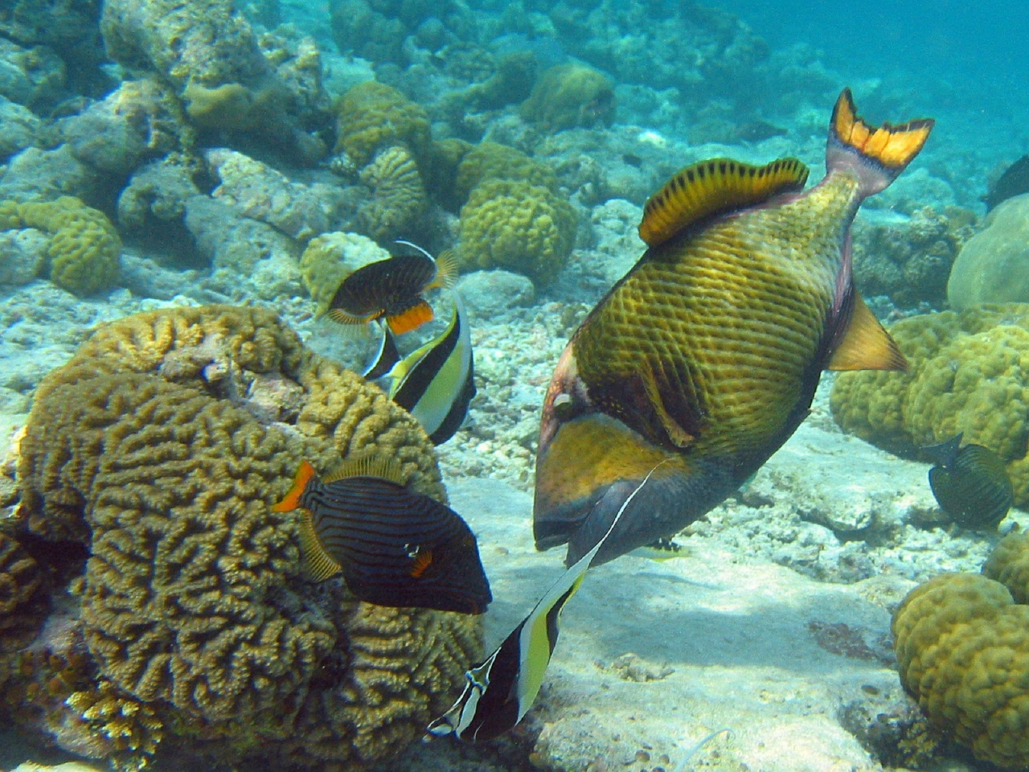
Marine Biologist

Slide 7
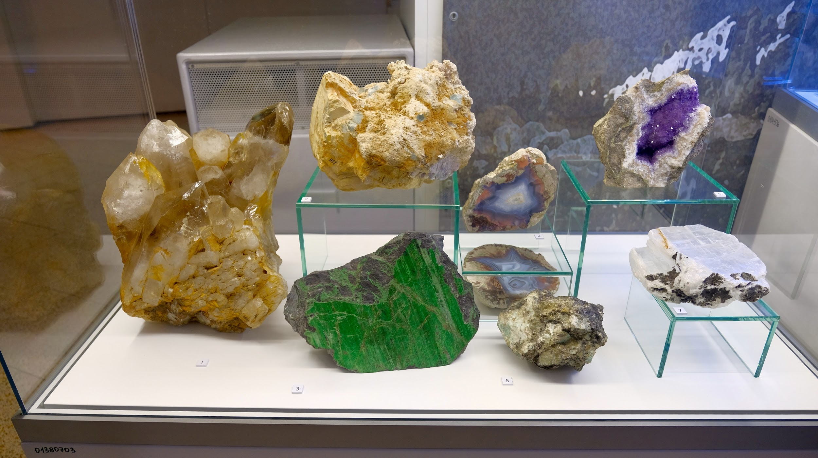
Geologist

Slide 8
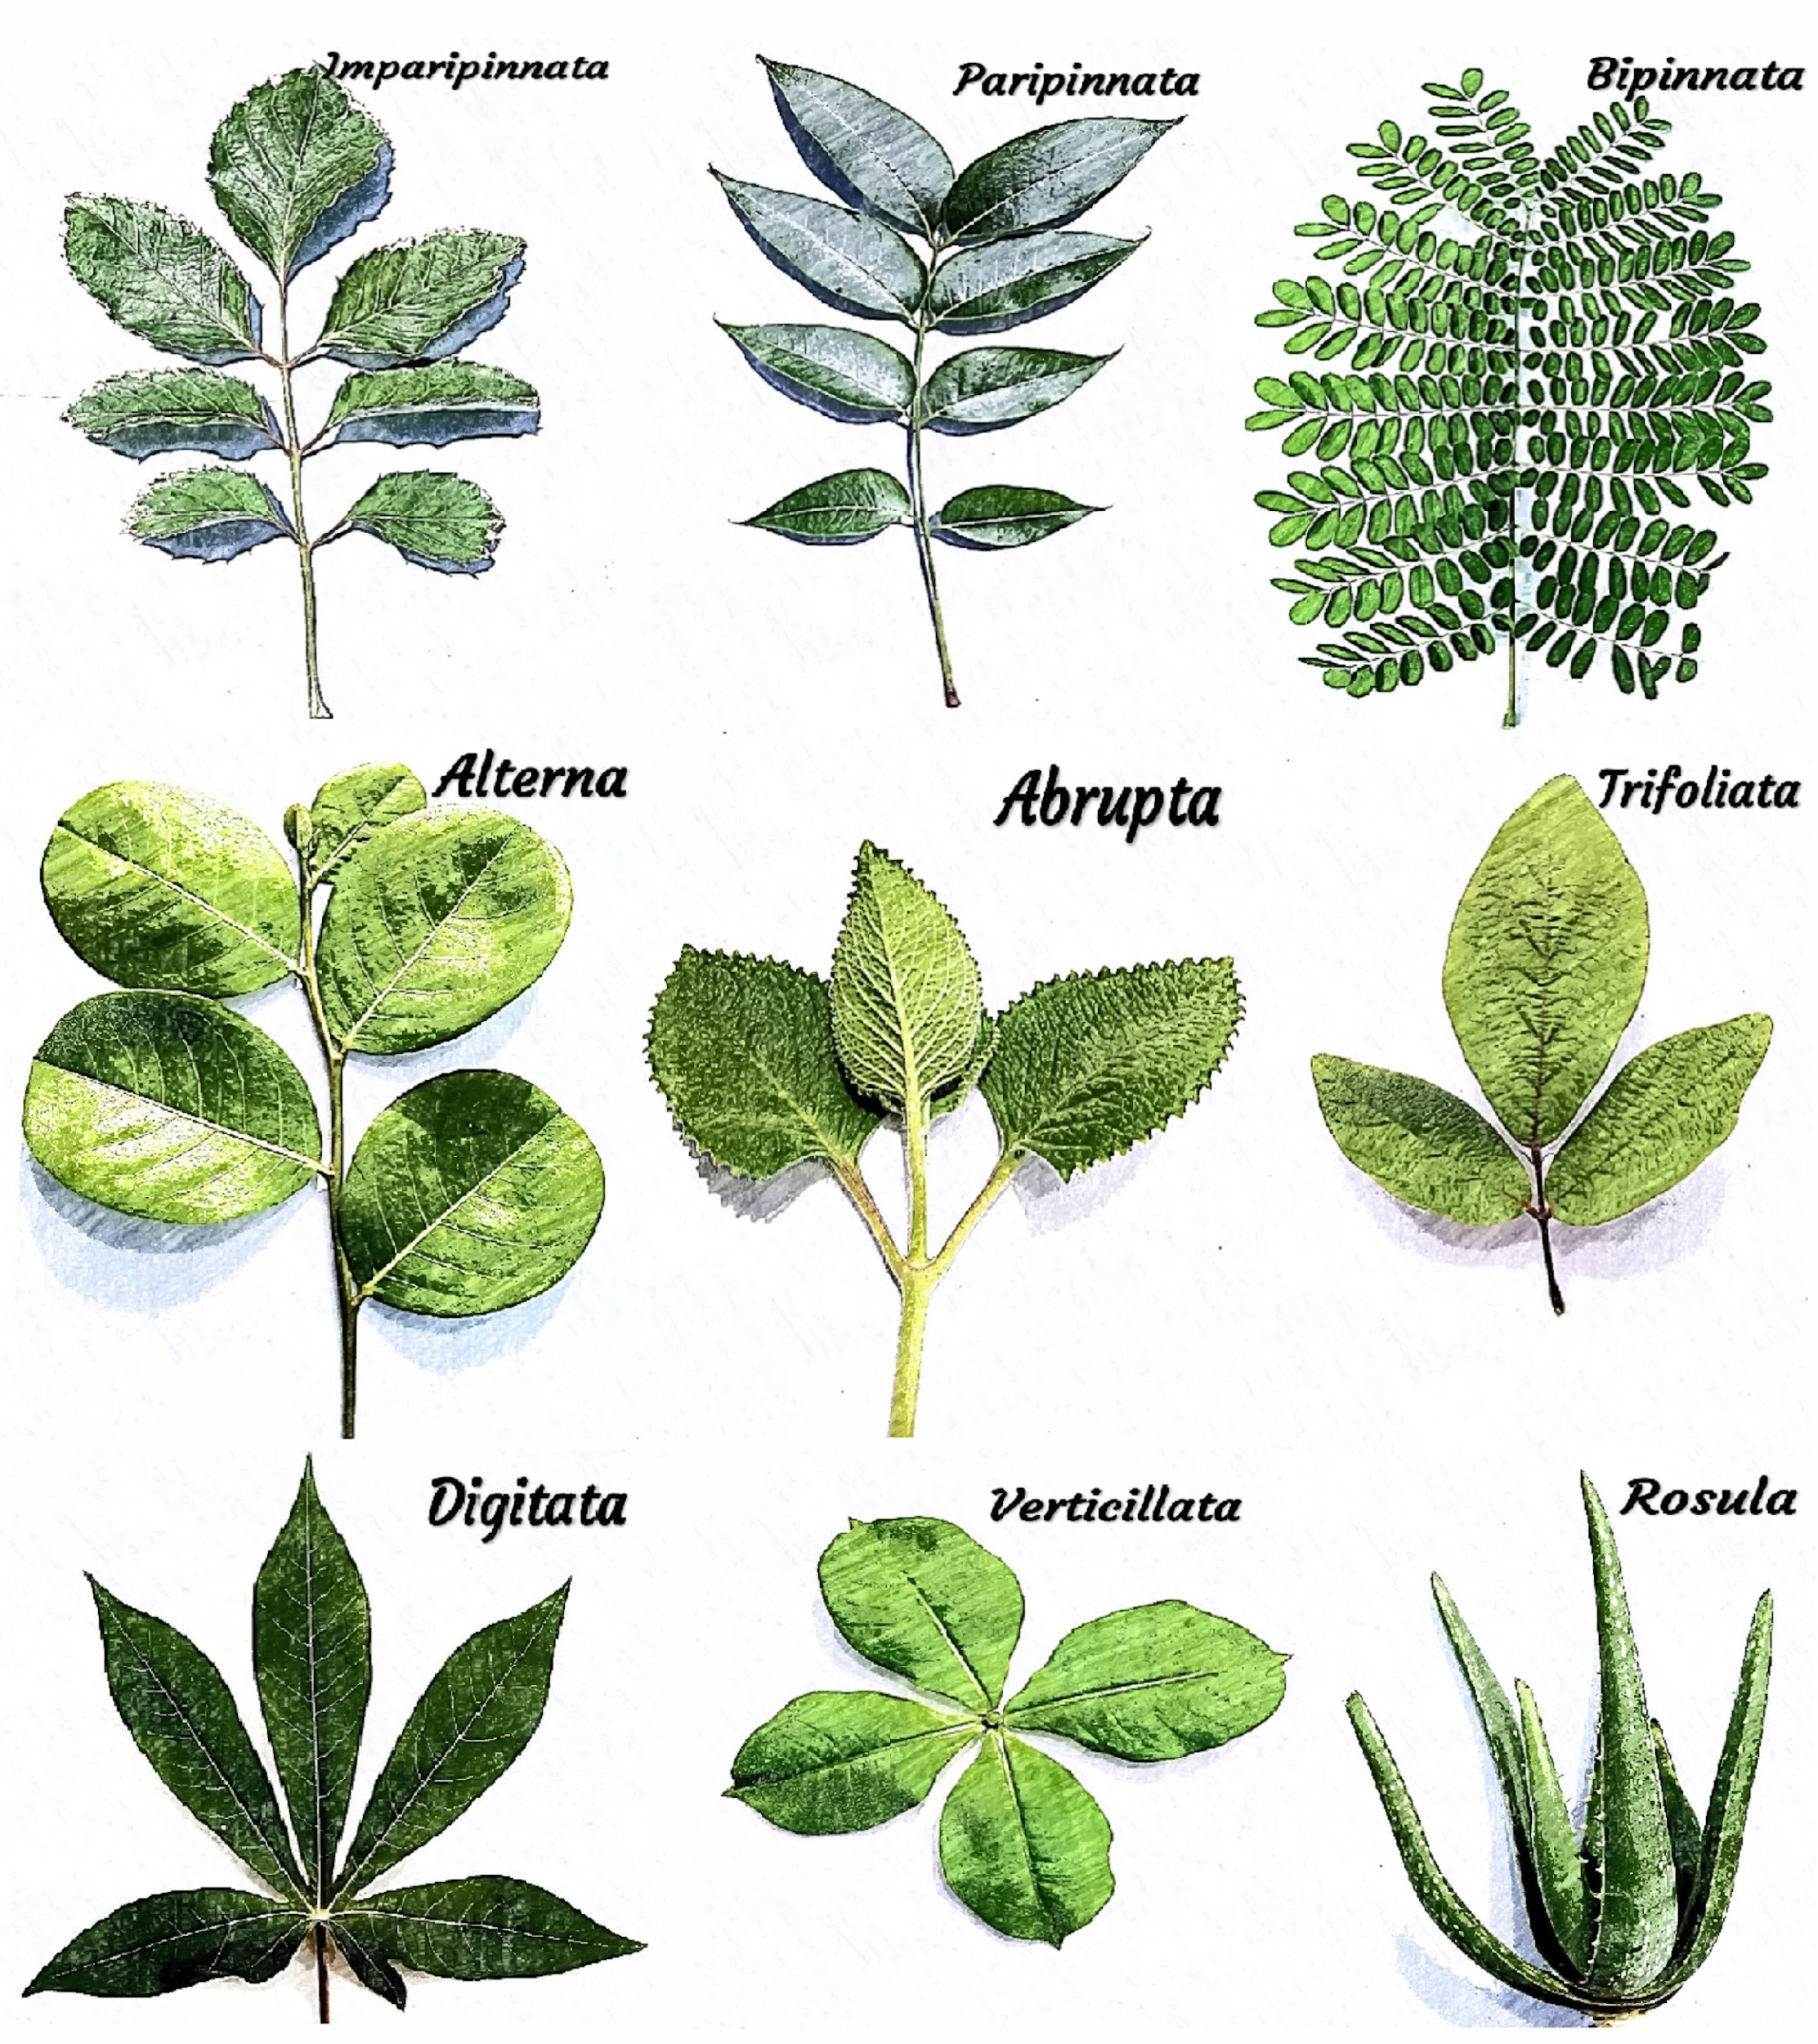
Botanist

