Slide 1
Mid-unit Assessment
Focus on First
Unit 4, Week 5

Slide 2
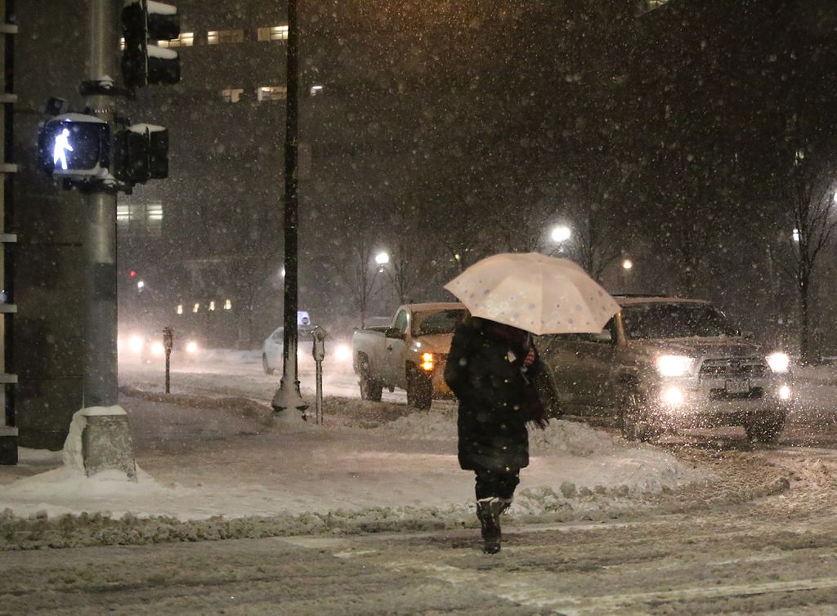
Notes:
https://www.bostonglobe.com/metro/2017/01/07/boston-can-expect-near-blizzard-conditions-with-snow-heavier-south/kajdmPdcmxy02azJyNCokJ/story.html

