Slide 1
End of Unit Assessment
Unit 2
Focus on First

Slide 2
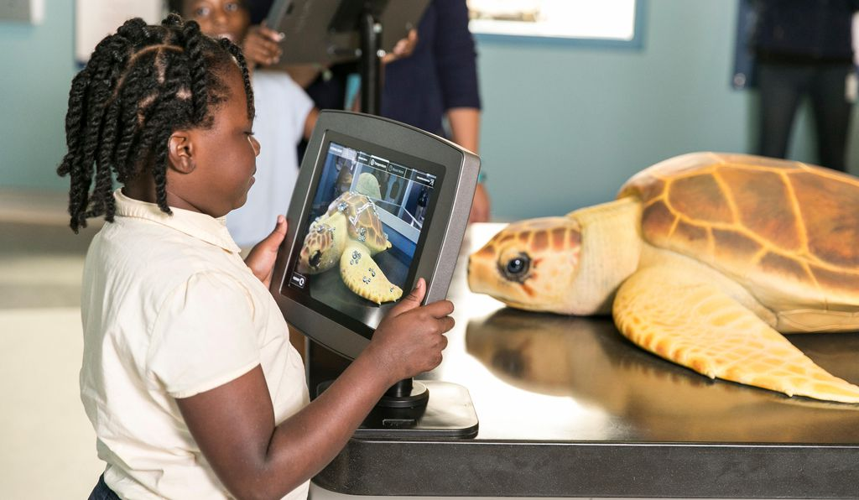
A Special Sea Turtle Hospital in South Carolina
Adapted from A State-of-the-Art Sea Turtle Hospital Welcomes Patients and Visitors in South Carolina
A visitor learns about sea turtle patients.

Slide 3
The South Carolina Aquarium Sea Turtle Care Center is a special kind of hospital. The scientists there rescue injured sea turtles and take care of them. Some sea turtles arrive after they have been hit by a boat. Some sea turtles have been bitten by a shark. Others have been hurt by eating trash in the ocean. Sea turtles that get better are sent back into the ocean so that they can be in their natural habitat with other sea turtles.

Slide 4
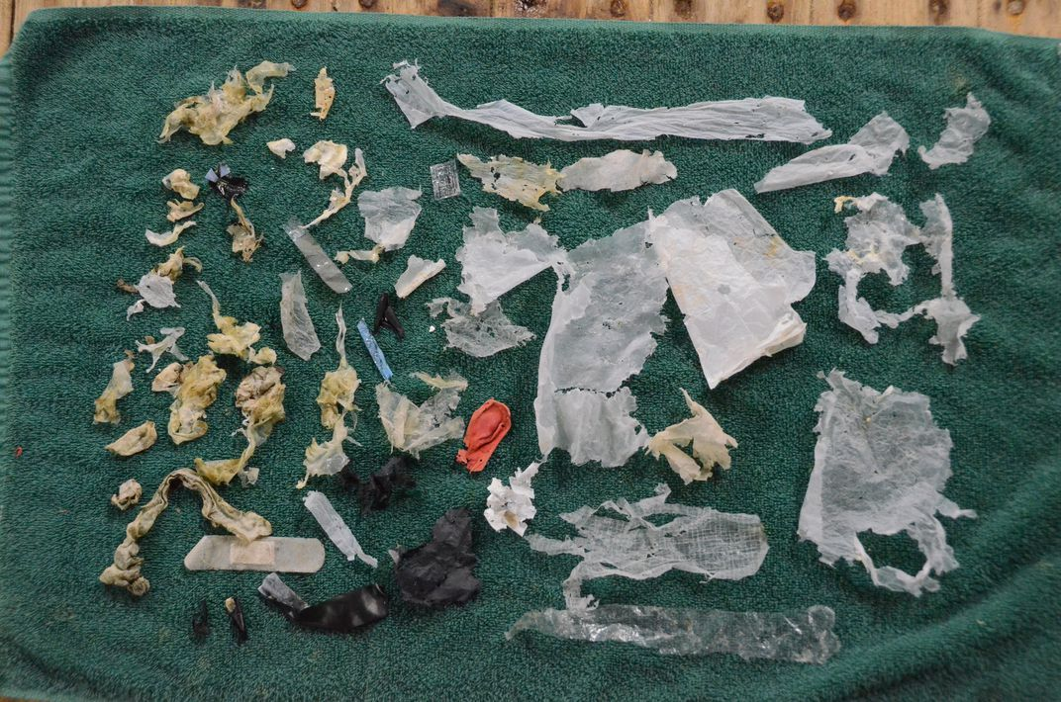
Trash is removed from a sea turtle’s stomach.

Slide 5
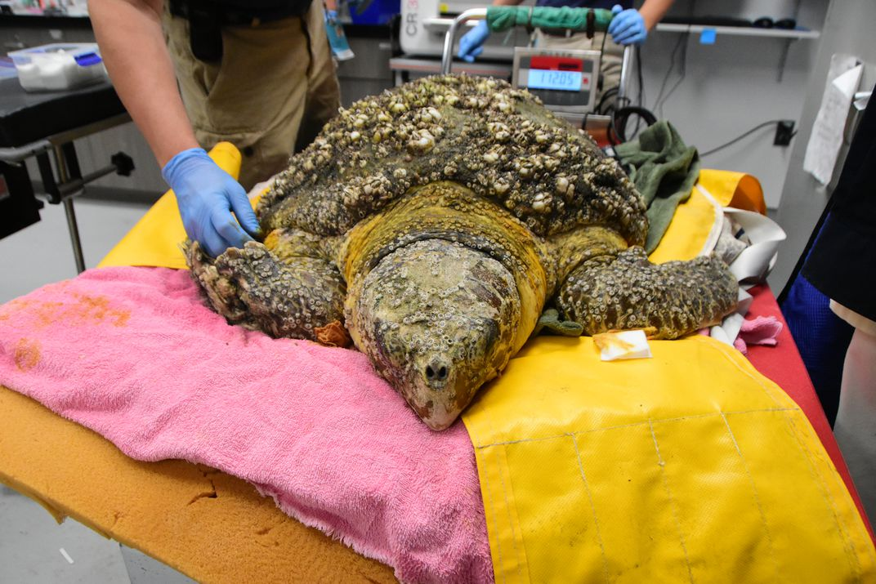
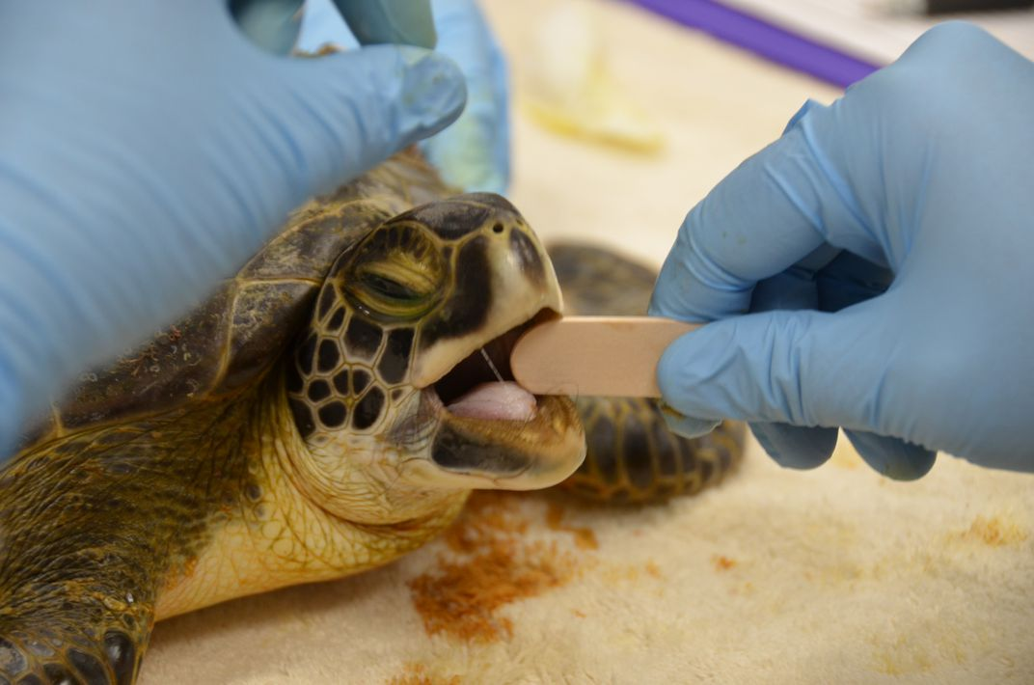
A new sea turtle patient comes to the Sea Turtle Care Center.
A sea turtle gets a check up.

Slide 6
Kelly Thorvalen is a scientist at the Sea Turtle Care Center. She says that educating visitors about sea turtles is a key part of the plan for rescuing sea turtles.
The Education Center at the hospital welcomes visitors. Children and adults observe and learn about the sea turtle patients. Visitors can pretend to be doctors in mock, or pretend, medical stations. This experience helps teach the visitors about how scientists take care of injured sea turtles. Visitors can also learn about sea turtles in a theater that shows videos about sea turtles and how to protect them. The videos also teach people about sea turtles’ lives in their natural habitat.
Some visitors even get to help send sea turtles back into the ocean once they get better!

Slide 7
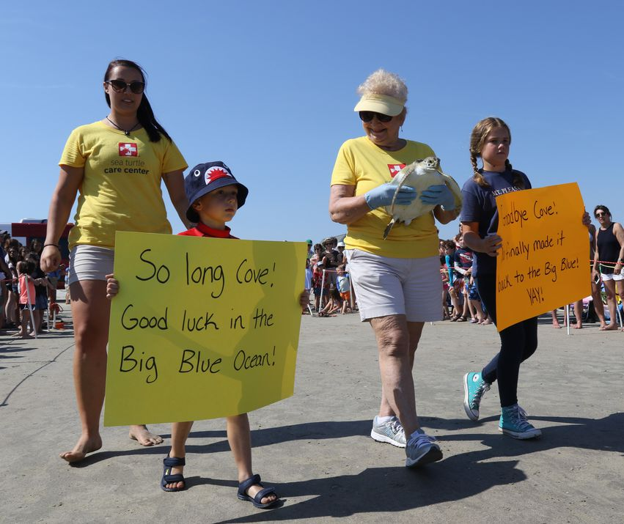
Volunteers and visitors release a healthy sea turtle back into the ocean.

Slide 8
What can visitors do at the Sea Turtle Care Center?
Why is the Sea Turtle Care Center an important place for sea turtles?
Use details from the words and photographs to support your responses.

Slide 9
Sources:
https://www.smithsonianmag.com/travel/sea-turtle-recovery-center-gives-turtles-second-chance-180963395/
http://scaquarium.org/recovery/

