Slide 1
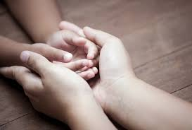
With My Own Two Hands
by Ben Harper
Shared Reading Week 8
Notes:
https://www.spectrumnews.org/news/soothing-sensory-sensitivity-may-ease-social-problems-mice/

Slide 2
I can change the world with my own two hands
Make a better place with my own two hands
Make a kinder place with my own two hands
With my own, with my own two hands

Slide 3
I can make peace on earth, with my own two hands
I can clean up the earth with my own two hands
And I can reach out to you with my own two hands
With my own, with my own two hands
With my own, with my own two hands

Slide 4
I'm gonna make it a brighter place
with my own two hands
I'm gonna make it a safer place
with my own two hands
I'm gonna help the human race
with my own two hands

Slide 5
Now I can hold you in my own two hands
And I can comfort you with my own two hands
But you got to use, use your own two hands
Use your own, use your own two hands
Use your own two hands
And with our own two hands
We’re gonna make it a brighter place

