Slide 1
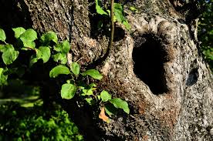
Hollow Tree Song
Sung to the tune of “Kookabura”
Shared Reading Week 8

Slide 2
Bluebird nests in a hollow tree
Watch her link sticks, one, two, three
Nest, bluebird, nest, bluebird,
Nest in the hollow tree.
Woodpecker nests in a hollow tree
Watch her yank worms, one, two, three
Nest, woodpecker, nest, woodpecker,
Nest in the hollow tree.

Slide 3
Brown bat hangs in a hollow tree
Watch her sleep, quiet as can be
Sleep, brown bat, sleep, brown bat,
Sleep in the hollow tree.
Chipmunk rests in a hollow tree
Watch her sleep, still as can be
Sleep, chipmunk, sleep, chipmunk,
Sleep in the hollow tree.

Slide 4
Insert a child’s name here:
__________________ plays in a hollow tree
While she/he sings with joy and glee.
Play, _________________, play, _________________,
Play in the hollow tree.

