Slide 1
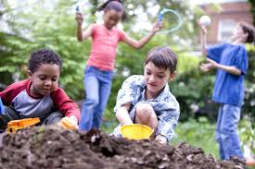
Friends Together
Sung to the tune of “Mary Had a Little Lamb”
Shared Reading Week 8

Slide 2
Will you be a friend with me, friend with me, friend with me?
Will you be a friend with me and have some fun together?
Will you be a friend with me and toss a ball together?
Will you be a friend with me and make some art together?
Will you be a friend with me and make a mess together?
Will you be a friend with me and tell some jokes together?
Will you be a friend with me, friend with me, friend with me?
Will you be a friend with me and have some fun together?

