Slide 1
End of Unit Assessment
Focus on First
Unit 3, Week 8

Slide 2
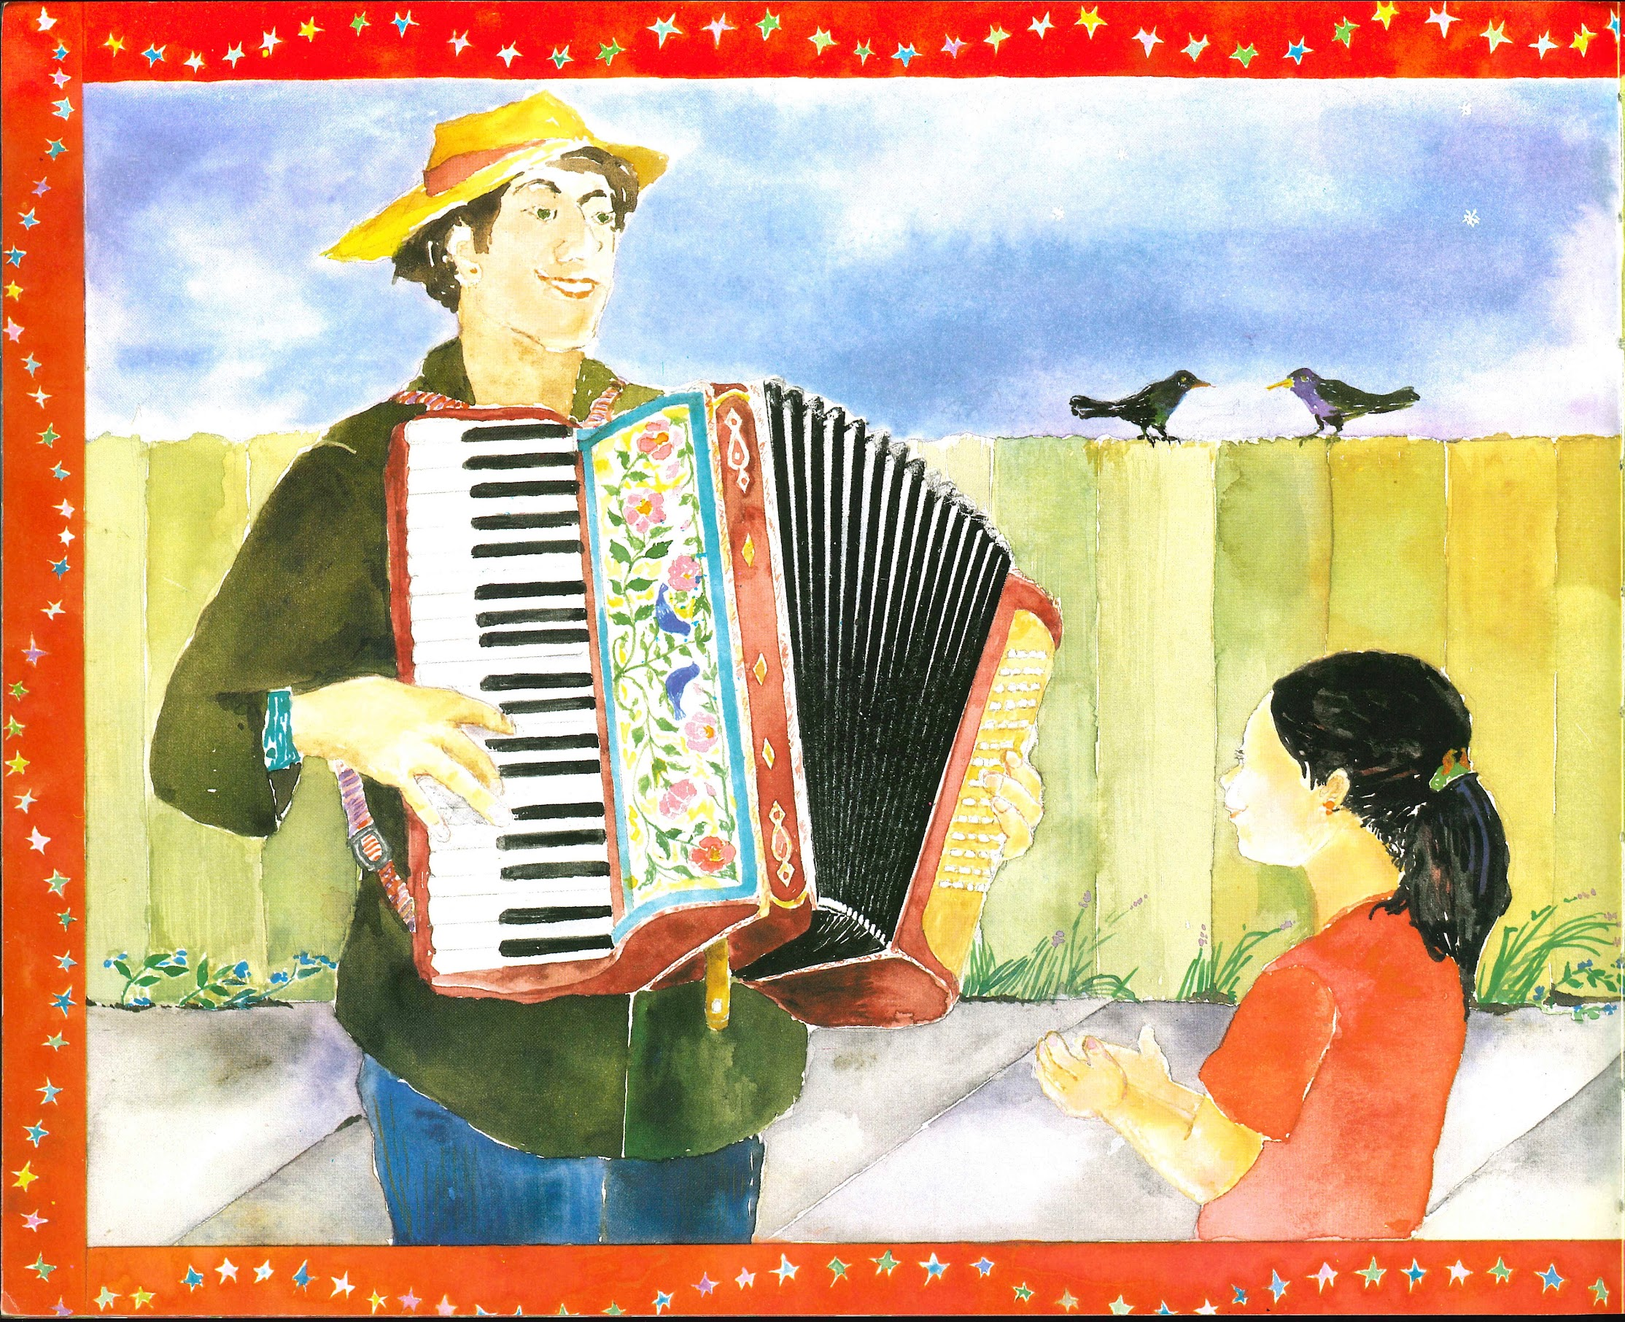
Slide 2

Slide 3
Slide 3

Slide 4
Slide 4

Slide 5
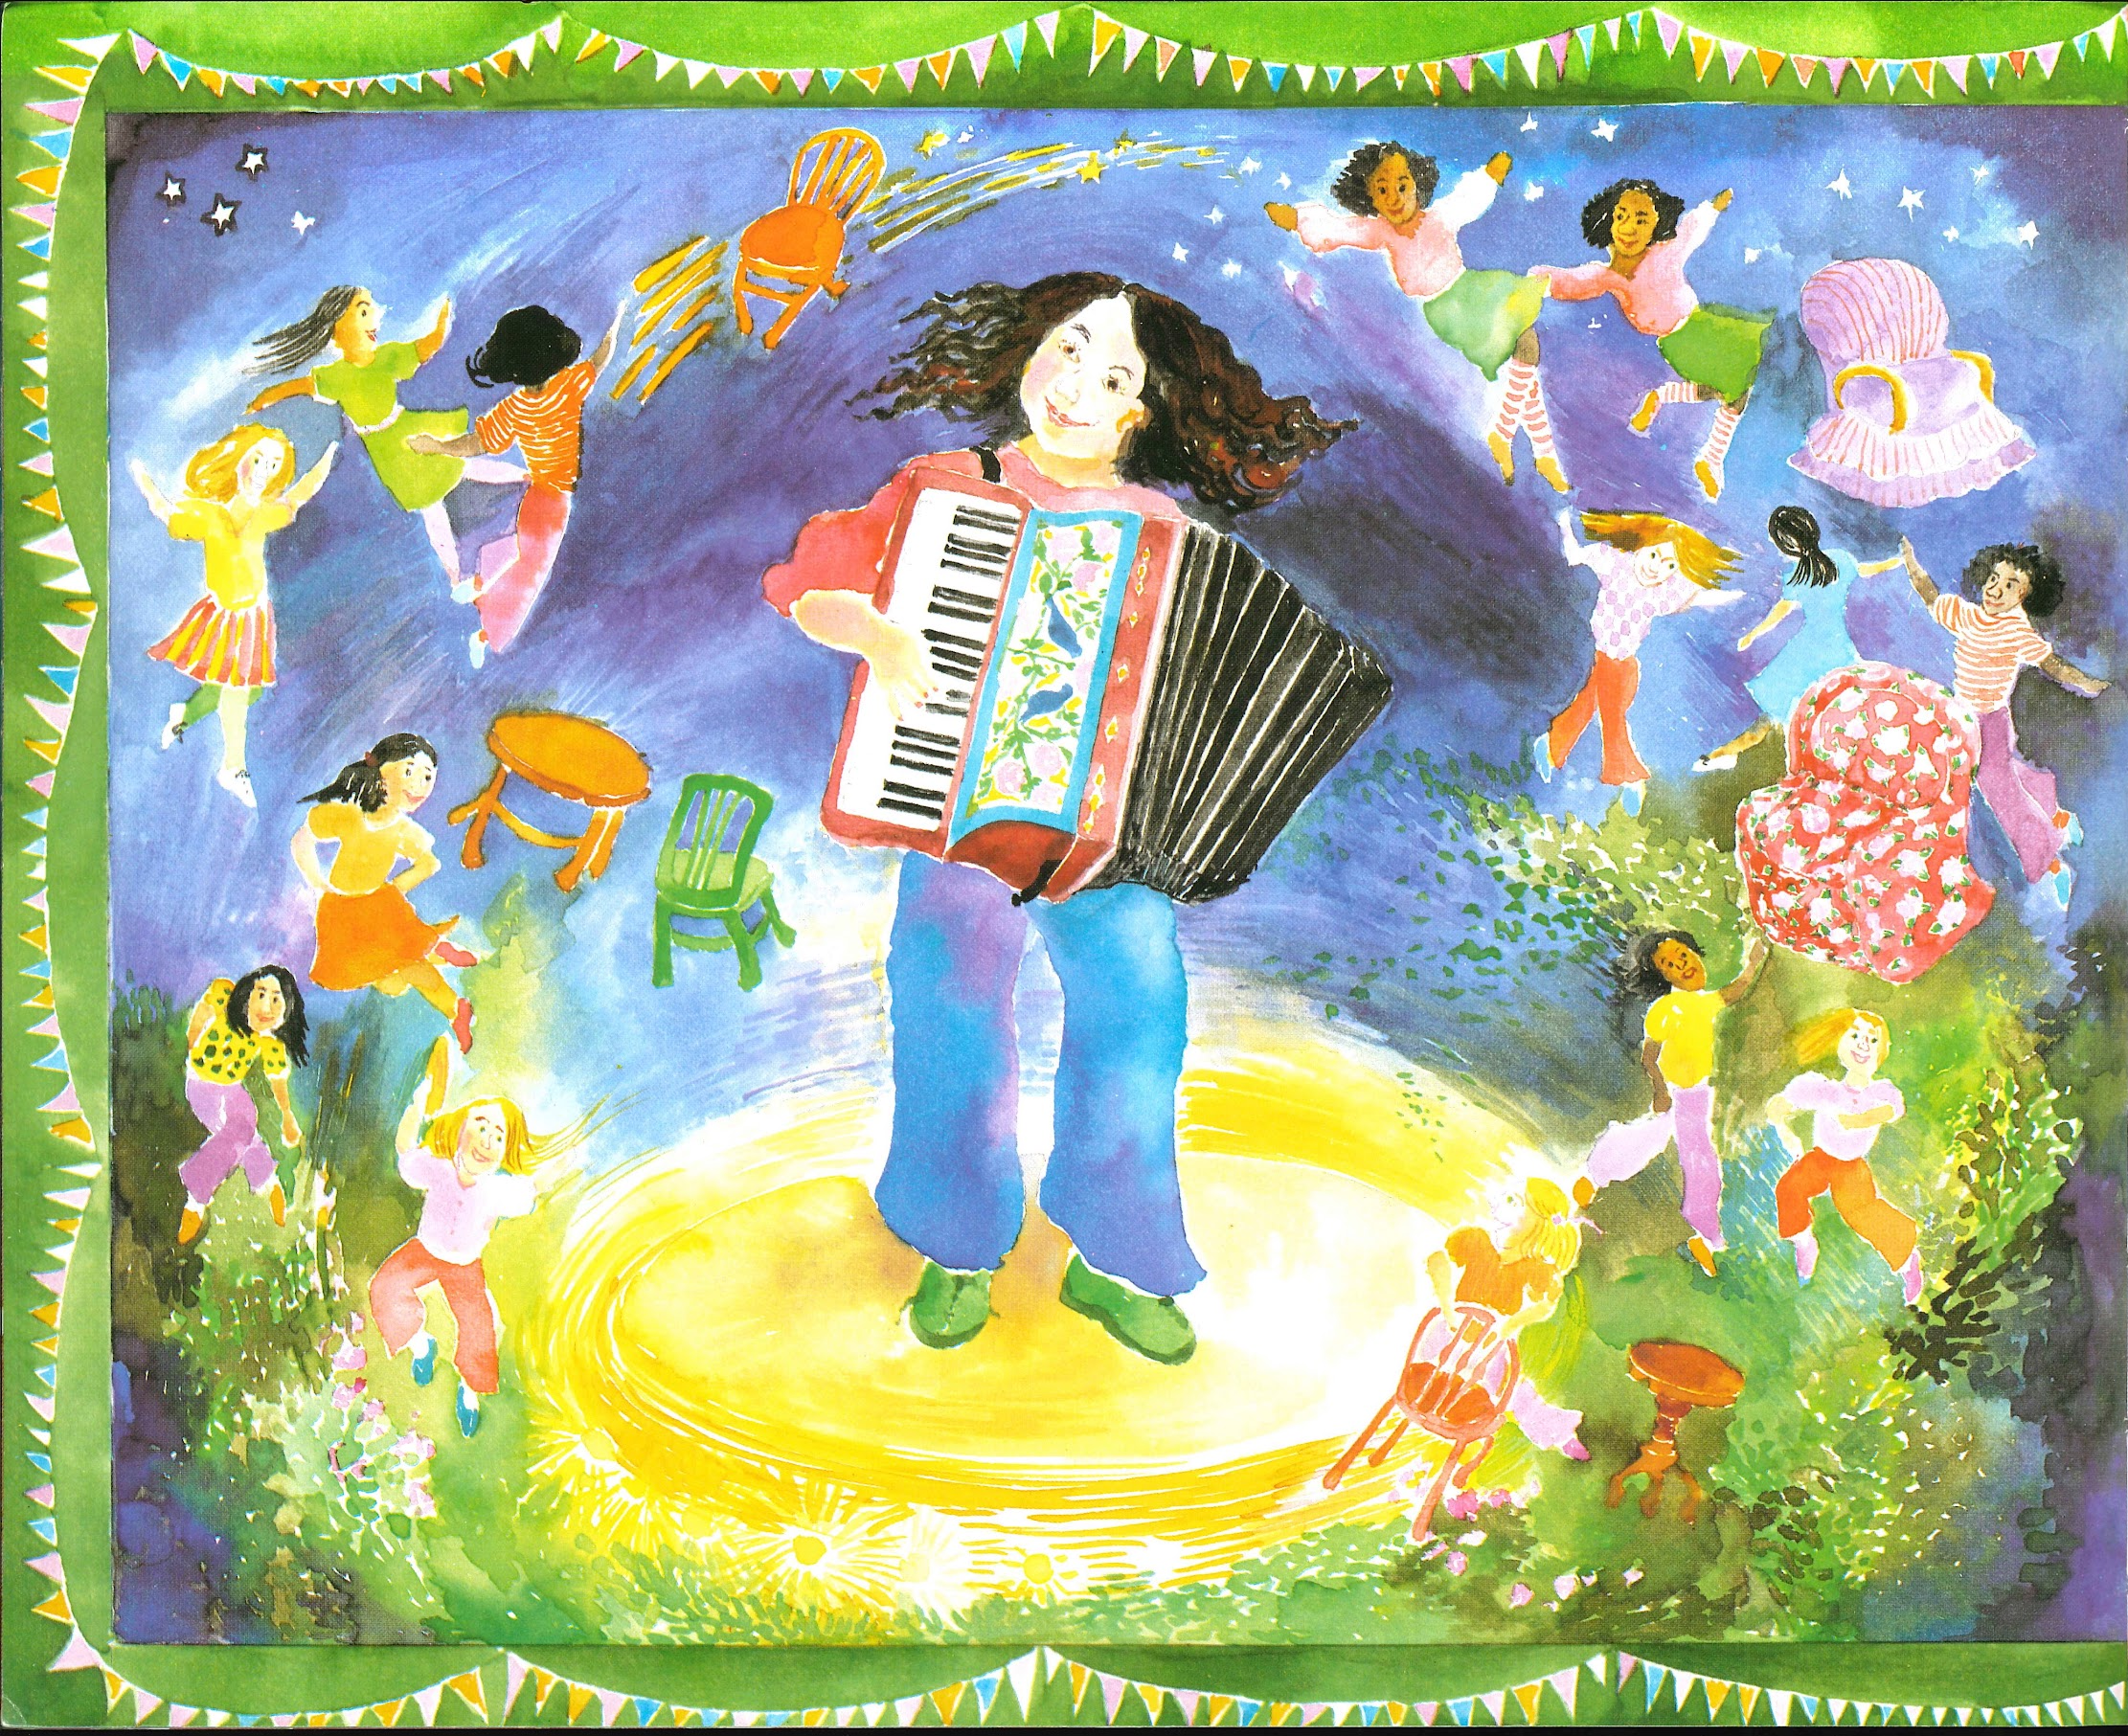
Slide 5

Slide 6
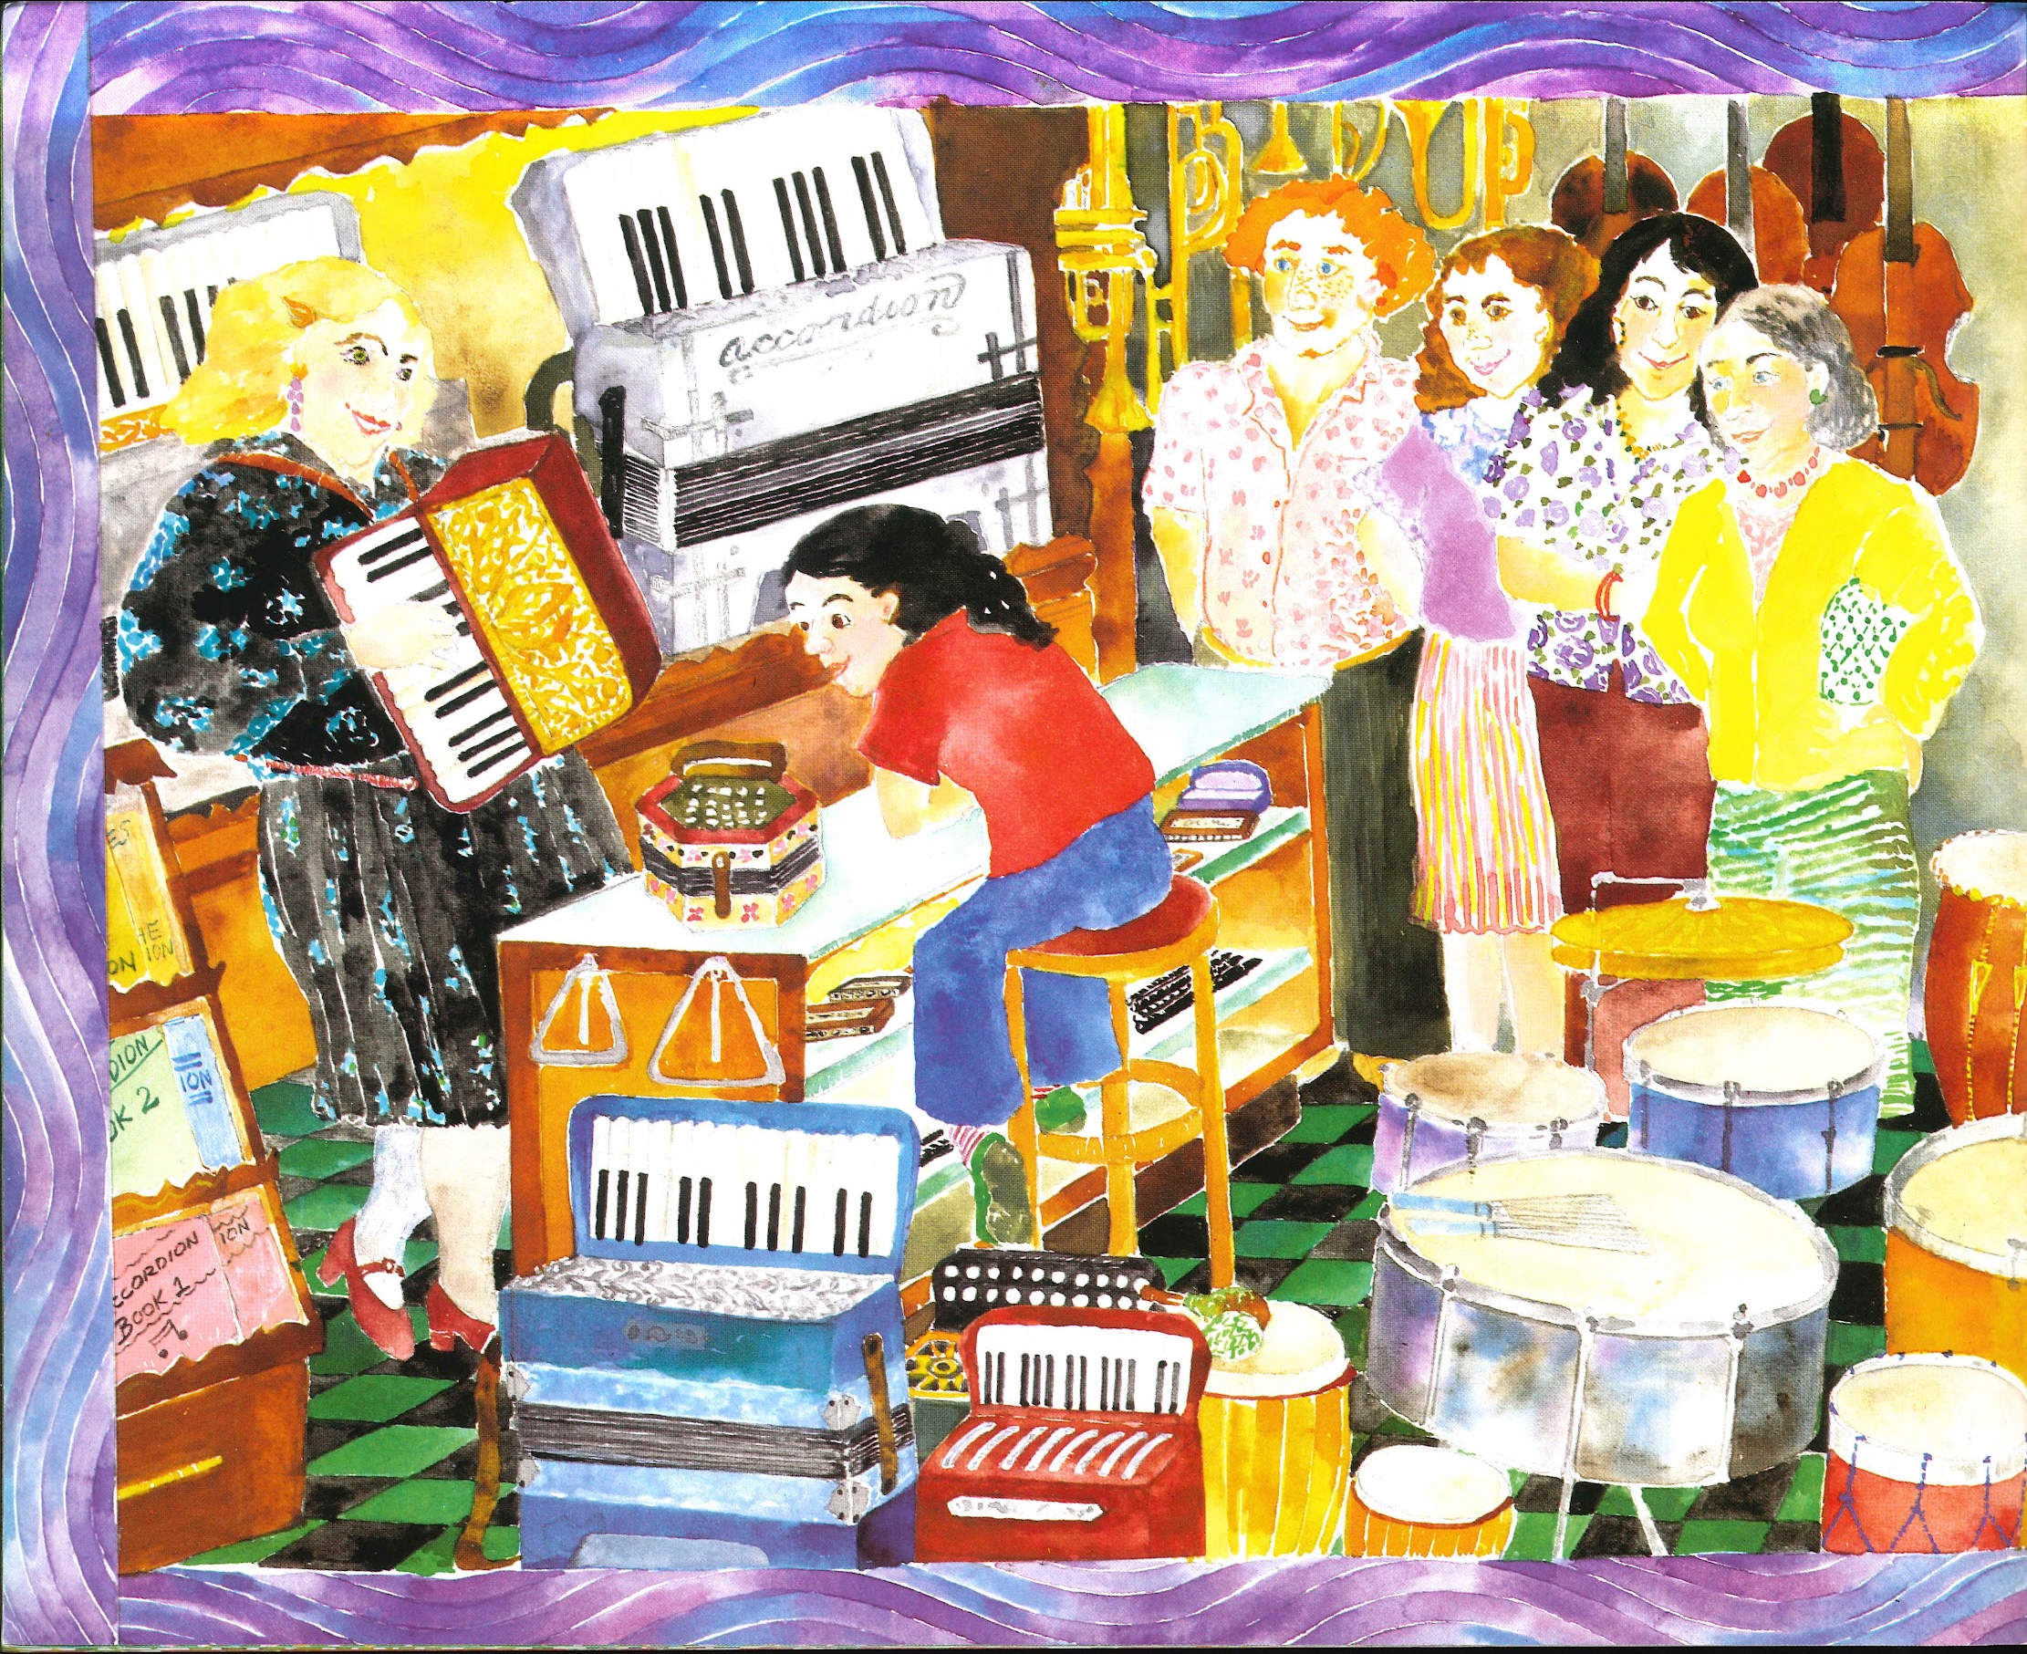
Slide 6

Slide 7
Slide 7

Slide 8
Read the text carefully, and look closely at the illustrations on these pages.
Then respond to these questions. Use details from the text to support your responses.
Why does Rosa choose the accordion for her birthday gift?
Describe what Rosa was thinking about as she made her decision.
In what ways is Rosa’s family important in this story?

