Slide 1
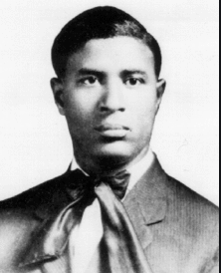
Garrett Morgan
by Brooke Childs, modified from “Inventors in Black” by Vicki Hall
Shared Reading Week 7

Slide 2
The streets back in 1920
Had cars, buggies, and bikes a plenty.
No lights or stop signs caused lots of messes,
Walkers were scared in their old-fashioned dresses!

Slide 3
When the flow of traffic was out of hand,
Inventor Garrett A. Morgan came up with a plan.
He stopped us on red, started us on green,
Kept us all safe, with yellow in between.

