Slide 1
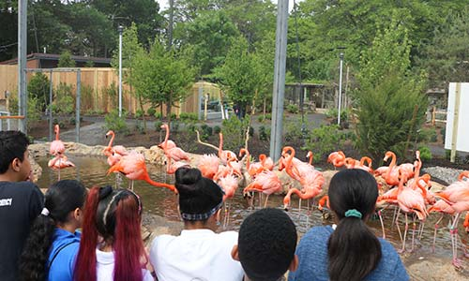
Going to the Zoo
Shared Reading Week 7
Based on the song by Raffi

Slide 2
We’re all going to the zoo tomorrow
Zoo tomorrow, zoo tomorrow
We’re all going to the zoo tomorrow
We can stay all day
Elephant with the long trunk swinging
Great big ears and the long trunk swinging
Sniffing up the peanuts with the long trunk swinging
We can stay all day

Slide 3
Seals in the pool all honk, honk, honking
Catching fish and honk, honk, honking
Little seals all honk, honk, honking
We can stay all day
Pink flamingos in the mud all muck, muck, mucking
Sucking up shrimp and muck, muck, mucking
Long neck bent and muck, muck, mucking
We can stay all day

