Slide 1
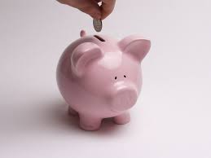
This or That?
Sung to the tune of “This Old Man”
Shared Reading Week 7
Notes:
Modified from National Geographic Sing with Me Phonics Songs, page 37

Slide 2
This or that?
Which is best?
Make a choice then save the rest
Saving money is the thing to do
Keep those coins, at least a few.

