Slide 1
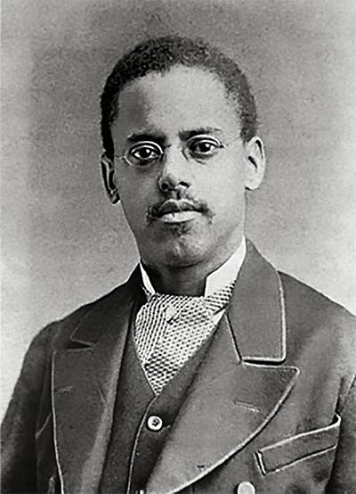
Lewis Latimer and the
Long-Lasting Light Bulb
End of Unit Assessment

Slide 2
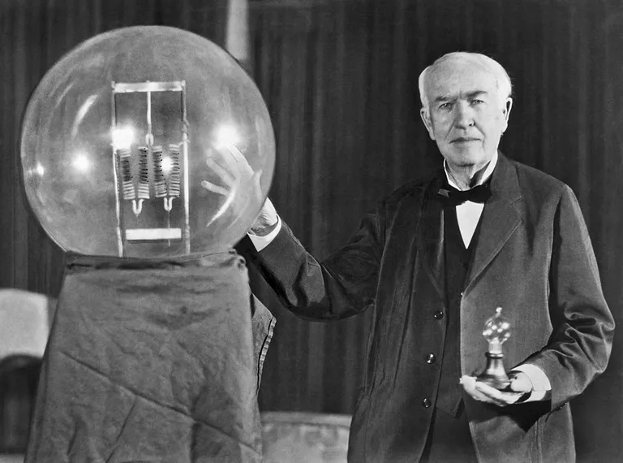
Inventing the Light Bulb
During the 1800’s many inventors were working on designing electric light bulbs. Thomas Edison worked with a team of scientists, and the light bulb they invented was much less expensive than other light bulbs. This was important because now light bulbs were available for everyday use.
Thomas Edison
at a celebration of his light bulb, 1929

Slide 3
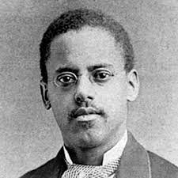
Unfortunately, they didn’t last very long.
Edison’s light bulbs were delicate. They only lasted a couple of days and then had to be thrown out.
Lewis Latimer worked with another team of scientists. He wanted to create a light bulb that lasted longer than the one Edison invented.
Lewis Latimer

Slide 4
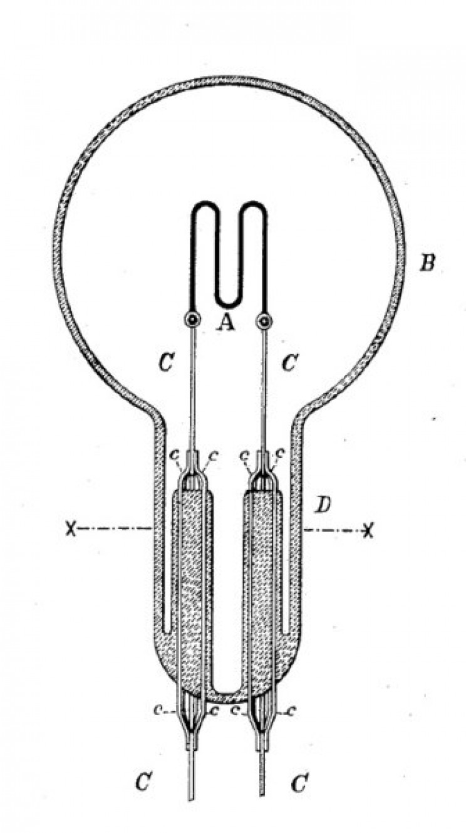
The filament is the part of the light bulb inside the glass that glows with light. This is the part of Edison’s light bulb that kept breaking. Sometimes the filament broke because it got too hot or even caught on fire. This was dangerous!
Lewis tested lots of different filaments. In 1880 he added a coating to the filament that protected it and made a longer-lasting light bulb.
filament
Drawing by Lewis Latimer

Slide 5
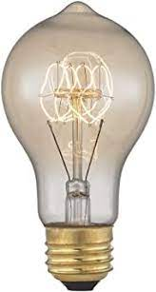
This was not Lewis Latimer’s first invention, but it was a very important one. The long-lasting light bulb helped light the daily activities in many people’s lives, like reading, cooking, playing games, and working. The new light bulb was safer than candles and safer than other light bulbs. It also helped to reduce trash, because light bulbs were not being thrown out as often as when each one only lasted a few hours.

Slide 6
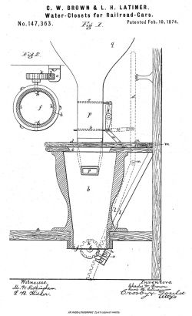
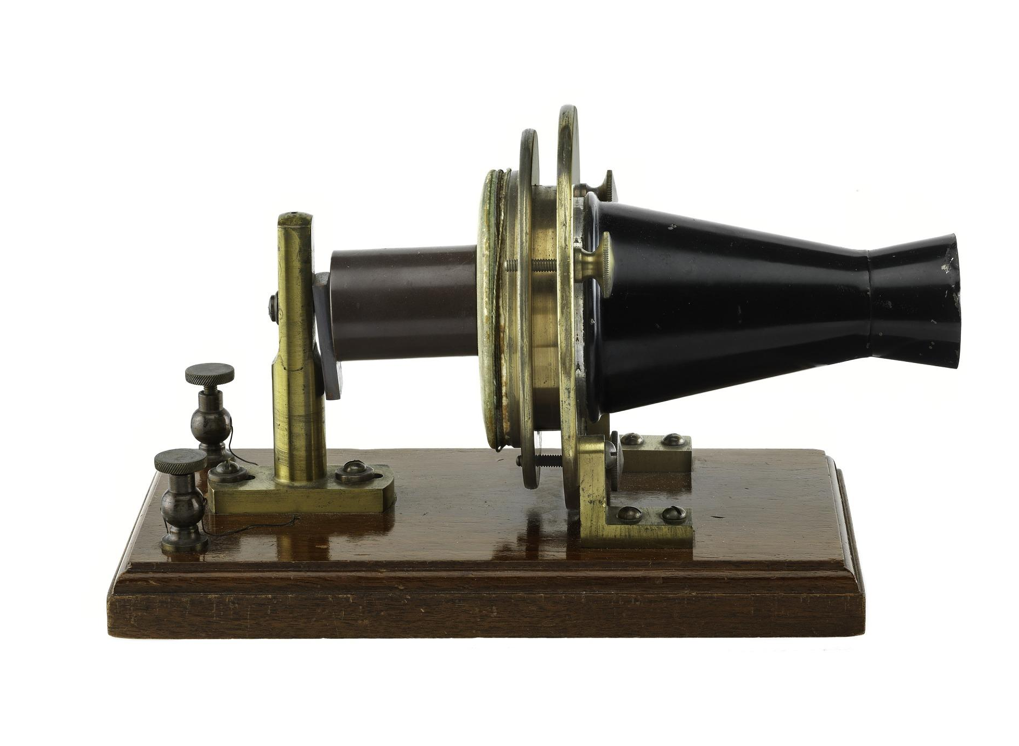
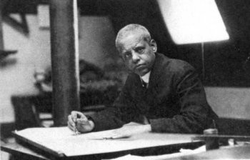
Many Inventions and Interests
Lewis designed many important inventions. He invented a toilet that could work on trains, and he drew the designs that helped Alexander Graham Bell invent the telephone.
He also painted, played the flute, and wrote poetry and plays.
Alexander Graham Bell’s first telephone
toilet system for trains

Slide 7
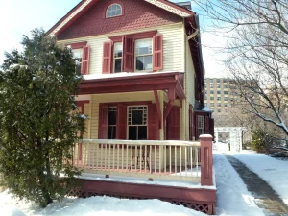
Lewis eventually moved to New York City. There, he began working for equal rights for African Americans. His home was a meeting place where inventors and anti-racist activists would gather to discuss ideas and try to solve different kinds of problems.
Today his home in Queens, New York is a museum. People visit to learn about the life and contributions of this important inventor.
Lewis Latimer House
Queens, NY

Slide 8
How did Lewis Latimer's invention improve the light bulb?
Use at least two details from the text to support your response.
Do you think all first graders should learn about Lewis Latimer? Why or why not?
State your opinion and provide at least two reasons using details from the text.

Slide 9
Citations
Information and photos for this text were gathered from the following sources.
Lewis Latimer: The Man Behind a Better Light Bulb, Smithsonian Little Explorers, Nancy Dickmann, 2020
Lewis Latimer Awarded First Patent
Innovative Lives: Lewis Latimer (1848-1928): Renaissance Man | Lemelson Center for the Study of Invention and Innovation
https://www.richardstucky.com/blog/87422/evening-study-by-candle-light-1830
"Biography of Thomas Edison, American Inventor
Lewis Latimer Helped Invent Lightbulbs and Patent the Telephone
Lewis Howard Latimer - Inventions, Accomplishments & Facts
View of Chelsea, Mass., from Eagle Hill East Boston. - Prints -
Lewis H. Latimer Glassblowing Apparatus, 1881
The Inventors or Muckers Who Worked for Thomas Edison
Lewis Latimer & The Invention Of Electric Light
Alexander Graham Bell Experimental Telephone | National Museum of American History
Lewis H. Latimer: Inventor and Early Advocate for Civil Rights

