Slide 1
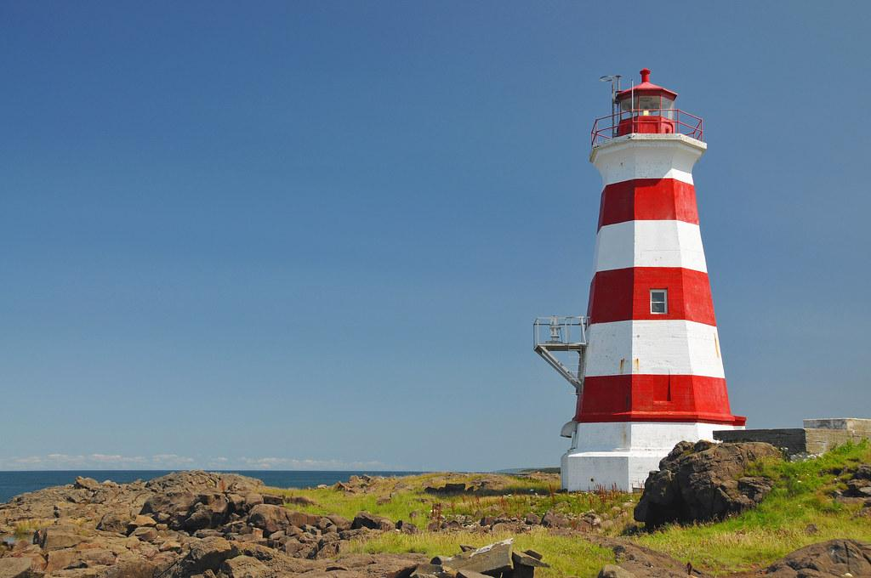
The Lighthouse
modified from the poem by CJ Heck
Shared Reading Week 6

Slide 2
There's a lighthouse on an island
built on boulders in the sea.
A home to no one anymore,
but it's beautiful to me.

Slide 3
Ocean waves come crashing,
their salty drops send spray
Upon the still, tall lighthouse
Who’s asleep during the day.

Slide 4
The lighthouse wakes at evening time,
Shines its light around and down,
Welcoming all the sailboats
As they come into the town.

Slide 5
I sit and send my wishes
way up high on seagull wings.
I know that they'll come true
on notes the kind lighthouse sings.

