Slide 1
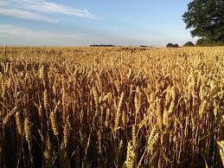
The Bread Song
By Frente Music Collective
Shared Reading Week 6

Slide 2
Bread, where does it come from?
You find it on the shelf with a paper bag on
It comes from the ground and a factory too
Takes a whole lot of work just to get it to you

Slide 3
From the sun and the air and the water and the land
Lots of working people and lots of working hands
From the sun and the air and the water and the land
Lots of working people and lots of working hands

Slide 4
Lettuce, where does it come from?
You find it near the pickle in a hamburger bun
Someone picks it from the ground
That's a lot of hard work and a lot of bending down

Slide 5
From the sun and the air and the water and the land
Lots of working people and lots of working hands
From the sun and the air and the water and the land
Lots of working people and lots of working hands

Slide 6
Peaches, where do they come from?
You find them in crates next to the plums
Someone picks a few from the tree
That's a lot of hard work that helps you and me.

Slide 7
Note:
The Frente Music Collective was inspired by the Frente Cultural de Trabajadores de Nuestra America (Cultural Workers Front of Our America).
The Frente Cultural de Trabajadores de Nuestra America was formed in 1974 in Mexico City, Mexico. It included musicians, writers, actors, and artists who wanted to unite people from both the northern and southern continents.
Source: Sing Out! Magazine, Volume 25, Number 3 (1980), page 11
Also appears in the Rise Up Singing Songbook, page 253

