Slide 1
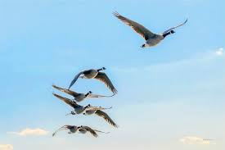
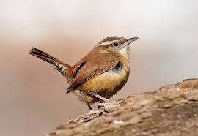
Boston Birds
Shared Reading Week 6

Slide 2
Wings spread wide
Up to the sky,
Wild geese honk
As they fly by.
Building a nest
Up in a tree,
Wrens open their lungs
To sing sweet songs for me.

