Slide 1
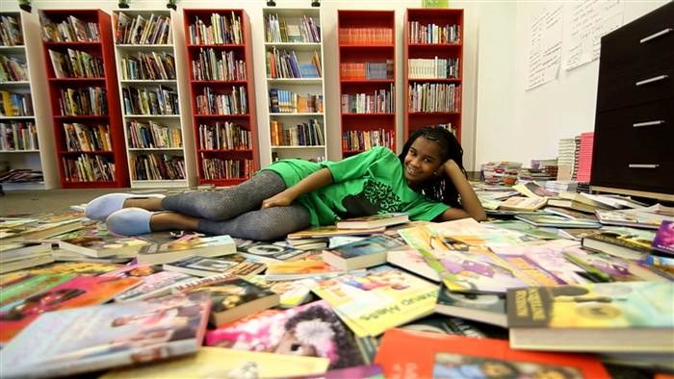
Books
excerpt from the poem by Eloise Greenfield
Shared Reading Week 6

Slide 2
I want to
Lie down on my bunk bed
Lean back in my chair
Curl up on the couch
And every old where
And read
More
books!

Slide 3
Photo citation:
https://www.nbcnews.com/news/nbcblk/marley-dias-continues-find-color-kid-s-literature-n583071

