Slide 1
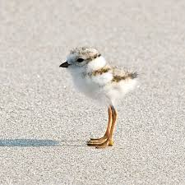
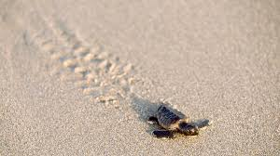
Harbor Animals
Shared Reading Week 5

Slide 2
In the harbor, a duckling swims.
The baby duck dives for a bite of fish!
In the air, a baby seagull flies.
Drops its clamshell open wide!

Slide 3
At the shoreline, a peep runs.
The baby sandpiper races on long, skinny legs!
On the beach, a hatchling crawls.
Go, baby sea turtle, go!

