Slide 1
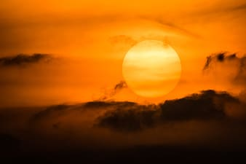
Golden Sun
by Elenor Hetrick
Shared Reading Week 4

Slide 2
Great, glorious golden sun,
Shine down on me today!
You are the life of this magic Earth,
You and your magic ray!

Slide 3
You are the life of bird and plant,
All must depend on you.
Shine down, great sun, the whole day long!
Shine from the heavens blue.

Slide 4
And I will welcome your golden rays,
For you mean life to me,
And you mean happiness and health,
Strength and energy.

Slide 5
Shine down, great sun, on flower and field,
And never say goodbye.
Forever and ever give us your light.
From out the wide, blue sky.

